Slide 1
Advances in Taylor Oil Spill Detection from Non-SAR Satellite: An Preliminary Analysis
Wei Li¹, Banghua Yan², Nan Chen¹,
Yongzhen Fan¹, Ellen Ramirez³, Dingkun P. Yan
(SAB Intern)^{3,4}, and Davida Streett³
Stevens Institute of Technology 2. NESDIS/STAR/Satellite Calibration and Data Assimilation 3. VA W.T. Woodson High School 4. OSPO/SPSD/Satellite Analysis 5. NJ Union County Magnet High School

Slide 2
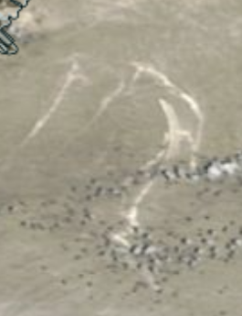
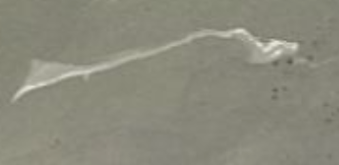
Background: MODIS Terra Case Study
Location: Taylor Energy Oil Platform
Oil spill can be easily detected by human eye when there is sun-glint exist.
Example: RGB image
T20160508
T20110612
T20130617
(Detected by OSPO/SAB Oil Team)

Slide 3
Can It Be Detected Automatically Using Non-SAR Satellite Observations?
Oil reflectance is always higher than sea water
The water reflectance will quickly decrease with the wavelength increase, even under the sun-glint situation, while oil has relative flat reflectance over visible and NIR wavelength range

Slide 4
Threshold Method
NDOI: Normalized Difference Oil Index.
NDOI = (R469-R859)/(R469+R859)
R555 > Δ₁
NDOI < Δ₂

Slide 5
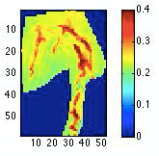
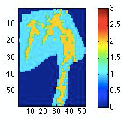
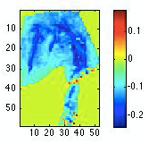
Threshold Method: Example 1 (20110612)
Normalized R at 555 nm
Oil feature detected
Oil thresholds:
R555 > 0.3
NDOI < 0.15
Case: T20110612
RGB image
NDOI

Slide 6
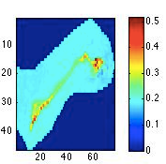
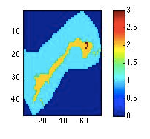
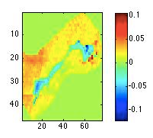
Threshold Method: Example 2 (20130617)
Normalized R at 555 nm
Oil feature by threshold
Oil thresholds:
R555 > 0.2
NDOI < 0.015

Slide 7
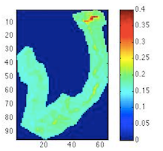
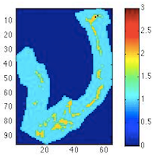
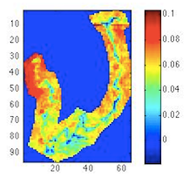
Threshold Method: Example 3 (20160508)
Normalized R at 555 nm
Oil feature by threshold
Oil thresholds:
R555 > 0.2
NDOI < 0.048

Slide 8
Challenge
The threshold values will change case by case due to the sun-glint intensity under different solar/viewing angles, wind as well as oil type.

Slide 9
Our Thought
Can we simulate the reflectance from oil and water and use machine learning techniques to identify them?
Oil and water have different refractive indices in visible and NIR. The higher refractive Index of oil will result in larger surface reflectance. From literature we find the refractive index of oil varies with oil type and we used 1.38 -1.46 range in this test. The refractive index of water is tabulated from Segelstein 1981.

Slide 10
Ocean Surface Reflectance Modeling

Slide 11
Rough Surface in DISORT3 Model

Slide 12
Validation Result by NASA CAR Measurement
MODEL
MEASUREMENT
MODEL
MEASUREMENT

Slide 13
RT Model Simulation Design
During sun-glint, the signal received from satellite comes mostly from water surface, the water leaving radiance can be ignore.
We setup a rough surface model to simulate the water and oil sun-glint reflectance in MODIS channels, separately. Then we mix the reflectance of oil and water cases by assuming the fraction of oil (fraction = 1 is oil, fraction=0 is water).
We generated 50,000 cases for oils and water separately, to cover the possible solar and satellite viewing angle in sun-glint area, as well as wind speed range from 0 to 10m/s.
The multi-layer neural network (MLNN) was used to train these 50,000 cases. Using the trained net, we can find the fraction from the satellite measured radiance and wind speed.
We assume the oil refractive index is from 1.38 to 1.46.

Slide 14
Retrieval Flowchart
RT model
Geometry angles
Wind speed
Refractive index(water, oil)
R_o:
simulated MODIS oil reflectance
R_w:
simulated MODIS water reflectance
50,000 mixed R with oil fraction f
R = f*R_o + (1-f)*R_w
MLNN train
Geometry angles
Wind speed
Refractive index(water, oil)
net
MODIS measurement
wind speed
Oil fraction f

Slide 15
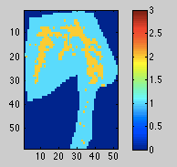
Threshold and Automatic Oil Detection Comparison: Example 1
Normalized R at 555nm
Oil feature by threshold
Case: T20110612
Oil feature by MLNN

Slide 16
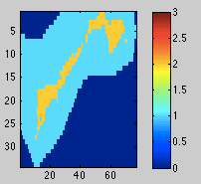
Threshold and Automatic Oil Detection Comparison: Example 2
Normalized R at 555 nm
Oil feature by threshold
Oil feature by MLNN

Slide 17
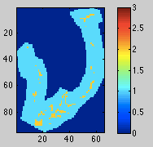
Threshold and Automatic Oil Detection Comparison: Example 3
Normalized R at 555 nm
Oil feature by threshold
Oil feature by MLNN

Slide 18
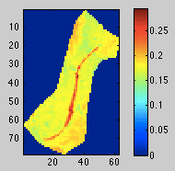
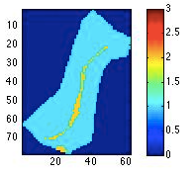
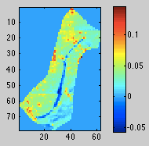
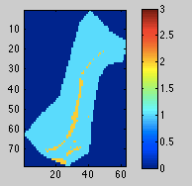
Threshold and Automatic Oil Detection Comparison: Example 4
Normalized R at 555 nm
Oil feature by threshold
Oil feature by MLNN

Slide 19
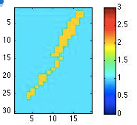
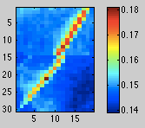
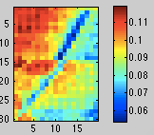
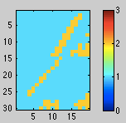
Threshold and Automatic Oil Detection Comparison: Example 5
Normalized R at 555 nm
Oil feature by threshold
Oil feature by MLNN
20140503

Slide 20
Summary
One threshold method has been developed to detect Taylor oil spills using MODIS Terra observations of reflectance:
NDOI = (R469-R859)/(R469+R859)
R555 > Δ₁
NDOI < Δ₂
where Δ₁ and Δ₂ vary with sun-glint intensity, wind speed, and oil type.
An automatic oil detection method is further developed by using multi-layer neural network (MLNN) with Radiative transfer model simulation.
The preliminary results show that this automatic oil detection algorithm works very well and can detect major oil spill features.
More studies are need to finalize the algorithm.

Slide 21
References
Fan, Y., Li, W., Gatebe, C.K., Jamet, C., Zibordi, G., Schroeder, T., and Stamnes, K., (2017) “Atmospheric correction and aerosol retrieval over coastal waters using multilayer neural networks”, submitted to Remote Sensing of Environment.
Y. Fan, W. Li, K. J. Voss, C.K. Gatebe, and K. Stamnes, (2016), A neural network method to correct bidirectional effects in water-leaving radiance, Appl. Opt., 55(1):10-21, DOI: 10.1364/AO.55.000010. Z
Z. Lin, W. Li, C. Gatebe, R. Poudyal, and K. Stamnes. (2016), Radiative transfer simulations of the two-dimensional ocean glint reflectance and determination of the sea surface roughness. Appl. Opt., 55(6):1206–1215.
T. Tanikawa, W. Li, K, Kuchiki, T. Aoki, M. Hori, and K. Stamnes, (2015), Retrieval of snow physical parameters by neural networks and optimal estimation: case study for ground-based spectral radiometer system, Optics Express 23(24), DOI: 10.1364/OE.23.0A1442.
Z. Lin, S. Stamnes, Z. Jin, I. Laszlo, S.-C. Tsay, W. Wiscombe, and K. Stamnes, (2015), Improved discrete ordinate solutions in the presence of an anisotropically reflecting lower boundary: upgrades of the DISORT computational tool, J. Quant. Spectrosc. Radiat. Transfer 157, 119–134.

