Slide 1
Detecting Taylor Oil Spills From SNPP Visible Infrared Imaging Radiometer Suite (VIIRS) Observations
Dingkun P. Yan (SAB Intern)^{1,2}, William Boll¹, Ellen Ramirez¹, Banghua Yan³, Wei Li⁴, Amanda Zheng⁵, Davida Streett¹, & Jerry Guo⁶
OSPO/SPSD/Satellite Analysis Branch 2. VA W.T. Woodson High School 3. OSPO/SPSD/Satllite Products Branch
4 Stevens Institute of Technology 5. NJ Union County Magnet High School 6. SMOMS Contractor Team

Slide 2
Outline
First Taylor Oil Spill Event
Detect Taylor Oil Spills from VIIRS Observations
Single Band of Observations
RGB Multiple Imagery of Observations
Enhanced VIIRS RGB Imagery of Observations
A New Oil Reflectance-Based Imagery Enhancement
Summary and Conclusions

Slide 3
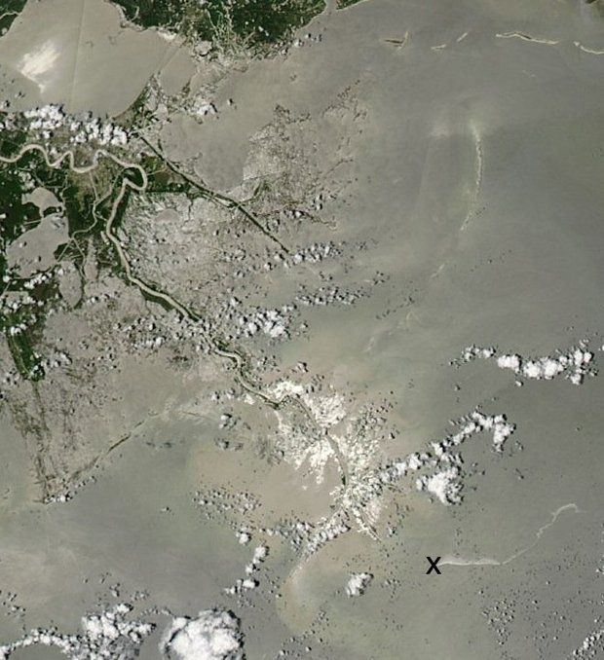
First Taylor Oil Spill Event
Taylor Energy Oil Platform towered 550 feet above 28 producing oil and gas wells drilled in water 479 feet deep.
Taylor Oil Platform was wrecked by Hurricane Ivan on Sept. 15, 2004, so-called first Taylor spill.
Taylor Oil Spills have been leaking up to now (OSPO SAB Oil Team has been monitoring Taylor Oil Spills using various satellite observations).
Notes:
Figure 1: A 32-mile-long oil slick stretches east from the former site of Taylor Energy's Mississippi Canyon 20 A platform (X), which was knocked down and covered by a landslide during Hurricane Ivan in 2004. (NASA Aqua satellite) Reference: http://www.nola.com/environment/index.ssf/2013/07/taylor_energy_oil_platform_des_1.html

Slide 4
Methodology to Detect Taylor Oil Spills from VIIRS Observations
Single Band of Observations
RGB Multiple Imagery of Observations
Enhanced VIIRS RGB Imagery of Observations
A New Oil Reflectance-Based Imagery Enhancement

Slide 5
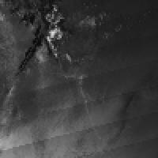
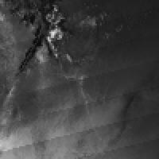
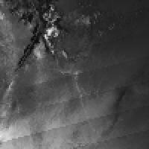
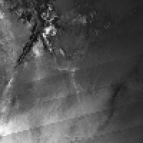
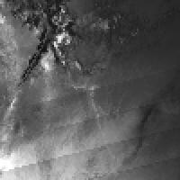
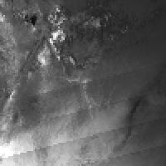
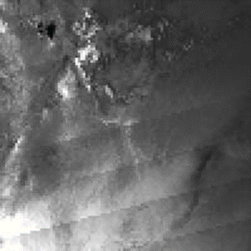
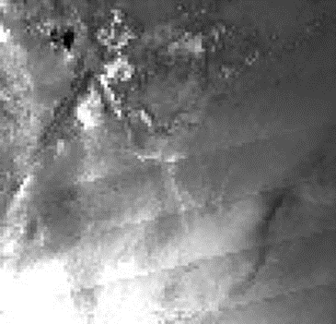
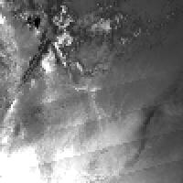
Method 1: VIIRS Single Band of Observations for a suspicious Taylor oil spill on May 18, 2016
(a) M1 Band (412 nm)
(b) M2 Band (445 nm)
(c) M3 Band (488 nm)
(d) M4 Band (555 nm)
Suspicious Taylor Oil Spill
(e) M5 Band (672 nm)
(f) M7 Band (865 nm)
(g) M8 Band (1240 nm)
(h) M10 Band (1610 nm)
(i) M11 Band (2250 nm)

Slide 6
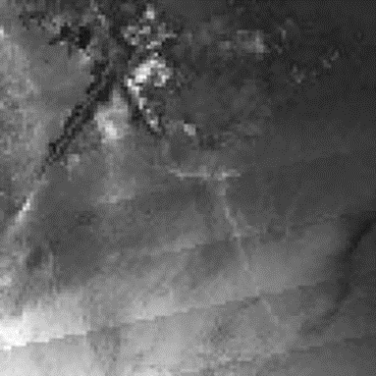
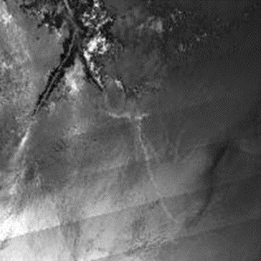
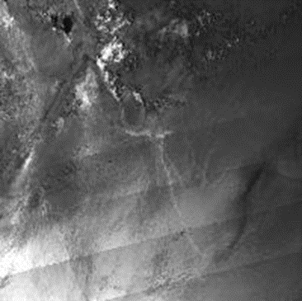
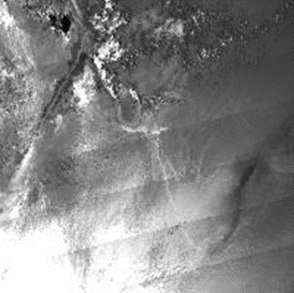
Method 1: VIIRS Single Band of Observations Continued
(j) DNB Band (700 nm)
(k) I1 Band (640 nm)
(l) I2 Band (865 nm)
(m) I3 Band (1610 nm)
Conclusion: VIIRS observations at DNB, M1 – M5, M7-M8, M10- M11 Bands can provide visible oil spill features.
Notes:
Figures 2(a)~(m). SNPP VIIRS imagery from I and M bands for a suspicious Taylor oil spill event on 05/18/2016

Slide 7
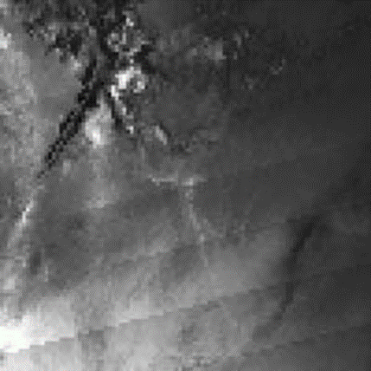
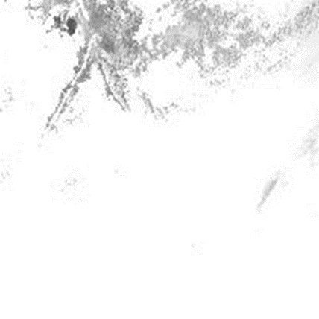
Method 2: VIIRS RGB Multiple Band of Imagery
(a) RGB (M10, M7, M5 Bands)
(b) RGB (M5, M4, M3 Bands)
The capability of detecting Taylor oil spills is analyzed using VIIRS RGB imagery:
VIIRS RGB imagery using M3-M4-M5, M5-M7-M10 and I1-I2-I3 bands provide more visible oil spill features than each of single band.
Oil spill features at I1-I2-I4 RGB bands are less visible without further imagery enhancement
(c) RGB (I3, I2, I1 Bands)
(d) RGB (I4, I2, I1 Bands)
Notes:
Figures 3(a)~(d). SNPP VIIRS RGB imagery from I and M bands for a suspicious Taylor oil spill event on 05/18/2016

Slide 8
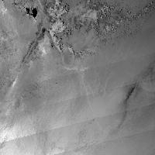
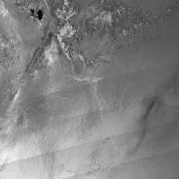
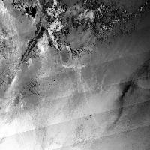
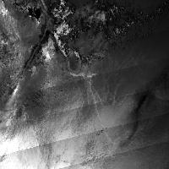
Method 3: Enhanced VIIRS RGB Imagery
(a) I1,I2,I3 RGB Gaussian
(b) I1,I2,I3 RGB Square Root
The enhancement methods of Linear 2%, Equalization, Gaussian, Square Root work well for all RGB imagery in contrasting oil spill feature. Among those methods, Linear 2% seems working better than others.
Linear 0-255 enhancement is less helpful for I Band and M5-M7-M10 RGB Imagery, but it does work for M3,M4,M5 RGB Imagery (figures are not shown here).
(c) I1,I2,I3 RGB Linear 2%
(d) I1,I2,I3 RGB Equalization
Notes:
Figures 4(a)~(d). Enhanced VIIRS RGB imagery from I 1,I2, and I3 RGB bands for a suspicious Taylor oil spill on 05/18/2016

Slide 9
Method 4: A New Oil Reflectance-Based
Imagery Enhancement
Shown are reflectance spectra of oil and seawater for a suspicious Taylor oil spill on 05/08/2016. Reflectance of oil varies between 0.15 and 0.25.
Analyses on more Taylor oil spills show that reflectance of oil and seawater will change with solar zenith and azimuthal angles and satellite viewing angle, ranging from 0.08 to 0.5 (figure is not shown here).
Figure Reflectance statistics of oil and seawater based on the suspicious Taylor oil spill on 05/08/2016
NO Enhancement:
0.05 (min.) ~ 0.63 (max.) in Refl.
(b) Oil Reflectance-based Enhancement:
0.1 (min.) ~ 0.3 (max.) in Refl.
Figure 6 MODIS/Terra imagery at 555 nm by using oil reflectance-based imagery enhancement

Slide 10
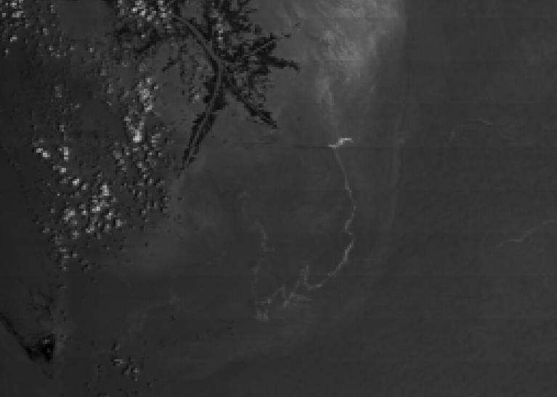
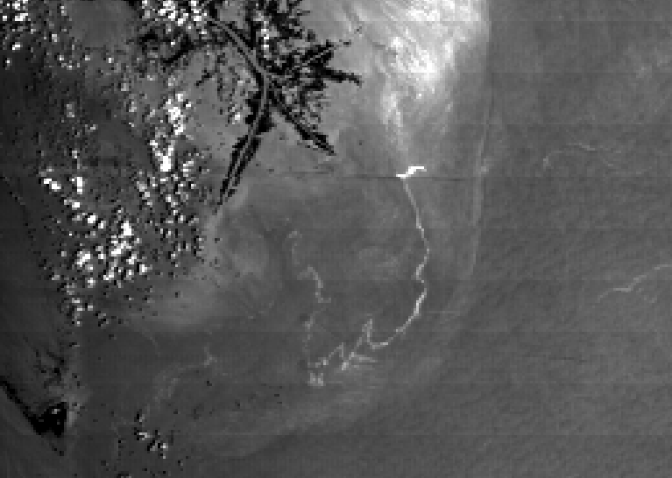
A New Imagery Enhancement: Example
(A Suspicious Taylor oil spill on 05/08/2016)
Taylor Oil Spill
MODIS/Terra imagery at 555 nm is shown in Figure 6 with/without the oil reflectance-based imagery enhancement. The oil minimum and maximum reflectance values used are given in the imagery.
(a)Without enhancement (reflectance: 0.05 ~ 0.63)
(a)With new reflectance enhancement
(reflectance: 0.15 ~ 0.3)
NO Enhancement:
0.05 (min.) ~ 0.63 (max.) in Refl.
(b) Oil Reflectance-based Enhancement:
0.1 (min.) ~ 0.3 (max.) in Refl.
Figure 6 MODIS/Terra imagery at 555 nm by using oil reflectance-based imagery enhancement

Slide 11
Summary and Conclusions
A series of case studies for Taylor oil spills have demonstrated that SNPP VIIRS Observations can provide important information about marine oil spill features:
VIIRS observations at DNB, M1 ~ M5, M7 ~ M8, M10 ~ M11, I1 ~ I4 Bands can provide visible oil spill features, although VIIRS observations at I Band can provide more notable oil features than M bands due to their higher spatial resolution.
SNPP VIIRS RGB imagery that are created using M3-M4-M5, M5-M7-M10 and I1-I2-I3 bands provide more visible oil spill features than each of single band.
The enhancement of Linear 2%, Equalization, Gaussian, Square Root work well for all RGB imagery in contrasting oil spill feature.
An oil reflectance range-based enhancement can significantly contract oil spill features even at single band. More studies are needed to generalize this enhancement.

