Slide 1
Satellite Analysis Branch
use of
Commercial Satellite Imagery
NOAA/NESDIS
July 2017

Slide 2
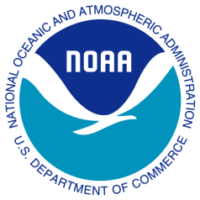
Imagery Request Overview
The NOAA/NESDIS Satellite Analysis Branch (SAB) uses high resolution commercial satellite imagery for incident response and for validation purposes.
Identify and monitor marine oil spills (sub Charter worthy events)
Track marine debris fields generated from tsunamis and U.S. land falling tropical cyclones
Validate oil boundary and oil thickness assessments from satellite against in-situ measurements.
SAB places approximately 6-12 requests per year and receives about 12-24 images
Our commercial satellite requests are primarily for Worldview-2, Worldview-3, and Radarsat-2
Often times the images provide our sole look, or in other words, provide an observation on a day that we wouldn’t have otherwise had imagery. (Revisits: Landsat7/8=16 days, Sentine1=12 days, Sentinel2=10 days)

Slide 3
Examples of Imagery Requests for:
Emergency/Disaster Operations
Helping Researchers who are Supporting of SAB Operations
Serving as Liaison to other Operational Components of NOAA that have a Need for Specialized Satellite Imagery

Slide 4
Emergency Operations
An explosion occurred on the Abkatun oil platform in the Bay of Campeche on April 1, 2015. Initial reports stated there was not an oil discharge. Out of concern of a possible oil sheen moving towards U.S. waters, SAB was asked to monitor this situation. Worldview imagery requests were placed.

Slide 5
Worldview-2 on 5 April 2015
SAB monitored this incident for 2 more weeks before being permitted to stand down.

Slide 6
Commercial imagery has been repeatedly requested by SAB over the past 2 years as part of a joint effort between NOAA and the Bureau of Safety and Environmental Enforcement (DOI) to enable SAB to better respond to oil spills.
Helping Researchers who are Supporting SAB Operations

Slide 7
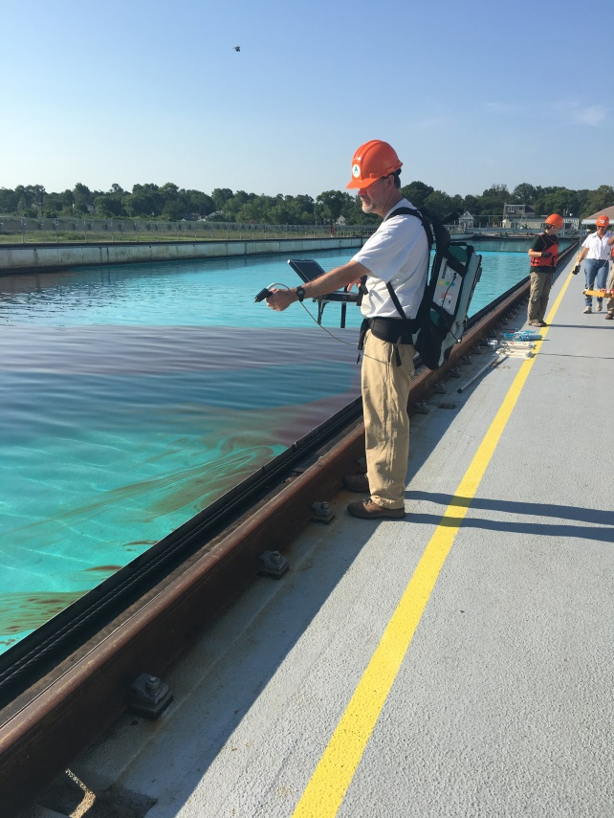
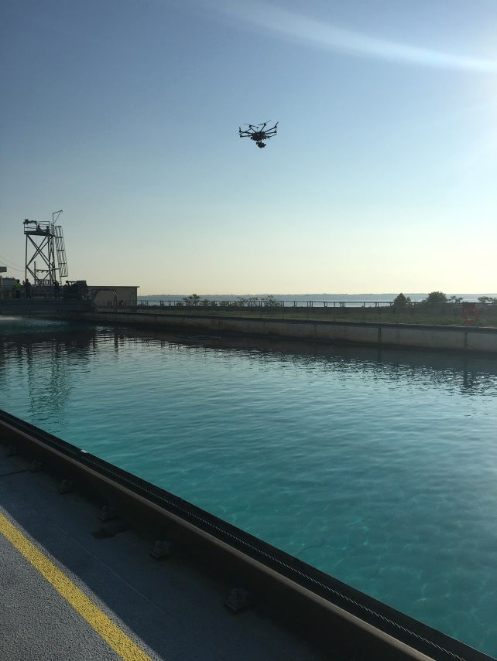
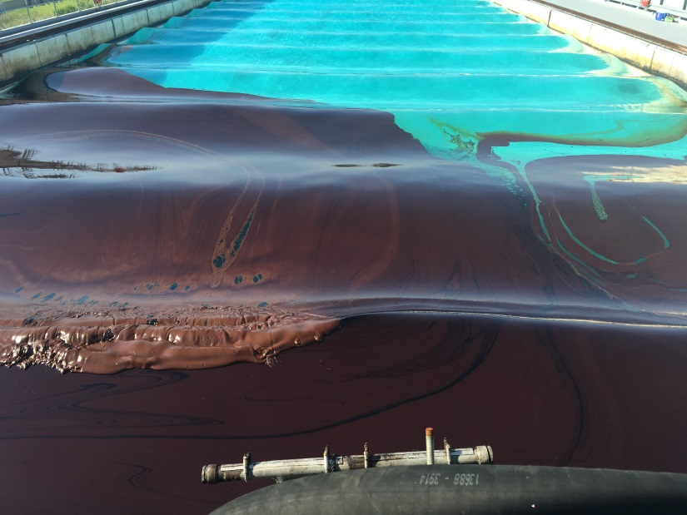
Ohmsett
Phase 1: Characterize the detection of known oil thicknesses and oil-emulsions in a controlled environment, performing multiple tests and calibrations for thermal, optical, and microwave sensors.
In July 2016 400 gallons of crude oil was released into the salt water tank and waves were applied to simulate mixing in the open ocean.
Ohmsett is the National Oil Spill Response Test Facility, located in Leonardo, New Jersey and stands for Oil and Hazardous Materials Simulated Environmental Test Tank.
Pictures courtesy of Ellen Ramirez

Slide 8
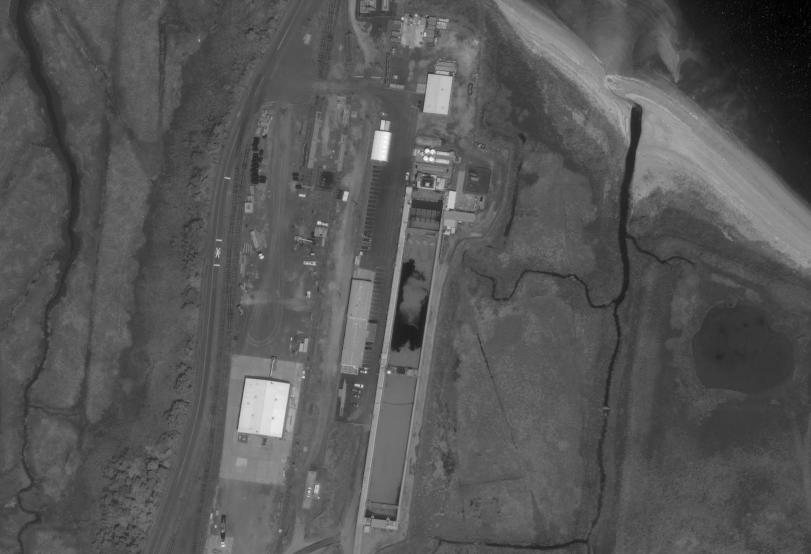
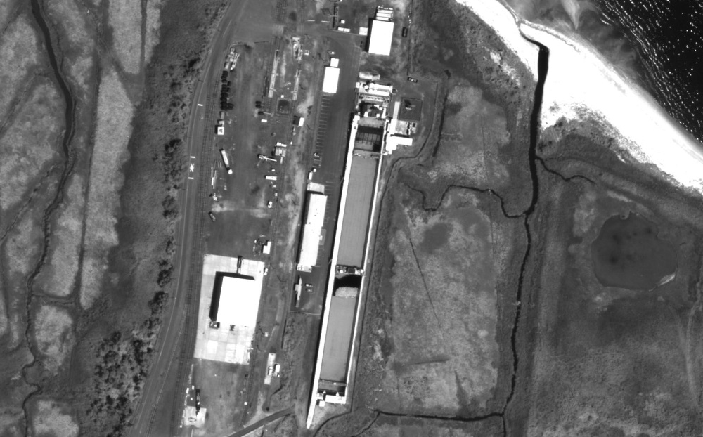
Worldview-3 Images Acquired

Slide 9
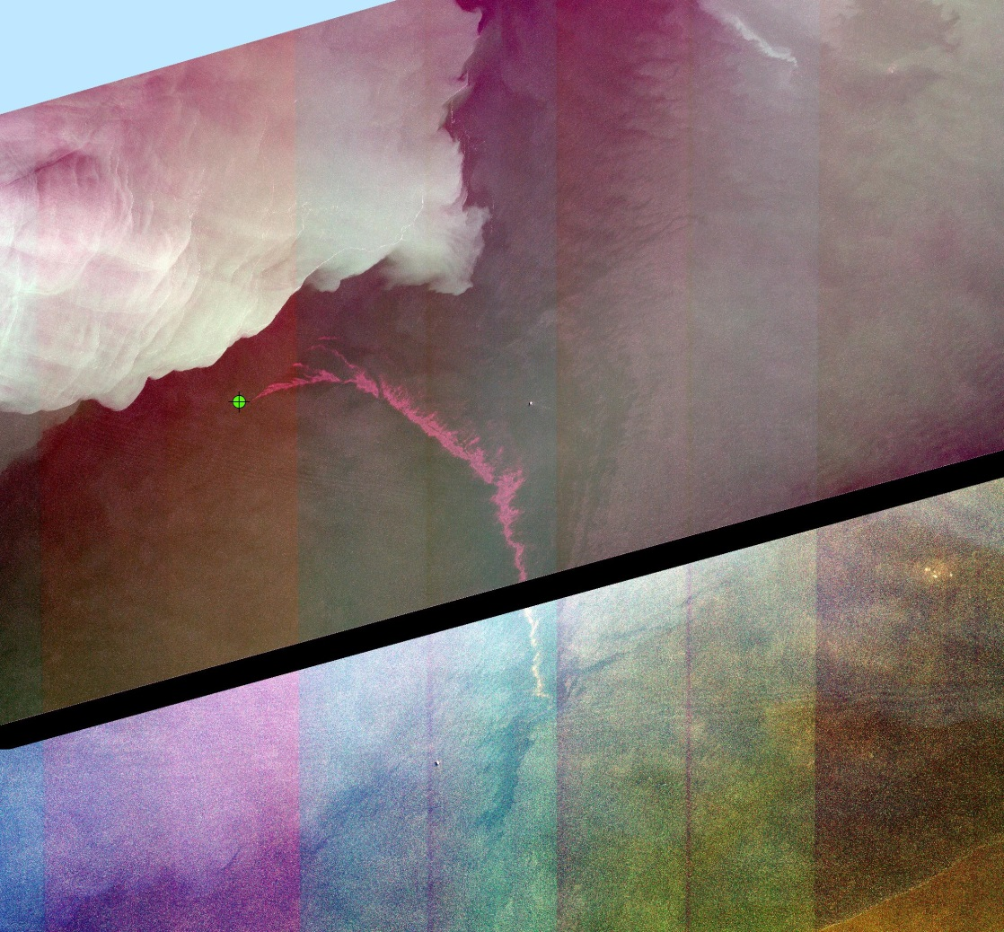
Aligned with BSEE and NOAA objectives to capture lessons-learned from DWH and advance our
understanding for oil spill preparedness, this proposal provides options for controlled as well as open
water synoptic data collection experiments from multiple sensors and platforms to support this needed
validation. This proposal has 3 major component phases:
Phase 1: Characterize the detection of known oil thicknesses and oil-emulsions in a controlled
environment, performing multiple tests and calibrations for thermal, optical, and microwave sensors
at the National Oil Spill Response Research &amp; Renewable Energy Test Facility (Ohmsett) which is
located at the Naval Weapons Station Earle Waterfront in Leonardo, New Jersey.
Phase 2: Measure the open water oil thicknesses and oil-emulsions at the damaged Taylor Energy
well field surface oiling site performing multiple tests and calibrations for thermal, optical and
microwave sensors.
Phase 3: Develop operational methods and procedures for processing and interpreting each of the
sensors products used during the experiments for future emergency operations.
By carrying out the simultaneous experiments in both controlled and marine settings, we will test a broad
range of sensors available that oil spill responders could use for surface oil characterization and
quantification. These experiments will demonstrate how each sensor detects oil and emulsions in the same
physical and environmental conditions. The ultimate goal of this proposal is to validate and quantify
the efforts put forward under the DWH NRDA OoW workgroup and provide BSEE and NOAA the
needed methodology and operational tools to assess future oil spills and the ability to monitor and
measure more accurately the thickness of surface oil slicks in the marine environment. We will
accomplish this goal by providing a comprehensive analysis of the capabilities and limitations of each
sensor, but more importantly, we will provide a methodology and workflow for NOAA NESDIS Satellite
Analysis Branch (SAB) image analysts on how to process, interpret and deliver the information generated
from each of the available products to the active spill responders and Trustees during future oil spill
responses. This workflow will ensure industry standard data formats will be produced and available to be
delivered directly to a Common Operation Picture (COP) such as the NOAA Office of Response and
Restoration’s Environmental Response Management Application (ERMA
Taylor Seep Site in the Gulf of Mexico
Phase 2: Measure the open water oil thicknesses and oil-emulsions at the damaged Taylor Energy well field surface oiling site performing multiple tests and calibrations for thermal, optical and microwave sensors.
Sheen
Emulsion
Worldview-2, April 25th 2017

Slide 10
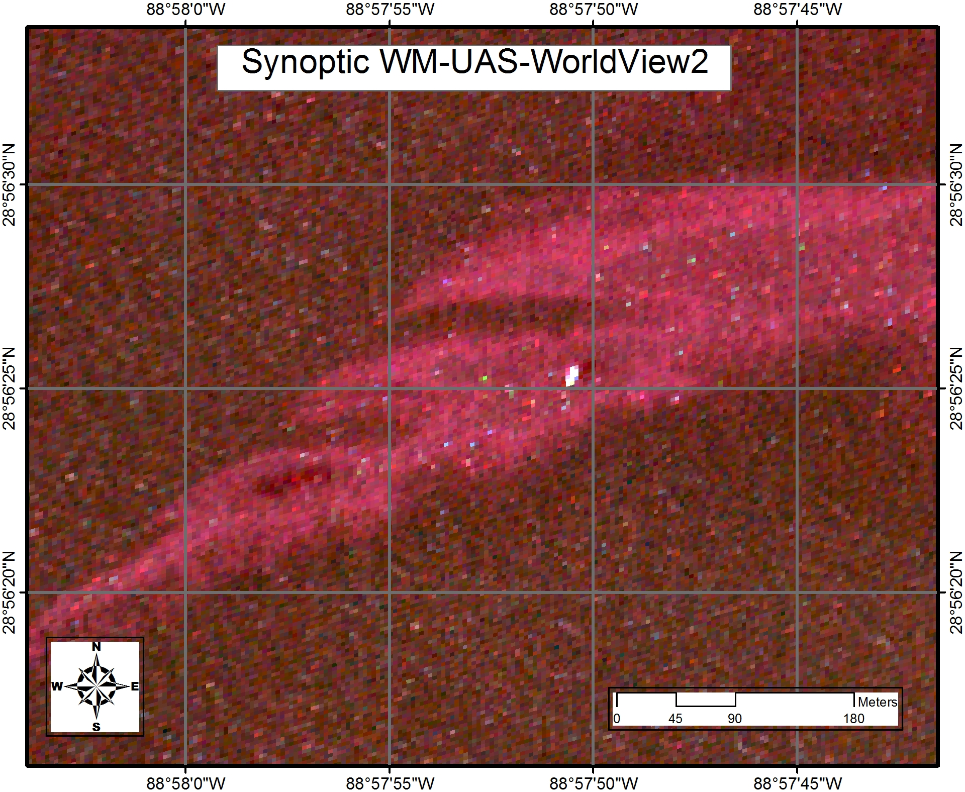
Sampling boat
Analysis courtesy of BSEE

Slide 11
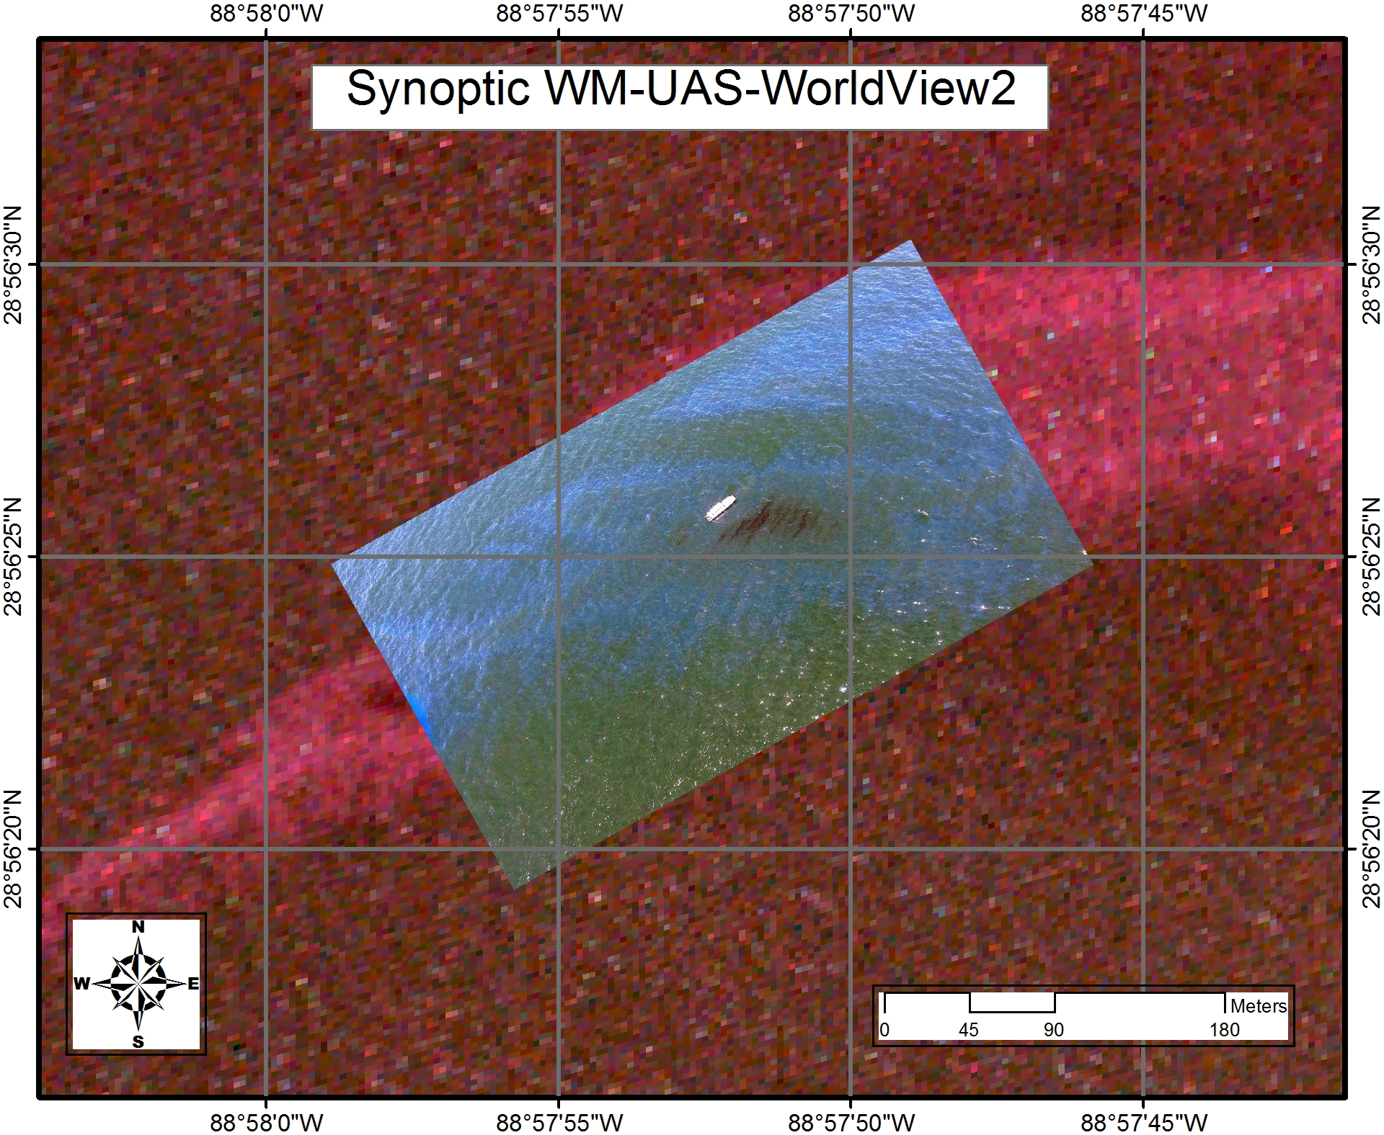
Analysis courtesy of BSEE

Slide 12
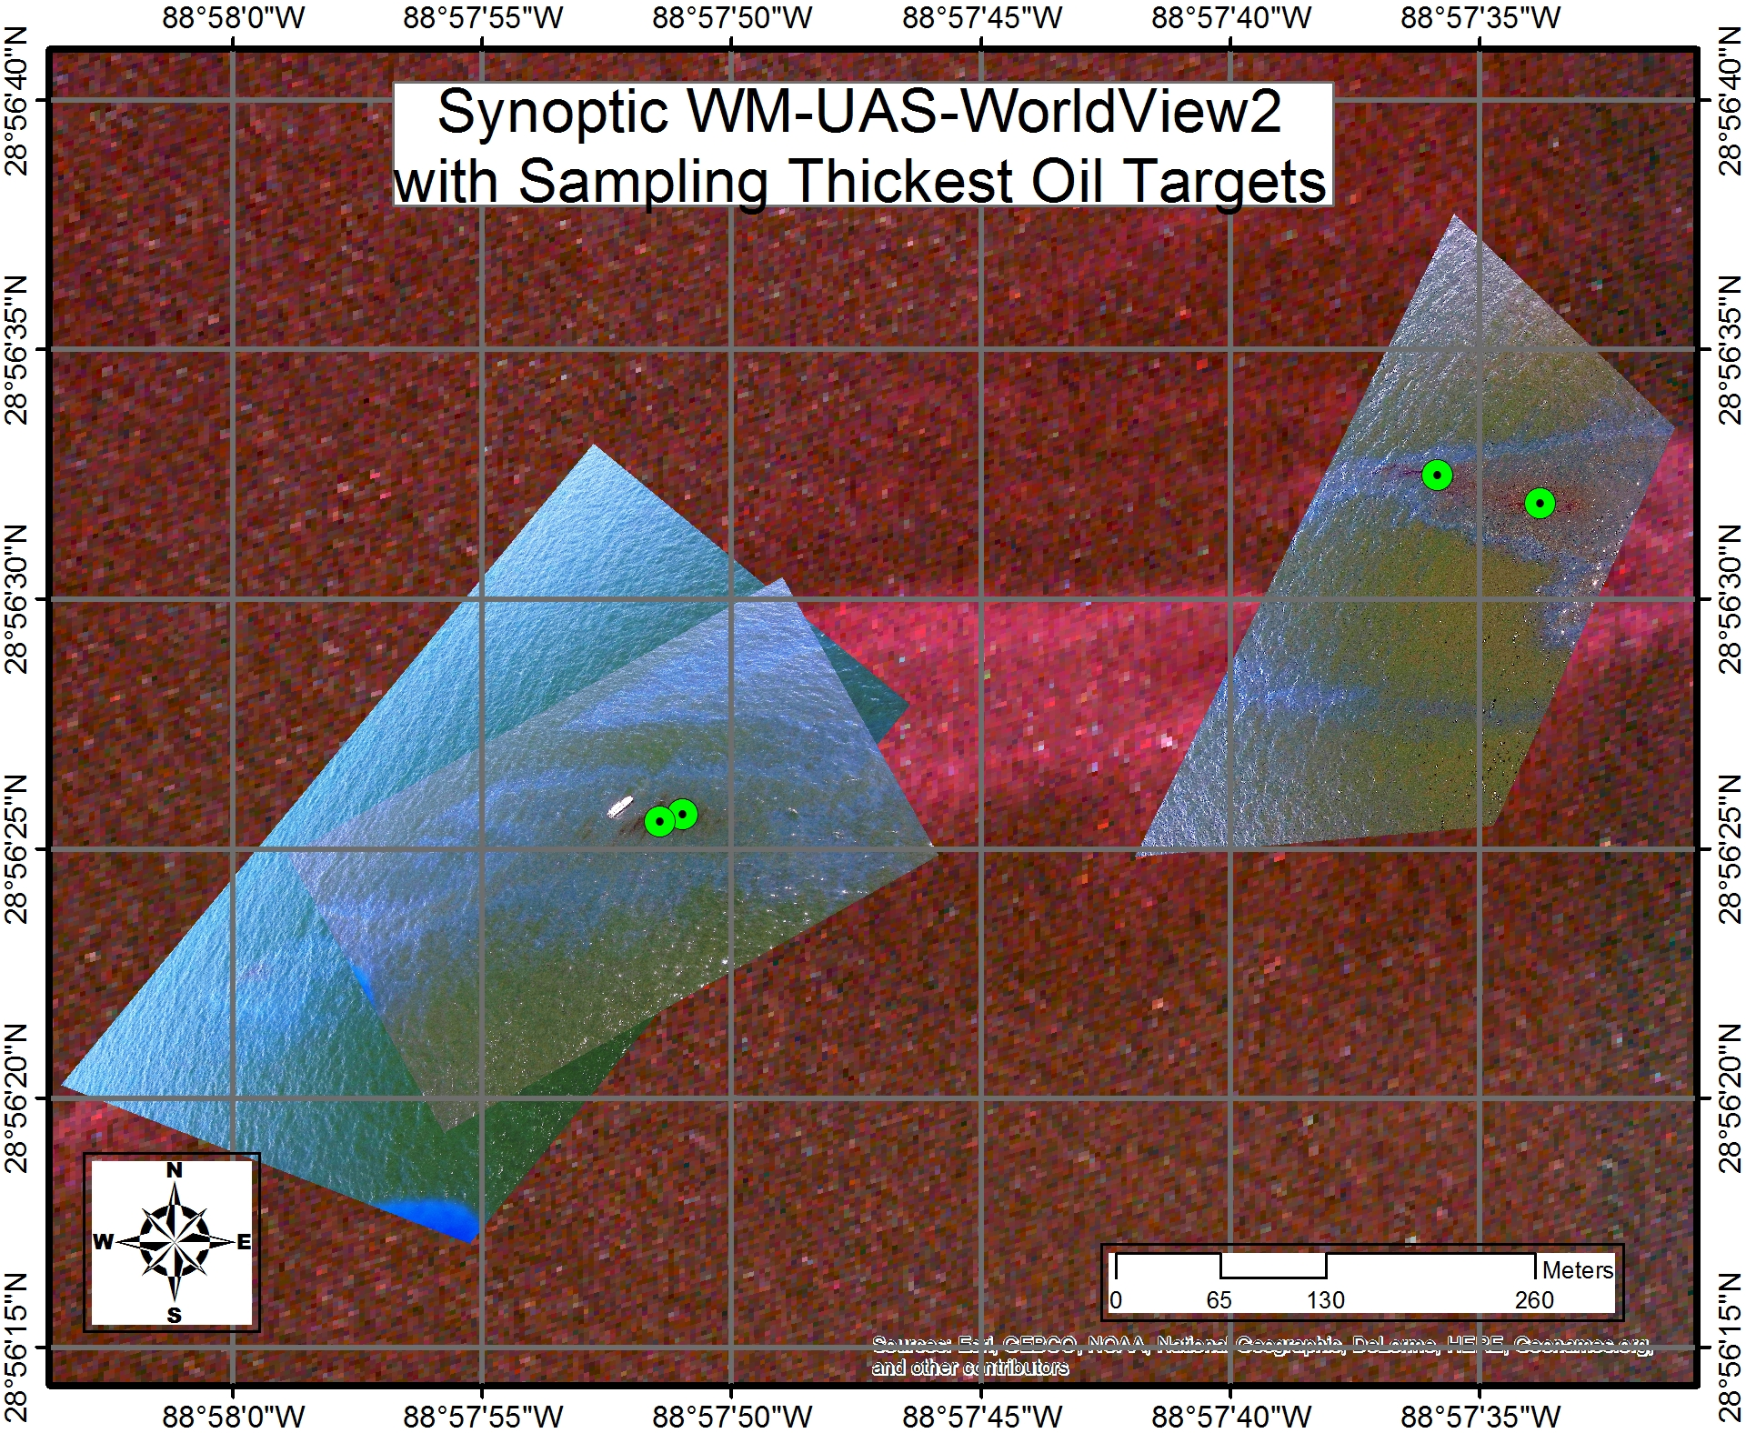
Analysis courtesy of BSEE

Slide 13
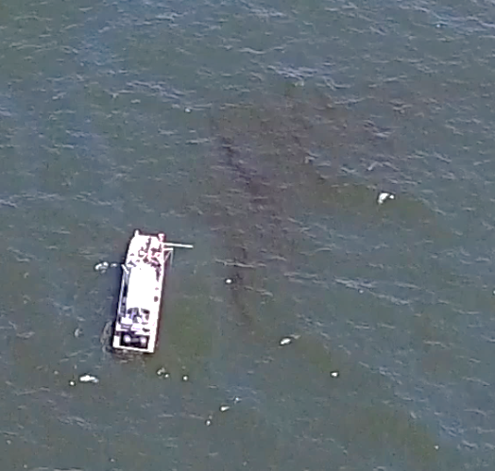
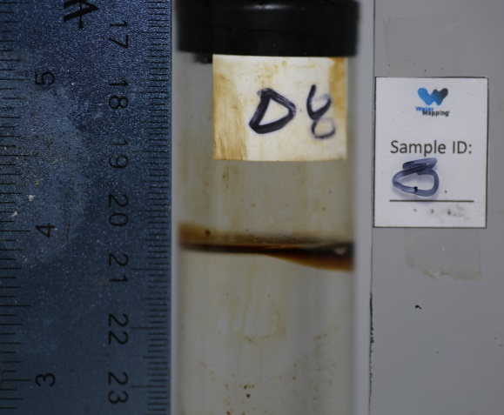
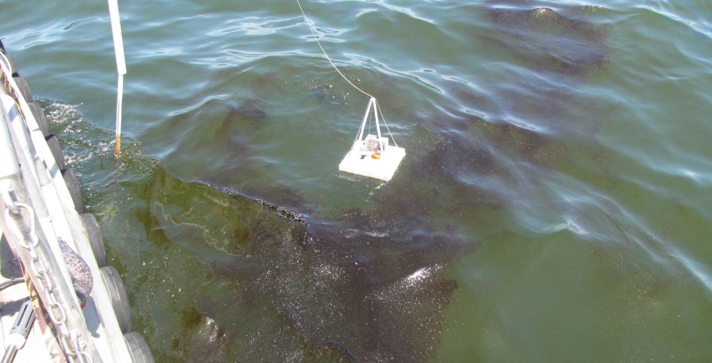
In-Situ Thickness Measurements
Pictures courtesy of Oscar Garcia-Pineda

Slide 14
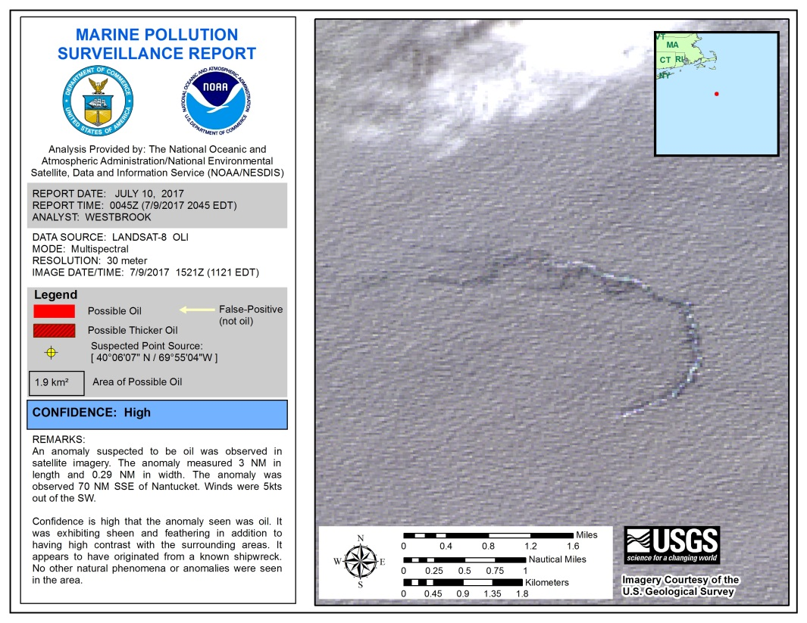
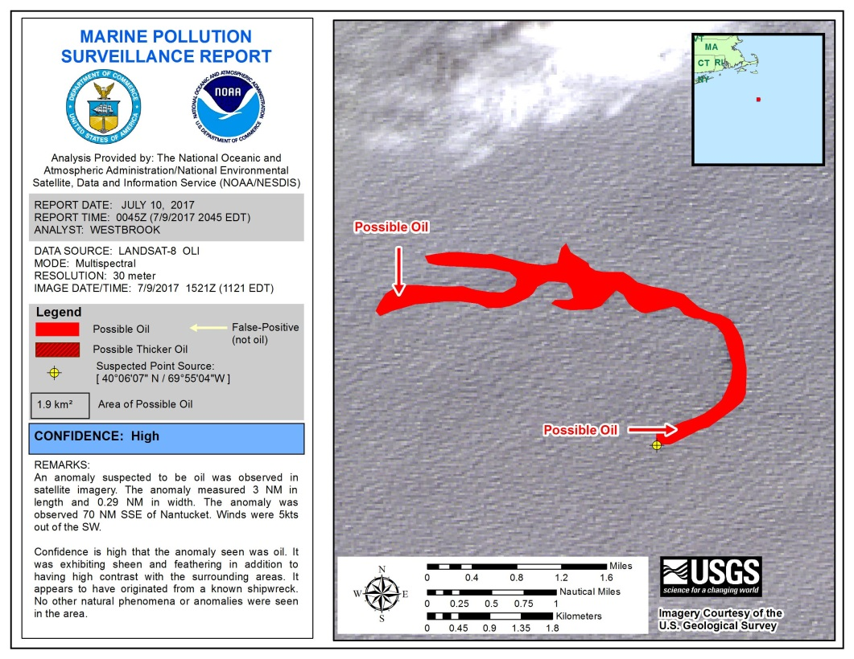
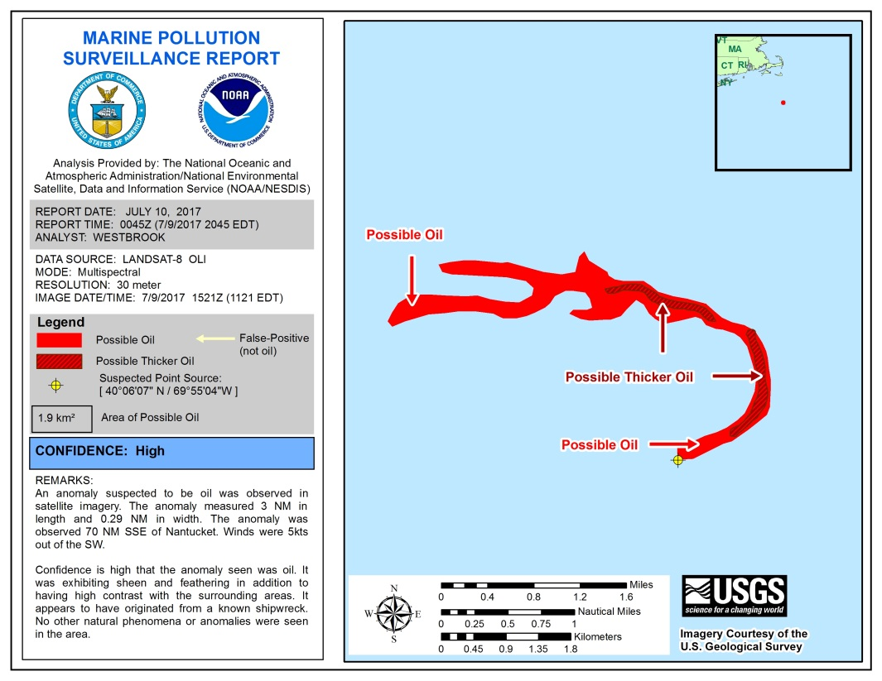
How Does This Translate Into Operations?
Prior to mid 2016, the Marine Pollution Surveillance Reports denoted only the boundary of the entire oil slick
Currently, when possible and using an optical image, the analyst will qualitatively assign areas of “relatively thick” oil based on visual inspection. We can confidently report this because we have high resolution imagery concurrent with field work validation

Slide 15
Aligned with BSEE and NOAA objectives to capture lessons-learned from DWH and advance our
understanding for oil spill preparedness, this proposal provides options for controlled as well as open
water synoptic data collection experiments from multiple sensors and platforms to support this needed
validation. This proposal has 3 major component phases:
Phase 1: Characterize the detection of known oil thicknesses and oil-emulsions in a controlled
environment, performing multiple tests and calibrations for thermal, optical, and microwave sensors
at the National Oil Spill Response Research &amp; Renewable Energy Test Facility (Ohmsett) which is
located at the Naval Weapons Station Earle Waterfront in Leonardo, New Jersey.
Phase 2: Measure the open water oil thicknesses and oil-emulsions at the damaged Taylor Energy
well field surface oiling site performing multiple tests and calibrations for thermal, optical and
microwave sensors.
Phase 3: Develop operational methods and procedures for processing and interpreting each of the
sensors products used during the experiments for future emergency operations.
By carrying out the simultaneous experiments in both controlled and marine settings, we will test a broad
range of sensors available that oil spill responders could use for surface oil characterization and
quantification. These experiments will demonstrate how each sensor detects oil and emulsions in the same
physical and environmental conditions. The ultimate goal of this proposal is to validate and quantify
the efforts put forward under the DWH NRDA OoW workgroup and provide BSEE and NOAA the
needed methodology and operational tools to assess future oil spills and the ability to monitor and
measure more accurately the thickness of surface oil slicks in the marine environment. We will
accomplish this goal by providing a comprehensive analysis of the capabilities and limitations of each
sensor, but more importantly, we will provide a methodology and workflow for NOAA NESDIS Satellite
Analysis Branch (SAB) image analysts on how to process, interpret and deliver the information generated
from each of the available products to the active spill responders and Trustees during future oil spill
responses. This workflow will ensure industry standard data formats will be produced and available to be
delivered directly to a Common Operation Picture (COP) such as the NOAA Office of Response and
Restoration’s Environmental Response Management Application (ERMA
Moving Forward…
The project is still in progress, with 1 more field experiment in August 2017.
Results to be reported include spectral properties and profiles of varying known oil thicknesses. The SAB marine pollution team intends to use this information to quantitatively differentiate oil thicknesses in future reports.
Additional conclusions pertinent to operations include how quickly does oil move? Spread? Dissipate? This is an inherently complicated question as the answers are dependent on both oceanic and atmospheric conditions.
The goal is to more accurately interpret satellite images of marine oil, such that our reports are increasingly useful to the spill responders during emergency operations.

Slide 16
Commercial imagery has been repeatedly requested by SAB throughout 2013, 2014, and 2015 as part of a joint effort between NESDIS SAB and NOS Marine Debris Program to optimize SAB operational response to marine debris in support of NOS, Coast Guard, and other responders.
Helping Researchers who are Supporting SAB Operations – Part 2
This work largely stems from the aftermath of the 2011 tsunami that struck Japan and generated from the NOAA A.A. a call for “all hands on deck”. Over the next two years NOAA was under substantial political pressure to determine if U.S. coastline would be inundated with marine debris. Through the use of Worldview imagery, SAB was able to provide NOS with the ammunition they needed to alleviate congressional concern.

Slide 17
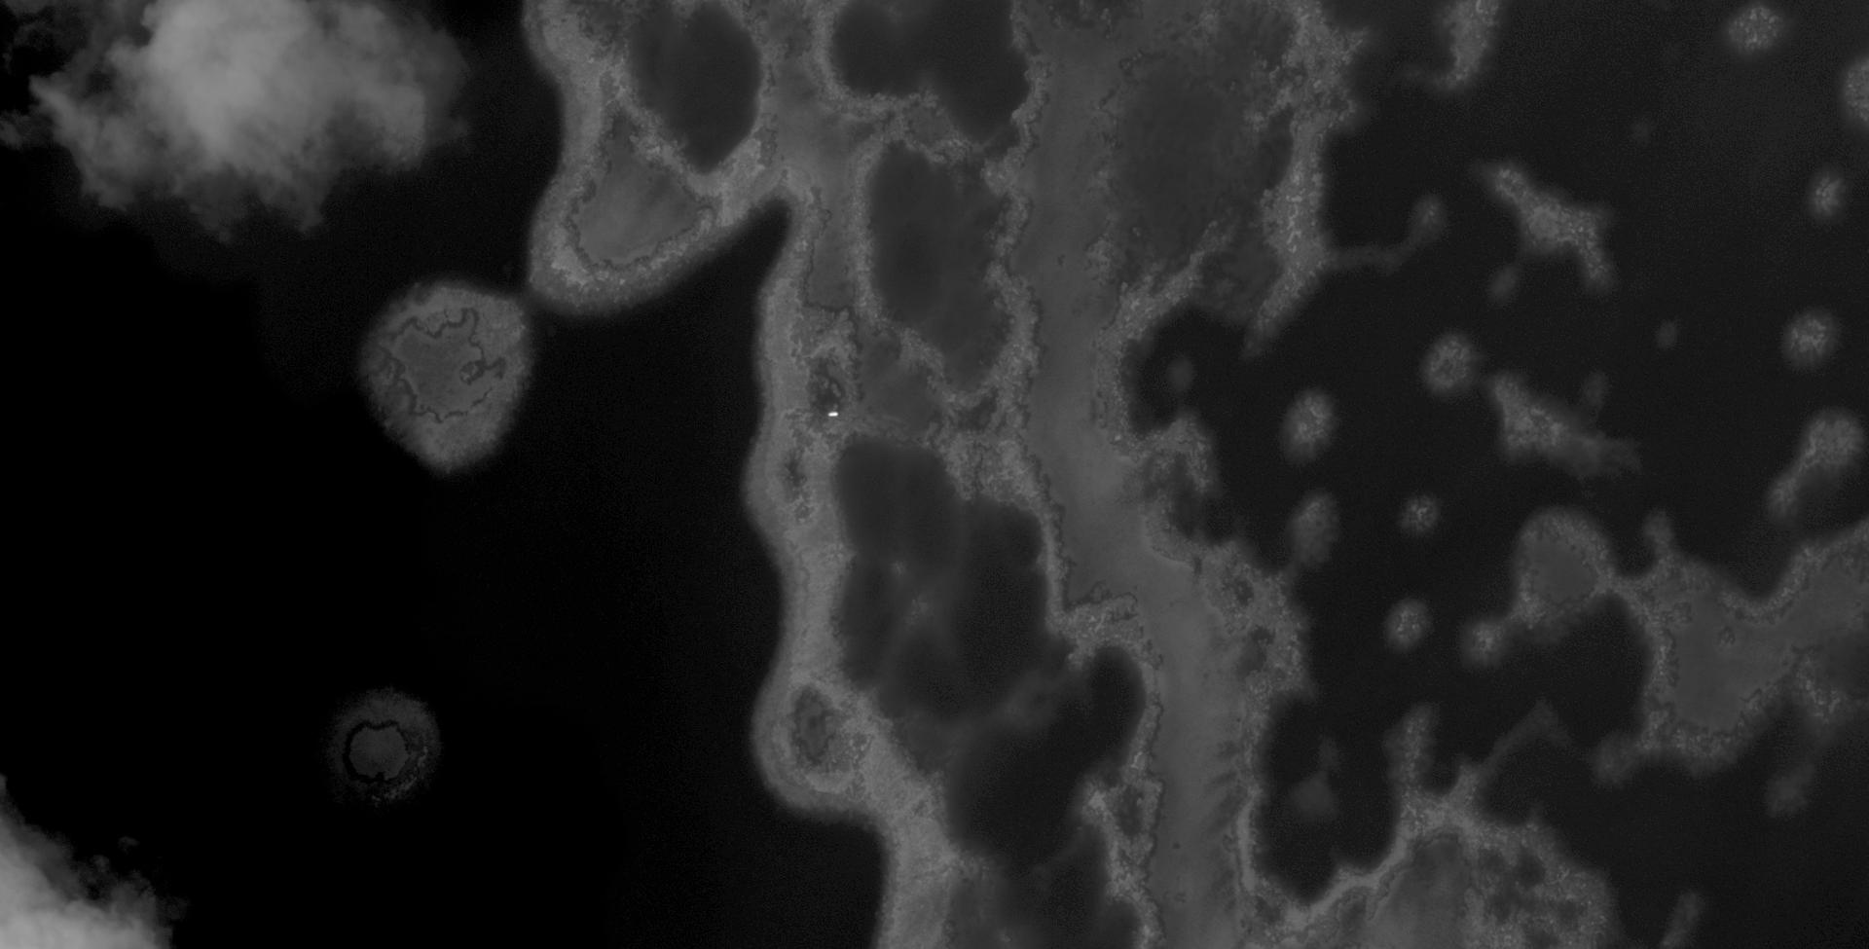
Boat removed on October 09, 2014
Image: WorldView2 September 19, 2014
Depth=0.5m
Length=6m
Width=1.75m
Boat Coordinates: Lat= 27.907718 N Lon= 175.811277 W

Slide 18
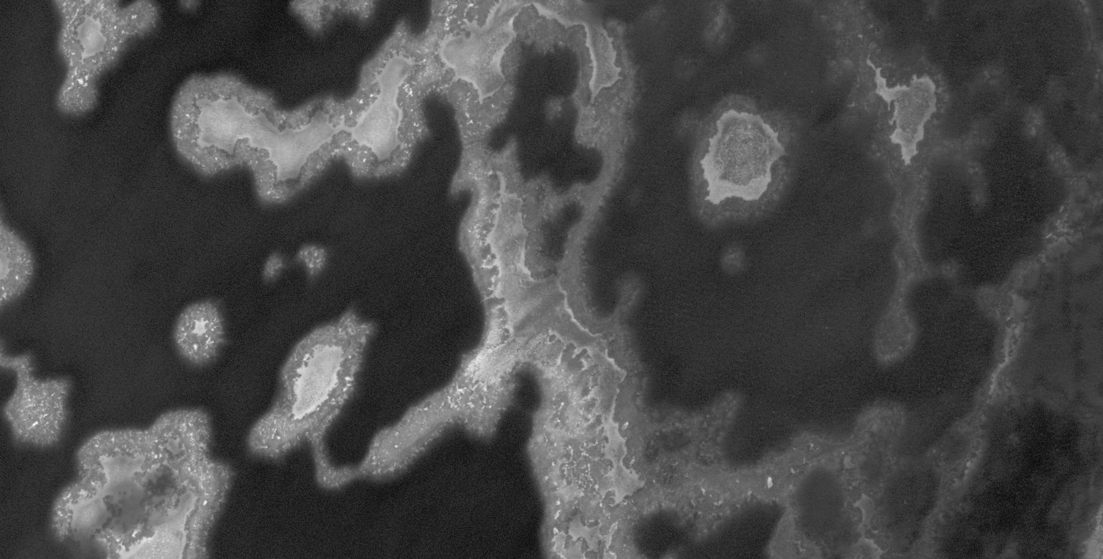
Boat removed on October 11, 2014
Image: WorldView2 September 19, 2014
Boat Coordinates: Lat= 27. 828716822 N Lon= 175. 78806784 W
Depth=1.75m
Length=9m
Width=1m

Slide 19
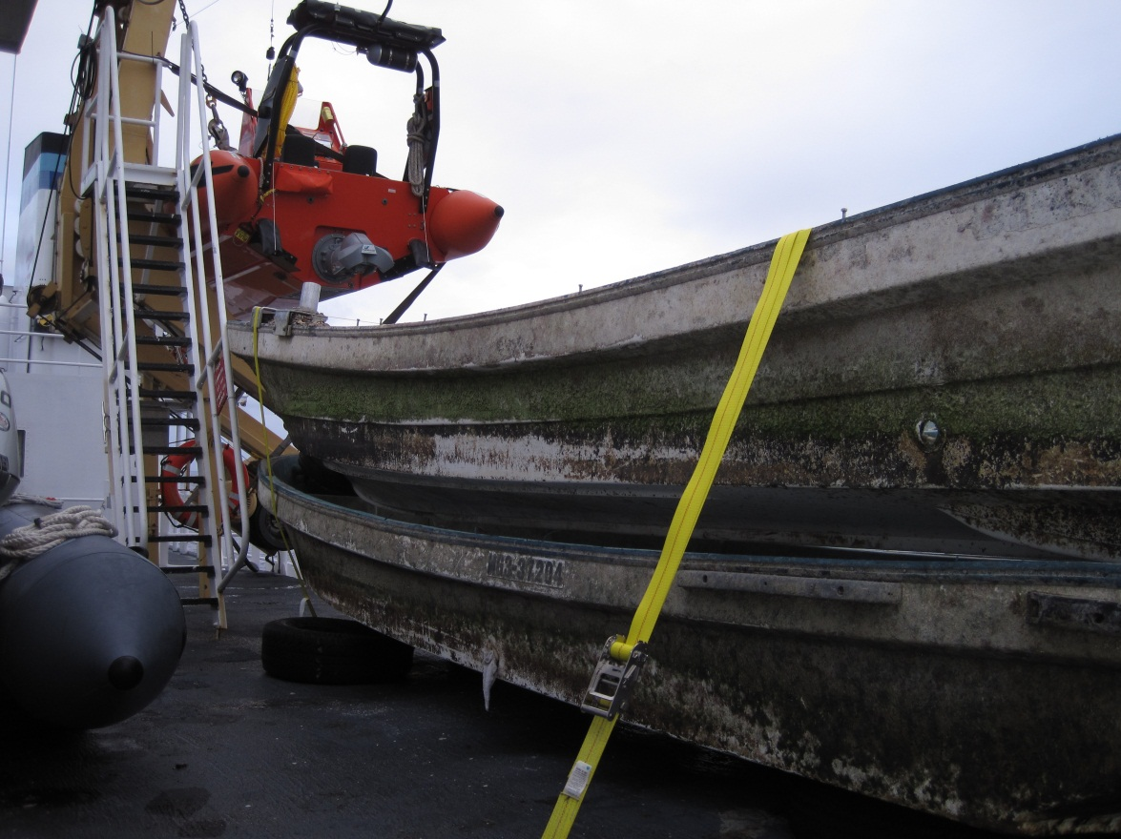
Derelict Boats
Picture provided by NOAA Marine Debris Program

Slide 20
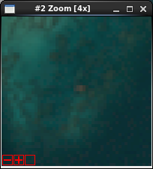
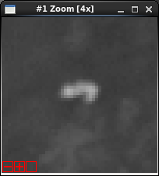
10.4 Ton Derelict Net
Multispectral
Panchromatic

Slide 21
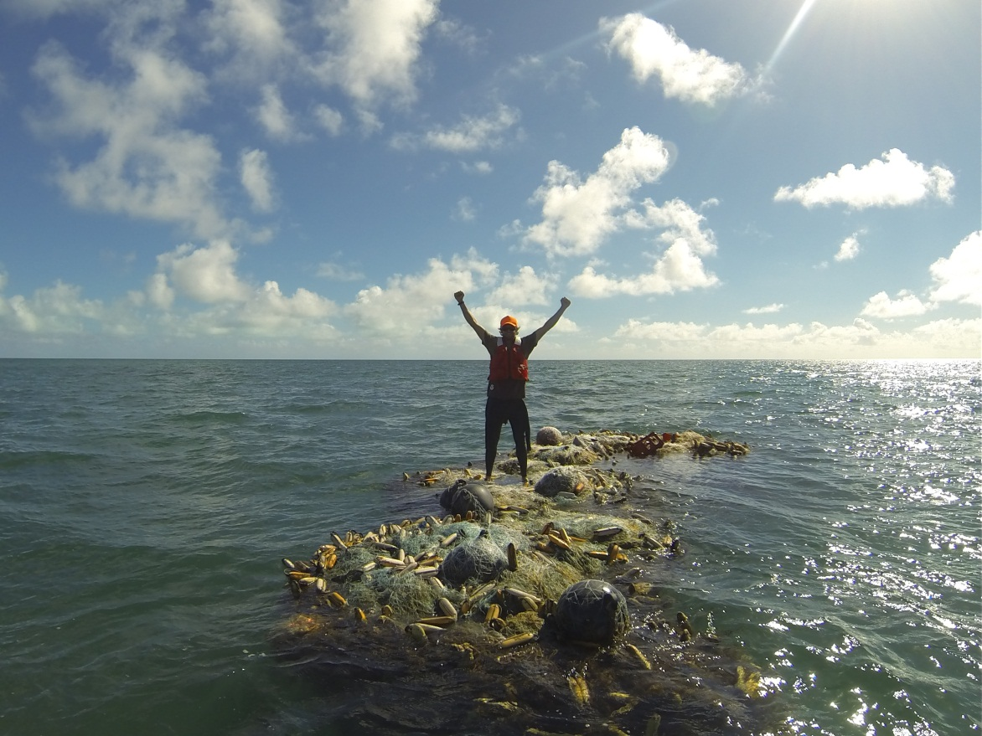
10.4 Ton Derelict Net
Picture provided by NOAA Marine Debris Program

Slide 22
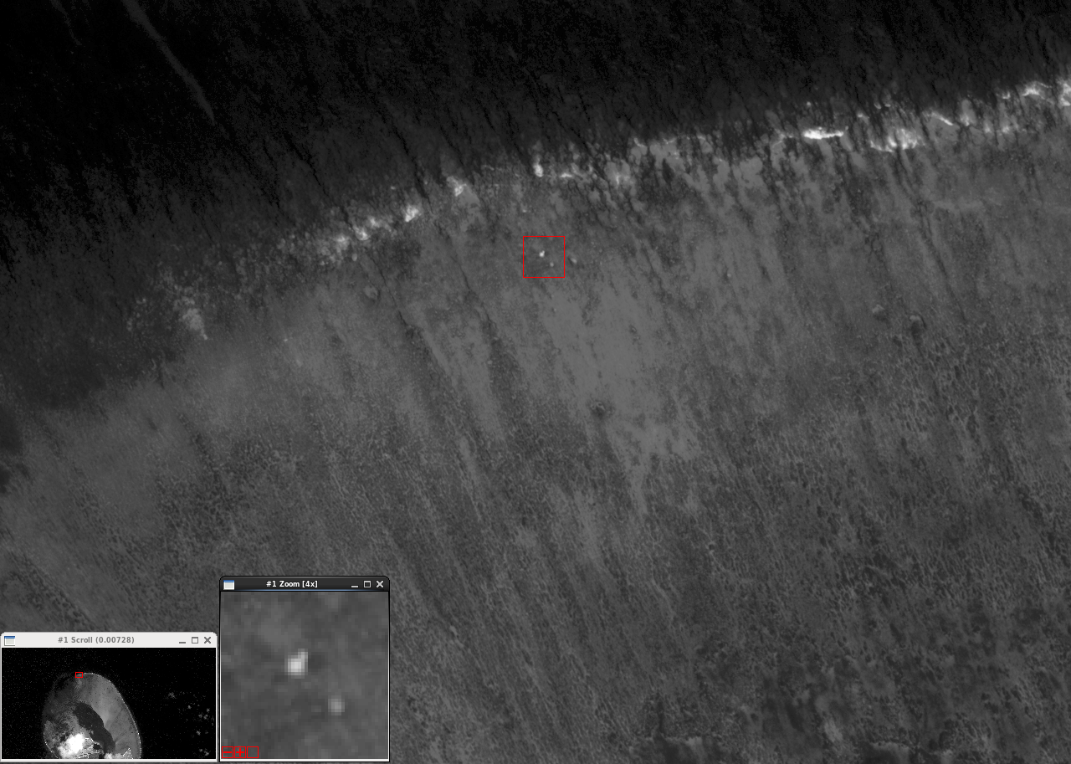
Possible Debris
Worldview2
8/1/2015
0.6m resolution
Zone C1
Lat: 28° 16’ 30.94” N
Lon: 177° 22’ 57.32” W

Slide 23
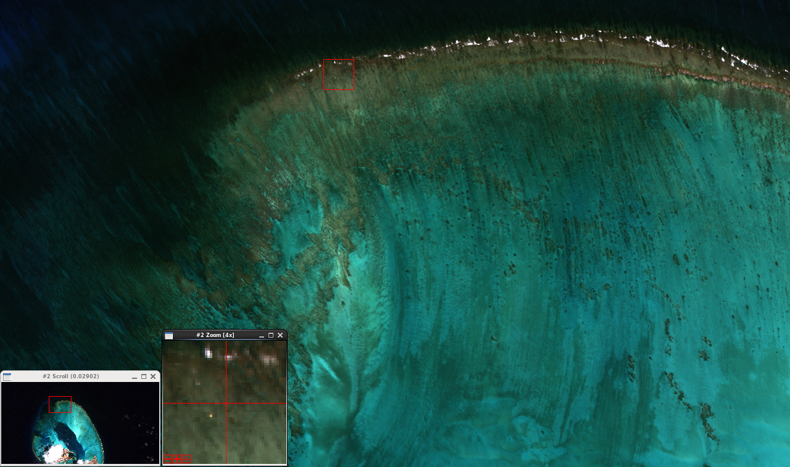
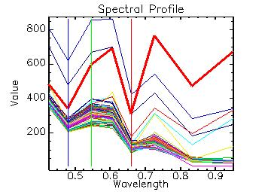
Possible Debris
1.5m resolution True Color Composite
White cap: Exhibits a downward trend with increasing λ (wavelength), consistent with water, and showing higher reflectivities
Anomaly: Exhibits increasing trend with increasing λ, consistent with debris
Ocean background: The cluster shows how consistent the spectral profile of the ocean surface is.

Slide 24
How Does This Translate Into Operations?
Not if, but when the next tsunami occurs, SAB will be much better equipped to analyze marine debris fields based on their visual and spectral characteristics.
SAB, with the aid of high resolution commercial imagery, will be able to effectively track marine debris fields over time, alleviating hazards to navigation, responding to high level inquiries, and improving the outcome for ecosystems.
SAB is continuing to intermittently support NOAA Marine Debris Program operations, when requested.

Slide 25
Closing Remarks
Worldview-2 and Worldview-3 datasets are uniquely helpful for their very high resolution, and 8 spectral bands.
High resolution commercial imagery, accessible to NESDIS SAB via the Civil Applications Committee, has played and continues to play a critical role in improving satellite based detection of marine oil and marine debris.
Without a means to obtain high resolution imagery, SAB will not be able to monitor some oil spill incidences as effectively.

