Slide 1
Operational Readiness Review eTRaP Upgrade-RCLIPER
Prepared by:
Liqun Ma¹, Bob Glassberg² , Bob Kuligowski³
¹ NOAA/NESDIS/OSPO
² SGT
³ NOAA/NESDIS/STAR
July 25, 2017
1
Notes:
1
BK: Done
BK: Need to put the final July date in there
GHE Operational Readiness Review

Slide 2
Review Agenda
Introduction
Risks and Actions
Requirements
System Description
System Test
System Operational Readiness
Summary
2
2
2
Notes:
2

Slide 3
Outline
Introduction
Risks and Actions
System Requirements
System Description
System Test
System Operational Readiness
Summary
3
3
3
Notes:
3

Slide 4
Introduction Bob Kuligowski NOAA/NEDSIS/STAR
4
4
Notes:
4

Slide 5
eTRaP Background (1/3)
Tropical Rainfall Potential (TRaP) is a forecast of rainfall from a tropical cyclone based on extrapolating satellite-derived instantaneous rain rate estimates along the predicted storm track.
Ensemble TRaP (eTRaP) uses an ensemble of TRaPs based on multiple satellite-derived rain rates and predicted storm tracks to derive a maximum likelihood rainfall forecast and probability of exceeding specified rainfall accumulation thresholds.
Forecasts are produced for the 0-24 h time frame at 6-h intervals with initialization times of 0, 6, 12, and 18 UTC. The code is run 3 h after initialization time and output is distributed ~4 h after initialization time.
5

Slide 6
eTRaP Background (2/3)
eTRaP became an operational product at OSPO in 2009
The retirement of the SSM/I and TMI and loss of AMSR-E degraded eTRaP availability, particularly over the Atlantic Basin, because of an insufficient number of ensemble members.
Subsequent improvements to eTRaP include
Adding rainfall rates from new instruments (SSMIS, GHE, ATMS, AMSR2 and GMI) to replace retired / lost instruments (SSM/I, TRMM, AMSR-E)
Calibrating the ensemble probabilities to remove bias
6

Slide 7
eTRaP Background (3/3)
The final improvement to eTRaP under this project is adding R-CLIPER to the ensemble (the subject of this review)
7
Notes:
BK: Modified the wording

Slide 8
Project Objectives
Add R-CLIPER rainfall forecasts to the eTRaP ensemble:
Run R-CLIPER for historic storms that made landfall over the CONUS
Determine the optimal weighting of R-CLIPER based on its skill relative to corresponding MW TRaPs.
Run eTRaP without and with R-CLIPER and evaluate the impact of R-CLIPER on forecast skill. Adding R-CLIPER must improve the reliability eTRaP without degrading forecast skill..
8
Notes:
BK: R-CLIPER is a forecast, not a rain rate, so modified the wording accordingly. Also changed “RCLIPER” to “R-CLIPER” and made the sub-bullets into a numbered list

Slide 9
Project Stakeholders
IPT Lead: Bob Kuligowski (STAR)
PAL and IPT Backup Lead: Liqun Ma (OSPO)
Science Advisor: Elizabeth Ebert (CAWCR - Melbourne, Australia)
NESDIS team:
STAR: Ralph Ferraro
OSPO: Liqun Ma, Limin Zhao, Nancy Merkle (Web Coordinator), Robert Glassberg (SGTPrimary Programmer), Clay Davenport (SGT Backup Programmer)
OSGS: Kathryn Shontz
NWS team:
NCEP/TPC/NHC: Mark DeMaria (RCLIPER)
User team
Leads: Michael Turk, Alan Schwartz
Others: Dan Brown (TPC), Mark Klein (HPC), Greg Shelton (West Gulf RFC), Alipate Waqaicelua (Nadi Regional Specialized Meteorological Centre (RSMC)), Andrew Burton (Perth TCWC)
Product Oversight Panel: PREPOP
9

Slide 10
Project Stakeholders – Customers / Users
SAB
Mike Turk
HPC
Mark Klein
10

Slide 11
Project Stakeholders – O&M
OSPO ESPC
Run eTRaP system
Distribute eTRaP products to users
Perform routine product quality monitoring and maintenance
OSPO Products Area Lead – Liqun Ma
OSPO QA Lead – Zhaohui Cheng
ESPC O&M Team
Robert Glassberg
STAR Science Maintenance Team
Bob Kuligowski
Elizabeth Ebert
11

Slide 12
Project Plan
Sep 13: Development Phase Begins
Sep 13: IPT Lead informed to begin product development
Dec 15: topography, climatology (RCLIPER) test cases processed
Mar 16: Critical Design Review
Nov 16: Code is prepared for implementation
May 17: Software Code Review
Nov 16: Pre-operational Phase Begins
Nov 16 : Operational and backup processing capabilities in place
Nov 16 : Pre-operational product output evaluated & tested
Jul 17: Operational Readiness Review
Aug 17: Brief SPSRB capability is ready to go operational
Aug 17: Operational Phase Begins
Aug 17: SPSRB manager and secretaries notified update/upgrade went into operations.
SPSRB Secretaries/manager update the SPSRB product metrics web pages
Aug 17: OSGS updates Satellite Products database
12

Slide 13
Project Plan - Milestones
Schedule (Milestones)
Critical Design Review – 03/2016
Algorithm Change Package delivered to OSPO – 11/2016
Algorithm Readiness Review – waived
Software Review – 05/01/2017
Operational Readiness Review – 07/2017
Transition to operations – 08/2017
13
Notes:
BK: Modified the formats of the dates to make them consistent with each other

Slide 14
ORR – Review Objectives
Review Project Plan
Review the open Risks and Actions
Review the System Requirements Updates
Review the System Description
Review the System Test Report
Review System Operational Readiness
14
Notes:
14

Slide 15
ORR Reviewers
ORR Review Leads
Antonio Irving, Zhaohui Cheng and Liqun Ma
ORR Review Team
Liqun Ma (OSPO/SPSD)
Zhaohui Cheng (OSPO/SPSD)
Antonio Irving (OSPO/SPSD)
Donna McNamara (OSPO/MOD)
Bob Kuligowski (STAR)
ORR Review Consultants
Kathryn Shontz (OSGS)
15
Notes:
15

Slide 16
ORR Guidelines and Checklist
Guidelines for ORR review is the OSPO QA process asset
ORR reviewers can access this document at
ftp://satepsanone.nesdis.noaa.gov/testTRAP/ORR_DOC
The ORR Review Check List and ORR related documents are available at:
ftp://satepsanone.nesdis.noaa.gov/testTRAP/ORR_DOC
16
Notes:
16

Slide 17
Outline
Introduction
Risks and Actions
System Requirements
System Description
System Test
System Operational Readiness
Summary
17
Notes:
17

Slide 18
Risks and Actions Bob Kuligowski NESDIS/STAR
18
Notes:
18

Slide 19
Risks and Actions
There are no remaining risks from previous reviews.
19
Notes:
Updated stats

Slide 20
ORR – Entry Criteria
Entry # 1 - The ORR reviewers have access to the review version of the following artifacts
Requirements Allocation Document (RAD)
Review Item Disposition Spreadsheet (RID)
Operational Readiness Review Document (ORRD)
Entry # 2 - The ORR reviewers have access to the old version of SPSRB Documents
User Manuals
System Maintenance Manual
Entry # 3 - The ORR reviewers have access to the review version of the Operations Procedure
20
Notes:
BK: Changed Entry #4 to #3 since there was no #3
GHE Operational Readiness Review
20

Slide 21
ORR – Exit Criteria
Exit # 1 - All open items in RID have been satisfactorily disposed of.
Exit # 2 - The updated RAD is satisfactory.
Exit # 3 - The SPSRB documents (UM, SMM, ICD, SDD, and OM) have been reviewed and are deemed to be satisfactory.
Exit # 4 - Test and validation results are satisfactory.
Exit # 5 - The operation readiness are satisfactory.
Exit # 6 - The security impact assessment (SIA) has been completed. -- deferred to Operational Decision Briefing
21
Notes:
GHE Operational Readiness Review
21

Slide 22
Outline
Introduction
Risks and Actions
System Requirements Updates
System Description
System Test
System Operational Readiness
Summary
22
Notes:
22

Slide 23
System Requirements
Bob Kuligowski
23
Notes:
23

Slide 24
Requirements Overview
All eTRaP requirements are documented in the RAD:
http://www.star.nesdis.noaa.gov/smcd/emb/bobk/eTRaP_docs/ORR/eTRaP_Requirements_Allocation_Document_v2.5.docx
Text highlighted
Changes/updates to requirements since the last review are in Green.
Requirements specific to this upgrade of eTRaP are in Brown
24

Slide 25
Requirement #0
ETRAP-R 0.0: The eTRaP Upgrade project shall adopt the standard practices of the SPSRB Review Process for transition of a product from research to operations.
Driver: SPSRB transition to operations process. Since this is an enhancement to an existing operational system, only the process steps related to modifying an existing system need be followed.
25

Slide 26
Requirement #0
ETRAP-R 0.1: The eTRaP Upgrade project reviews shall be tailored.
This derived requirement has been adopted to mitigate schedule risk by eliminating the overhead of preparing review slide packages and reports.
ETRAP-R 0.1.1: The Requirements Review (RADR), Preliminary Design Review (PDR), Critical Design Review (CDR), and the Unit Test Readiness Review (TRR) for the S-NPP upgrade of eTRaP have been waived.
This derived requirement has been adopted to mitigate schedule risk by eliminating the overhead of preparing a RADR, PDR, CDR, and TRR slide packages and reports. The Technical risk is assessed as Low because the update to the system only involves processing a new data set.
26

Slide 27
Requirement #0
ETRAP-R 0.1.2: There shall be an Algorithm Readiness Review (ARR) for the S-NPP upgrade of eTRaP.
This derived requirement has been adopted from the SPSRB Review process.
ETRAP-R 0.1.3: There shall be an Algorithm Readiness Review Report (ARRR) for the S-NPP upgrade of eTRaP.
The ARRR is one of the exit criteria for ARR.
27

Slide 28
Requirement #0
ETRAP-R 0.1.4: There shall be an Operational Readiness Review (ORR) for the S-NPP upgrade of eTRaP.
This derived requirement has been adopted from the SPSRB Review process.
ETRAP-R 0.1.5: There shall be an Operational Readiness Review Report (ORRR) for the S-NPP upgrade of eTRaP.
The ORRR is one of the exit criteria for ORR.
28

Slide 29
Requirement #0
ETRAP-R 0.1.6: The Requirements Review (RADR), Preliminary Design Review (PDR), Critical Design Review (CDR), and Unit Test Readiness Review (UTRR) for the AMSR2 upgrade of eTRaP have been waived.
This derived requirement has been adopted to mitigate schedule risk by eliminating the overhead of preparing a RADR, PDR, CDR, and TRR slide packages and reports. The Technical risk is assessed as Low because the update to the system only involves processing a new data set.
29

Slide 30
Requirement #0
ETRAP-R 0.1.7: There shall be an Algorithm Readiness Review (ARR) for the AMSR2 upgrade of eTRaP.
This derived requirement has been adopted from the SPSRB Review process.
ETRAP-R 0.1.8: There shall be an Algorithm Readiness Review Report (ARRR) for the AMSR2 upgrade of eTRaP.
The ARRR is one of the exit criteria for ARR.
30

Slide 31
Requirement #0
ETRAP-R 0.1.9: There shall be an Operational Readiness Review (ORR) for the AMSR2 upgrade of eTRaP.
This derived requirement has been adopted from the SPSRB Review process.
ETRAP-R 0.1.10: There shall be an Operational Readiness Review Report (ORRR) for the AMSR2 upgrade of eTRaP.
The ORRR is one of the exit criteria for ORR.
31

Slide 32
Requirement #0
ETRAP-R 0.1.11: There shall be a Critical Design Review (CDR) for the R-CLIPER and orography upgrade of eTRaP.
This upgrade will require design upgrades that will be presented at the CDR.
ETRAP-R 0.1.12: There shall be a Critical Design Review Report (CDRR) for the R-CLIPER and orography upgrade of eTRaP.
The CDRR is one of the exit criteria for CDR.
32

Slide 33
Requirement #0
ETRAP-R 0.1.13: There shall be an Algorithm Readiness Review (ARR) for the R-CLIPER and orography upgrade of eTRaP.
This derived requirement has been adopted from the SPSRB Review process.
ETRAP-R 0.1.14: There shall be an Algorithm Readiness Review Report (ARRR) for the R-CLIPER and orography upgrade of eTRaP.
The ARRR is one of the exit criteria for ARR.
33

Slide 34
Requirement #0
ETRAP-R 0.1.15: There shall be a eTRaP R-CLIPER Upgrade Operational Readiness Review (ORR).
This derived requirement has been adopted from the SPSRB Review process.
ETRAP-R 0.1.16: There shall be a eTRaP R-CLIPER Upgrade Operational Readiness Review Report (ORR).
The ORRR is one of the exit criteria for ORR.
34

Slide 35
Requirement #0
ETRAP-R 0.1.17: The Requirements Review (RADR), Preliminary Design Review (PDR), Critical Design Review (CDR), Unit Test Readiness Review (UTRR), and Algorithm Readiness Review (ARR) for the GMI upgrade of eTRaP have been waived.
This derived requirement has been adopted to mitigate schedule risk by eliminating the overhead of preparing RADR, PDR, CDR, UTRR, and ARR slide packages and reports. The Technical risk is assessed as Low because the update to the system only involves processing a new data set.
35

Slide 36
Requirement #0
ETRAP-R 0.1.18: There shall be an Operational Readiness Review (ORR) for the GMI upgrade of eTRaP.
This derived requirement has been adopted from the SPSRB Review process.
ETRAP-R 0.1.19: There shall be an Operational Readiness Review Report (ORRR) for the GMI upgrade of eTRaP.
The ORRR is one of the exit criteria for ORR.
36

Slide 37
Requirement #0
ETRAP-R 0.2: The Requirements Allocation Document (RAD) shall be created and maintained by the eTRaP development team.
This derived requirement has been adopted from the SPSRB Review process. The RAD will follow document standards stated in EPL v3 process asset DG-6.2
ETRAP-R 0.3: The Review Item Disposition (RID) spreadsheet shall be created and maintained by the eTRaP development team.
This derived requirement has been adopted from the SPSRB Review process.
ETRAP-R 0.4: Configuration Management shall be implemented.
OSPO will CM the code and associated documents using Subversion.
37

Slide 38
Requirement #1
ETRAP-R 1.0: The Ensemble Tropical Rainfall Potential (eTRaP) forecast of rainfall for a tropical system shall be upgraded.
Driver: This basic requirement is traced to user needs as stated in SPSRB User Requests: SPSRB user request # 1001-0001 “eTRaP Upgrade” by NWS/NCEP/HPC”.
38

Slide 39
Requirement #1
ETRAP-R 1.0.1: The rain rates generated from the DMSP SSMIS sensor shall be incorporated into the eTRaP ensemble.
ETRAP-R 1.0.2: The rain rates generated from the Global Hydro-Estimator shall be incorporated into the eTRaP ensemble.
ETRAP-R 1.0.3: The rain rates generated from the S-NPP ATMS sensor shall be incorporated into the eTRaP ensemble.
ETRAP-R 1.0.4: The rain rates generated from the GCOM-W AMSR2 sensor shall be incorporated into the eTRaP ensemble.
39

Slide 40
Requirement #1
ETRAP-R 1.0.5: The rain rates generated by the R-CLIPER model shall be incorporated into the eTRaP ensemble.
ETRAP-R 1.0.6: The rain rates generated from the GPM GMI sensor shall be incorporated into the eTRaP ensemble.
40

Slide 41
Requirement #1
ETRAP-R 1.1: The generated TRaP forecasts shall be combined in a weighted simple ensemble to produce quantitative precipitation forecasts and probabilistic forecasts of heavy rain exceeding several thresholds.
Weights depend on the latency of the TRaP (greater weight for more recent input) and optionally for the sensor used.
ETRAP-R 1.2: The probabilities generated by eTRaP shall be adjusted to remove bias.
ETRAP-R 1.3: The eTRAP system shall take into account the impact of topography of the region and cyclone climatology using use the NHC Rainfall Climatology persistence model (R-CLIPER) in the individual ensemble members to improve the accuracy of the forecast.
41

Slide 42
Requirement #1
ETRAP-R 1.4: The eTRaP rain rates shall be generated for the entire globe for 5 time intervals (0-6, 6-12, 12-18, 18-24, and 0-24 h).
User request
ETRAP-R 1.4.1: The eTRaP algorithm shall be applied to data from NOAA-18, NOAA-19, MetOp-A/B, DMSP F16, DMSP F17, DMSP F18, GOES-E, GOES-W, METEOSAT-7, METEOSAT-10, Himawari-8, S-NPP, GCOM-W, and GMI satellites, plus R-CLIPER.
42

Slide 43
Requirement #1
ETRAP-R 1.5: Accuracy of the eTRaP rain rates shall be such that to achieve reduced random errors in rain field, more accurate location and intensity of maximum rainfall.
User Request.
ETRAP-R 1.6: Latency (average elapsed time from data observation to delivery of the product to the user) shall not exceed 2.5 hours (assuming receipt of blind orbits).
User Request.
43

Slide 44
Requirement #1
ETRAP-R 1.7: Timeliness (Latest time after observation by which a product can be delivered and still be useful to the customer) shall be 4.5 hours (assuming receipt of blind orbits).
User Request.
ETRAP-R 1.8: The output format for eTRaP product shall be McIDAS Area file, ASCII, GRiB2 and GIF.
User Request; ASCII format requested by HPC and NCEI will be provided in addition to McIDAS and GIF formats.
44

Slide 45
Requirement #1
ETRAP-R 1.9: The eTRaP developers shall perform validation and verification of the eTRaP rain rate product and exceedence probabilities.
ETRAP-R 1.9.1: The eTRaP developers shall perform tests to verify functional performance of the code that produces the eTRaP Product.
Tests will be conducted.
45

Slide 46
Requirement #1
ETRAP-R 1.9.2: The eTRaP developers shall verify that the eTRaP product files are generated correctly.
This will be done as part of the tests.
ETRAP-R 1.9.3: The eTRaP developers shall verify the error handling capability of the pre-operational system.
Already done in the existing system.
46

Slide 47
Requirement #1
ETRAP-R 1.10: The eTRaP rain rates shall be compared with in situ measurements.
ETRAP-R 1.10.1: Metrics for assessing eTRaP performance shall be:
Quantitative Precipitation Forecasts (QPFs) (maximum rainfall, spatial rainfall pattern
Bias (mean difference), root mean square error, correlation coefficient
Frequency bias, probability of detection, false alarm ratio, equitable threat score
Location, volume, and pattern errors estimated using Contiguous Rain Area (CRA) verification
Probabilistic forecasts of rain exceeding various thresholds:
Reliability diagrams
Relative operating characteristics (ROC) and relative value diagrams
Brier score, ranked probability score
47

Slide 48
Requirement #1
ETRAP-R 1.10.2: The eTRaP developers shall produce and distribute eTRaP test sample products to the user community.
To ensure user acceptance of the product.
48

Slide 49
Requirement #2
ETRAP-R 2.0: The eTRaP processing system shall have a data ingest capability.
Driver: This basic requirement is traced to algorithm input needs, as documented in the ATBD.
49

Slide 50
Requirement #2
ETRAP-R 2.1: The upgraded eTRaP system shall ingest DMSP SSMIS TRaP forecast data in McIDAS AREA format.
ETRAP-R 2.2: The upgraded eTRaP system shall ingest GHE forecast data in McIDAS AREA format
ETRAP-R 2.3: The upgraded eTRaP system shall ingest S-NPP ATMS TRaP forecast data in McIDAS AREA format.
50

Slide 51
Requirement #2
ETRAP-R 2.4: The upgraded eTRaP system shall ingest GCOM-W AMSR2 TRaP forecast data in McIDAS AREA format.
ETRAP-R 2.5: The upgraded eTRaP system shall produce and use R-CLIPER forecast data in McIDAS AREA format.
ETRAP-R 2.6: The upgraded eTRaP system shall ingest GPM GMI TRaP forecast data in McIDAS AREA format.
51

Slide 52
Requirement #3
ETRAP-R 3.0: The eTRaP processing system shall have QC monitoring capability.
Driver: This basic requirement is traced to an OSPO need for QC monitoring.
52

Slide 53
Requirement #3
ETRAP-R 3.1: The eTRaP processing system outputs shall include overall quality control flags and quality summary level metadata.
Needed for distribution, archive, quality control, and post-processing in the products files. eTRaP code will generate metadata for this purpose.
ETRAP-R 3.2: The eTRaP system shall be capable of monitoring input data latency and overall quality.
Current operational eTRaP system is monitoring input data latency and update the product every hour.
53

Slide 54
Requirement #3
ETRAP-R 3.3: The eTRaP system shall be capable of monitoring product latency.
ETRAP-R 3.4: The eTRaP system shall produce real-time imagery files for visual inspection of output data files
ETRAP-R 3.5: The eTRaP system shall be capable of monitoring product distribution status to ensure that the data/products are successfully available for transfer to the user community.
There is an eTRaP system monitoring webpage which monitors all system processing stages including distribution status.
54

Slide 55
Requirement #3
ETRAP-R 3.5.1: Each log file shall include all runtime error messages.
Error messages will include system messages and error conditions written by the code.
ETRAP-R 3.5.2: The log file shall indicate whether or not the run was completed without error.
Code will write this message.
55

Slide 56
Requirement #4
ETRAP-R 4.0: The eTRaP developers shall produce a fully functional pre-operational system in the STAR Development Environment.
Driver: This basic requirement is traced to an OSPO need for a fully functional system ready for integration and system testing.
56

Slide 57
Requirement #4
ETRAP-R 4.1: The STAR Development Environment shall host the pre-operational system.
Pre-operational system is to be developed in this environment
ETRAP-R 4.1.1: The STAR Development Environment shall include a Linux machine.
Needed for the code.
ETRAP-R 4.1.2: The STAR Development Environment shall have storage of 520KB for code storage, 400KB for input data, 80MB for output data and 130MB RAM .
57

Slide 58
Requirement #4
ETRAP-R 4.1.3: The STAR Development Environment shall include the McIDAS graphical/imaging program.
Needed for running the code.
ETRAP-R 4.1.4: The STAR Development Environment shall include FORTRAN programming language/compiler and Perl, Bash, korn scripting languages.
Needed for running the code.
58

Slide 59
Requirement #4
ETRAP-R 4.2: The STAR Development Environment shall be capable of hosting unit tests.
ETRAP-R 4.2.1: The pre-operational system shall include all processing code and all input test data needed to conduct unit tests
Complete unit test of each stage of the pre-operational system is expected before delivery to OSPO
59

Slide 60
Requirement #5
ETRAP-R 5.0: The upgraded eTRaP system shall be able to run on the existing OSPO Operational environment running eTRaP.
Driver: eTRaP is currently running operationally on GEOPROD3 in OSPO.
60

Slide 61
Requirement # 5
ETRAP-R 5.1: The upgraded eTRaP system shall use the RedHat Linux platform for the processing task required.
ETRAP-R 5.2: Disk storage for the input data (60 – 400 KB for each storm run) shall be established within OSPO.
Input data will be retained for 2 days and this includes the additional storage on 18.5 KB required for the AMSR2 input.
ETRAP-R 5.3: The upgraded eTRaP system shall use the Fortran90 (Absoft90) compiler.
61

Slide 62
Requirement #5
ETRAP-R 5.4: The upgraded eTRaP system shall use the Perl, Bash and korn scripting languages and IDL and McIDAS libraries.
ETRAP-R 5.5: The upgraded eTRaP system shall be monitored by ESPC helpdesk monitoring tool TIDAL.
ETRAP-R 5.6: The eTRaP outputs shall be stored in operational environment for at least 7 days for distribution.
62

Slide 63
Requirement #5
ETRAP-R 5.6.1: The total storage of data for distribution shall be 80MB.
This includes 30 each of McIDAS, GIF and ASCII files.
ETRAP-R 5.6.2: The eTRaP products shall be distributed using the ESPC Data Distribution Server(DDS) and webserver to the user community at http://www.ssd.noaa.gov/PS/TROP/etrap.html.
Standard procedure for this user community.
63

Slide 64
Requirement #6
ETRAP-R 6.0: The eTRaP pre-operational system shall be transitioned from the STAR Development Environment to the OSPO Environment.
Driver: This basic requirement is traced to an OSPO need for a fully functional system in its Environment.
64

Slide 65
Requirement #6
ETRAP-R 6.1: The pre-operational system shall include all processing code and all input test data needed to reproduce the unit tests.
For system testing. A complete system test of the integrated pre-operational system is expected before delivery to OSPO Environment.
ETRAP-R 6.2: The integrated pre-operational system shall include all output data produced by the unit tests.
Needed by OSPO to verify the system tests in its Environment.
65

Slide 66
Requirement #6
ETRAP-R 6.3: The eTRaP development team shall set up an internal FTP site for transferring the pre-operational system to OSPO as a tar file on a STAR server that is accessible to OSPO.
ETRAP-R 6.3.1: The eTRaP development team shall ensure that the OSPO PAL has the information needed to acquire the pre-operational system as a tar file.
66

Slide 67
Requirement #7
ETRAP-R 7.0: STAR shall deliver updated eTRaP documents to OSPO.
Driver: This basic requirement is traced to an OSPO need for documentation to support operations, maintenance, and distribution
67

Slide 68
Requirement #7
ETRAP-R 7.1: The eTRaP document package shall include a User’s Manual (UM)
The existing eTRaP UM following the SPSRB Version1 document standards will be updated.
ETRAP-R 7.2: The eTRaP document package shall include a System Maintenance Manual (SMM)
The existing eTRaP SMM following the SPSRB Version1 document standards will be updated.
68

Slide 69
Requirement #7
ETRAP-R 7.3: The eTRaP document package shall include an Interface Control Document (ICD).
The existing eTRaP ICD following the SPSRB Version1 document standards will be updated.
ETRAP-R 7.4: The eTRaP document package shall include a System Description Document (SDD).
The existing eTRaP SDD following the SPSRB Version1 document standards will be updated.
69

Slide 70
Requirement #7
ETRAP-R 7.5: The eTRaP document package shall include an Operations Manual (OM).
The existing eTRaP OM following the SPSRB Version1 document standards will be updated.
ETRAP-R 7.6: The eTRaP document package shall include an updated Archive Agreement.
70

Slide 71
Requirement #8
ETRAP-R 8.0: The eTRaP products shall be archived.
Daily tar file for each storm will be sent to NCEI; no changes to archive plan for eTRaP upgrades.
71

Slide 72
Requirement #8
ETRAP-R 8.1: Distribution of the Archive Products to NCEI shall be in accordance with a Data Submission Agreement (DSA).
ETRAP-R 8.2: The eTRaP files and associated metadata shall be archived by NCEI .
NCEI will generate the metadata for the eTRaP during archival of the products. Archive users will obtain eTRaP data from the NCEI servers.
72

Slide 73
Requirement #9
ETRAP-R 9.0: The eTRaP system shall comply with OSPO Code Review Security check lists.
Driver: OSPO code standards and OSPO security requirements
73

Slide 74
Requirement #9
ETRAP-R 9.1: The eTRaP system shall comply with OSPO data integrity check list.
OSPO data integrity check list is part of the OSPO Code Review Security check lists
ETRAP-R 9.2: The eTRaP system shall comply with OSPO development security check list.
OSPO development security check list is part of the OSPO Code Review Security check lists
ETRAP-R 9.3: The eTRaP system shall comply with OSPO code check list.
OSPO code check list is part of the OSPO Code Review Security check lists
74

Slide 75
Requirements – Summary
The eTRaP Requirements have been established.
The Requirements have been documented in the Requirements Allocation Document (RAD).
The Requirements are traceable to drivers (customer needs or expectations) and other requirements.
75

Slide 76
System Description Liqun Ma
76
Notes:
76

Slide 77
Major Components
Retrieve information about active tropical cyclones.
Retrieve rain rate data from N-18/19/MetOp-A/B, F17/18, GHE, S-NPP/ATMS, GCOM/AMSR2, and GPM/GMI.
Generate 6-hour total Tropical Rainfall Potential (TRaP) for each active storm and each satellite listed above.
Run RCLIPER module to generate 6-hour total Tropical Rainfall forecast.
For each active storm, generate Ensemble Tropical Rainfall Potential (eTRaP).
77

Slide 78
System Architecture, Data Flow, Security
GPM MGI MW Mcidas converter
MGTPROD
Linux
GPM GMI rain rate
SFS/GEODIST
McIDAS Area Files: ADDE pull
DDS/PDA
HPC
GCOM-W1 AMSR-2 rain rate
SFS/GEODIST
Ascii ftp pull
GCOM-W1 AMSR-2 MW Mcidas converter
MGTPROD
Linux
Ascii and Tar file
ftp push
NCEI
S-NPP ATMS MW rain rate
SFS/GEODIST
Production
GEOPROD3
Linux
Tar file containing GIF, McIDAS Area Files, ASCII
ftp pull
Distribution via web
GP5 (OSPO web)
Linux
S-NPP ATMS MW Mcidas converter
MGTPROD
Linux
N-18/19 /MetOp-A/B MHS MW rain rates
SFS/GEODIST
Test
GEOPROD3t
Linux
GIF sftp push
N-18/19 /MetOp-A/B MHS MW Mcidas converter
Polarprod
AIX
DMSP F17/18 SSMI/S
FNMOC MW rain rates
SFS/GEODIST
Distribution via ftp
SATEPSANONE
AIX
CM Repository
cm-espc
Linux
Ascii, GIF sftp push
DMSP F17/18 SSMI/S
FNMOC MW Mcidas converter
Polarprod
Linux
GHE IRRRs
SFS/GEODIST
Development
GEODEV
Linux
Storm SHIPS(R-CLIPER)
SFS
GHE SATEPSDIST IRRRs
GHE1
Linux
ASCII
ADDE
Pull
FOS Forecasts (JTWC,,NHC CPHC)
FOS2
Linux
JTWC, NHC,CPHC,
SATEPS Security at ESPC/NSOF
Production Zone
Conversion to McIDAS AREA file format is extrernal to eTRaP processing
Development Zone
Distribution Zone (DMZ)
78
External User Zone
Notes:
LM:

Slide 79
Production
eTRaP is running on ESPC geo system
Development / Test – Server
Pre-operational codes (DAP) received from STAR have been thoroughly tested on geoprdo3t at ESPC
Production – Server
eTRaP is running on geoprod3.
The products are distributed to users through ESPC Data Distribution server (DDS/PDA) and ESPC website server (GP5)
79
Notes:
LM: yes. Added. And also change ‘will be runing’ to is running’
BK: Should we mention PDA also?

Slide 80
Hardware / Software
Ops Server: Vmware server ‘geoprod3’
Intel(R) Xeon(R) CPU E7- 4850
2.00 GHz
1 GB memory
RedHat 5.8 64-bit
Libraries installed
McIDASv2012.2
80

Slide 81
Input Data Sources
N18/N19, MetopA/B MHS single-orbit rain rates from SFS/geodist
SSMIS (F17/F18) single-orbit rain rates from SFS/geodist
GHE 1HR rain rates accumulations from SFS/geodist
NPP MIRS rain rates from SFS/geodist
GCOM-W AMSR2 rain rates from SFS/geodist
GPM GMI rain rates from SFS/geodist
RSMC bulletins from FOS2
NHC/JTWC SHIPS files from SFS
81

Slide 82
TC Forecast File
TC forecast files (bulletins) are pulled from FOS every ten minutes.
Tropical cyclone position and intensity are extracted from bulletins.
82

Slide 83
SHIPS File
SHIPS diagnostic files are pulled from SFS every 6 hours.
Shear data are extracted from SHIPS file.
83
Notes:
BK: Modified to add details about SHIPS diagnostic files

Slide 84
Orbit Geolocation Data
(NOAA-18/19, MetOp-A/B, SSMIS F17/18, NPP/ATMS, GCOM/AMSR2, GMI)
Geolocation data for NOAA-18/19 , Metop-A/B and SSMSI F17/18 are generated on ESPC Polarprod and pushed to SFS for eTRaP (binary)
Geolocation data for NPP/ATMS, GCOM/AMSR2, and GPM/GMI are generated on ESPC Linux server MGTPROD and pushed to SFS for eTRaP (binary)
Geolocation data for GHE is generated on ESPC Linux server GHE1 and pushed to SFS for eTRaP (binary)
Those geolocation data are used to check whether any orbital data from any of the above satellites covers the active storm.
84

Slide 85
Orbital Rain Rate Data
(NOAA-18/19, MetOp-A/B, SSMIS F17/18, NPP/ATMS, GCOM/AMSR2, GMI)
Rain rate data for NOAA-18/19 , Metop-A/B and SSMSI F17/18 are converted to McIDAS format on ESPC Polarprod and pushed to geodist for eTRaP
Rain rate data for NPP/ATMS , GCOM/AMSR2 and GPM/GMI are converted to McIDAS format on ESPC Linux server MGTPROD and pushed to SFS for eTRaP
Rain rate data from GHE are generated on ESPC Linux server GHE1 and pushed to geodist for eTRaP
These rain rate data are used to generate 6-hour total Tropical Rainfall Potential (TRaP) for each active storm.
TraPs from each satellite are used to generate ensemble Tropical Rainfall Potential (eTRaP) for each active storm.
85

Slide 86
Product Processing (1/5)
Generate TRaPs
Search FOS for active storms
For each active storm, loop thorough each satellite orbits to search for orbits that cover the storm and within 6 hours of forecast time.
Get the orbit rain rate data and generate 6-hr TRaPs and 24-hr TRaP.
Get SHIPS files and generate 6-hr RCLIPER forecasts.
86

Slide 87
Product Processing (2/5)
Geolocation data for AMSU/MHS orbit
Geolocation data for SSMIS orbit
Geolocation data for GHE
Geolocation data for ATMS orbit
Get latest TRaP geolocation data
Geolocation data for AMSR2 orbit
Geolocation data for GMI
TRaP generator
Collect info on all active storms
ADDE
FOS forecast bulletins
Done
AMSU/MHS TRaPs
Active storms?
Geolocation data matching storm coverage and time?
Run TRaP code for orbits meeting time and location criteria [pctrpauto.pgm]
SSMIS TRaPs
Y
Y
GHE TRaPs
N
N
Rain Rate for AMSU/MHS orbit
ATMS TRaPs
Exit
Exit
Rain Rate for SSMIS orbit
AMSR2 TRaPs
GMI TRaPs
GMI TRaPs
Rain Rate from GHE
Rain Rate for AMSR2 orbit
Rain Rate for ATMS orbit
Rain Rate for GMI orbit
87

Slide 88
Product Processing (3/5)
Get SHIPS file
RCLIPER generator
ADDE
Collect info on all active storms
FOS forecast bulletins
Done
Active storms?
Run RCLIPER code to generate RCLIPER forecasts
Convert RCLIPER forecast to Mcidas area file/image
Y
R-CLIPER
N
Exit
88

Slide 89
Product Processing (4/5)
Generate eTRaPs
For each storm, collect all TRaPs and RCLIPERs for this storm at different time period and generate eTRaP products for this storm in McIDAS format.
Convert eTRaP product from McIDAS to ASCII and images.
89

Slide 90
Product Processing (5/5)
AMSU/MHS TRaPs
ATMS TRaPs
SSMIS TRaPs
AMSR2 TRaPs
GHE TRaPs
GMITRaPs
GMI TRaPs
eTRaP generator
R-CLIPER
Collect info on all active storms
1.ensemble mean rainfall(6-h and 24-h)
2.probability-matched ensemble mean rainfall(6-h and 24-h)
3.PoP exceeding 25 mm (6-h)
4.PoP exceeding 50mm (6-h and 24-h)
5. PoP exceeding 75mm( 6-h)
6. PoP exceeding 100m (6-h and 24-h)
7. PoP exceeding 150 mm (24-h)
8. PoP exceeding 200 mm (24-h)
Active storms?
Y
Collect TRaPs and generate eTRaP products
eTRaP data format converter
N
Exit
McIDAS
eTRaP product in Ascii and image and tar file
90
Notes:
BK: Changed “Pop” to “PoP”

Slide 91
eTRaP – Run Schedule Data Retrieval and Processing
0,10,20,30,40,50 * * * * $HOME/mcidas/pctrap-V3/getpPass.pl > /data/TRAP/log/getpPass.log 2>&1
1,11,21,31,41,51 * * * * $HOME/mcidas/pctrap-V3/pctrap-auto-newTime.pl >> /data/TRAP/log/autoTRAP.log 2>/data/TRAP/log/autoTRAP.err
5 03,09,15,21 * * * $HOME/run_rclip.sh > /data/Petrap/log/rclip_sh.log 2>&1
5 * * * * $HOME/mcidas/etrap/scripts/etrap_mainF.sh > /tmp/etrap.out 2>&1
5 23 * * * $HOME/mcidas/etrap/scripts/createTar_NCDC.sh > /tmp/sendTar_NCDC.log 2>&1
91
Notes:
91

Slide 92
Output Files
File | File name | Array Size | Units
Ensemble average accumulated rainfall for 0-6, 6-12, 12-18, 18-24, and 00-24 h (separate files) | AREA file: YYYY<NAME>avgqpf.MMDDHH00.LL, where YYYY is the year, NAME is the storm name, MMDDHH is the initialization month, day, GMT hour, and LL is the time at the beginning of the forecast interval (except 24=24-h forecast). The ASCII file has the same naming convention except with a .TXT at the end. | 800x800 | 6-h accumulations: inches*255/20; 24-h accumulations: inches*255/40.
Probability-weighted accumulated rainfall for 0-6, 6-12, 12-18, 18-24, and 00-24 h (separate files) | AREA file: YYYY<NAME>pmqpf.MMDDHH00.LL. The ASCII file has the sane naming convention except with a .TXT at the end. | 800x800 | Same as above
Probability of exceedence of 25, 50, 75, or 100 mm rainfall accumulation in 6 h (separate files) | YYYY<NAME>pPP(P).MMDDHH00.LL(.TXT) where PP(P) is the threshold value (mm) for the exceedance probability. | 800x800 | Percentage (0-100)
Probability of exceedence of 50, 100, 150, or 200mm rainfall accumulation in 24 h (separate files) | YYYY<NAME>pPP(P).MMDDHH00.24 (.TXT) | 800x800 | Percentage (0-100)
92

Slide 93
Output Files
93

Slide 94
Outline
Introduction
Risks and Action
System Requirements
System Description
System Test
System Operational Readiness
Summary
94
Notes:
94

Slide 95
System Test Bob Kuligowski, Robert Glassberg, and Liqun Ma
95
Notes:
95

Slide 96
System Test - Objectives
Ensure that RCLIPER Module runs correctly.
Ensure that RCLIPER data are added to eTRaP correctly.
Ensure eTRaP distribution and monitoring systems work correctly.
No Unit Test for this enhancement.
96

Slide 97
System Test - Test Environment
The system test for this eTRaP update was performed on geoprod3t:
Intel(R) Xeon(R) CPU E7- 4850
2.00 GHz
1 GB memory
RedHat 6.4 64-bit
McIDAS libraries installed
McIDASv2012.2
97
Notes:
Update?

Slide 98
System Test - Test Datasets
Overall system test is conducted on geoprod3t with all required real-time data, including:
N18/N19, MetopA/B MHS single-orbit rain rates from SFS/geodist
SSMIS(F17/F18) single-orbit rain rates from SFS/geodist
GHE 1HR rainfall accumulations from SFS/geodist
NPP ATMS MIRS single-orbit rain rates from SFS/geodist
GCOM-W AMSR2 single-orbit rain rates from SFS/geodist
GPM GMI single-orbit rain rates from SFS/geodist
RSMC bulletins from FOS2
SHIPS files from NHC/JTWC
98
Notes:
BK: Added “GPM” before “GMI” for consistency

Slide 99
System Test - Test Datasets
eTRaP is an event-driven product. It was tested with new input data on the following real storms since it was installed on its test server on June 2017:
CINDY, DON – Atlantic basin
DORA, EUGENE, FERNANDA, GREG - East Pacific basin
NANMADOL, TALAS - Northwest Pacific basin
99
Notes:
LM: done
BK: Need to fill in the number in the last bullet

Slide 100
System Test - Test Items
Production Components
Generate R-CLIPER forecasts for active storms
Add R-CLIPER forecasts to eTRaP
Dissemination Components
PDA – ASCII and tar files
GP50 – gifs and text logs for Web monitoring
Since this is just a product upgrade for eTRaP, all dissemination components are unchanged and no test for data distribution.
QC Monitoring Components
No test for monitoring.
100
Notes:
BK: Replaced “rain rate” with “forecast”

Slide 101
System Test - Test Configuration
Define input/output locations
Make sure the input data are all available
Make sure all output directories are generated
Compile source code
In ../src, execute ‘make’
Verify all executable ‘*.exe’ generated and put in ../bin
Prepare scripts
Test acquisition drivers, process driver, product generation driver, and dissemination scripts individually
System test of scripts’ interactivity and compatibility on cron daemon
Set up cron table for eTRaP
101

Slide 102
System Test Results
System Test Results were reviewed by the eTRaP algorithm developer, PAL and eTRaP Programmer
Product output generated from geo test were compared with the same products generated from geo product.
102

Slide 103
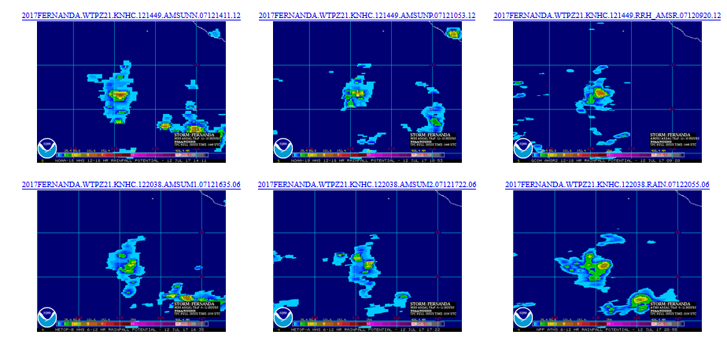
System Test Test Result (without RCLIPER)—FERNANDA
Without RCLIPER, fewer members to produce eTRaPs for some periods
103
Notes:
Changed “less” to “fewer”

Slide 104
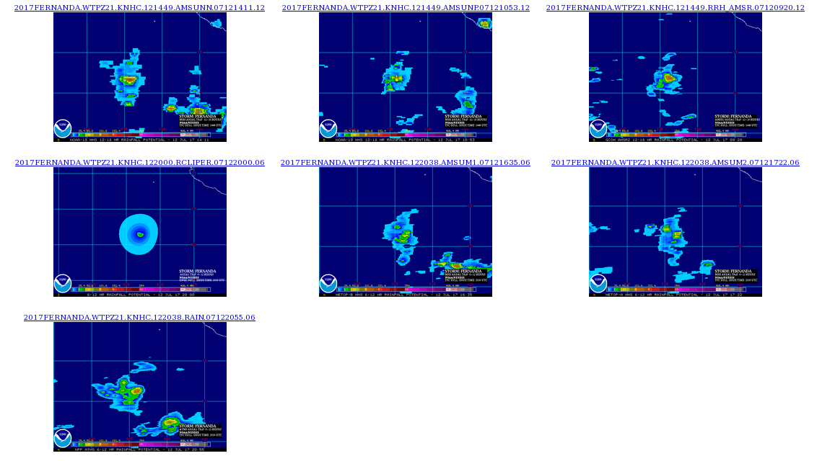
System Test Test Result (with RCLIPER)—FERNANDA
With RCLIPER, more members to produce eTRaPs for all periods
104

Slide 105
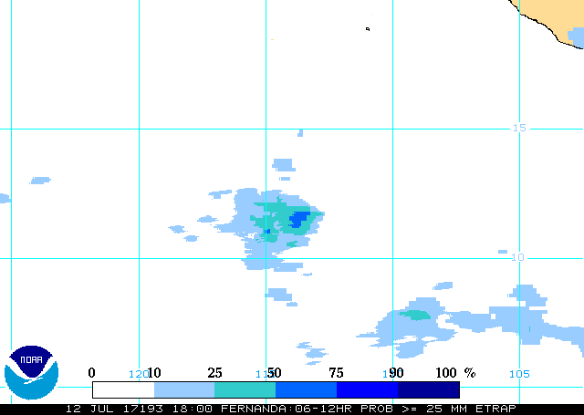
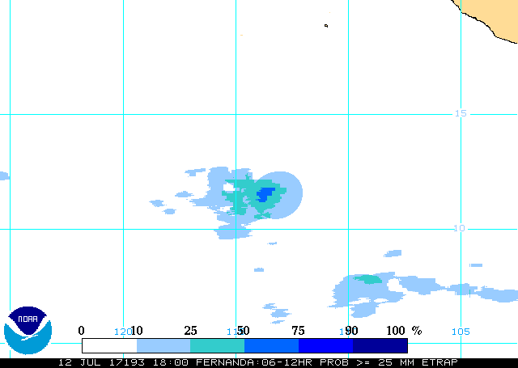
System Test Test Result—FERNANDA
Additional members improved probability resolution
Pop > 25 mm(without RCLIPERI)
Pop > 25 mm(with RCLIPER)
105
Notes:
Changed “more” to “additional”

Slide 106
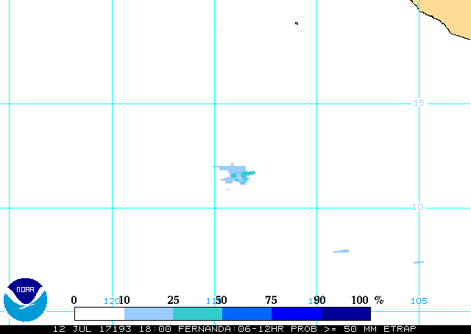
System Test Test Result—FERNANDA
Additional members improved probability resolution
Pop > 50mm(without RCLIPER)
Pop > 50 mm(with RCLIPER)
106
Notes:
Changed “more” to “additional”

Slide 107
System Test – Verification (data)
R-CLIPER forecasts for all tropical systems making landfall in the CONUS during 2004-2016 were computed using archive storm bulletins from NHC and shear diagnostic files from http://rammb.cira.colostate.edu/research/tropical_cyclones/ships/docs/AL/lsdiaga_1982_2016_sat_ts.dat
Archive eTRaPs, individual TRaPs, and R-CLIPER forecasts stored in STAR at /data/data081/bobk/eTRaP/SABarchive
Archive Stage IV data for ground-truth validation stored in STAR at /data/data081/bobk/eTRaP/Stage4_data
The number of R-CLIPER forecasts available for validation (a threshold of 250 pixels ≥12.7 mm for 6-h forecasts and ≥ 25.4 mm for 24-h forecasts was applied to ensure reliable statistics) ranged from 110 (00-06 h) to 185 (00-24 h)
107
Notes:
BK: Updated for R-CLIPER

Slide 108
System Test – Verification (Ensemble parameters)
The first step is to determine the two parameters required to integrate a new instrument into the eTRaP ensemble as outlined in Ebert et al. (2009):
Bias adjustment (SensorBias): the inverse of the volume bias of the TRaPs from the new instrument to those from the baseline instruments;
Ensemble weight (SensorWeight): the ratio of the Equitable Threat Score of the new instrument to that from the baseline instruments.
The ETS is computed at a threshold of 12.7 mm for 6-h accumulations and 25.4 mm for 24-h accumulations
108
Notes:
BK: Corrected spelling of “Ensemble” in title

Slide 109
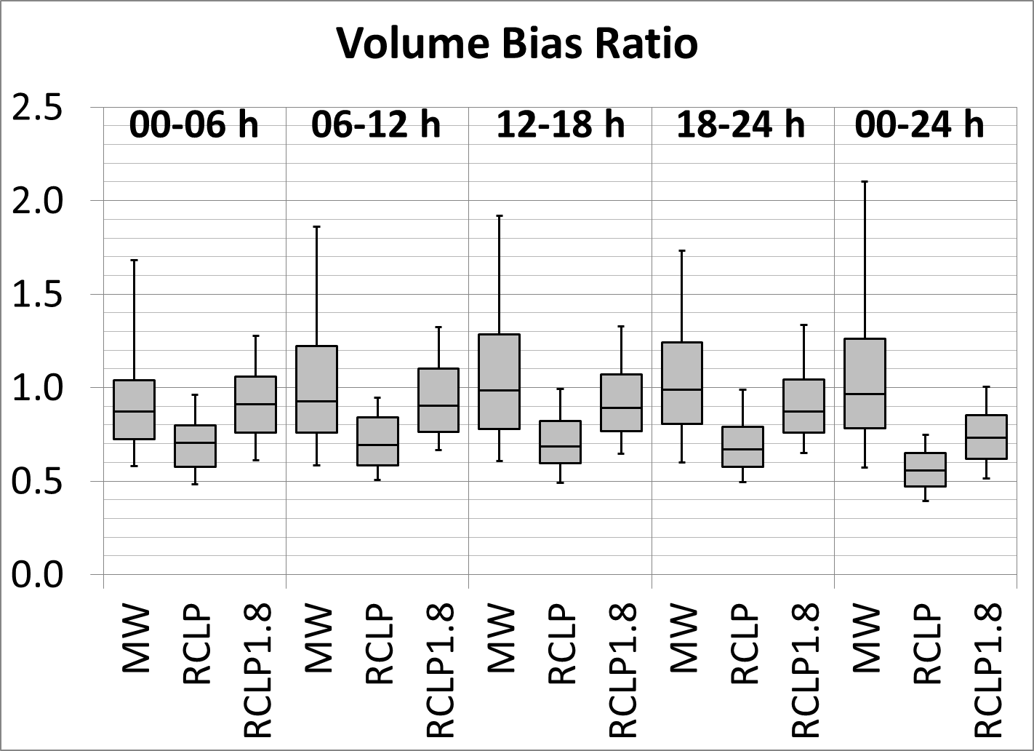
System Test – Verification (Ensemble parameters)
R-CLIPER had a significant dry bias relative to the other MW TRaPs, so the SensorBias was set at 1.8.
109

Slide 110
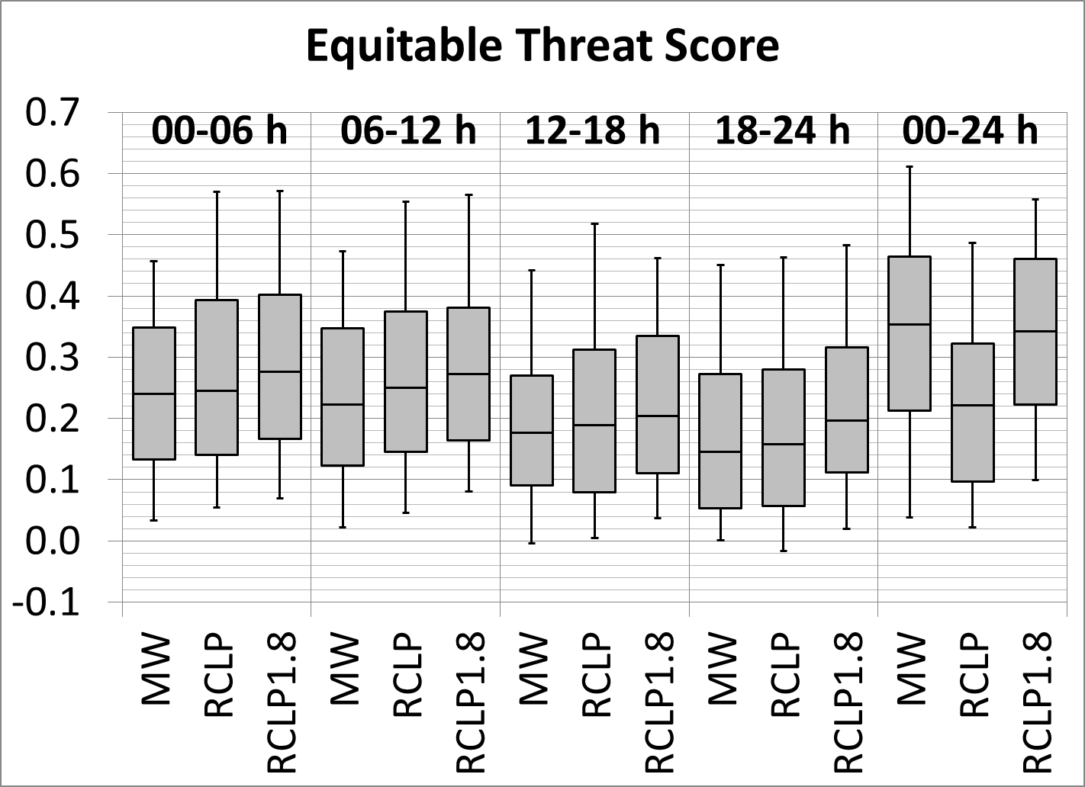
System Test – Verification (Ensemble parameters)
The skill of R-CLIPER after the bias adjustment was basically the same as MW TRaP, so a SensorWeight of 1 was chosen.
110

Slide 111
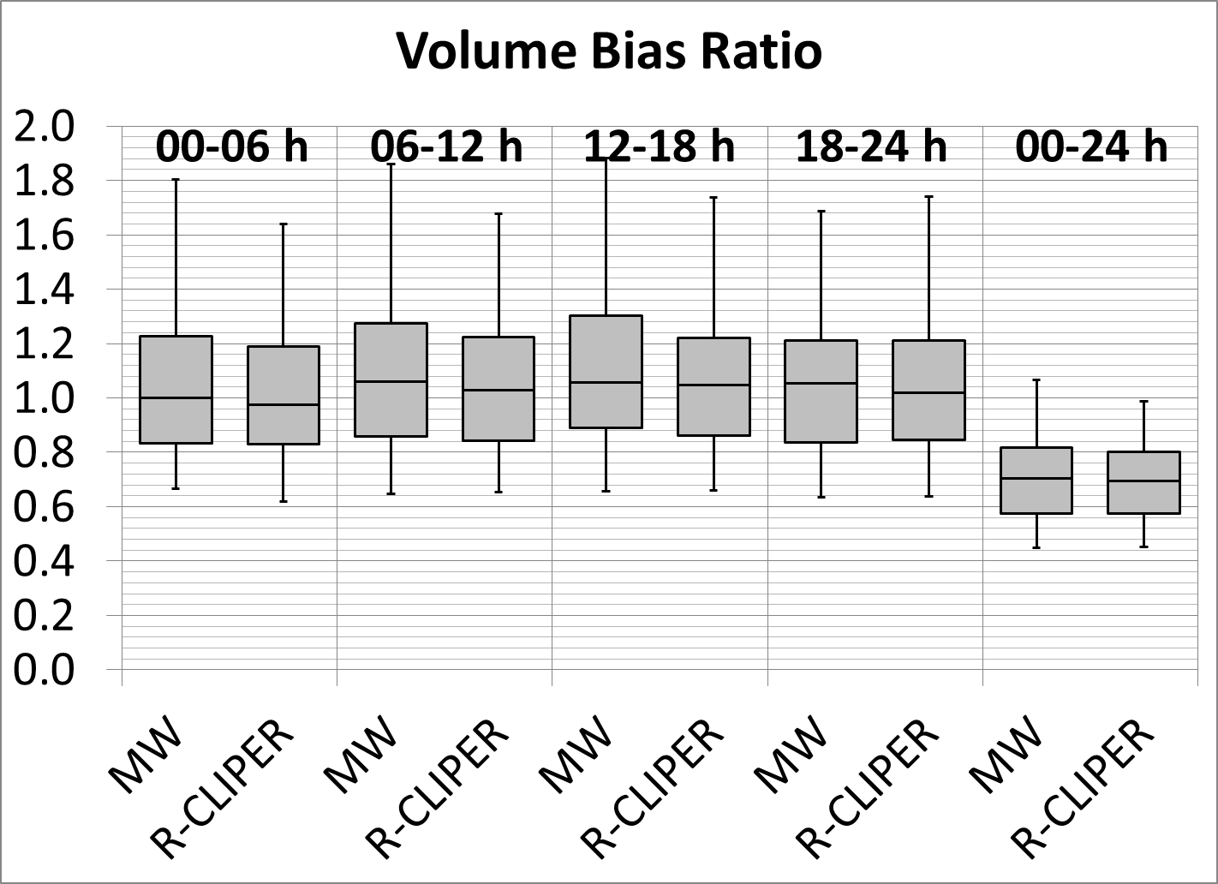
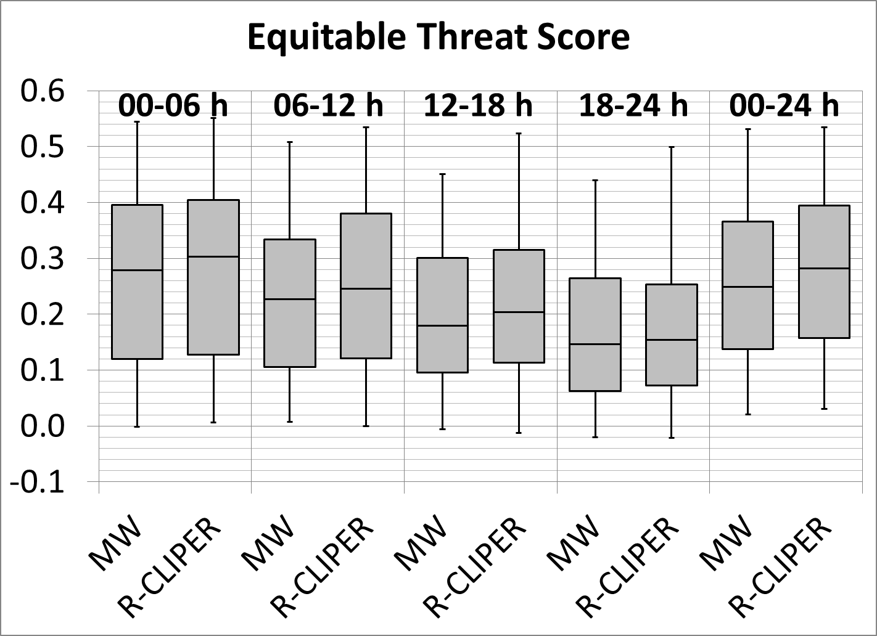
System Test – Verification
Validation of the resulting eTRaP for 165-188 forecasts for 2004-2016 actually show an improvement in skill at all lead times—not the primary goal but an encouraging result!
111
Notes:
BK: Replaced placeholders with final validation results.
BK: This is placeholder preliminary validation for 2004 only. I’ll add the other cases when I get back from vacation on 10 July.

Slide 112
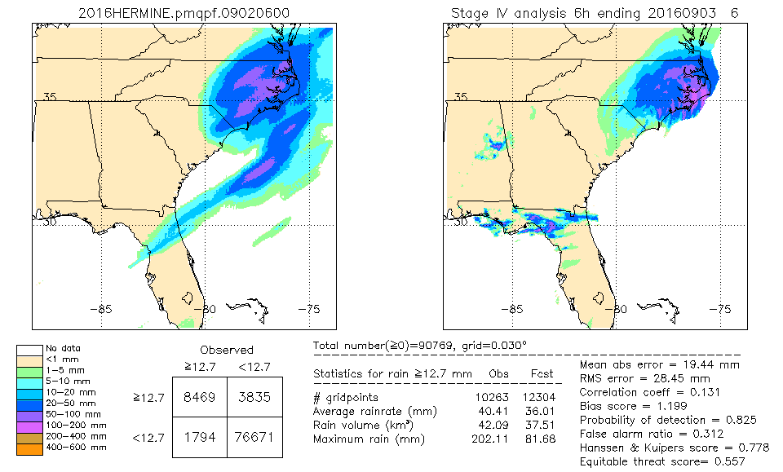
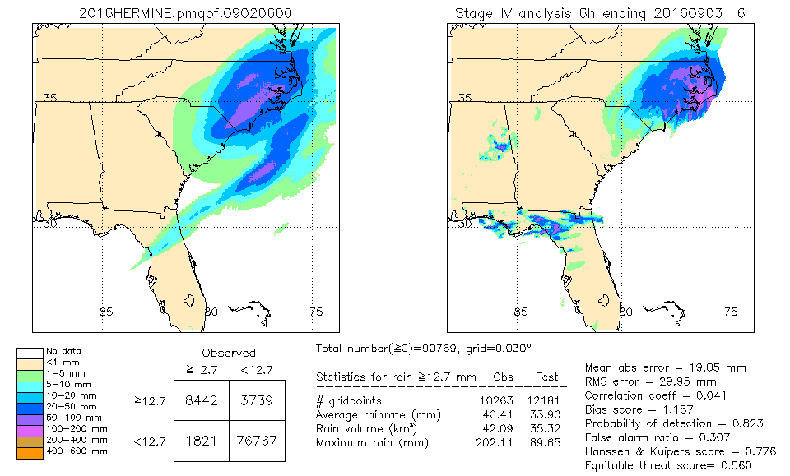
System test – verification (Example—Hermine / 2016)
Comparison of 18-24 h forecasts of rainfall initialized at 06 UTC 2 September 2016
eTRaP w/o R-CLIPER
eTRaP w/R-CLIPER
Stage IV
Stage IV
112
Notes:
BK: Replaced the 2004 case with the final case for the ORR.
BK: This case is a placeholder; I’ll insert a more recent one when I get back from vacation on 10 July.

Slide 113
System Test Processing Monitoring - Operators Needs
No test needed.
Notes:
113
LM: updated.
BK: No test needed or just no test?

Slide 114
System Test Product Monitoring – QC/QA Needs
No test needed.
114
Notes:
114

Slide 115
System Operational Readiness Liqun Ma NESDIS/OSPO
115
Notes:
115

Slide 116
System Operational Readiness: Products
Inputs
N18/N19, MetopA/B MHS single-orbit rain rates from SFS/geodist
SSMIS (F17/F18) single-orbit rain rates from SFS/geodist
GHE 1HR rainfall accumulations from SFS/geodist
NPP MIRS rain rates from SFS/geodist
GCOM-W AMSR2 rain rates from SFS/geodist
GPM GMI rain rates from SFS/geodist
RSMC bulletins from FOS2
SHIPS file from SFS
Coverage
Global
Formats
McIDAS AREA / ASCII / Binary
Latency
4 hours
116

Slide 117
System Operational Readiness: Products
output
File | File name | Array Size | Units
Ensemble average accumulated rainfall for 0-6, 6-12, 12-18, 18-24, and 00-24 h (separate files) | AREA file: YYYY<NAME>avgqpf.MMDDHH00.LL, where YYYY is the year, NAME is the storm name, MMDDHH is the initialization month, day, GMT hour, and LL is the time at the beginning of the forecast interval (except 24=24-h forecast). The ASCII file has the same naming convention except with a .TXT at the end. | 800x800 | 6-h accumulations: inches*255/20; 24-h accumulations: inches*255/40.
Probability-weighted accumulated rainfall for 0-6, 6-12, 12-18, 18-24, and 00-24 h (separate files) | AREA file: YYYY<NAME>pmqpf.MMDDHH00.LL. The ASCII file has the sane naming convention except with a .TXT at the end. | 800x800 | Same as above
Probability of exceedence of 25, 50, 75, or 100 mm rainfall accumulation in 6 h (separate files) | YYYY<NAME>pPP(P).MMDDHH00.LL(.TXT) where PP(P) is the threshold value (mm) for the exceedance probability. | 800x800 | Percentage (0-100)
Probability of exceedence of 50, 100, 150, or 200mm rainfall accumulation in 24 h (separate files) | YYYY<NAME>pPP(P).MMDDHH00.24 (.TXT) | 800x800 | Percentage (0-100)
117

Slide 118
System Operational Readiness Users of Products
User | POCs | Products | Dissemination
HPC/WPC | Mark Klein | 6-hourly | ESPC ftp server / PDA
NESDIS/SAB | Mike Turk | 6-hourly | ESPC WEB Server
NCDC/CLASS | Philip Johns | daily | ESPC ftp server / PDA
All other users | All other users | 6-hourly / daily | ESPC Web Server / ftp server
118

Slide 119
System Operational Readiness Production Environment
Development – geodev
Testing – geoprod3t
Production – geoprod3
Upgraded eTRaP will be running to generate the operational products on geoprod3
eTRaP products are distributed to users through ESPC web server(GP5), DDS and anonymous ftp server Satepsanone.
Backup – No backup server
119

Slide 120
System Operational Readiness Dissemination
Internet (web Interface)
No change
PDA
No change
Satepsanone
No change
120

Slide 121
System Operational Readiness Monitoring
Quality Monitoring
No change
Performance Monitoring
No change
121

Slide 122
System Operational Readiness Operation and Maintenance
O&M Procedures remain the same (no change)
Operational Support remain the same (no change)
122

Slide 123
System Operational Readiness QA – Code Standards
The eTRaP operational team has been working with the development team to ensure that the upgraded eTRaP follows ESPC operational requirements / guidance:
Directory structures
File/directory naming conventions
Operational log file content
Error tracking and handling
123

Slide 124
System Operational Readiness QA – CM and IT security
Product Implementation
Implementation on parallel test environment and transition to operation are tasked and managed by CRs (WR1805 and CCR3833) through OSPO Enterprise Configuration Management Tool (ECMT)
Software CM follows ESPC Software Configuration Management Process and Procedures Manual
Related code and scripts will be checked into subversion
Security Procedures
This upgraded eTRaP is being tested in a separate test environment (geoprod3t) before installation in operational environment (geoprod3)
SIA will be performed for this eTRaP upgrade before the system is promoted into operations
Documents will be under the CM control at OSPO
G:\Common\ESPC Library
124

Slide 125
System Operational Readiness QA – Documentation
Interface Control Document(ICD) will be updated.
All other documentations remain the same (no change)
125

Slide 126
System Operational Readiness Archive
eTRaP products (tar file) will continue being archived at CLASS.
126

Slide 127
System Operational Readiness User Readiness (1 of 2)
Data Access
Data access remains the same (no change)
Acceptance of Product
HPC, WPC and SAB already using eTRaP since 2009
127

Slide 128
System Operational Readiness User Readiness (2 of 2)
Training
User manuals are available to all users
HPC/WPC/SAB
No specific training from OSPO is required. Users have been using current eTRaP Since July 2009. This eTRaP upgrade is just an enhancement.
ESPC Operator
Monitoring eTRaP will be the same as current eTRaP. No training is needed for ESPC help desk.
128

Slide 129
System Operational Readiness Summary
The product system is ready for operations
The documentation will be complete by the time the eTRaP Upgrade is officially declared operational (final touches need to be done to the documents)
The users are ready to receive and use the data
129

Slide 130
Summary Liqun Ma NESDIS/OSPO
130
Notes:
130

Slide 131
Summary
Risk and Actions have been reviewed
Requirements and their Allocations have been reviewed
System Description and Test have been reviewed
Products Quality Readiness have been reviewed
Operation Readiness has been reviewed
User Readiness has been reviewed
131
Notes:
131

Slide 132
Next Steps
Operational Phase
SPSRB Decision Briefing – August 2017
Operational Commencement – August 2017
132
Notes:
BK: Added dates; I presume the decision brief would be in August?
132

Slide 133
Open Discussion
The review is now open for free discussion
133
Notes:
133

