Slide 1
Operational Readiness Review eTRaP Upgrade-NPP-ATMS/GCOM-AMSR2
Prepared by:
Liqun Ma¹, Rachel Hatteberg² , Bob Kuligowski³
¹ NOAA/NESDIS/OSPO
² SGT
³ NOAA/NESDIS/STAR
April 11, 2016
1
Notes:
1
GHE Operational Readiness Review

Slide 2
Review Agenda
Introduction
Risks and Actions
Requirements
System Description
System Test
System Operational Readiness
Summary
2
2
Notes:
2

Slide 3
Outline
Introduction
Risks and Actions
System Requirements
System Description
System Test
System Operational Readiness
Summary
3
3
Notes:
3

Slide 4
Introduction Bob Kuligoski NOAA/STAR
4
Notes:
4

Slide 5
eTRaP Background
Tropical Rainfall Potential (TRaP) is a forecast of rainfall from a tropical cyclone based on extrapolating satellite-derived instantaneous rain rate estimates along the predicted storm track.
Ensemble TRaP (eTRaP) uses an ensemble of TRaPs based on multiple satellite-derived rain rates and predicted storm tracks to derive a maximum likelihood rainfall forecast and probability of exceeding specified rainfall accumulation thresholds.
Forecasts are produced for the 0-24 h time frame at 6-h intervals with initialization times of 0, 6, 12, and 18 UTC. The code is run 3 h after initialization time and output is distributed ~4 h after initialization time.
5

Slide 6
eTRaP Background
eTRaP became an operational product at OSPO in 2009
The retirement of the SSM/I and TMI and loss of AMSR-E have degraded eTRaP availability, particularly over the Atlantic Basin, because of an insufficient number of ensemble members.
Subsequent improvements to eTRaP include
Adding rainfall rates from new instruments (SSMIS, GHE) to replace retired / lost instruments (SSM/I, TRMM, AMSR-E)
Calibrating the ensemble probabilities to remove bias
Additional improvements to eTRaP are ongoing, including
Additional instruments (ATMS, AMSR-2, GMI)
Addition of R-CLIPER to the ensemble
Correction for orographic effects
6

Slide 7
Project Objectives
To add TRaPs produced using S-NPP ATMS rain rates retrieved using the Microwave Integrated Retrieval System (MiRS) to the eTRaP ensemble
TRaPs using the ATMS rain rates must be optimally weighted in the ensemble.
To add TRaPs produced using GCOM-W AMSR2 rain rates retrieved using the GCOM AMSR2 Algorithm Software Processor (GAASP) to the eTRaP ensemble
TRaPs using the AMSR2 rain rates must be optimally weighted in the ensemble.
The addition of ATMS rain rate and AMSR2 rain rates must improve the reliability and / or accuracy of eTRaP DE.
7

Slide 8
Project Stakeholders
IPT Lead: Bob Kuligowski (STAR)
PAL and IPT Backup Lead: Liqun Ma (OSPO)
Science Advisor: Elizabeth Ebert (CAWCR - Melbourne, Australia)
NESDIS team:
STAR: Ralph Ferraro
OSPO: Liqun Ma, Limin Zhao, Nancy Merkle (Web Coordinator), Rachel Hatteberg (SGT Primary Programmer) Robert Glassberg (SGTBackup Programmer), Clay Davenport (SGT Backup Programmer)
OSGS: Tom Schott
NWS team:
NCEP/TPC/NHC: Mark DeMaria (RCLIPER)
OAR team:
AOML/HRD: Frank Marks (topography)
User team
Leads: Michael Turk, Alan Schwartz
Others: Dan Brown (TPC), Mark Klein (HPC), Greg Shelton (West Gulf RFC), Alipate Waqaicelua (Nadi Regional Specialized Meteorological Centre (RSMC)), Andrew Burton (Perth TCWC)
Product Oversight Panel: PREPOP

Slide 9
Project Stakeholders – Customers/ Users
SAB
Mike Turk
HPC
Mark Klein
9

Slide 10
Project Stakeholders – O&M
OSPO ESPC
Run eTRaP system
Distribute eTRaP products to users
Perform routine product quality monitoring and maintenance
OSPO Products Area Lead – Liqun Ma
OSPO QA Lead – Zhaohui Cheng
ESPC O&M Team
Rachel Hatteberg
Robert Glassberg
STAR Science Maintenance Team
Bob Kuligowski
Elizabeth Ebert
10

Slide 11
Project Plan(ATMS)
Sep 14: Development Phase Begins
Sep 14: IPT Lead informed to begin product development
Nov 14: Development processing system defined
Dec 14: Test case processed
Jan 15: Code is prepared for implementation
Jan 15: Pre-operational Phase Begins
Jan 15: Operational and backup processing capabilities in place
Feb 15: Pre-operational product output evaluated & tested
May 15: System/Algorithm Readiness Review
Jul 15 : Code transitions to operations; all documentation is complete
Jul15 : Operational and backup capabilities reach ops status
Aug 15: Operational Readiness Review
Aug 15: Update SPSRB Oversight Panel(s) on product status
Aug 15: Brief OSPO capability is ready to operational
Sep 15: Operational Phase Begins
Sep 15: SPSRB manager and secretaries notified update/upgrade went into operations.
SPSRB Secretaries/manager update the SPSRB product metrics web pages
Sep 15: OSD updates Satellite Products database

Slide 12
Project Plan(AMSR2)
May 15: Development Phase Begins
May 15: IPT Lead informed to begin product development
Jun 15: Development processing system defined
Aug 15: Test case processed
Oct 15: Code is prepared for implementation
Nov 15: Pre-operational Phase Begins
Nov 15: Operational and backup processing capabilities in place
Dec 15: Pre-operational product output evaluated & tested
Dec 15: System/Algorithm Readiness Review
Jan 16: Code transitions to operations; all documentation is complete
Jan 16: Operational and backup capabilities reach ops status
Feb 16 : Operational Readiness Review
Mar 16 : Update SPSRB Oversight Panel(s) on product status
Mar 16 : Brief OSPO capability is ready to operational
Apr 16: Operational Phase Begins
Apr 16: SPSRB manager and secretaries notified update/upgrade went into operations.
SPSRB Secretaries/manager update the SPSRB product metrics web pages
Apr 16: OSGS updates Satellite Products database

Slide 13
Project Plan – Schedule
Schedule (Milestones)
Critical Design Review – waived
Algorithm Change Package delivered to OSPO – 06/26/2015(ATMS) and 12/21/2015(AMSR2)
Algorithm Readiness Review – 06/26/2015(ATMS) and 12/21/2015(AMSR2)
Software Review – waived
Transition to operations – 05/2016
Operational Readiness Review – 04/11/2016

Slide 14
ORR – Review Objectives
Review Project Plan
Review the open Risks and Actions
Review the System Requirements Updates
Review the System Description
Review the System Test Report
Review System Operational Readiness
Notes:
14

Slide 15
ORR Reviewers
ORR Review Lead
Antonio Irving, Zhaohui Cheng and Liqun Ma
ORR Review Team
Liqun Ma (OSPO/SPSD)
Zhaohui Cheng(OSPO/SPSD)
Antonio Irving(OSPO/SPSD)
Donna McNamara (OSPO/MOD)
Bob Kuligowski (STAR)
ORR Review Consultants
Tom Schott (OSGS)
Notes:
15

Slide 16
ORR Guidelines and Check List
Guidelines for ORR review is the OSPO QA process asset
ORR reviewers can access this document at
ftp://satepsanone.nesdis.noaa.gov/testTRAP/ORR_DOC
The ORR Review Check List and ORR related documents are available at:
ftp://satepsanone.nesdis.noaa.gov/testTRAP/ORR_DOC
Notes:
16

Slide 17
Outline
Introduction
Risks and Actions
System Requirements
System Description
System Test
System Operational Readiness
Summary
Notes:
17

Slide 18
Risks and Actions Bob Kuligowski NESDIS/STAR
Notes:
18

Slide 19
ARR Review Item
Risk #1: Since eTRaP is an event-driven product, if system testing is not performed using real-time active storms, then system performance cannot be ensured.
Risk Mitigation: Delay ORR to Feb. 2016 and OPS to April 2016 to ensure sufficient real-time test cases.
Assessment: Low
Status: Open
Closure Date: March 2016
CONSEQUENCES
1
2
3
4
5
5
4
LIKELIHOOD
3
X
2
1
Notes:
Need update

Slide 20
ARR Review Item
Risk #2: If OSPO is not able to allot contractor support via the SMOMS Contract, it will impact project schedule due to resource shortage.
Risk Mitigation: Work with SMOMS management and OSPO/SPB management to ensure that there is enough resources for this project.
Assessment: Low
Status: Open
Closure Date: March 2016
CONSEQUENCES
1
2
3
4
5
5
4
LIKELIHOOD
3
X
2
1

Slide 21
Risks and Actions Summary
There are 2 total risks from the ARR.
We recommend closing 2.
21
Notes:
Updated stats

Slide 22
ORR – Entry Criteria
Entry # 1 - The ORR reviewers have access to the review version of the following artifacts
Algorithm Readiness Review Report
Requirements Allocation Document (RAD)
Review Item Disposition Spreadsheet (RID)
Operational Readiness Review Document (ORRD)
Entry # 2 - The ORR reviewers have access to the old version of SPSRB Documents
User Manuals
System Maintenance Manual
Entry # 4 - The ORR reviewers have access to the review version of the Operations Procedure
22
Notes:
GHE Operational Readiness Review
22

Slide 23
ORR – Exit Criteria
Exit # 1 - All open items in RID have been satisfactorily disposed of.
Exit # 2 - The updated RAD is satisfactory.
Exit # 3 - The SPSRB documents (UM, SMM and ATBD) have been reviewed and are deemed to be satisfactory.
Exit # 4 - Test and validation results are satisfactory.
Exit # 5 - The operation readiness are satisfactory.
Exit # 6 - The security impact assessment (SIA) has been completed. -- deferred to Operational Decision Briefing
23
Notes:
GHE Operational Readiness Review
23

Slide 24
Outline
Introduction
Risks and Actions
System Requirements Updates
System Description
System Test
System Operational Readiness
Summary
Notes:
24

Slide 25
System Requirements
Bob Kuligowski
Notes:
25

Slide 26
Requirements Overview
All eTRaP requirements are documented in the RAD:
http://www.star.nesdis.noaa.gov/smcd/emb/bobk/eTRaP_docs/ARR/eTRaP_Requirements_Allocation_Document_v2.0.docx
Text highlighted
Changes/updates to requirements since the last review are in Green.
Requirements specific to this upgrade of eTRaP are in Brown
26

Slide 27
Requirement #0
ETRAP-R 0.0: The eTRaP Upgrade project shall adopt the standard practices of the SPSRB Review Process for transition of a product from research to operations.
Driver: SPSRB transition to operations process. Since this is an enhancement to an existing operational system, only the process steps related to modifying an existing system need be followed.

Slide 28
Requirement #0
ETRAP-R 0.1: The eTRaP Upgrade project reviews shall be tailored.
This derived requirement has been adopted to mitigate schedule risk by eliminating the overhead of preparing review slide packages and reports.
ETRAP-R 0.1.1: The Requirements Review (RADR), Preliminary Design Review (PDR), Critical Design Review (CDR), and the Unit Test Readiness Review (TRR) for the S-NPP upgrade of eTRaP have been waived.
This derived requirement has been adopted to mitigate schedule risk by eliminating the overhead of preparing a RADR, PDR, CDR, and TRR slide packages and reports. The Technical risk is assessed as Low because the update to the system only involves processing a new data set.

Slide 29
Requirement #0
ETRAP-R 0.1.2: There shall be an Algorithm Readiness Review (ARR) for the S-NPP upgrade of eTRaP.
This derived requirement has been adopted from the SPSRB Review process.
ETRAP-R 0.1.3: There shall be an Algorithm Readiness Review Report (ARRR) for the S-NPP upgrade of eTRaP.
The ARRR is one of the exit criteria for ARR.

Slide 30
Requirement #0
ETRAP-R 0.1.4: There shall be an Operational Readiness Review (ORR) for the S-NPP upgrade of eTRaP.
This derived requirement has been adopted from the SPSRB Review process.
ETRAP-R 0.1.5: There shall be an Operational Readiness Review Report (ORRR) for the S-NPP upgrade of eTRaP.
The ORRR is one of the exit criteria for ORR.

Slide 31
Requirement #0
ETRAP-R 0.1.6: The Requirements Review (RADR), Preliminary Design Review (PDR), Critical Design Review (CDR), and Unit Test Readiness Review (UTRR) for the AMSR2 upgrade of eTRaP have been waived.
This derived requirement has been adopted to mitigate schedule risk by eliminating the overhead of preparing a RADR, PDR, CDR, and TRR slide packages and reports. The Technical risk is assessed as Low because the update to the system only involves processing a new data set.
Notes:
Priyanka: Requirements 0.1.7 to 0.1.11 to be reviewed at the R-CLIPER upgrade review

Slide 32
Requirement #0
ETRAP-R 0.1.7: There shall be an Algorithm Readiness Review (ARR) for the AMSR2 upgrade of eTRaP.
This derived requirement has been adopted from the SPSRB Review process.
ETRAP-R 0.1.8: There shall be an Algorithm Readiness Review Report (ARRR) for the AMSR2 upgrade of eTRaP.
The ARRR is one of the exit criteria for ARR.

Slide 33
Requirement #0
ETRAP-R 0.1.9: There shall be an Operational Readiness Review (ORR) for the AMSR2 upgrade of eTRaP.
This derived requirement has been adopted from the SPSRB Review process.
ETRAP-R 0.1.10: There shall be an Operational Readiness Review Report (ORRR) for the AMSR2 upgrade of eTRaP.
The ORRR is one of the exit criteria for ORR.

Slide 34
Requirement #0
ETRAP-R 0.1.11: There shall be a Critical Design Review (CDR) for the R-CLIPER and orography upgrade of eTRaP.
This upgrade will require design upgrades that will be presented at the CDR.
ETRAP-R 0.1.12: There shall be a Critical Design Review Report (CDRR) for the R-CLIPER and orography upgrade of eTRaP.
The CDRR is one of the exit criteria for CDR.

Slide 35
Requirement #0
ETRAP-R 0.1.13: There shall be an Algorithm Readiness Review (ARR) for the R-CLIPER and orography upgrade of eTRaP.
This derived requirement has been adopted from the SPSRB Review process.
ETRAP-R 0.1.14: There shall be an Algorithm Readiness Review Report (ARRR) for the R-CLIPER and orography upgrade of eTRaP.
The ARRR is one of the exit criteria for ARR.
Notes:
Priyanka: Requirements 0.1.7 to 0.1.11 to be reviewed at the R-CLIPER upgrade review

Slide 36
Requirement #0
ETRAP-R 0.1.15: There shall be a eTRaP R-CLIPER Upgrade Operational Readiness Review (ORR).
This derived requirement has been adopted from the SPSRB Review process.
ETRAP-R 0.1.16: There shall be a eTRaP R-CLIPER Upgrade Operational Readiness Review Report (ORR).
The ORRR is one of the exit criteria for ORR.
Notes:
Priyanka: Requirements 0.1.7 to 0.1.11 to be reviewed at the R-CLIPER upgrade review

Slide 37
Requirement #0
ETRAP-R 0.1.17: The Requirements Review (RADR), Preliminary Design Review (PDR), Critical Design Review (CDR), and Unit Test Readiness Review (UTRR) for the GMI upgrade of eTRaP have been waived.
This derived requirement has been adopted to mitigate schedule risk by eliminating the overhead of preparing a RADR, PDR, CDR, and TRR slide packages and reports. The Technical risk is assessed as Low because the update to the system only involves processing a new data set.
Notes:
Priyanka: Requirements 0.1.7 to 0.1.11 to be reviewed at the R-CLIPER upgrade review

Slide 38
Requirement #0
ETRAP-R 0.1.18: There shall be a Algorithm Readiness Review (ARR) for the GMI upgrade of eTRaP.
This derived requirement has been adopted from the SPSRB Review process.
ETRAP-R 0.1.19: There shall be an Algorithm Readiness Review Report (ARRR) for the GMI upgrade of eTRaP.
The ARRR is one of the exit criteria for ARR.
Notes:
Priyanka: Requirements 0.1.7 to 0.1.11 to be reviewed at the R-CLIPER upgrade review

Slide 39
Requirement #0
ETRAP-R 0.1.18: There shall be an Operational Readiness Review (ORR) for the GMI upgrade of eTRaP.
This derived requirement has been adopted from the SPSRB Review process.
ETRAP-R 0.1.19: There shall be an Operational Readiness Review Report (ORRR) for the GMI upgrade of eTRaP.
The ORRR is one of the exit criteria for ORR.
Notes:
Priyanka: Requirements 0.1.7 to 0.1.11 to be reviewed at the R-CLIPER upgrade review

Slide 40
Requirement #0
ETRAP-R 0.2: The Requirements Allocation Document (RAD) shall be created and maintained by the eTRaP development team.
This derived requirement has been adopted from the SPSRB Review process. The RAD will follow document standards stated in EPL v3 process asset DG-6.2
ETRAP-R 0.3: The Review Item Disposition (RID) spreadsheet shall be created and maintained by the eTRaP development team.
This derived requirement has been adopted from the SPSRB Review process.
ETRAP-R 0.4: Configuration Management shall be implemented.
OSPO will CM the code and associated documents using Subversion.

Slide 41
Requirement #1
ETRAP-R 1.0: The Ensemble Tropical Rainfall Potential (eTRaP) forecast of rainfall for a tropical system shall be upgraded.
Driver: This basic requirement is traced to user needs as stated in SPSRB User Requests: SPSRB user request # 1001-0001 “eTRaP Upgrade” by NWS/NCEP/HPC”.

Slide 42
Requirement #1
ETRAP-R 1.0.1: The rain rates generated from the DMSP SSMIS sensor shall be incorporated into the eTRaP ensemble.
ETRAP-R 1.0.2: The rain rates generated from the Global Hydro-Estimator shall be incorporated into the eTRaP ensemble.
ETRAP-R 1.0.3: The rain rates generated from the S-NPP ATMS sensor shall be incorporated into the eTRaP ensemble.
ETRAP-R 1.0.4: The rain rates generated from the GCOM-W AMSR2 sensor shall be incorporated into the eTRaP ensemble.

Slide 43
Requirement #1
ETRAP-R 1.0.5: The rain rates generated by R-CLIPER model shall be incorporated into the eTRaP ensemble.
ETRAP-R 1.0.6: The rain rates generated from the GPM GMI sensor shall be incorporated into the eTRaP ensemble.

Slide 44
Requirement #1
ETRAP-R 1.1: The generated TRaP forecasts shall be combined in a weighted simple ensemble to produce quantitative precipitation forecasts and probabilistic forecasts of heavy rain exceeding several thresholds.
Weights depend on the latency of the TRaP (greater weight for more recent input) and optionally for the sensor used.
ETRAP-R 1.2: The probabilities generated by eTRaP shall be adjusted to remove bias.
ETRAP-R 1.3: The eTRAP system shall take into account the impact of topography of the region and cyclone climatology using NHC Rainfall Climatology persistence model (RCLIPER) in the individual ensemble members to improve accuracy of the forecast.

Slide 45
Requirement #1
ETRAP-R 1.4: The eTRaP rain rates shall be generated for the entire globe for 5 time intervals (0-6, 6-12, 12-18, 18-24, and 0-24 h).
User request
ETRAP-R 1.4.1: The eTRaP algorithm shall be applied to data from NOAA-18, NOAA-19, MetOp-B, DMSP F16, DMSP F17, DMSP F18, GOES-E, GOES-W, METEOSAT-7, METEOSAT-10, Himawari-8, S-NPP, GCOM-W, and GMI satellites, plus R-CLIPER.

Slide 46
Requirement #1
ETRAP-R 1.5: Accuracy of the eTRaP rain rates shall be such that to achieve reduced random errors in rain field, more accurate location and intensity of maximum rainfall.
User Request.
ETRAP-R 1.6: Latency (average elapsed time from data observation to delivery of the product to the user) shall not exceed 2.5 hours (assuming receipt of blind orbits).
User Request.

Slide 47
Requirement #1
ETRAP-R 1.7: Timeliness (Latest time after observation by which a product can be delivered and still be useful to the customer) shall be 4.5 hours (assuming receipt of blind orbits).
User Request.
ETRAP-R 1.8: The output format for eTRaP product shall be McIDAS Area file, ASCII, GRiB2 and GIF.
User Request; ASCII format requested by HPC and NCEI will be provided in addition to McIDAS and GIF formats.

Slide 48
Requirement #1
ETRAP-R 1.9: The eTRaP developers shall perform validation and verification of the eTRaP rain rate product and exceedence probabilities.
ETRAP-R 1.9.1: The eTRaP developers shall perform tests to verify functional performance of the code that produces the eTRaP Product.
Tests will be conducted.

Slide 49
Requirement #1
ETRAP-R 1.9.2: The eTRaP developers shall verify that the eTRaP product files are generated correctly.
This will be done as part of the tests.
ETRAP-R 1.9.3: The eTRaP developers shall verify the error handling capability of the pre-operational system.
Already done in the existing system.

Slide 50
Requirement #1
ETRAP-R 1.10: The eTRaP rain rates shall be compared with in situ measurements.
ETRAP-R 1.10.1: Metrics for assessing eTRaP performance shall be:
Quantitative Precipitation Forecasts (QPFs) (maximum rainfall, spatial rainfall pattern
Bias (mean difference), root mean square error, correlation coefficient
Frequency bias, probability of detection, false alarm ratio, equitable threat score
Location, volume, and pattern errors estimated using Contiguous Rain Area (CRA) verification
Probabilistic forecasts of rain exceeding various thresholds:
Reliability diagrams
Relative operating characteristics (ROC) and relative value diagrams
Brier score, ranked probability score

Slide 51
Requirement #1
ETRAP-R 1.10.2: The eTRaP developers shall produce and distribute eTRaP test sample products to the user community.
To ensure user acceptance of the product.

Slide 52
Requirement #2
ETRAP-R 2.0: The eTRaP processing system shall have a data ingest capability.
Driver: This basic requirement is traced to algorithm input needs, as documented in the ATBD.

Slide 53
Requirement #2
ETRAP-R 2.1: The upgraded eTRaP system shall ingest DMSP SSMIS TRaP forecast data in McIDAS AREA format.
ETRAP-R 2.2: The upgraded eTRaP system shall ingest GHE forecast data in McIDAS AREA format
ETRAP-R 2.3: The upgraded eTRaP system shall ingest S-NPP ATMS TRaP forecast data in McIDAS AREA format.

Slide 54
Requirement #2
ETRAP-R 2.4: The upgraded eTRaP system shall ingest GCOM-W AMSR2 TRaP forecast data in McIDAS AREA format.
ETRAP-R 2.5: The upgraded eTRaP system shall produce and use R-CLIPER forecast data in McIDAS AREA format.
ETRAP-R 2.6: The upgraded eTRaP system shall ingest GPM GMI TRaP forecast data in McIDAS AREA format.

Slide 55
Requirement #3
ETRAP-R 3.0: The eTRaP processing system shall have QC monitoring capability
Driver: This basic requirement is traced to an OSPO need for QC monitoring.

Slide 56
Requirement #3
ETRAP-R 3.1: The eTRaP processing system outputs shall include overall quality control flags and quality summary level metadata.
Needed for distribution, archive, quality control, and post-processing in the products files. eTRaP code will generate metadata for this purpose.
ETRAP-R 3.2: The eTRaP system shall be capable of monitoring input data latency and overall quality.
Current operational eTRaP system is monitoring input data latency and update the product every hour.

Slide 57
Requirement #3
ETRAP-R 3.3: The eTRaP system shall be capable of monitoring product latency.
ETRAP-R 3.4: The eTRaP system shall produce real-time imagery files for visual inspection of output data files
ETRAP-R 3.5: The eTRaP system shall be capable of monitoring product distribution status to ensure that the data/products are successfully available for transfer to the user community.
There is an eTRaP system monitoring webpage which monitors all system processing stages including distribution status.

Slide 58
Requirement #3
ETRAP-R 3.5.1: Each log file shall include all runtime error messages.
Error messages will include system messages and error conditions written by the code.
ETRAP-R 3.5.2: The log file shall indicate whether or not the run was completed without error.
Code will write this message.

Slide 59
Requirement #4
ETRAP-R 4.0: The eTRaP developers shall produce a fully functional pre-operational system in the STAR Development Environment.
Driver: This basic requirement is traced to an OSPO need for a fully functional system ready for integration and system testing.

Slide 60
Requirement #4
ETRAP-R 4.1: The STAR Development Environment shall host the pre-operational system.
Pre-operational system is to be developed in this environment
ETRAP-R 4.1.1: The STAR Development Environment shall include a Linux machine.
Needed for the code.
ETRAP-R 4.1.2: The STAR Development Environment shall have storage of 520KB for code storage, 400KB for input data, 80MB for output data and 130MB RAM .

Slide 61
Requirement #4
ETRAP-R 4.1.3: The STAR Development Environment shall include the McIDAS graphical/imaging program.
Needed for running the code.
ETRAP-R 4.1.4: The STAR Development Environment shall include FORTRAN programming language/compiler and Perl, Bash, korn scripting languages.
Needed for running the code.

Slide 62
Requirement #4
ETRAP-R 4.2: The STAR Development Environment shall be capable of hosting unit tests.
ETRAP-R 4.2.1: The pre-operational system shall include all processing code and all input test data needed to conduct unit tests
Complete unit test of each stage of the pre-operational system is expected before delivery to OSPO

Slide 63
Requirement #5
ETRAP-R 5.0: The upgraded eTRaP system shall be able to run on the existing OSPO Operational environment running eTRaP.
Driver: eTRaP is currently running operationally on GEOPROD3 in OSPO.

Slide 64
Requirement # 5
ETRAP-R 5.1: The upgraded eTRaP system shall use the RedHat Linux platform for the processing task required.
ETRAP-R 5.2: Disk storage for the input data (60 – 400 KB for each storm run) shall be established within OSPO.
Input data will be retained for 2 days and this includes the additional storage on 18.5 KB required for the AMSR2 input.
ETRAP-R 5.3: The upgraded eTRaP system shall use the Fortran90 (Absoft90) compiler.

Slide 65
Requirement #5
ETRAP-R 5.4: The upgraded eTRaP system shall use the Perl, Bash and korn scripting languages and IDL and McIDAS libraries.
ETRAP-R 5.5: The upgraded eTRaP system shall be monitored by ESPC helpdesk monitoring tool TIDAL.
ETRAP-R 5.6: The eTRaP outputs shall be stored in operational environment for at least 7 days for distribution.

Slide 66
Requirement #5
ETRAP-R 5.6.1: The total storage of data for distribution shall be 80MB.
This includes 30 each of McIDAS, GIF and ASCII files.
ETRAP-R 5.6.2: The eTRaP products shall be distributed using the ESPC Data Distribution Server(DDS) and webserver to the user community at http://www.ssd.noaa.gov/PS/TROP/etrap.html.
Standard procedure for this user community.

Slide 67
Requirement #6
ETRAP-R 6.0: The eTRaP pre-operational system shall be transitioned from the STAR Development Environment to the OSPO Environment.
Driver: This basic requirement is traced to an OSPO need for a fully functional system in its Environment.

Slide 68
Requirement #6
ETRAP-R 6.1: The pre-operational system shall include all processing code and all input test data needed to reproduce the unit tests.
For system testing. A complete system test of the integrated pre-operational system is expected before delivery to OSPO Environment.
ETRAP-R 6.2: The integrated pre-operational system shall include all output data produced by the unit tests.
Needed by OSPO to verify the system tests in its Environment.

Slide 69
Requirement #6
ETRAP-R 6.3: The eTRaP development team shall set up an internal FTP site for transferring the pre-operational system to OSPO as a tar file on a STAR server that is accessible to OSPO.
ETRAP-R 6.3.1: The eTRaP development team shall ensure that the OSPO PAL has the information needed to acquire the pre-operational system as a tar file.

Slide 70
Requirement #7
ETRAP-R 7.0: STAR shall deliver updated eTRaP documents to OSPO.
Driver: This basic requirement is traced to an OSPO need for documentation to support operations, maintenance, and distribution

Slide 71
Requirement #7
ETRAP-R 7.1: The eTRaP document package shall include a User’s Manual (UM)
The existing eTRaP UM following the SPSRB Version1 document standards will be updated.
ETRAP-R 7.2: The eTRaP document package shall include a System Maintenance Manual (SMM)
The existing eTRaP SMM following the SPSRB Version1 document standards will be updated.

Slide 72
Requirement #7
ETRAP-R 7.3: The eTRaP document package shall include an Interface Control Document (ICD).
The existing eTRaP ICD following the SPSRB Version1 document standards will be updated.
ETRAP-R 7.4: The eTRaP document package shall include a System Description Document (SDD).
The existing eTRaP SDD following the SPSRB Version1 document standards will be updated.

Slide 73
Requirement #7
ETRAP-R 7.5: The eTRaP document package shall include an Operations Manual (OM).
The existing eTRaP OM following the SPSRB Version1 document standards will be updated.
ETRAP-R 7.6: The eTRaP document package shall include an updated Archive Agreement.

Slide 74
Requirement #8
ETRAP-R 8.0: The eTRaP products shall be archived.
Daily tar file for each storm will be sent to NCEI; no changes to archive plan for eTRaP upgrades.

Slide 75
Requirement #8
ETRAP-R 8.1: Distribution of the Archive Products to NCEI shall be in accordance with a Data Submission Agreement (DSA).
ETRAP-R 8.2: The eTRaP files and associated metadata shall be archived by NCEI .
NCEI will generate the metadata for the eTRaP during archival of the products. Archive users will obtain eTRaP data from the NCEI servers.

Slide 76
Requirement #9
ETRAP-R 9.0: The eTRaP system shall comply with OSPO Code Review Security check lists.
Driver: OSPO code standards and OSPO security requirements

Slide 77
Requirement #9
ETRAP-R 9.1: The eTRaP system shall comply with OSPO data integrity check list.
OSPO data integrity check list is part of the OSPO Code Review Security check lists
ETRAP-R 9.2: The eTRaP system shall comply with OSPO development security check list.
OSPO development security check list is part of the OSPO Code Review Security check lists
ETRAP-R 9.3: The eTRaP system shall comply with OSPO code check list.
OSPO code check list is part of the OSPO Code Review Security check lists

Slide 78
Requirements – Summary
The eTRaP Requirements have been established.
The Requirements have been documented in the Requirements Allocation Document (RAD).
The Requirements are traceable to drivers (customer needs or expectations) and other requirements.

Slide 79
System Description Liqun Ma
Notes:
79

Slide 80
Major Components
Retrieve information about active tropical cyclones.
Retrieve rain rate data from N-18/19/metOp-A/B, F17/18/19,GHE, S-NPP/ATMS and GCOM/AMSR2
Generate 6-hour total tropical rain fall potential(TRaP) for each active storm and each satellite listed above.
For each active storm, generate ensemble tropical rainfall potential (eTRaP)

Slide 81
System Architecture, Data Flow, Security
McIDAS Area Files: ADDE pull
DDS
AIX
HPC
GCOM-W1 AMSR-2 MW Mcidas converter
MGTPROD
Linux
GCOM-W1 AMSR-2 rain rate
SFS/GEODIST
Linux
Ascii ftp pull
Ascii and Tar file
ftp push
NCEI
Production
GEOPROD3
Linux
Tar file containing GIF, McIDAS Area Files, ASCII
ftp pull
S-NPP ATMS MW Mcidas converter
MGTPROD
Linux
S-NPP ATMS MW rain rate
SFS/GEODIST
Linux
Distribution via web
GP5 (OSPO web)
Linux
Test
GEOPROD3t
Linux
GIF sftp push
N-18/19 /MetOp-A/B MHS MW Mcidas converter
Polarprod
AIX
N-18/19 /MetOp-A/B MHS MW rain rates
SFS/GEODIST
Linux
Distribution via ftp
SATEPSANONE
AIX
DMSP F/17/18/19 SSMI/S
FNMOC MW Mcidas converter
Polarprod
Linux
CM Repository
cm-espc
Linux
Ascii, GIF sftp push
DMSP F17/18/19 SSMI/S
FNMOC MW rain rates
SFS/GEODIST
Linux
Development
GEODEV
Linux
GHE SATEPSDIST IRRRs
GHE1
Linux
GHE SATEPSDIST IRRRs
SFS/GEODIST
Linux
ASCII
ADDE
Pull
FOS Forecasts (JTWC,,NHC CPHC)
FOS2
Linux
JTWC, NHC,CPHC,
SATEPS Security at ESPC/NSOF
Production Zone
Development Zone
Conversion to McIDAS AREA file format is extrernal to eTRaP processing
Distribution Zone (DMZ)
External User Zone

Slide 82
Production
eTRaP is running on ESPC geo system
Development /Test – Server
Pre-operational codes (DAP) received from STAR have been thoroughly tested on geoprdo3t at ESPC
Production – Server
eTRaP will be run to generate the operational products on geoprod3
The products will be distributed to users through ESPC Data Distribution server(DDS) and ESPC website server(GP5)

Slide 83
Hardware/Software
Ops Server: Vmware server ‘geoprod3’
Intel(R) Xeon(R) CPU E7- 4850
2.00 GHz
1 GB memory
RedHat 5.8 64-bit
Libraries installed
McIDASv2010.1

Slide 84
Input Data Sources
Input data:
N18/N19, MetopA/B MHS single-orbit rain rates from SFS/geodist
SSMIS (F17/F18/F19) single-orbit rain rates from SFS/geodist
GHE 1HR rain rates accumulations from SFS/geodist
NPP MIRS rain rates from SFS/geodist
GCOM-W AMSR2 rain rates from SFS/geodist
RSMC bulletins from FOS2
Notes:
Changed “GCOME” to “GCOM-W”

Slide 85
TC forecast file
TC forecast files (bulletins) are pulled from FOS every fifteen minutes.
Extracts tropical cyclone position.

Slide 86
Orbit geolocation data for NOAA-18/19, Metop-A/B, SSMIS F17/18/19, NPP/ATMS and GCOM/AMSR2(SFS)
Geolocation data for NOAA-18/19 , Metop-A/B and SSMSI F17/18/19 are generated on ESPC Polarprod and pushed to SFS for eTRaP(binary)
Geolocation data for NPP/ATMS and GCOM/AMSR2 are generated on ESPC Linux server MGTPROD and pushed to SFS for eTRaP(binary)
Geolocation data for GHE is generated on ESPC Linux server GHE1 and pushed to SFS for eTRaP(binary)
Those geolocation data are used to check if any orbit data from all above satellite is cover the active storm or not.

Slide 87
Orbit rain rate data retrieved from NOAA-18/19, MetopA/B, SSMIS F17/18/19, NPP/ATMS and GCOM/AMSR2(geodist)
Rain rate data for NOAA-18/19 , Metop-A/B and SSMSI F17/18/19 are converted to Mcidas format on ESPC Polarprod and pushed to geodist for eTRaP
Rain rate data for NPP/ATMS and GCOM/AMSR2 are converted to Mcidas format on ESPC Linux server MGTPROD and pushed to SFS for eTRaP
Rain rate data from GHE is generated on ESPC Linux server GHE1 and pushed to geodist for eTRaP
Those rain rate data are used to generate 6-hour total tropical rain fall potential(TRaP) for each active storm.
TraPs from each satellites are used to generate ensemble tropical rainfall potential (eTRaP) for each active storm

Slide 88
Product Processing(1/4)
Generate TRaPs
1. Search FOS for active storms
2. For each active storm, loop thorough each satellite orbits to
search for orbits that cover the storm and within 6 hours of
forecast time.
3. Get the orbit rain rate data and generate 6-hr TRaPs and 24-hr
TRaP.

Slide 89
Product Processing(2/4)
Geolocation data for AMSU/MHS orbit
Geolocation data for SSMIS orbit
Geolocation data for GHE
Geolocation data for ATMS orbit
TRaP generator
Get latest TRaP geolocation data
Geolocation data for AMSR2 orbit
Collect info on all active storms
ADDE
FOS forecast bulletins
AMSU/MHS TRaPs
Active storms?
Y
Look for geolocation data matching storm coverage and time?
Run TRaP code for orbits meeting time and location criteria [pctrpauto.pgm]
SSMIS TRaPs
Y
GHE TRaPs
N
Exit
N
ATMS TRaPs
Exit
Done
AMSR2 TRaPs
R-CLIPER
Rain Rate for AMSU/MHS orbit
Rain Rate for SSMIS orbit
Rain Rate from GHE
Rain Rate for ATMS orbit
Rain Rate for AMSR2 orbit

Slide 90
Product Processing(3/4)
Generate eTRaPs
1. Search FOS for active storms.
2. For each storm, collect all TRaPs for this storm at different time
period and generate eTRaP products for this storm in Mcidas
format.
3. Convert eTRaP product from Mcidas to Ascii and imag.

Slide 91
Product Processing(4/4)
AMSR2 TRaPs
AMSU/MHS TRaPs
SSMIS TRaPs
GHE TRaPs
ATMS TRaPs
eTRaP generator
Collect info on all active storms
ADDE
FOS forecast bulletins
1.ensemble mean rainfall(6-h and 24-h)
2.probability-matched ensemble mean rainfall(6-h and 24-h)
3.Pop exceeding 25 mm(6-h)
4.Pop exceeding 50mm(6-h and 24-h)
5. Pop exceeding 75mm(6-h)
6. Pop exceeding 100m(6-h and 24-h)
7. Pop exceeding 150 mm(24-h)
8. Pop exceeding 200 mm(24-h)
Active storms?
Y
Collect TRaPs and generate eTRaP products
eTRaP data format converter
N
Exit
Mcidas
eTRaP product in Ascii and image and tar file

Slide 92
eTRaP – Run Schedule Data Retrieval and Processing
0,10,20,30,40,50 * * * * $HOME/mcidas/pctrap-V3/getpPass.pl > /data/TRAP/log/getpPass.log 2>&1
1,11,21,31,41,51 * * * * $HOME/mcidas/pctrap-V3/pctrap-auto-newTime.pl >> /data/TRAP/log/autoTRAP.log 2>/data/TRAP/log/autoTRAP.err
5 * * * * $HOME/mcidas/etrap/scripts/etrap_mainF.sh > /tmp/etrap.out 2>&1
5 23 * * * $HOME/mcidas/etrap/scripts/createTar_NCDC.sh > /tmp/sendTar_NCDC.log 2>&1
Notes:
92

Slide 93
Output Files
File | File name | Array Size | Units
Ensemble average accumulated rainfall for 0-6, 6-12, 12-18, 18-24, and 00-24 h (separate files) | AREA file: YYYY<NAME>avgqpf.MMDDHH00.LL, where YYYY is the year, NAME is the storm name, MMDDHH is the initialization month, day, GMT hour, and LL is the time at the beginning of the forecast interval (except 24=24-h forecast). The ASCII file has the sane naming convention except with a .TXT at the end. | 800x800 | 6-h accumulations: inches*255/20; 24-h accumulations: inches*255/40.
Probability-weighted accumulated rainfall for 0-6, 6-12, 12-18, 18-24, and 00-24 h (separate files) | AREA file: YYYY<NAME>pmqpf.MMDDHH00.LL. The ASCII file has the sane naming convention except with a .TXT at the end. | 800x800 | Same as above
Probability of exceedence of 25, 50, 75, or 100 mm rainfall accumulation in 6 h (separate files) | YYYY<NAME>pPP(P).MMDDHH00.LL(.TXT) where PP(P) is the threshold value (mm) for the exceedance probability. | 800x800 | Percentage (0-100)
Probability of exceedence of 50, 100, 150, or 200mm rainfall accumulation in 24 h (separate files) | YYYY<NAME>pPP(P).MMDDHH00.24 (.TXT) | 800x800 | Percentage (0-100)

Slide 94
Outline
Introduction
Risks and Action
System Requirements
System Description
System Test
System Operational Readiness
Summary
Notes:
94

Slide 95
System Test Rachel Hatteberg and Liqun Ma
Notes:
95

Slide 96
System Test - Objectives
Ensure that NPP/ATMS and GCOM/AMSR2 TRaPs are generated correctly.
Ensure that NPP/ATMS and GCOM/AMSR2 TRaPs are added to eTRaP correctly.
Ensure eTRaP distribution and monitoring systems work correctly.
No Unit test for this enhancement.

Slide 97
System Test - Test Environment
The system test f0r this eTRaP update was performed on geoprod3t.
geoprod3t:
Intel(R) Xeon(R) CPU E7- 4850
2.00 GHz
1 GB memory
RedHat 6.4 64-bit
McIDAS libraries installed
McIDASv2012.2
Notes:
Update?

Slide 98
System Test - Test Datasets
Overall system test is conducted on geoprod3t with all required real-time data, including:
N18/N19, MetopA/B MHS single-orbit rain rates from SFS
SSMIS(F17/F18/F19) single-orbit rain rates from SFS
GHE 1HR rainfall accumulations from SFS
NPP ATMS MIRS single-orbit rain rates from SFS
GCOM-W AMSR2 single-orbit rain rates from SFS
RSMC bulletins from FOS2
Notes:
Was F19 actually available or did it die before the System Test?
Corrected “GCOME” to “GCOM-W”

Slide 99
System Test - Test Datasets
eTRaP is an event-driven product. It was tested with new input data on the following real storms since it was installed on its test server on Feb 2016:
WINSTON - Southeast Pacific
EMERAUDE - Southwest Indian
17S - Southwest Indian
ZENA – Southeast Pacific
Notes:
Should we mention which basin this storm is from?

Slide 100
System Test - Test Items
Production Components
Get NPP MIRS rain rate data and generate NPP TRaPs
Add NPP TRaPs to eTRaP
Get GCOM/AMSR2 rain rate data and generate GCOM/AMSR2 TRaPs
Add GCOM/AMSR2 TRaPs to eTRaP
Dissemination Components
DDS – Ascii and tar files
GP50 – gifs and text logs for Web monitoring
Since this is just a product upgrade for eTRaP, all dissemination components are unchanged. And no test for data distribution.
QC Monitoring Components
No test for monitoring.
Notes:
Can you update?

Slide 101
System Test Test Configuration
Define input/output locations
Make sure the input data are all available
Make sure all output directories are generated
Compile source code
In ../src, execute ‘make’
Verify all executable ‘*.exe’ generated and put in ../bin
Prepare scripts
Test acquisition drivers, process driver, product generation driver, and dissemination scripts individually
System test of scripts’ interactivity and compatibility on cron daemon
Set up cron table for eTRaP

Slide 102
System Test Results
System Test Results were reviewed by the eTRaP algorithm developer, PAL and installation Programmer
Product output generated from Goe test were compared with the same products generated from geo product.
Test data were sent to user and tested by user.

Slide 103
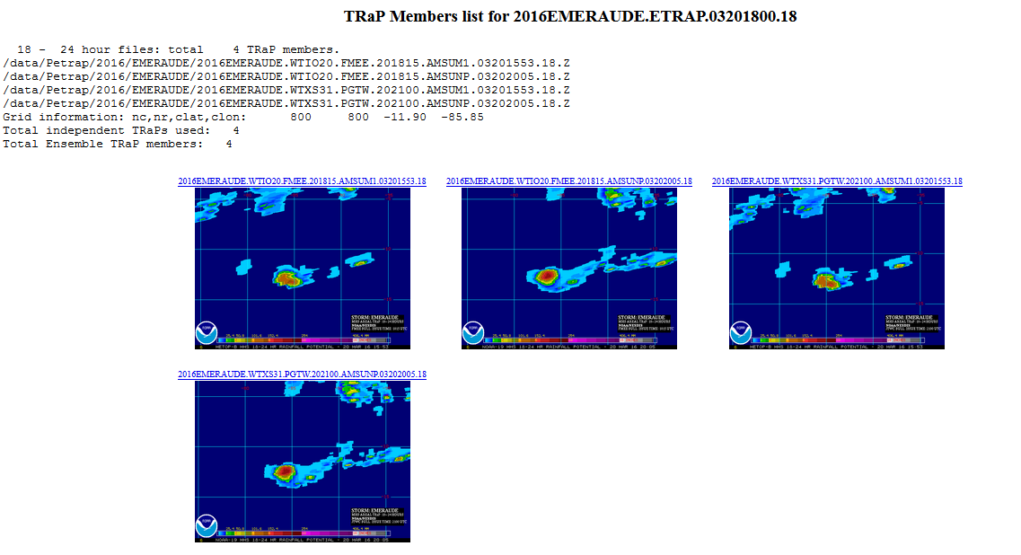
System Test Test Result (without ATMS/AMSR2)—EMERAUDE
Without ATMS/AMSR2, fewer members to produce eTRaPs for some periods
Notes:
Changed “less” to “fewer”

Slide 104
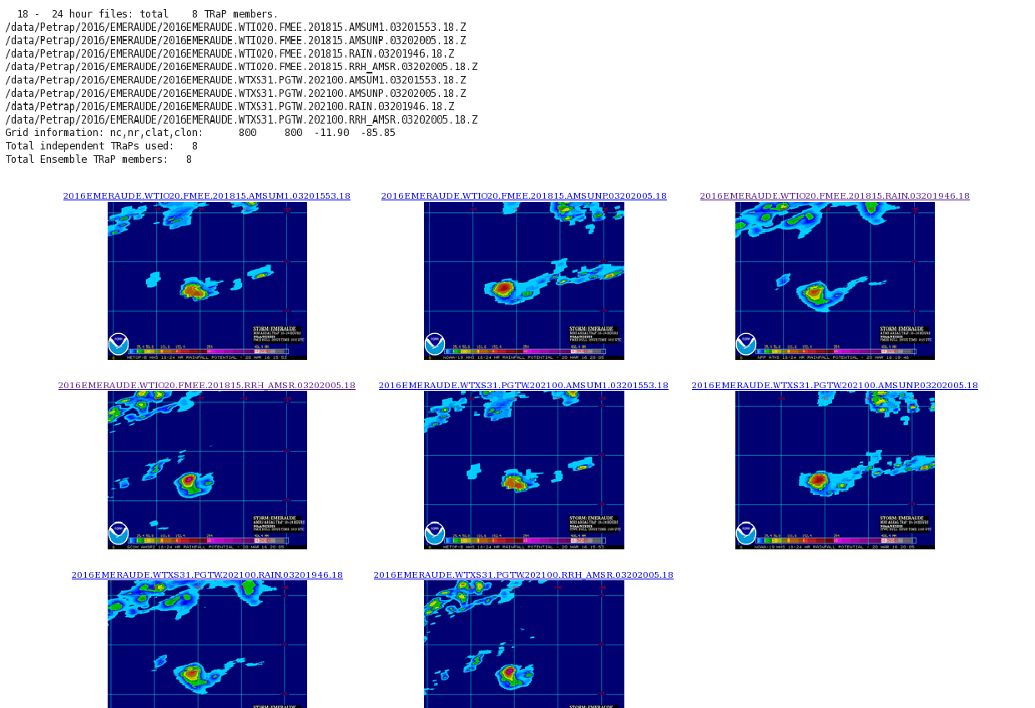
System Test Test Result (with ATMS/AMSR2)—EMERAUDE
With ATMS/AMSR2, more members to produce eTRaPs for all periods

Slide 105
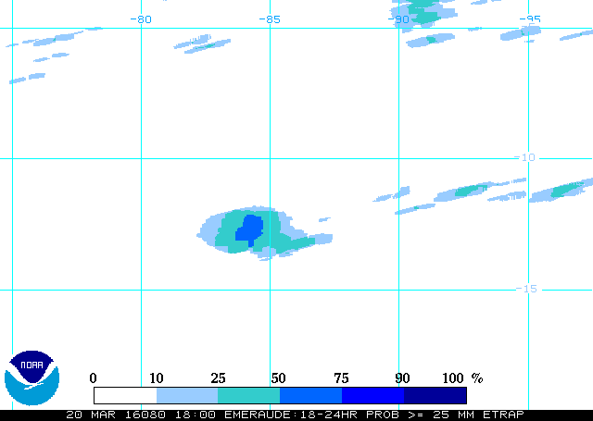
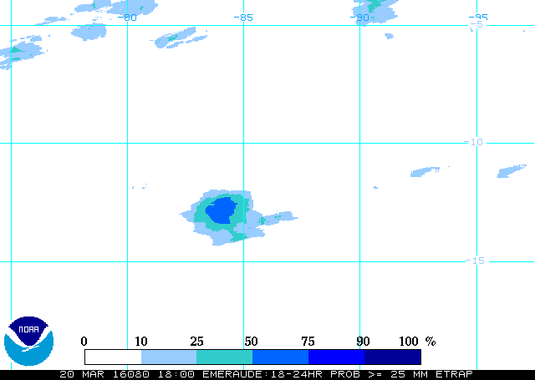
System Test Test Result—EMERAUDE
Additional members improved probability resolution
Probability of > 25 mm(without ATMS/AMSR2)
Probability of > 25 mm(with ATMS/AMSR2)
Notes:
Changed “more” to “additional”

Slide 106
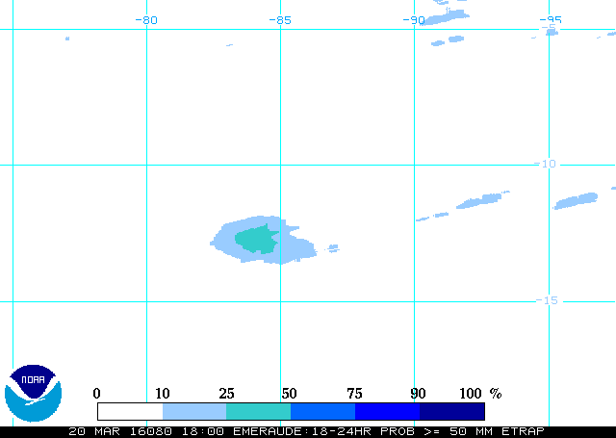
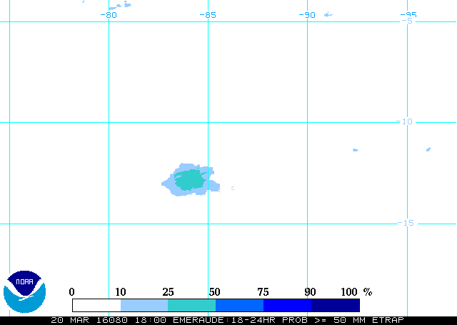
System Test Test Result—EMERAUDE
Additional members improved probability resolution
Probability of > 50 mm(without ATMS/AMSR2)
Probability of > 50 mm(with ATMS/AMSR2)
Notes:
Changed “more” to “additional”

Slide 107
System Test Processing Monitoring - Operators Needs
No test.
Notes:
107

Slide 108
System Test Products Monitoring – QC/QA Needs
No test needed.
Notes:
108

Slide 109
System Operational Readiness Liqun Ma NESDIS/OSPO
Notes:
109

Slide 110
System Operational Readiness Products
Inputs
N18/N19, MetopA/B MHS single-orbit rain rates from SFS/geodist
SSMIS(/F17/F18/F19) single-orbit rain rates from SFS/geodist
GHE 1HR rainfall accumulations from SFS/geodist
NPP MIRS rain rates from SFS/geodist
GCOM-W AMSR2 rain rates from SFS/geodist
RSMC bulletins from FOS2
Coverage
Global
Formats
McIDAS AREA / ASCII / Binary
Latency
4 hours
Notes:
Changed “GCOME” to “GCOM-W”

Slide 111
System Operational Readiness Users of Products
User | POCs | Products | Dissemination
HPC/WPC | Mark Klein | 6 hourly | ESPC ftp server/DDS
NESDIS/SAB | Mike Turk | 6 hourly | ESPC WEB Server
NCDC/CLASS | Philip Johns | daily | ESPC ftp server/DDS
All other users | All other users | 6 hourly/daily | ESPC WEB Server/ftp server

Slide 112
System Operational Readiness Production Environment
Development – geodev
Testing – geoprod3t
Production – geoprod3
Upgraded eTRaP will be running to generate the operational products on geoprod3
eTRaP products are distributed to users through ESPC web server(GP5), DDS and anonymous ftp server Satepsanone.
Backup
No backup server

Slide 113
System Operational Readiness Dissemination
Internet (web Interface)
No change
DDS*
No change
Satepsanone
No change

Slide 114
System Operational Readiness Monitoring
Quality Monitoring
No change
Performance Monitoring
No change.

Slide 115
System Operational Readiness Operation and Maintenance
O&M Procedures
Operation Procedure and System Maintenance Manual will be updated
The ESPC CM and security procedures will be enforced for any codes and documents changes
Multi-level monitoring capability has been already set up and no change in this upgrade.
The primary and backup maintenance personnel have been identified to cover normal maintenance needs
The PAL will work with STAR scientists for any science maintenance needs when identified.
Operational Support
The production machines are maintained by the ESPC IT team
ESPC help desk monitors any job failure, data outage and anomaly, and the monitoring tools and operation procedures are in place.

Slide 116
System Operational Readiness QA – Code Standards
The eTRaP operational team has been working with the development team to ensure that the upgraded eTRaP follows the ESPC operational requirements/guidance:
Directory structures
File/directory naming conventions
Operational log file content
Error tracking and handling

Slide 117
System Operational Readiness QA – CM and IT security
Product Implementation
Implementation on parallel test environment and transition to operation are tasked and managed by Change Requests (WR1403, WR1734 and CCR3450) through the ESPC Request for Action Tracking System (RATS)
Software CM follows ESPC Software Configuration Management Process and Procedures Manual
Related code and scripts will be checked into subversion
Security Procedures
This upgraded eTRaP is being tested in a separate test environment (geoprod3t) before its installation in operational environment (geoprod3)
SIA will be performed for this eTRaP upgrade before the system is promoted into operations
Documents will be under the CM control at OSPO
G:\Common\ESPC Library

Slide 118
System Operational Readiness QA – Documentation
ESPC Operation Procedure has been developed for operators
Operational maintenance procedures have been developed to support O&M needs at OSPO, which include:
Procedures for installation and build
Run procedures (includes normal and emergency operations)
Monitoring, diagnosis, and recovery procedures
Product distribution procedures
Interpretation of error messages
System shutdown and startup procedures
SPSRB Required Docs
Update External User Manuals, System Maintenance Manual, and ATBD
Need to be finalized before eTRaP Upgrade is declared operational

Slide 119
System Operational Readiness Archive
eTRaP products (tar file)will continue being archived at CLASS.

Slide 120
System Operational Readiness User Readiness (1 of 2)
Data Access
Data access remains the same(no change)
Acceptance of Product
HPC, WPC and SAB
Already using eTRaP since 2009

Slide 121
System Operational Readiness User Readiness (2 of 2)
Training
User manuals will be updated and is available to all users
HPC/WPC/SAB
No specific training from OSPO is required. Users have been using current eTRaP Since July 2009. This eTRaP upgrade is just an enhancement.
ESPC Operator
Monitoring eTRaP will be the same as current eTRaP. No training is needed for ESPC help desk.

Slide 122
System Operational Readiness Summary
The product system is ready for operations
The documentation will be complete by the time the eTRaP Upgrade is officially declared operational (final touches need to be done to the documents)
The users are ready to receive and use the data

Slide 123
Summary Liqun Ma NESDIS/OSPO
Notes:
123

Slide 124
Summary
Risk and Actions have been reviewed
Requirements and their Allocations have been reviewed
System Description and Test have been reviewed
Products Quality Readiness have been reviewed
Operation Readiness has been reviewed
User Readiness has been reviewed
Notes:
124

Slide 125
Next Steps
Operational Phase
SPSRB Decision Briefing – May, 2016
Operational Commencement – June, 2016
Notes:
125

Slide 126
Open Discussion
The review is now open for free discussion
Notes:
126

Slide 127
Backup
Notes:
127

Slide 128
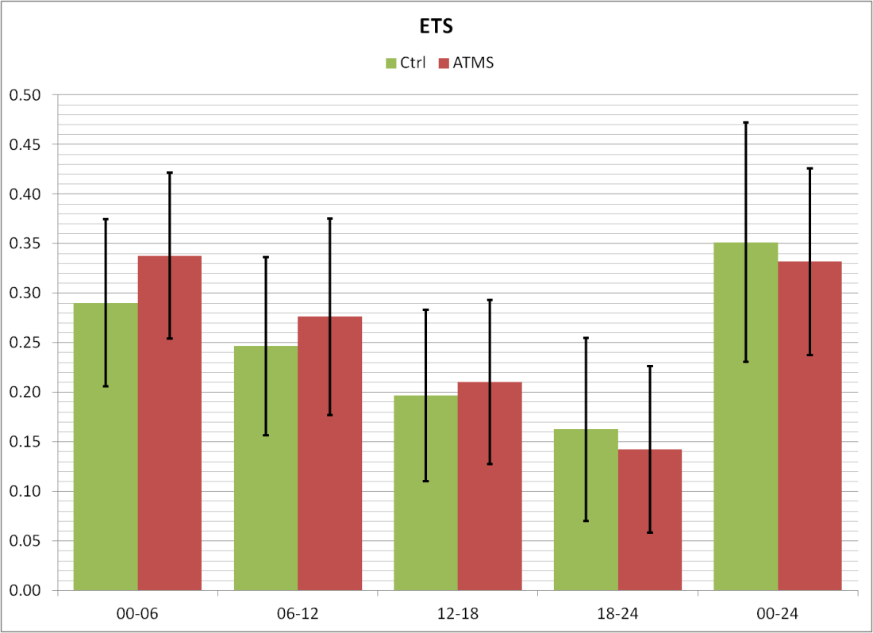
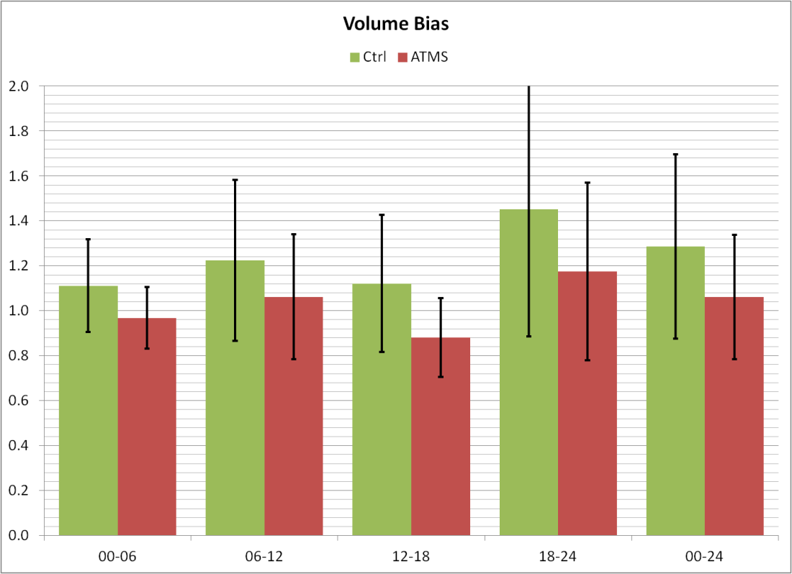
Results(ATMS)
Validation of the resulting eTRaP for 13 forecasts for 4 different storms in 2012-13 minimal change in ETS but some reduction in bias:

Slide 129
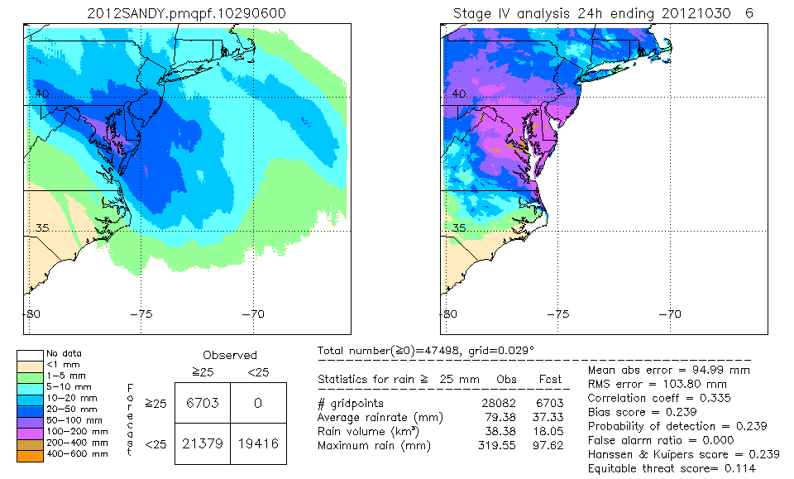
Example: Sandy (2012)
Comparison of the validation of 24-h rainfall forecasts without (left) and with (right) ATMS for Hurricane Sandy, initialized 0600 UTC 29 October 2012:
Slightly improved rain forecast over PA and NY (though still underdone)
ETS (0.121 vs. 0.114); and bias (0.252 vs. 0.239) essentially unchanged

Slide 130
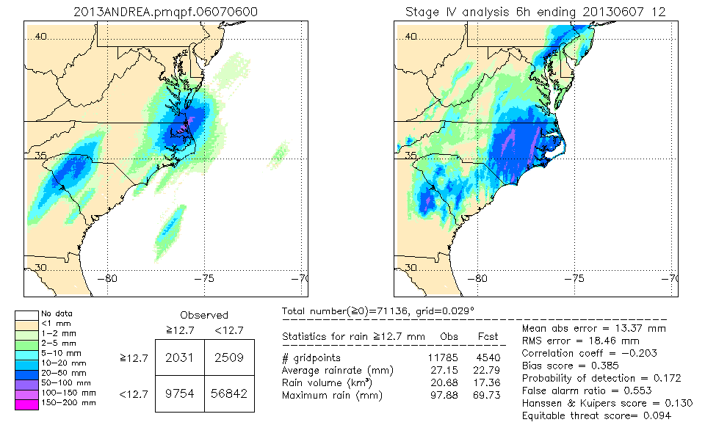
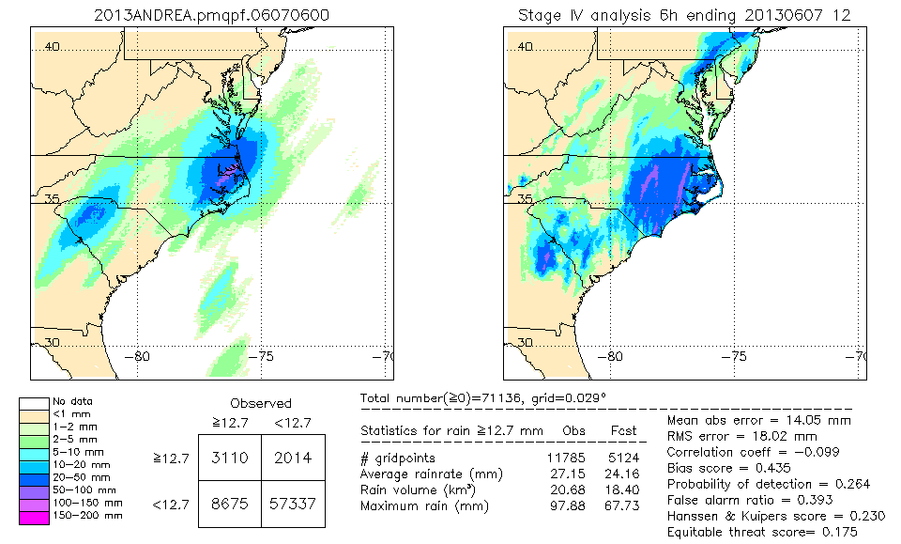
Example: Andrea (2013)
Comparison of the validation of 0-6 h rainfall forecasts without (left) and with (right) ATMS for TS Andrea, initialized 0600 UTC 7 June 2013:
Slight improvement in forecast over eastern NC (though still underdone)
ETS improved from 0.094 to 0.175; bias improved from 0.385 to 0.435

Slide 131
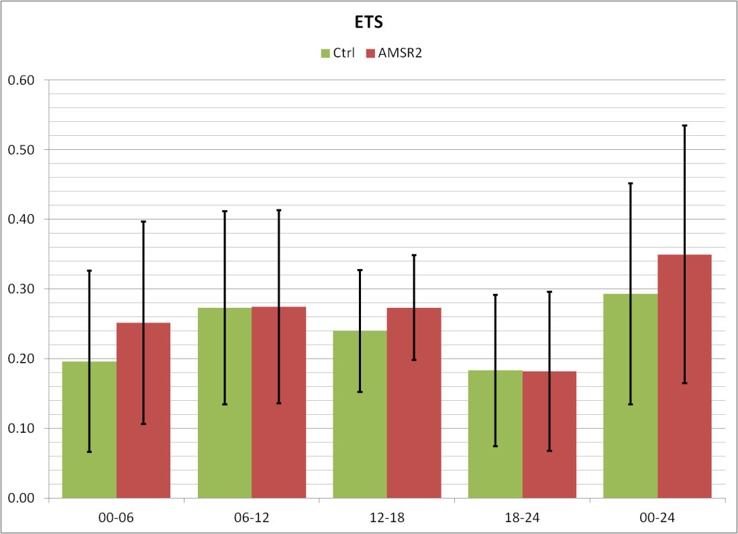
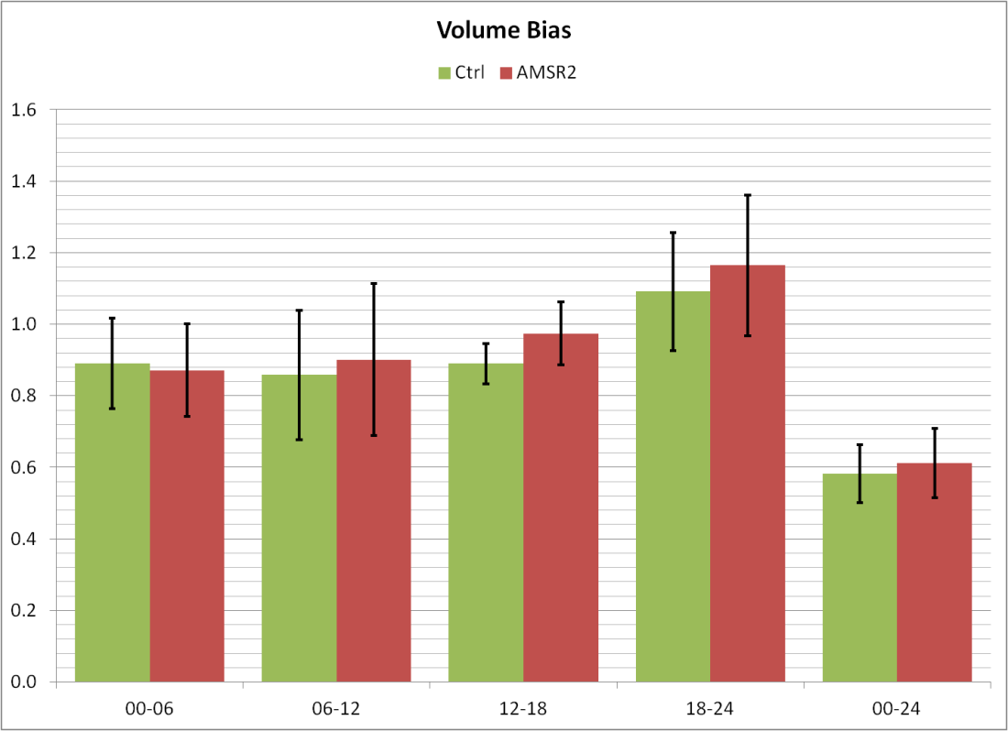
Results(AMSR2)
Validation of the resulting eTRaP for 7 forecasts for 3 different storms in 2012-13 shows slight improvement in ETS and marginal impact on bias:

Slide 132
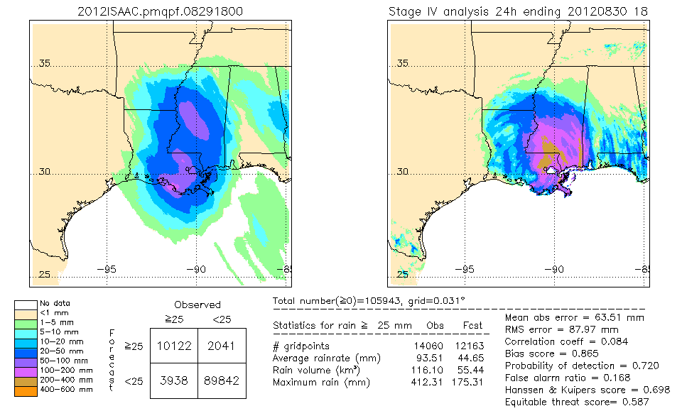
Example: Isaac (2012)
Comparison of the validation of 24-h rainfall forecasts without (left) and with (right) AMSR2 for Hurricane Isaac, initialized 1800 UTC 29 August 2012:

Slide 133
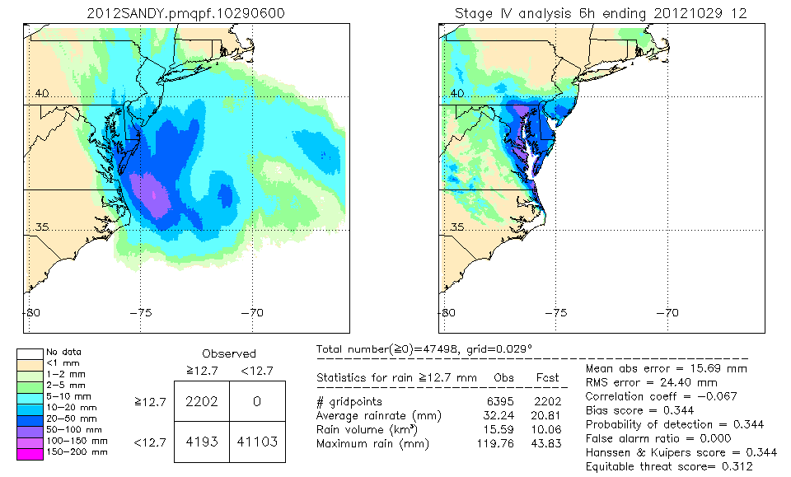
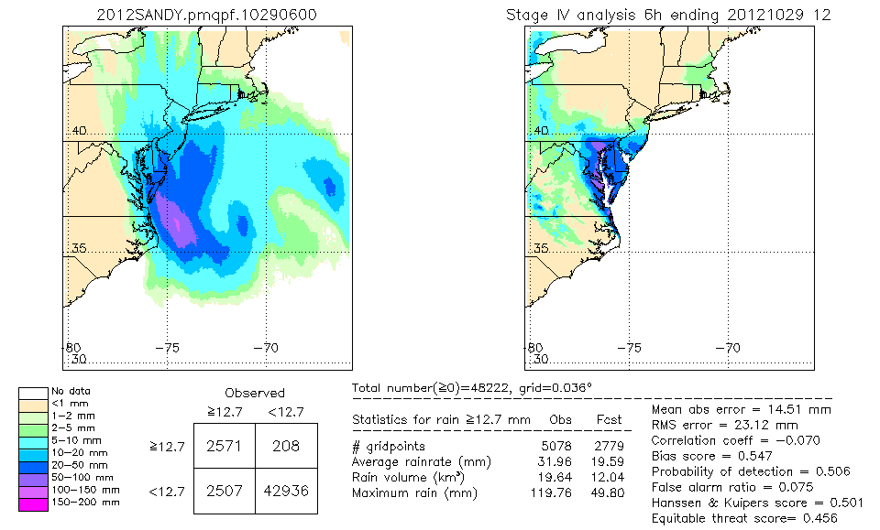
Example: Sandy (2012)
Comparison of the validation of 0-6 h rainfall forecasts without (left) and with (right) AMSR2 for Hurricane Sandy, initialized 1800 UTC 28 October 2012:

