Slide 1
Satellite Proving Ground for Marine, Precipitation, and Satellite Analysis
GOES-R and JPSS Products At
OPC, SAB, TAFB, and WPC
Michael J. Folmer, PhD

Slide 2
Hurricane Sandy GOES-Sounder RGB Air Mass Product

Slide 3
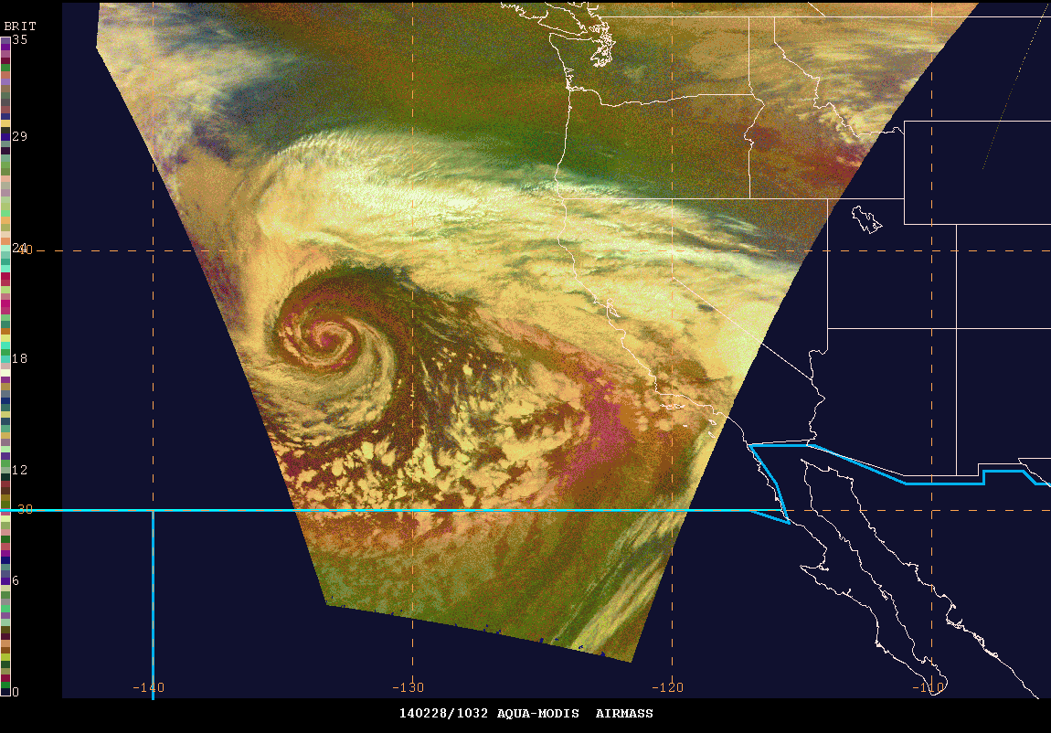
AIRS Ozone Products
Total Column Ozone
Ozone Anomaly

Slide 4
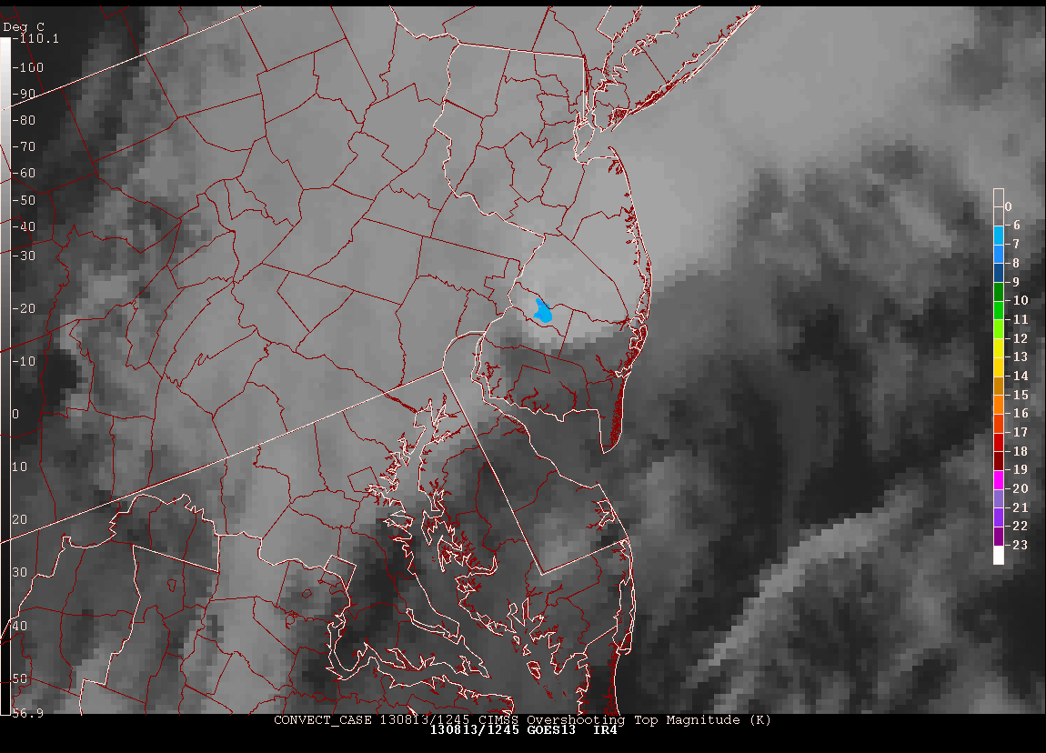
Overshooting Top Detection Magnitude
W
W
W
T
W
W
W
W
W
W
W

Slide 5
June 12-13, 2013 “Derechoes” GOES-14 SRSOR 5-min Visible overlaid with (Vaisala) GLD-360 Lightning Density

Slide 6
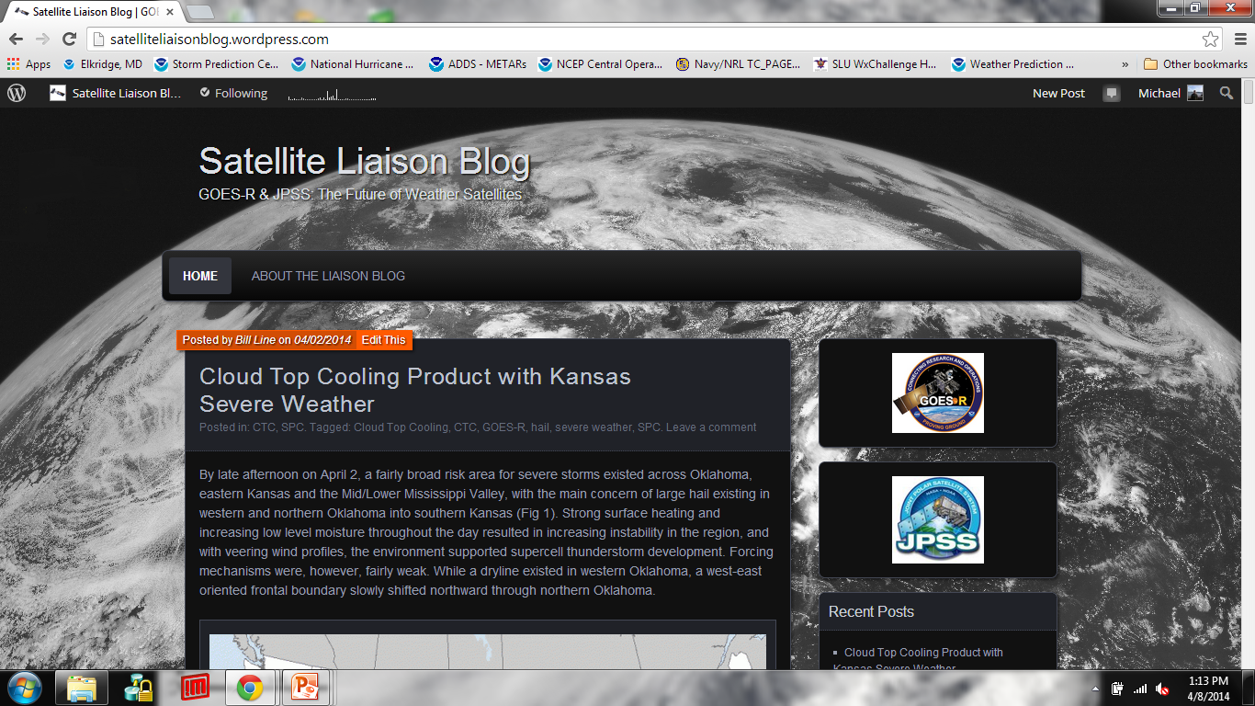
New Satellite Liaison Blog

Slide 7
More Information
If you want to see these or other GOES-R/JPSS products, please contact Chad Gravelle (NWSTC Satellite Liaison) or Dave Radell (ERH)
www.goes-r.gov
www.jpss.noaa.gov
Summer Plans at the MPS Proving Ground: Nearcast, Convective Initiation, Overshooting Top Detection, Lightning Density, Fog and Low Stratus
You can contact me at michael.folmer@noaa.gov for more information on our PG activities.

