Slide 1
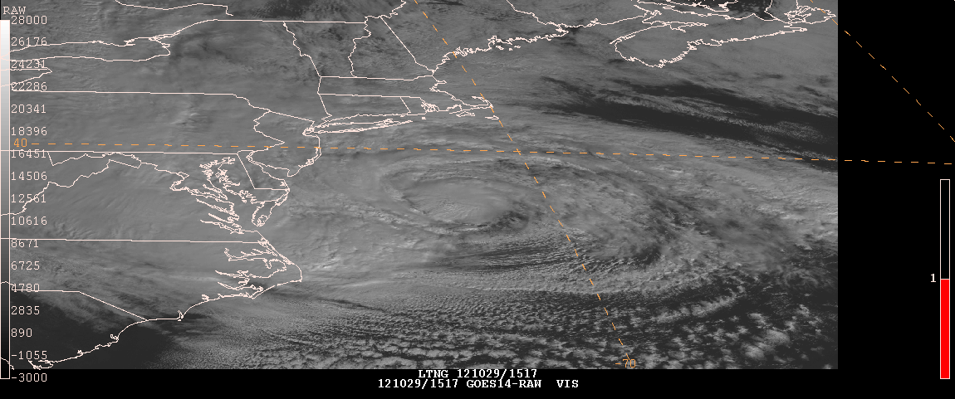
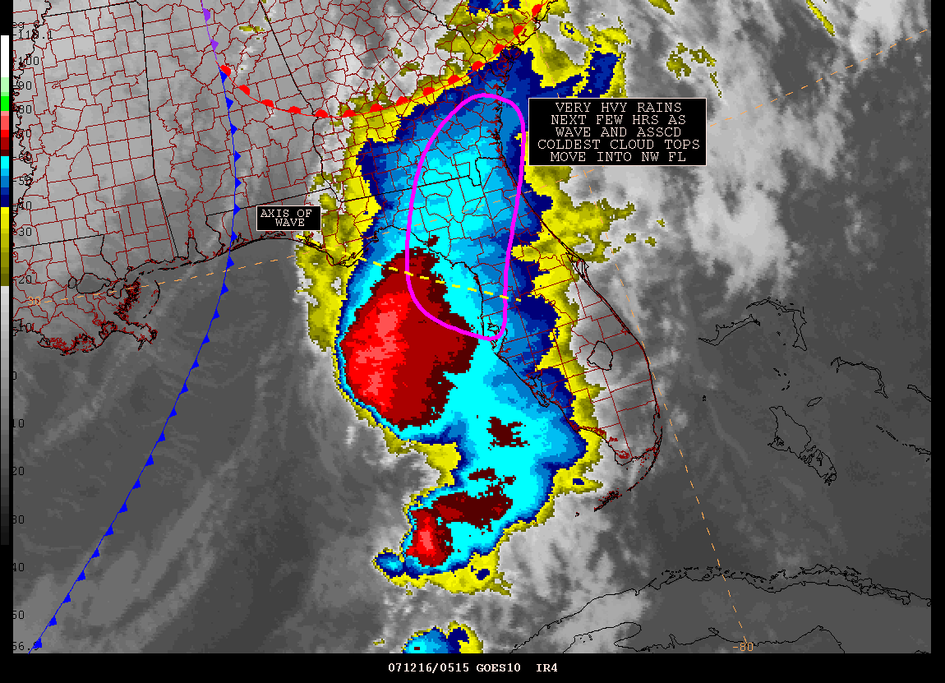


Hazard Mitigation Programs of the
Satellite Analysis Branch
Dallas Fort Worth WFO and West Gulf River Forecast Center
January 10, 2013
Josh Jankot and Jamie Kibler, Meteorologist/User Service Leads of the Satellite Analysis Branch
NESDIS/OSPO/SPSD/Satellite Analysis Branch
Josh.Jankot@noaa.gov and Jamie.Kibler@noaa.gov
(301) 683-1400 or SABSupervisor@noaa.gov
Notes:
1

Slide 2
Outline of Presentation
Precipitation Program
Tropical Program
Current GOES Satellite Constellation
GOES-R and Lightning Instrument

Slide 3
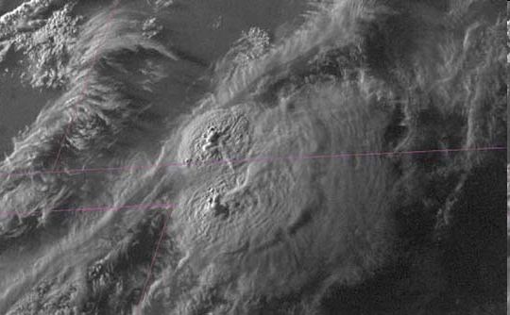
NESDIS
Satellite Analysis Branch
Precipitation Desk
Contact: 301-683-1404
Email: SSDPrecip@noaa.gov
Team Lead: John Simko

Slide 4
Operations
NWS Field Support (including PR and HI)
    SPENES Messages and annotated graphics
    12 Planet Chat (NESDIS)
Hydrometeorlogical Prediction Center (HPC) briefings
    6 hour QPF for Lower 48
    12 Hour Basic Weather Forecast

Slide 5
Products
Blended TPW Product (now global)
GOES 13/15 VIS, IR, Water Vapor Channels
Derived Products: LI, Cape, Precipitable water GOES operational satellite winds, overshooting top algorithm
Experimental Satellite Winds
Automated Satellite Estimates: Hydro-estimator, Auto-estimator, QMORPH
Manual Satellite Estimate: Convective, tropical, winter storm technique

Slide 6
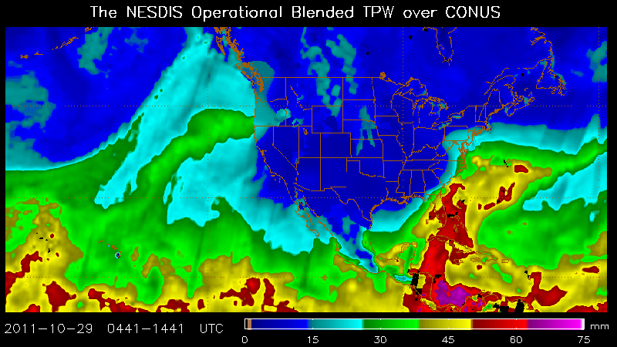
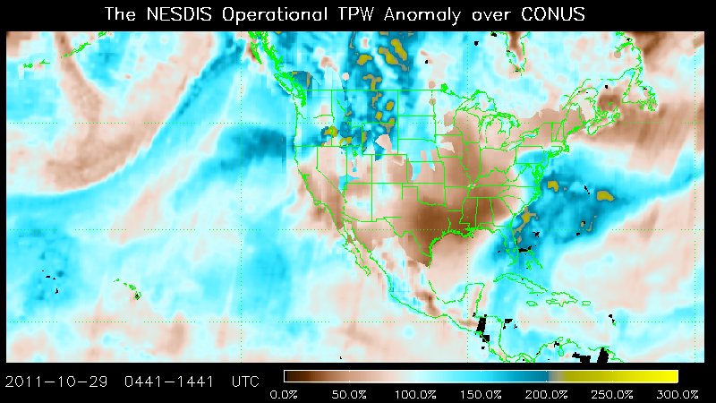
Blended TPW Product
Now Global coverage over land
(thanks to MIRS technique)
Derived from multi-sources: Microwave sensors: SSMI/S, AMSU, and GPS land sites via MSPPS and MIRS (independent of NWP)
Available on various platforms including AWIPS/NAWIPS/MCIDAS
Available on web: http://www.osdpd.noaa.gov/bTPW/

Slide 7
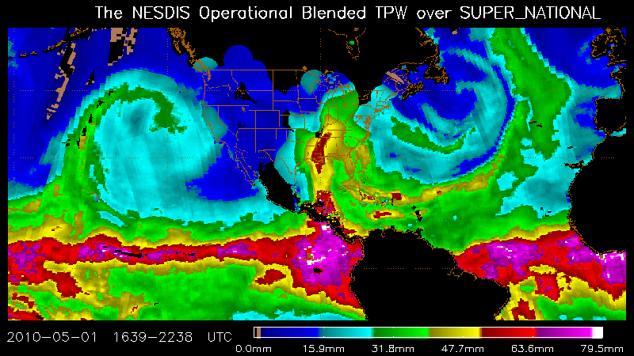

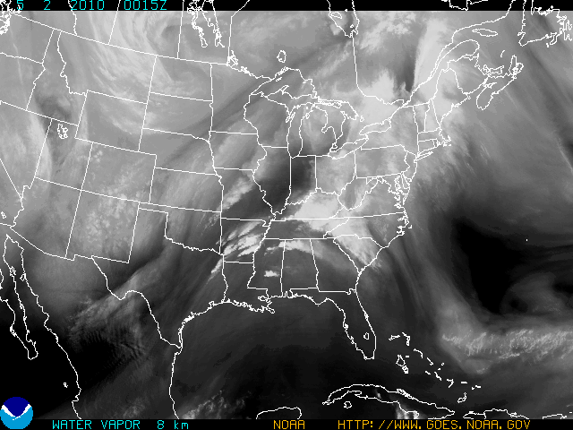
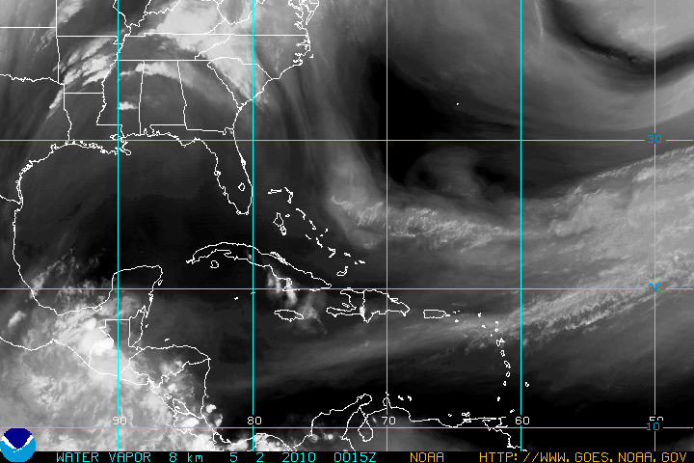

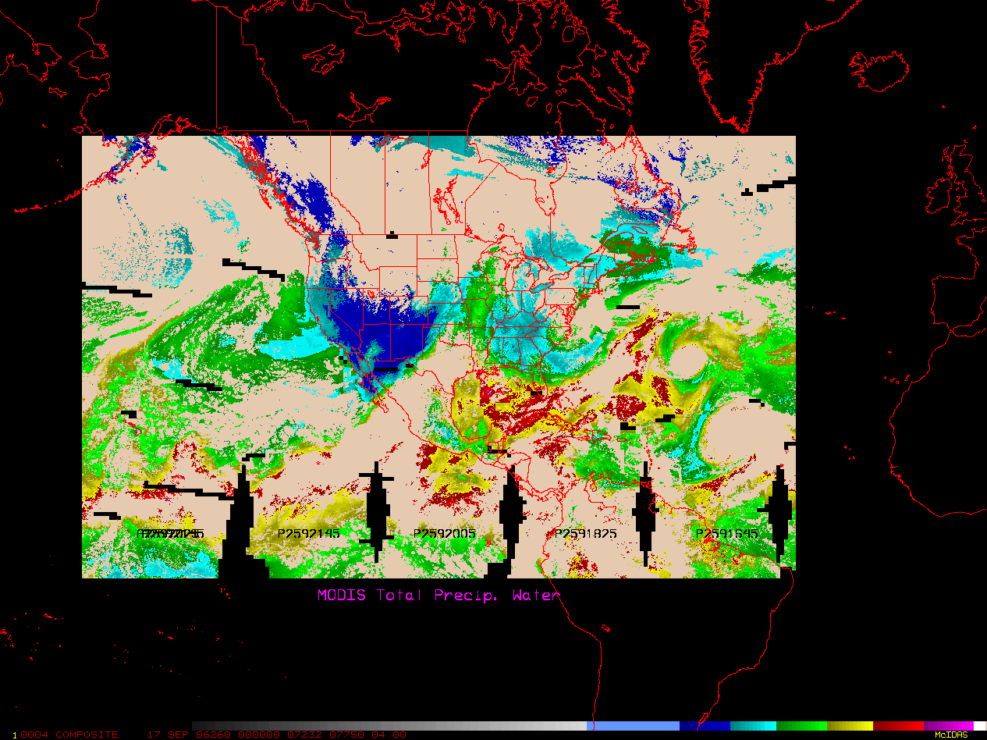
Blended Total Precipitable Water (TPW) and
Geostationary 6.7µ Water Vapor (WV)
Compare and Contrast; Complement and Supplement
0000 UTC May 2, 2010
0015 UTC May 2, 2010
LW trof
===========
polar jet
LW Ridge
SW trof
WWWWW
- =====
Subtropical jet
tropical jet
0.25 0.50 1.0 1.5 2.0 > 2.5 in
<<<<<<< lower moisture higher moisture >>>>>>>>
Total Precipitable Water
Geostationary 6.7µ WV
Total moisture
Moisture 12000-25000 ft
Senses low level moisture
Senses mid/high level moisture
Identifying moisture plumes
Identifying jets, trofs, short waves, diffluence
Mid to high level moisture transport
Low level moisture transport
7
Notes:
7
Slide 7 - Is an analysis type of slide where the main point is that no one type of satellite can do it all and it compares a GOES water vapor image from around midday on May 1 with a blended Total Precipitable Water image for about the same time. Take away points are that moisture and location of lift will almost always determine the extent of a heavy rain event (boundary also important from surface data and other satellite data (VIS) )and geostationary water vapor is great at showing the lifting mechanisms while Blended TPW is great at showing the low level moisture. [Reinforcement for you: Since most of the moisture in the atmosphere is below 10000 feet, the blended TPW product is best at depicting mostly the low level moisture, while the geo water vapor sensing moisture in the mid to high levels is best at showing upper level short waves, jets, diffluence, troughs, etc for the important lifting of that low level moisture and the added middle level moisture coming from a different location (like the Pacific over the Mexican mountains) for deepening the moist atmosphere for an even greater chance of an excessive rainfall event.

Slide 8
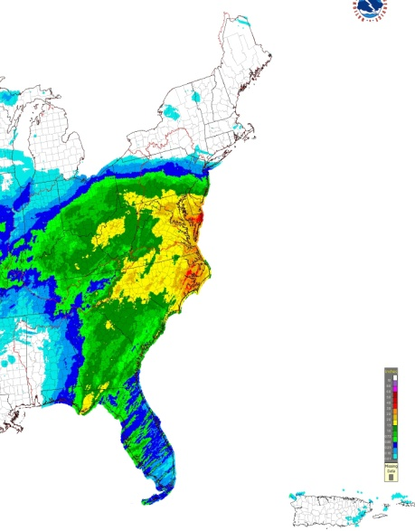
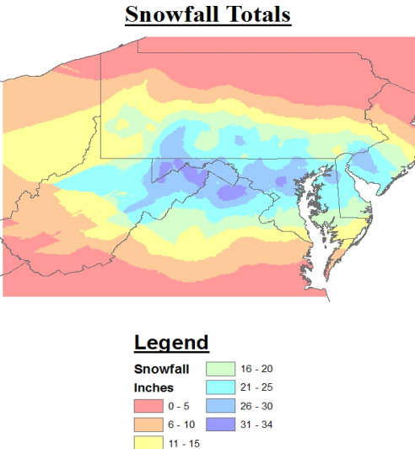
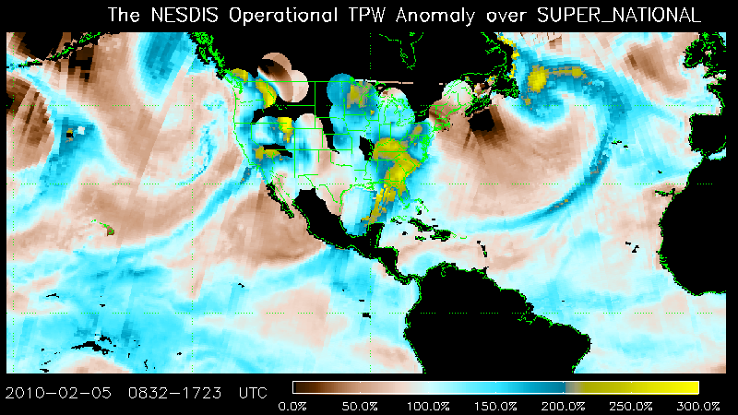
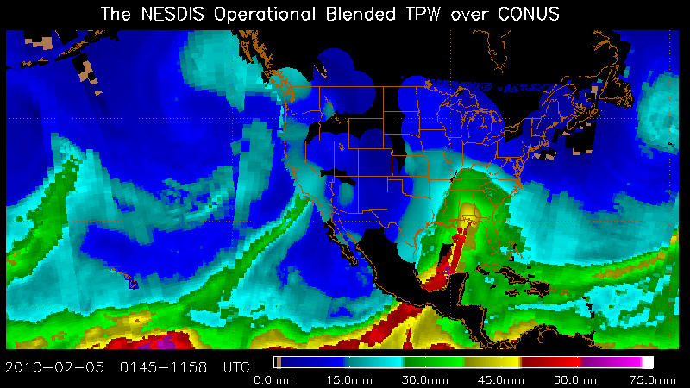
Winter Case Using TPW
• Feb 5-6 2010 event exhibited a huge supply of moisture with TPW anomalies for large portion of E CONUS at 250% of normal
•Continuous PW Plume originating in the ITCZ nosed into SE USA with 45-60mm of TPW. Provided plenty of moisture for WCB to produce warm air advection precipitation
• As storm evolved could see 15-45 mm TROWAL/moisture wrapping into Mid Atlantic coastal plane helping to advect moisture into area of heavy snow
ATMOSHPHERIC RIVER CONNECTED TO ITCZ
200-250% PW Anomalies

Slide 9
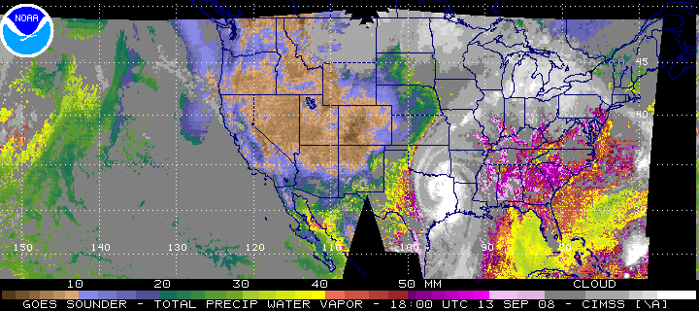
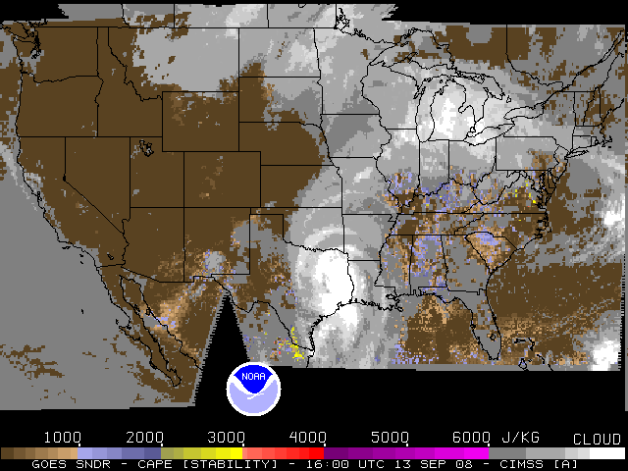
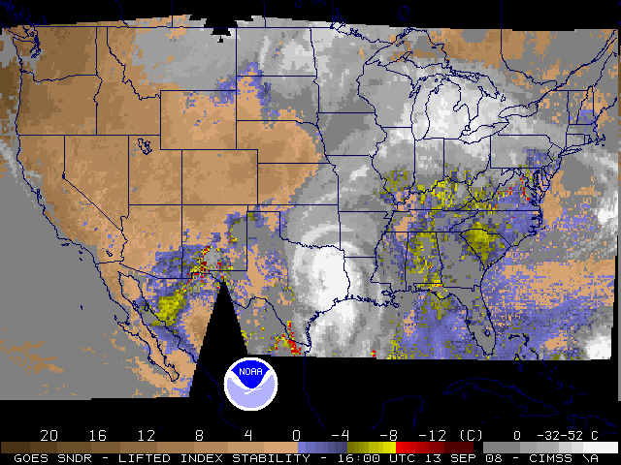
GOES Sounder Derived Products
Precipitable Water
Cape
Updated Hourly
Lifted Index

Slide 10
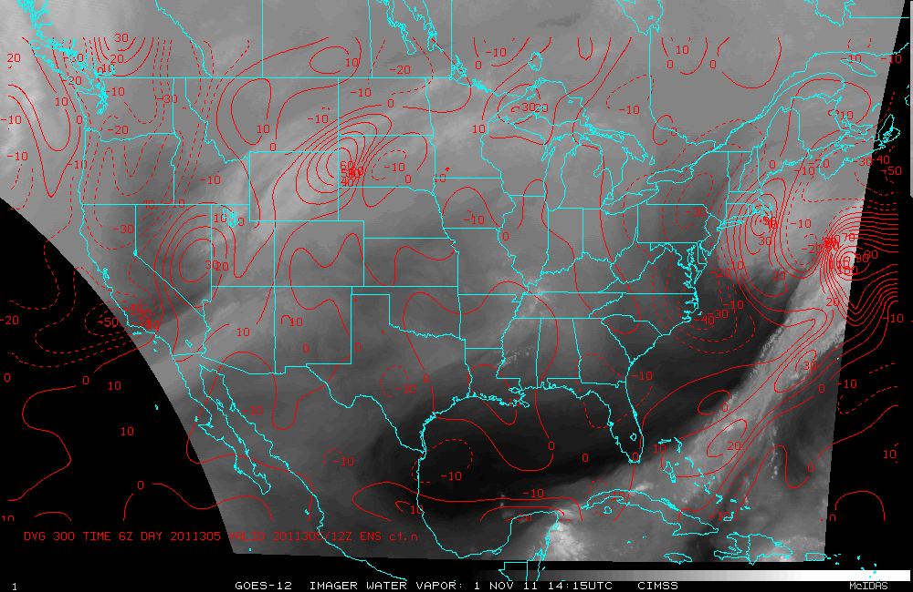
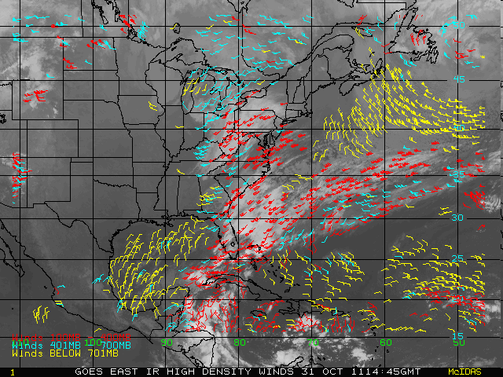
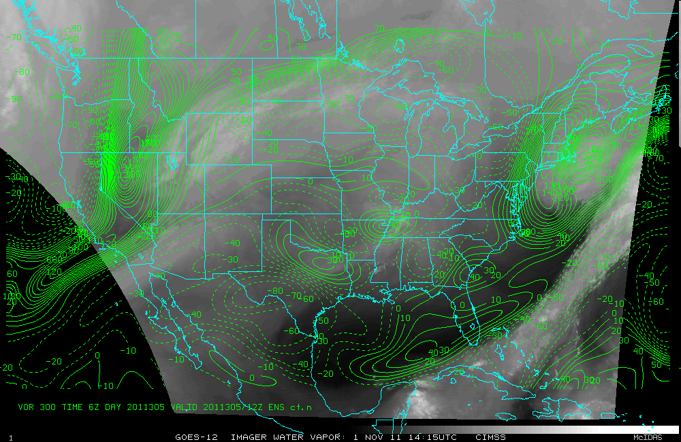
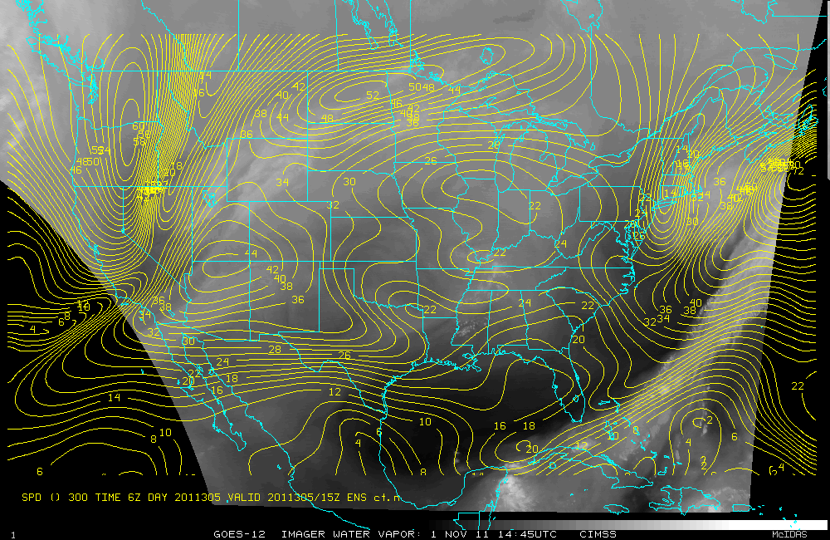
GOES Operational and Experimental Winds
GOES operational winds updated every 3 hours
Experimental Winds algorithm developed by CIMMS (UWISC)
Incorporates best guess with GFS via winds/background field
Experimental winds updated hourly
Available: http://www.nssl.noaa.gov/users/rabin/public_html/winds/

Slide 11
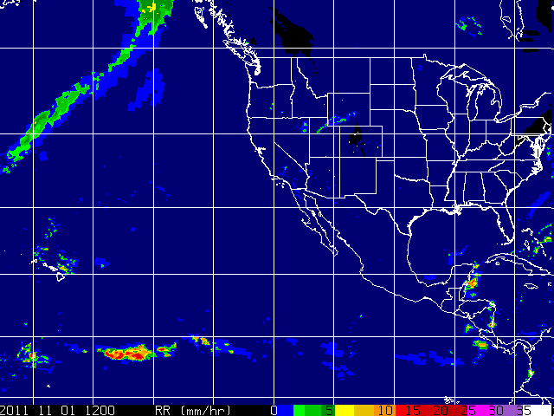
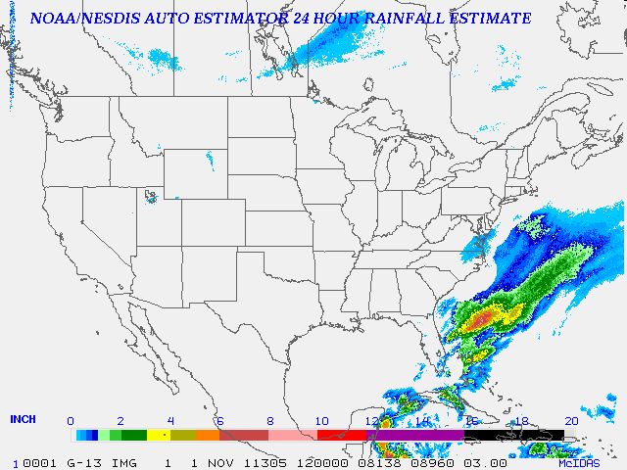
Automated Satellite Estimates
1, 3, 6, 24 HR estimates
Hydor-estimator (based on cloud top temperatures, but also include moisture, stability parameters, radar, topography etc) Available in AWIPS, produced every 15 minutes
QMORPH (derived from microwave observations to include SSMI/S, TRMM, AMSU-B, IR imagery used to produce propagation vectors, algorithm produces hourly estimates that can produce 6, 12, 24, multi-day estimates)
Available on AWIPS or:
http://satepsanone.nesdis.noaa.gov/PS/PCPN/HE.html
Available: http://cat.cira.colostate.edu/QMORPH/QMORPH.htm

Slide 12
Auto-estimate Technique
30 min estimate
Based on MB curve enhancement (grayscale)
Factors include rain burst factor, cloud top temperatures, inflow/divergence aloft, overshooting top factor (+.3), merging factor (+.5), speed of storm/saturated environment factor, moisture correction factor
30 min estimate= (CT or RB + OS + M + SE)MC x S

Slide 13
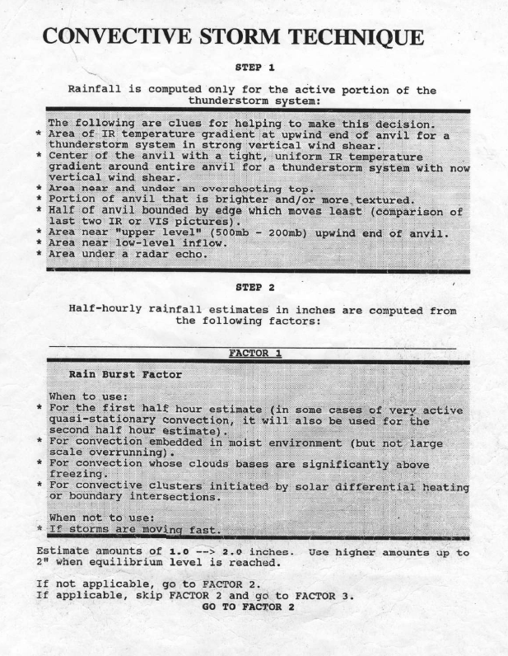
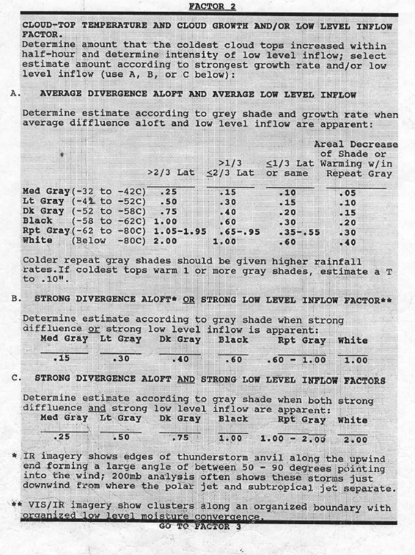

Slide 14
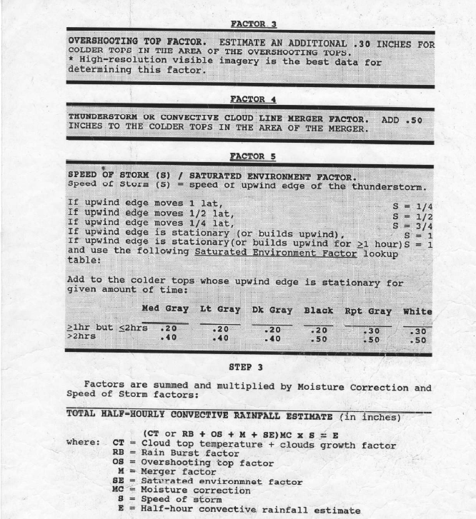

Slide 15
Possible Future changes
HPC will take over mesoscale heavy rain discussions (MCD) from SPC (Spring 2013 or beyond)
Due to overlap of product area(s) SPE’s might discontinue and SAB will brief HPC from satellite perspective
Possible adaptation to more graphic based product and messages left to HPC
Impact/comments from WFO perspective as SAB would no longer provide direct consultation?

Slide 16
Questions?
Josh Jankot
Email: josh.jankot@noaa.gov
Phone: 301-683-1404

Slide 17
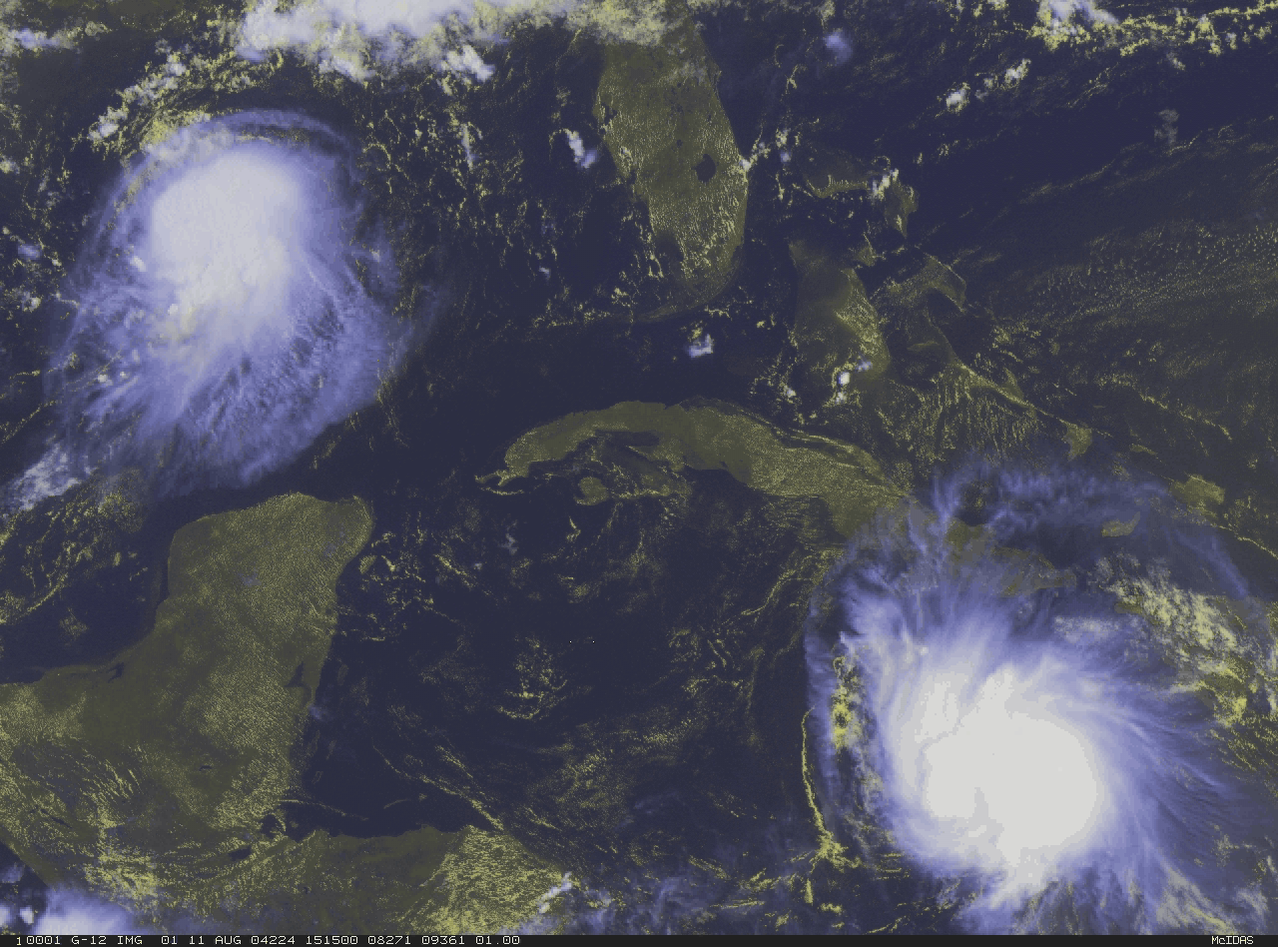
Satellite Analysis Branch Tropical Program
Tropical Desk
Contact: 301-683-1400
Email: Michael.Turk@noaa.gov
Team Lead: Michael Turk
Notes:
17

Slide 18
Satellite Analysis Branch Tropical Program History
The Tropical program at the Satellite Analysis Branch (SAB) began monitoring tropical systems in early 1970s using a technique called the Dvorak technique created by Vern Dvorak of NESDIS.
The Dvorak technique is a method using enhanced Infrared and/or visible satellite imagery to quantitatively estimate the intensity of a tropical system. Indications of continued development and/or weakening can be found in the cloud features. Using these features, the pattern formed by the clouds of a tropical cyclone, expected systematic development, and a series of rules, an intensity analysis and forecast can be made. This information is then standardized into an intensity code.
http://www.ssd.noaa.gov/PS/TROP/dvorak.html
CI MWS MWS MSLP MSLP Saffir-Simpson
Number (Knots) (MPH) (Atlantic) (NW Pacific) Category
25 KTS 29 MPH (Approximate)
1.5 25 KTS 29 MPH
30 KTS 35 MPH 1009 mb 1000 mb
2.5 35 KTS 40 MPH 1005 mb 997 mb
45 KTS 52 MPH 1000 mb 991 mb
3.5 55 KTS 63 MPH 994 mb 984 mb
65 KTS 75 MPH 987 mb 976 mb 1 (64-83 KTS)
4.5 77 KTS 89 MPH 979 mb 966 mb 1 (64-83 KTS); 2 (84-96 KTS)
90 KTS 104 MPH 970 mb 954 mb 2 (84-96 KTS); 3 (97-113 KTS)
5.5 102 KTS 117 MPH 960 mb 941 mb 3 (97-113 KTS)
115 KTS 132 MPH 948 mb 927 mb 4 (114-135 KTS)
6.5 127 KTS 146 MPH 935 mb 914 mb 4 (114-135 KTS)
140 KTS 161 MPH 921 mb 898 mb 5 (136+ KTS)
7.5 155 KTS 178 MPH 906 mb 879 mb 5 (136+ KTS)
8 170 KTS 196 MPH 890 mb 858 mb 5 (136+ KTS)

Slide 19
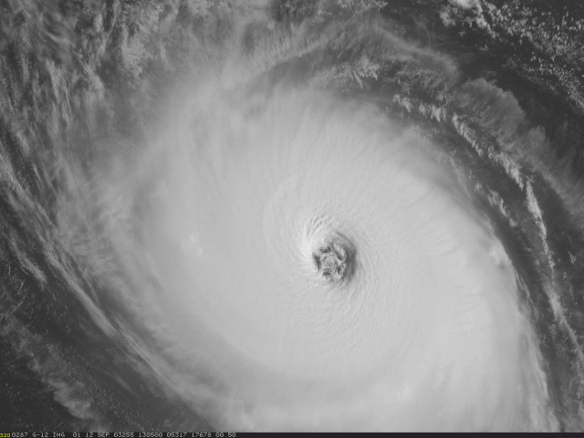
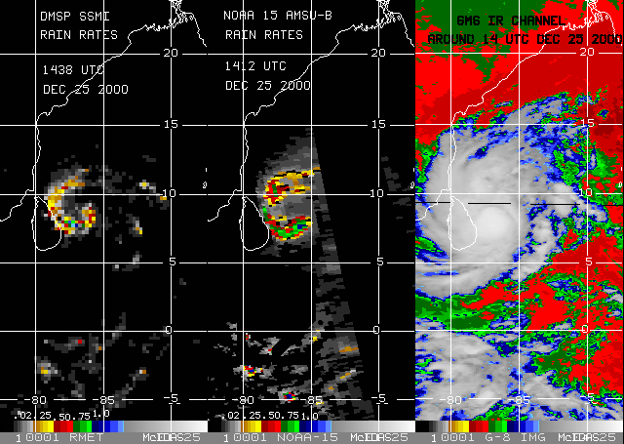
Tropical Program
Tropical Storms: Global Geostationary and Polar Orbiting microwave satellite data are monitored for the formation, movement, and intensity of tropical storms, hurricanes, and typhoons.
Routine analyses of these storms are relayed to the National Weather Service and many other international agencies such as the Regional Specialized Meteorological Centres (RSMC) forecast Tropical Cyclones.

Slide 20
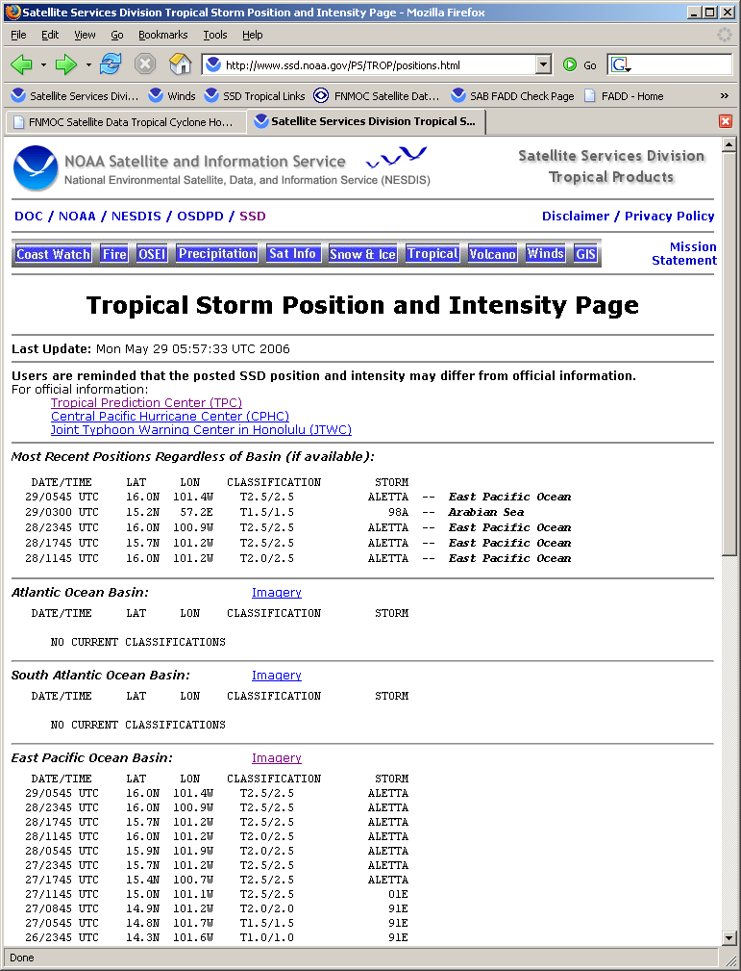
Tropical Cyclone Center Location and Intensity Estimation
Dvorak Infrared and Visible
Satellite Technique
Areas Users
North Atlantic Ocean
Eastern North Pacific Ocean
Central Pacific Ocean
URL: For Tropical Positions
www.ssd.noaa.gov/PS/TROP/positions.html
Western North Pacific
Arabian Sea
Bay of Bengal
South Indian Ocean
South Pacific Ocean
}
NOAA NHC/CPHC/NWS
}
US Military -JTWC
WMO Regional Specialized Meteorological Centers (RSMC) in Tokyo, New Delhi, Reunion, Brisbane, Perth, Darwin, Fiji and Wellington
URL: For Tropical Bulletins
http://www.ssd.noaa.gov/PS/TROP/bulletins.html

Slide 21
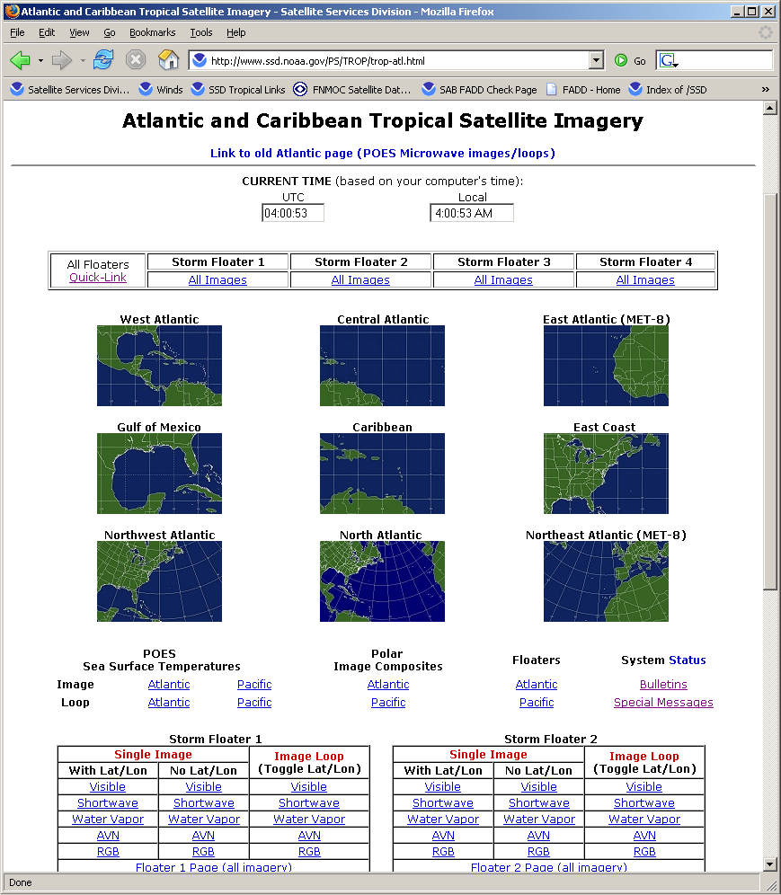
NOAA
Satellite Imagery on the Web
- Tropical Cyclone Sectors
North Atlantic
www.ssd.noaa.gov/PS/TROP/trop-atl.html
North Pacific
www.ssd.noaa.gov/PS/TROP/trop-epac.html
- NWS Regional Sectors
http://www.ssd.noaa.gov/goes/east/wfo/index.html
http://www.ssd.noaa.gov/goes/west/wfo/index.html

Slide 22
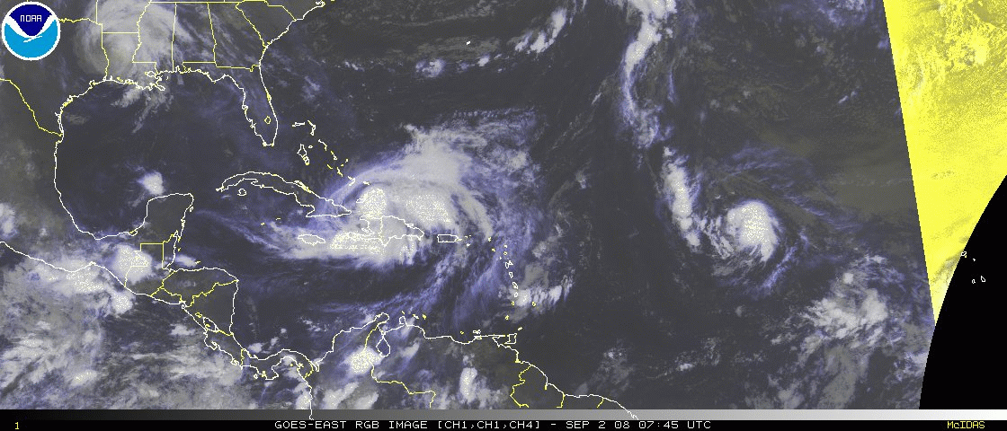
Tropics - 2008
TS-Gustav Hurr-Hanna TS-Ike TD-Josephine
www.ssd.noaa.gov/PS/TROP/index.html
Notes:
TS Gustav – Gulf
Hur Hanna – Caribbean
TS Ike – Atlantic
TD Josephine – Africa Coast

Slide 23
NOAA's GOES Satellites:
Current, Future Status, and Short-Term Plans

Slide 24
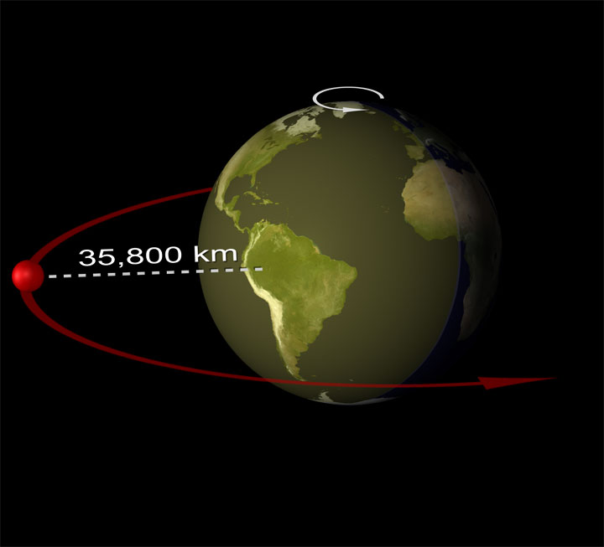
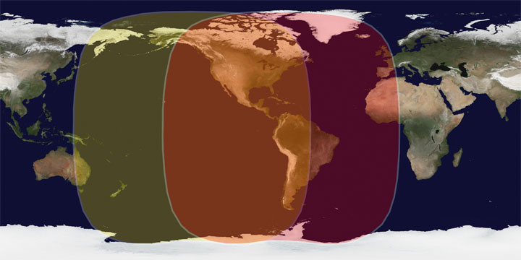
Geostationary Satellites
35,800 km high
Two Satellite System continuously monitors the Western Hemisphere
Northern Hemisphere Imaged every 15 minutes
Weather sentinel – constant monitoring of Hurricanes, Severe Storms, and more
Input to weather models, forecasts, and warnings
Sea surface temperature monitoring for fisheries and climate
Winds for aviation
Solar imagery for communication satellites, utility companies, and astronaut safety
Environmental data collection from buoys, stream gauges, etc.
Satellite-aided Search and Rescue

Slide 25
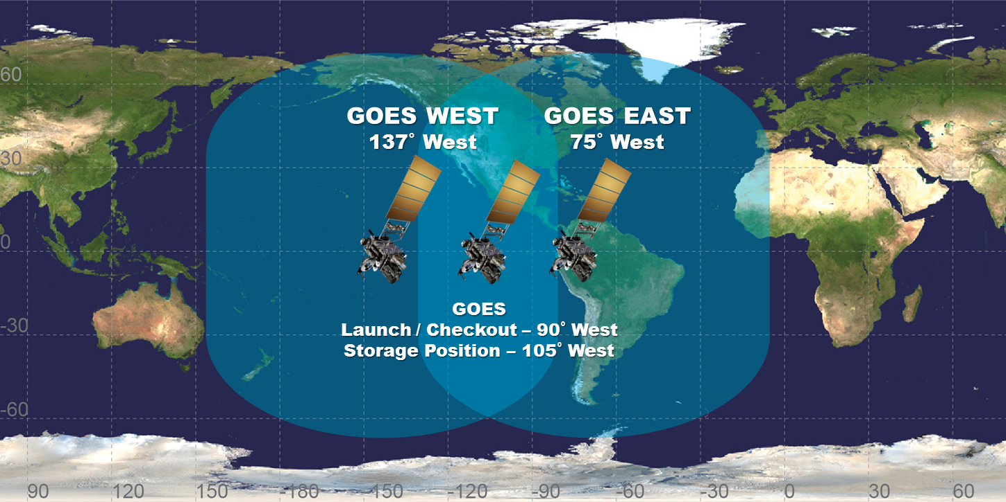
Current GOES Fleet
GOES N/O/P (13/14/15)
  *GOES-13 operational as GOES-East at 75° W – April 14, 2010
  *GOES-14 in Z-axis storage at 105º W – launched June 27, 2009
  *GOES-15 operational as GOES-West at 137° - December, 2011.
25
Notes:
25

Slide 26
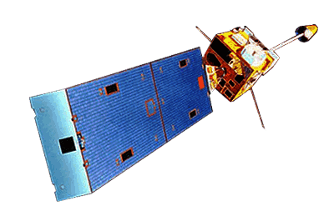
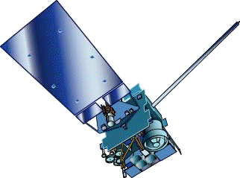
Comparisons of GOES Series
  GOES-13/14/15 have similar instruments to GOES-8-12, but on a different spacecraft bus.
  Spring and fall eclipse outages are avoided by larger onboard batteries.
  Improved navigation
  Starting with GOES-14, all IR channels at 4km
GOES-8/12
GOES-13/14/15

Slide 27
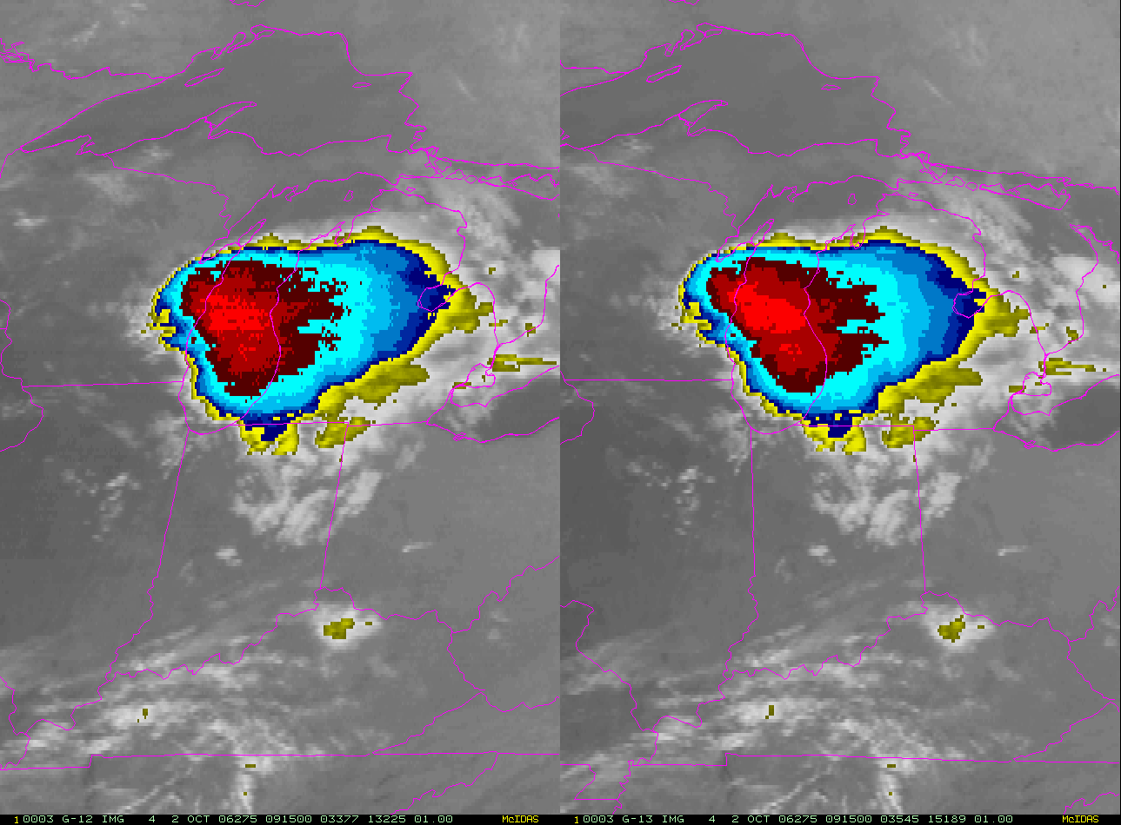
GOES-13: Less Thermal Distortion
GOES-12
GOES-13
27
NOAA Satellite and Information Service: National Environmental Satellite, Data, and Information Service (NESDIS)
Notes:
27

Slide 28
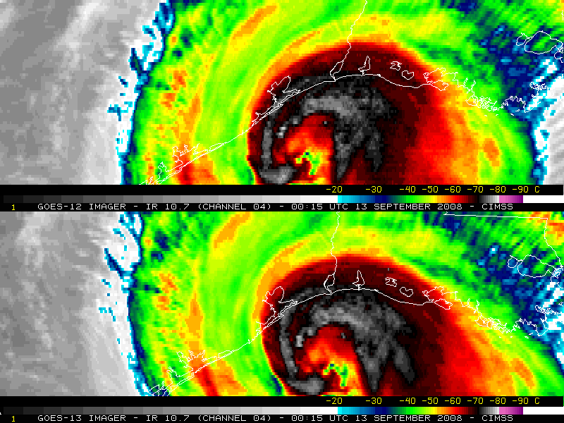
GOES-12/13 (During eclipse)
GOES-13 GOES-12
Figure courtesy of S. Bachmeier, CIMSS
Notes:
Hurricane Ike

Slide 29
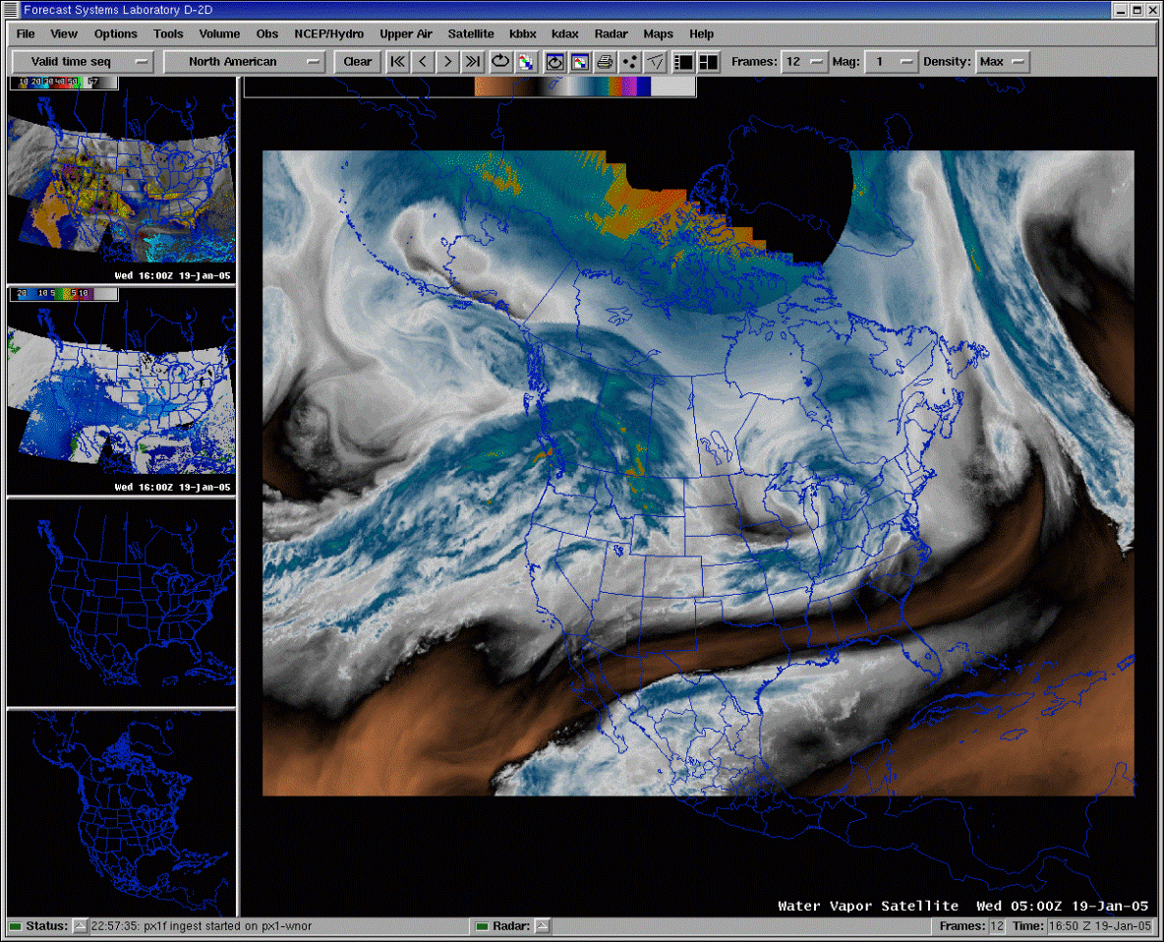
Satellite Imagery to
National Weather Service http://www.nws.noaa.gov/om/ord/iob/NOAAPORT/index.shtml
  AWIPS Display
  Used at:
    NWS Forecast Offices
    National Centers (N-AWIPS)
    River Forecast Centers
    NESDIS
    Others
See Talk at 9:45 on AWIPS-2

Slide 30
GOES-R

Slide 31
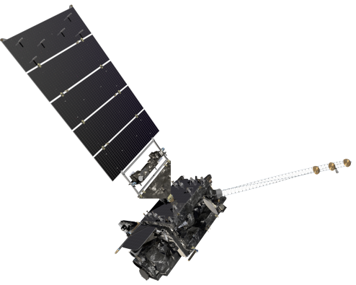
GOES–R Milestones and Future
 | 2010 | 2011 | 2012 | 2013 | 2014 | 2015
Mission PDR Part
Program/System
Flight Segment
Ground Segment
System Design Review complete
Launch Readiness Early 2016
Mission PDR Part II
Mission CDR
Spacecraft
S/C PDR complete
S/C SDR complete
S/C CDR
Instruments
ABI Delta CDR complete
ABI Delivery
SEISS Delivery
All instruments have passed CDR
EXIS Delivery
SUVI Delivery
GLM Delivery
Core GS PDR complete
RBU/NSOF/WCDAS installation
Antenna System PDR completed
Antenna System CDR
GS Project PDR complete
WCDAS complete
ESPDS CDR
RBU complete
100 % delivery of baseline product algorithms
CLASS CDR
NSOF complete
GS CDR
Development Integration and Testing
31
Notes:
31

Slide 32
GOES-R Products
Baseline Products
Future Capabilities
Advanced Baseline Imager (ABI)
Aerosol Detection (Including Smoke and Dust) Aerosol Optical Depth (AOD) Clear Sky Masks Cloud and Moisture Imagery Cloud Optical Depth Cloud Particle Size Distribution Cloud Top Height Cloud Top Phase Cloud Top Pressure Cloud Top Temperature Derived Motion Winds Derived Stability Indices Downward Shortwave Radiation: Surface Fire/Hot Spot Characterization Hurricane Intensity Estimation Land Surface Temperature (Skin) Legacy Vertical Moisture Profile Legacy Vertical Temperature Profile Radiances Rainfall Rate/QPE Reflected Shortwave Radiation: TOA Sea Surface Temperature (Skin) Snow Cover Total Precipitable Water Volcanic Ash: Detection and Height
Geostationary Lightning Mapper (GLM)
Lightning Detection: Events, Groups & Flashes
Space Environment In-Situ Suite (SEISS)
Energetic Heavy Ions Magnetospheric Electrons & Protons: Low Energy Magnetospheric Electrons: Med & High Energy Magnetospheric Protons: Med & High Energy Solar and Galactic Protons
Magnetometer (MAG)
Geomagnetic Field
Extreme Ultraviolet and X-ray Irradiance Suite (EXIS)
Solar Flux: EUV Solar Flux: X-ray Irradiance
Solar Ultraviolet Imager (SUVI)
Solar EUV Imagery
Advanced Baseline Imager (ABI)
Absorbed Shortwave Radiation: Surface Aerosol Particle Size Aircraft Icing Threat Cloud Ice Water Path Cloud Layers/Heights Cloud Liquid Water Cloud Type Convective Initiation Currents Currents: Offshore Downward Longwave Radiation: Surface Enhanced “V”/Overshooting Top Detection Flood/Standing Water Ice Cover Low Cloud and Fog Ozone Total Probability of Rainfall Rainfall Potential Sea and Lake Ice: Age Sea and Lake Ice: Concentration Sea and Lake Ice: Motion Snow Depth (Over Plains) SO₂ Detection Surface Albedo Surface Emissivity Tropopause Folding Turbulence Prediction Upward Longwave Radiation: Surface Upward Longwave Radiation: TOA Vegetation Fraction: Green Vegetation Index Visibility
32

Slide 33

GOES–R Spacecraft
Specifications
Size ~5.5 meters (from launch vehicle interface to top of ABI)
Mass Satellite (spacecraft and payloads) dry mass <2800kg
Power Capacity >4000W at end-of-life (includes accounting for limited array degradation)
Spacecraft on-orbit life of 15 years with orbit East-West and North-South position maintained to within +/-0.1 degree
3-axis stabilized
Extreme Ultraviolet and X-ray Irradiance Sensors (EXIS)
Space Environment
In-situ Suite (SEISS)
Solar Ultraviolet Imager (SUVI)
Magnetometer
Current Status
Design activities progressing well
Preliminary Design Review (PDR) held January 18-20, 2011
Proceeding toward Critical Design Review (CDR) in April 2012
Geostationary
Lightning Mapper (GLM)
Advanced Baseline Imager (ABI)
Lockheed Martin Space Systems Co (LMSSC) of Newtown, PA is primary contractor
33
Notes:
33

Slide 34
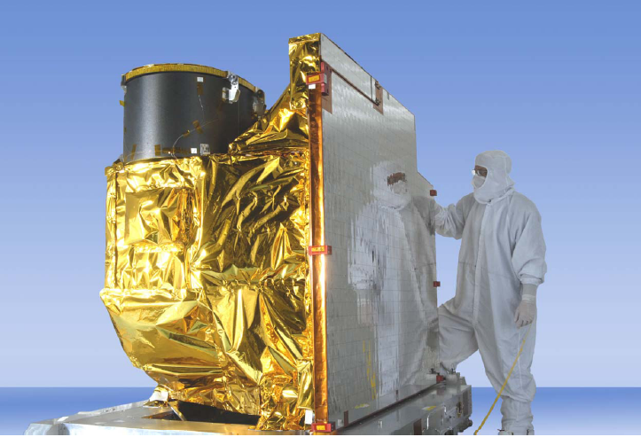
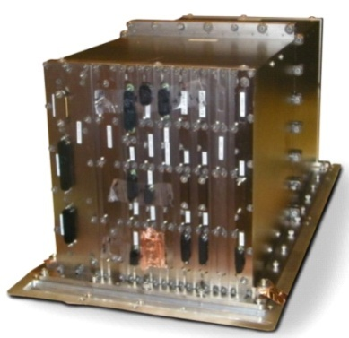
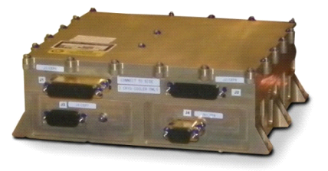
Advanced Baseline Imager (ABI)
ABI Proto-Type Model (PTM)
Specifications
16 channel imager
Measures radiances in the visible and near-infrared wavelengths
Improves upon current capabilities in spectral information (3X), spatial coverage (4X), and temporal resolution (5X)
Improves every product from current GOES Imager and will offer new products for severe weather forecasting, fire and smoke monitoring, and more
Cryocooler Control Electronics
Electronics Unit
34
Notes:
34

Slide 35
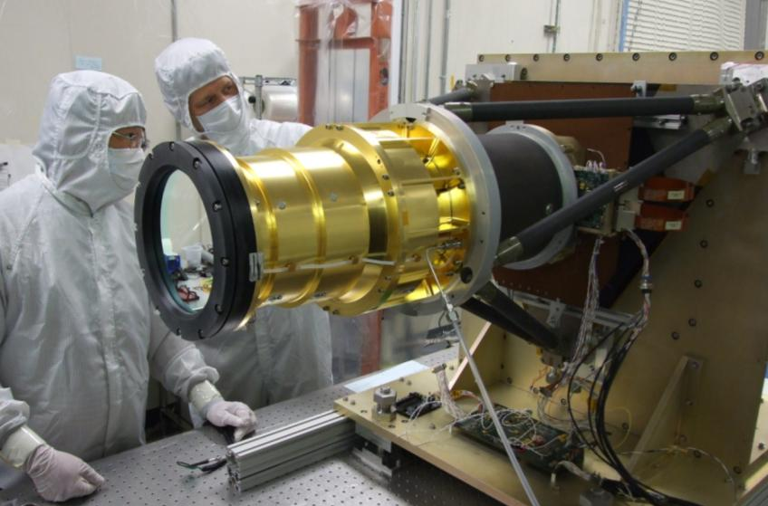
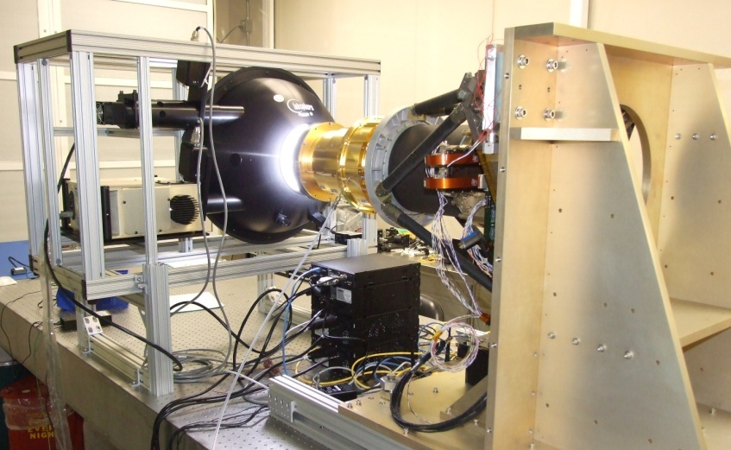
Geostationary Lightning Mapper (GLM)
Specifications
Continuously maps all (in-cloud and cloud-to-ground) lightning events
Provides early indication of storm intensification and severe weather events; tornado warning lead time of 20 minutes or more
CCD event detector
    777.4 nm wavelength
    2 ms frame rate
    7.7 Mbps downlink rate
Near uniform spatial resolution
    8 km (nadir) – 14 km (edge of FOV)
    70-90% flash detection (currently 10%)
  Product availability < 20 sec
Optical Assembly
Metering tube
Sensor Unit Mechanical Support Structure
GLM in the calibration fixture
35
Notes:
35

Slide 36
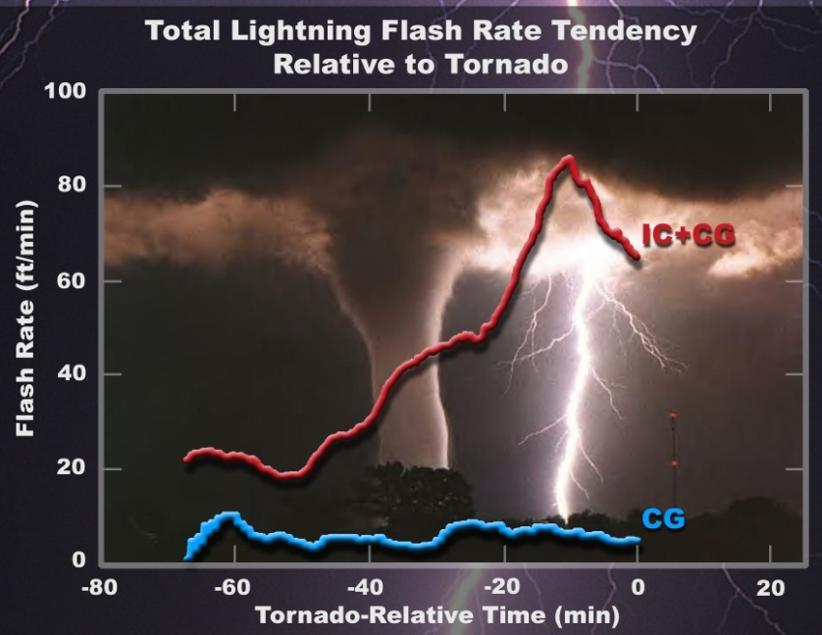
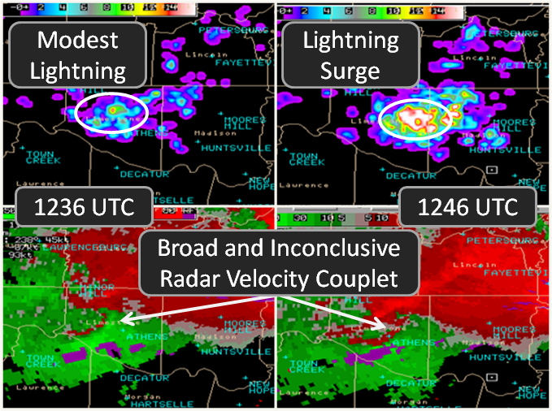
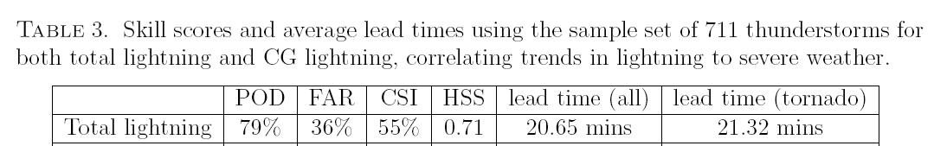
Geostationary Lightning Mapper (GLM)
National Average for Tornado warning lead-time is only 13 minutes
POD – Probability of Detection
FAR – False Alarm Rate
36
Notes:
GLM Characteristics
Staring CCD imager (1372x1300 pixels)
- Single band 777.4 nm
- 2 ms frame rate
- 7.7 Mbps downlink data rate
Near uniform spatial resolution to 52 deg N lat
- 8 km nadir to 14 km at edge
70-90% flash detection
Product Availability (event, group, flash)
- < 20 sec total latency
- satellite rebroadcast and internet
36

Slide 37
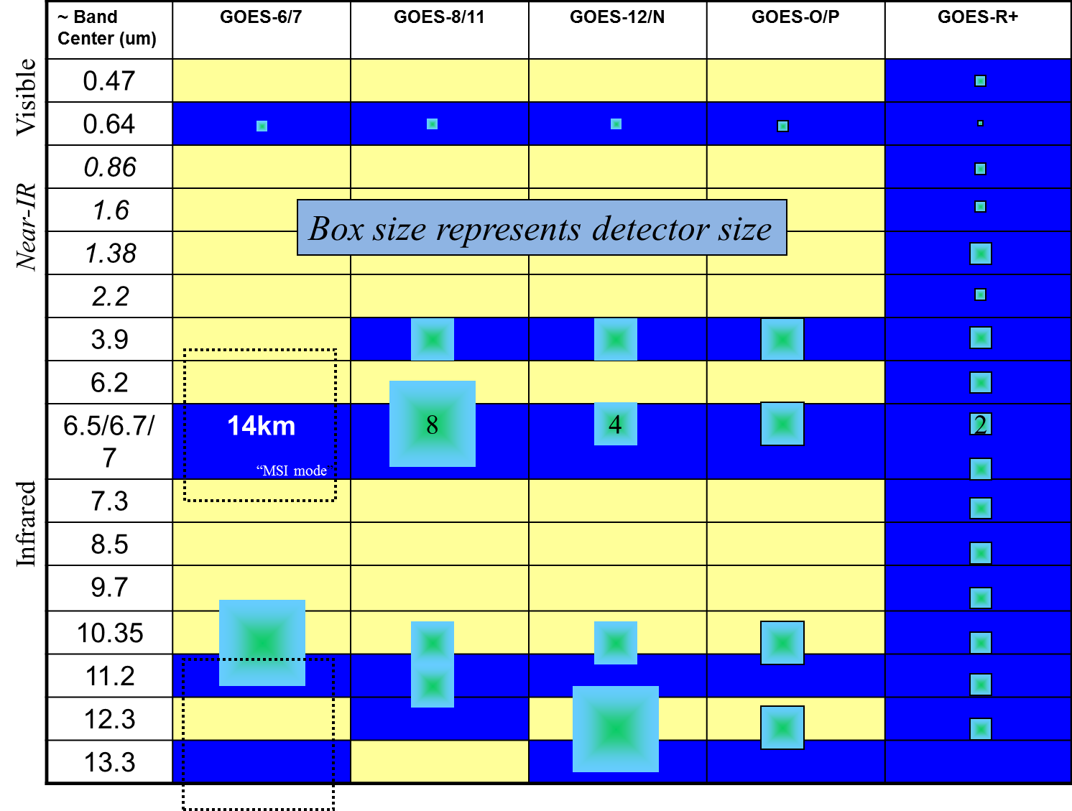
Approximate spectral and spatial resolutions of US GOES Imagers
37
The Advanced Baseline Imager on the GOES-R Series: Tim Schmit – Thu, Oct 20, 9:15 AM
Notes:
37

Slide 38
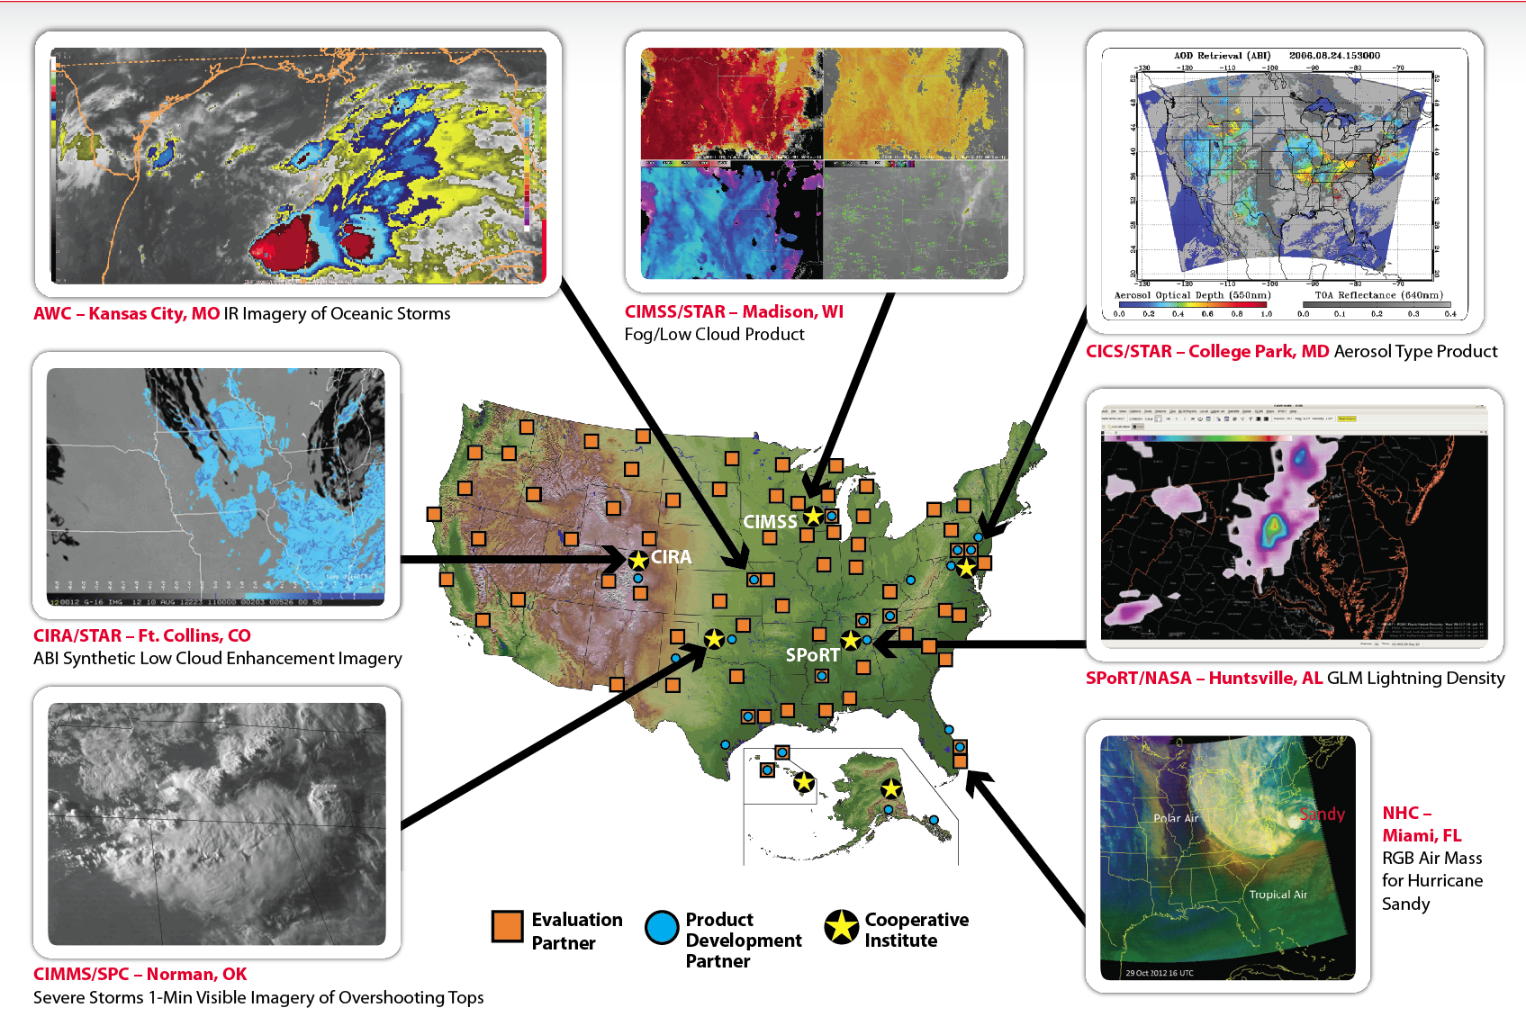
The GOES-R Proving Ground
38
Notes:
GOES-R Proving Ground bridges the gap between research and operations:
Utilizing current systems (satellite, terrestrial, or model/synthetic) to emulate future GOES-R capabilities
Infusing GOES-R products and techniques into NWS operations with emphasis on AWIPS and transitioning to AWIPS-II.
Putting prototype GOES-R products in hands of forecasters
Keeping lines of communication open between developers and forecasters
Allowing end user to have say in final product, how it is displayed and integrated into operations
TOP RIGHT: CIMSS - West Projection simulation of select ABI bands showing the Pacific Projection at 137° West.
BOTTOM RIGHT: National Hurricane Center - Image shows 6 hour period of lightning locations (gold points) from 16 Sep 2010 at 15:21 UTC superimposed on a color-enhanced infrared GOES image which depicts 3 hurricanes: Hurricane Igor (center), Julia (east of Igor), and Karl (in the southern Gulf of Mexico).
BOTTOM LEFT: Hazardous Weather Testbed (at the Storm Prediction Center) - Forecaster AWIPS display of PGLM flash extent density product and IR image over Central Tennessee and Northern Alabama at 2215 UTC on 9 June 2010. The overlay of PGLM on IR allowed the forecaster to focus on the most active convective cores.
TOP LEFT: CIRA - Example of the GeoColor imagery displayed in AWIPS for the continental United States domain. GeoColor depicts high clouds and daytime snow cover (when present) in white, low clouds/fog at night in red, nighttime terrain in purple, city lights from major metropolitan areas in yellow, and daytime land and shallow-water features in true color; illustrating the potential of synergy between the future GOES-R and JPSS observing systems which will both contribute to this blended product.
38

Slide 39


GOES-R User Readiness
Re-launched www.goes-r.gov in May 2011 with expanded User Community content
GOES-R Facebook page launched June 2011 (https://www.facebook.com/GOESRsatellite)
GOES-R Proving Ground
  Demonstrations
  CIMMS, CIRA, SPoRT, HWT blogs
Visiting Scientist Program
Forecaster Feedback
Training and Outreach
Fact sheets
Tri-fold brochure
User Readiness Plan under
development
39

Slide 40




Training and Education
Online Training Modules
GOES-R: Benefits of Next-Generation Environmental Monitoring (COMET)
GOES-R 101
Satellite Hydrology and Meteorology for Forecasters (SHyMet)
SPoRT product training modules
Commerce Learning Center
Printed Materials
GOES-R Fact Sheets (17)
GOES-R Tri-fold
Outreach Projects (with NWSFOs):
COMET will reach out to the GOES-R Proving Ground Partners and connect them with university faculty to use current and prototype data products for the purpose of building a bridge from products that are currently available to those that will become available when GOES-R is launched.
40
Training in the NOAA Satellite Proving Ground – Focus on User Readiness and Decision Support Services: Brian Motta
Notes:
40

Slide 41


For more information visit www.goes-r.gov
http://www.facebook.com/GOESRsatellite
41
Notes:
41

Slide 42
Dallas Fort Worth WFO and West Gulf River Forecast Center
January 10, 2013
Thank you!
For additional information please contact
Jamie.Kibler@noaa.gov
Josh.Jankot@noaa.gov

