Slide 1
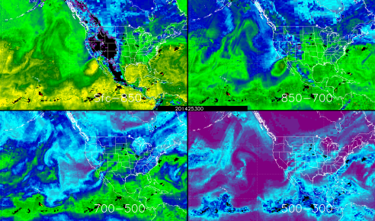
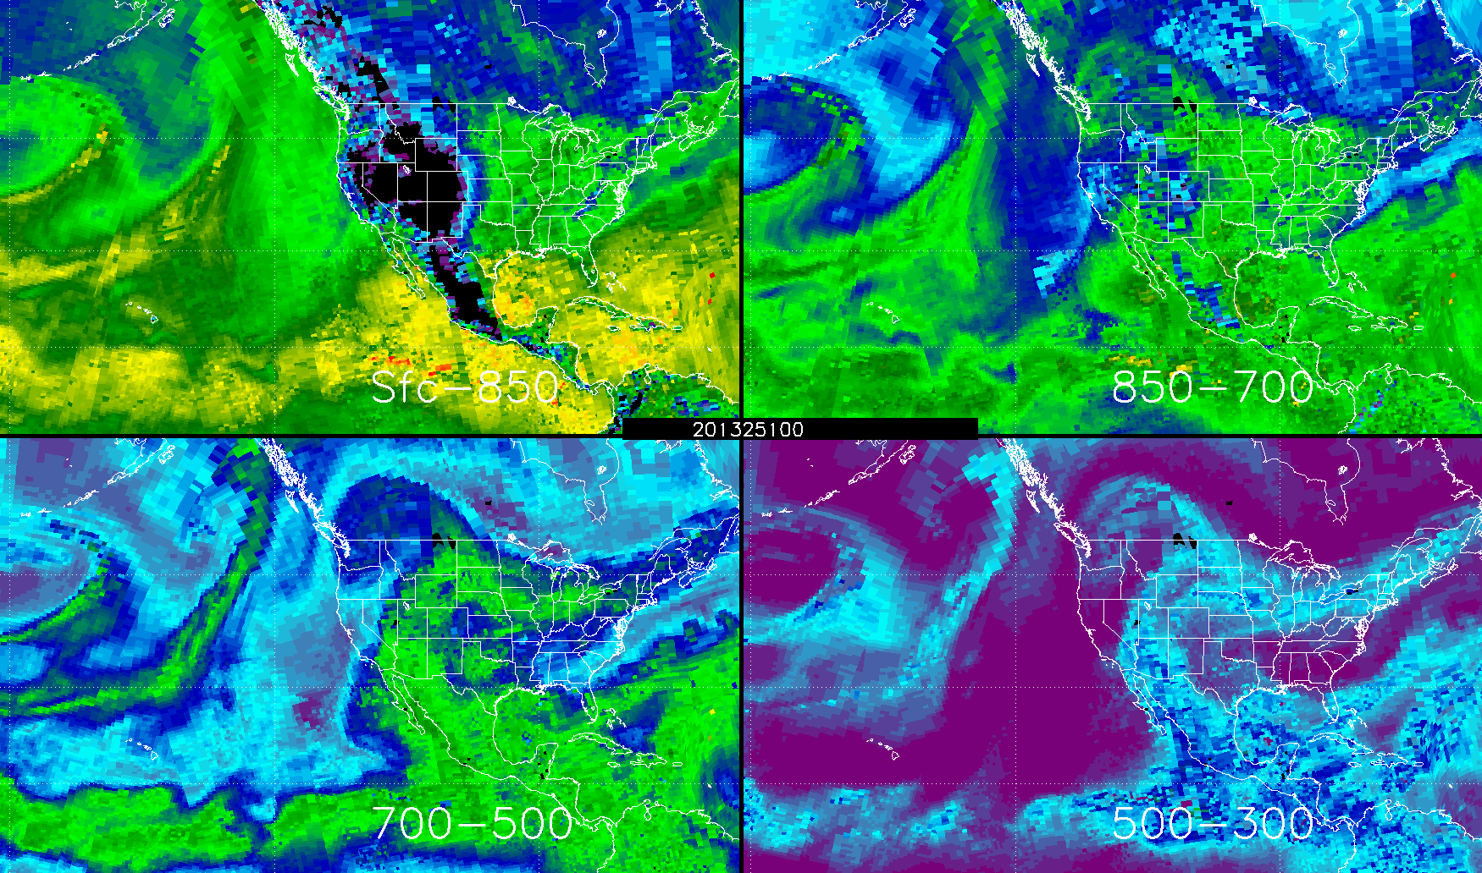
Layer Precipitable Water (LPW) Briefing
21 November 2014
Sheldon Kusselson
NOAA/NESDIS/OSPO/SPSD/Satellite Analysis Branch
Contributions by
John Forsythe, Stan Kidder (CIRA/Colorado State University)
Kevin Fuell, Anita LeRoy (NASA/SPoRT via UAH)
Luis Rosa (NWS San Juan, Puerto Rico) and Christopher Gitro (NWS Pleasant Hill, Missouri)
00 UTC 10 Sep 2014
00 UTC 8 Sep 2013
ftp://satepsanone.nesdis.noaa.gov/Presentations/Other/LPW_Briefing_for_NWS_November21,2014.pptx
1

Slide 2
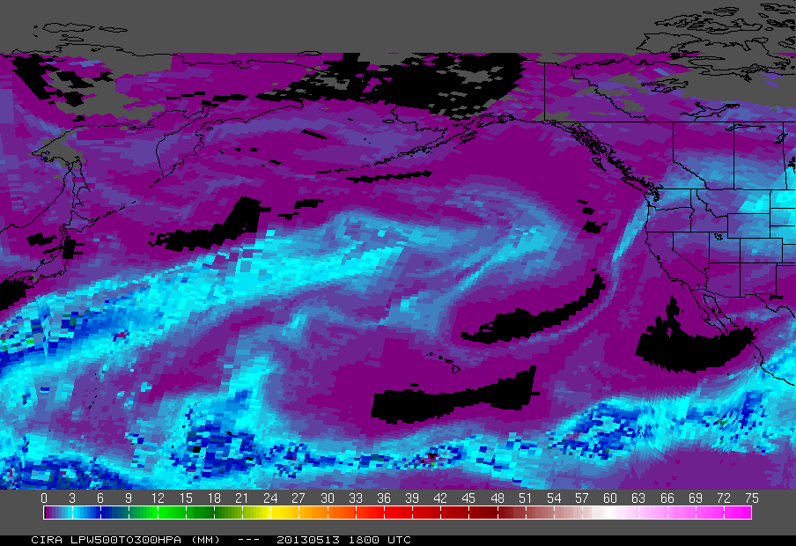
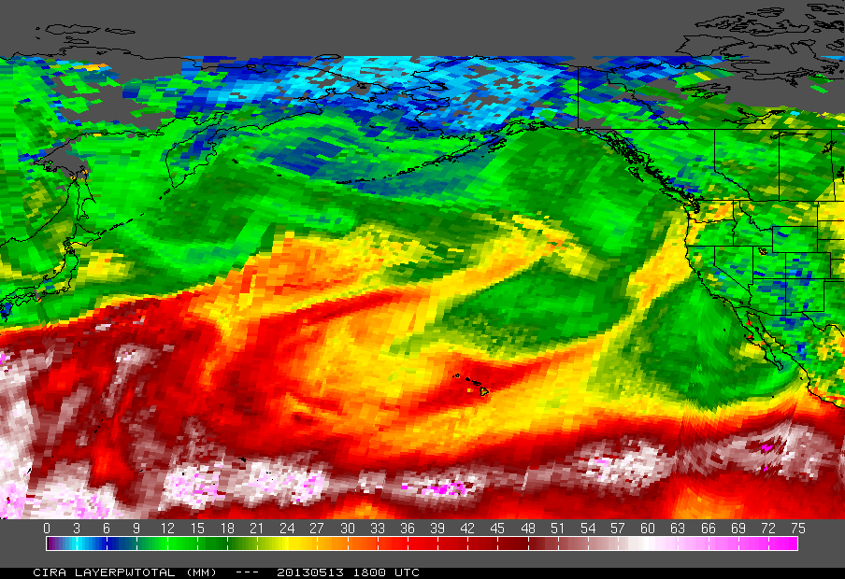
Why have Layer PW?
GOES Water Vapor
WV imagery only senses upper level moisture
TPW has no vertical moisture distribution information
Note how WV and 500-300 hPa layer PW match well
WV only a small portion of TPW as most moisture is near lower boundary layer
Dry
Dry
Moist
More Moist
TPW (of layers)
LPW 500-300mb
Many TPW values of 0.75” or more
Dry
Dry
Most PW values 0.2” or less
Moist
More Moist
2

Slide 3
Microwave Integrated Retrieval System - MIRS
Retrieves many variables from microwave sounding instruments (Boukabara et al. 2011)
AMSU-A, MHS, SSMI/S
Uses 1DVAR (e.g., Rodgers 2000) retrieval scheme to retrieve atmospheric profile + surface conditions.
Retrievals through clouds
Over water AND land!
Operationally produced by NOAA / NESDIS
37GHz (H) Brightness Temperatures from SSMI/S instrument on DMSP satellite. Just one example of the channels used by MIRS
3

Slide 4
Layer Precipitable Water (LPW)
MIRS mixing ratios (q) integrated to yield Layer Precipitable Water: $LPW≡\int_{p_{top}}^{p_{bottom}}{q\frac{dp}{g}}$
When p_{bottom} is at the surface (p_{sfc} )it is a function of surface elevation only; it does not change with changing weather conditions.
If p_{sfc} is less than 850 hPa but greater than 700 hPa, then the bottom layer is missing (black) and the 850 to 700 hPa layer is calculated from p_{sfc} to 700 hPa.
850mb-700mb LPW over Pacific and western North America regions derived from MIRS
4

Slide 5
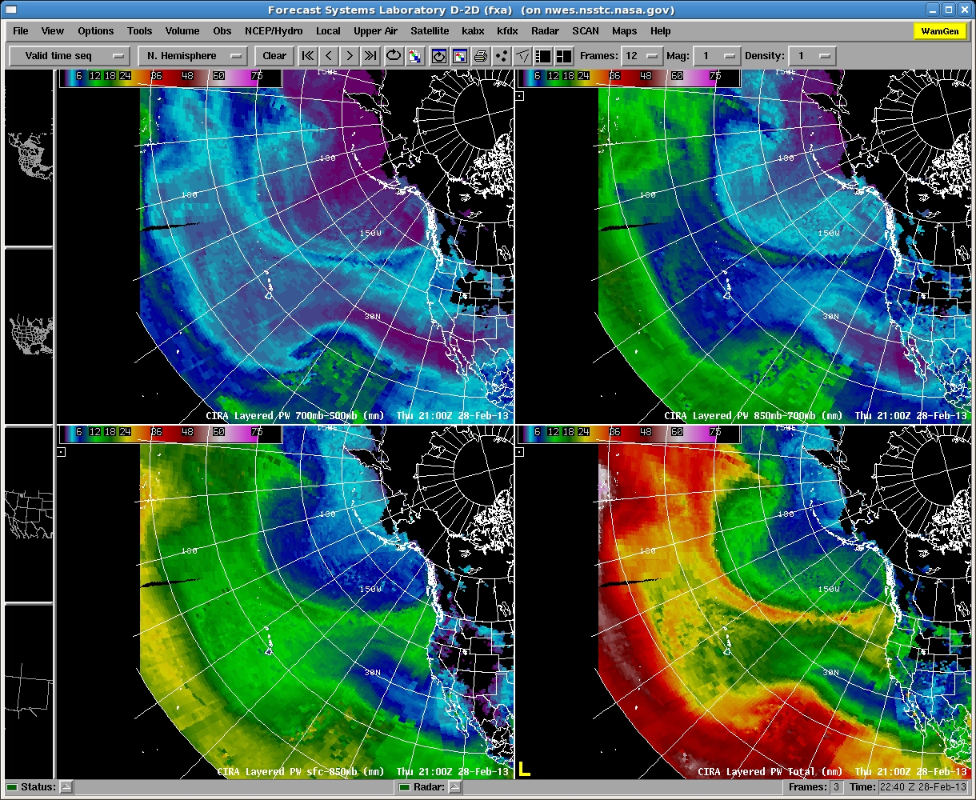
Chosen Layers of LPW – in D2d
21Z 28-Feb-2013
NOTE: 500-300 hPa layer not shown
Atmos. River evident even at upper layer
Tropical Moisture tongue creating sharp gradient
700-500
850-700
Wide moisture plume compared to upper layers
Atmospheric River
SFC - 850
TPW
5

Slide 6
Satellite Local Time Passes
Satellite (Instrument) | Approx. Local Time Ascending | Approx. Local Time Descending
NOAA 18 (AMSU-A, MHS) | 1500 | 0300
NOAA 19 (AMSU-A, MHS) | 1330 | 0130
Metop-A/B (AMSU-A, MHS) | 2130 | 0930
DMSP F18 (SSMI/S) | 2000 | 0800
NASA Aqua (AIRS, infrared) | 1330 | 0130
Notes
The actual observation time is within about ½ orbit (50 min) of the above times.
2. AIRS retrievals only in clear or thin cloud areas
6

Slide 7
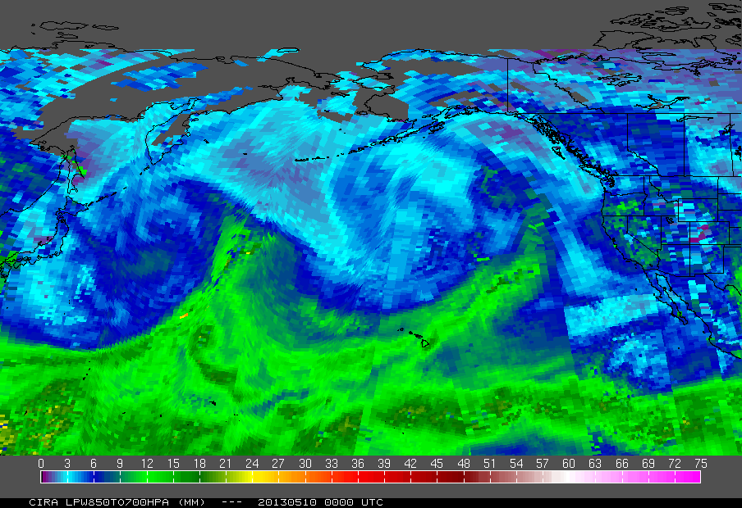
850-700 hPa LPW Loop – May 10, 2013
7

Slide 8
When LPW available; How LPW Composited; Where on the web?
Program runs every 3 hours at 00Z, 03Z, ….
Data latency to user is ~40 minutes (i.e. 1800Z arrives at 1840Z)
Data for the last 12 hours are plotted with the newest observation on top (covering up older observations)
No averaging or smoothing of data
1-2 hour gap between time on image and latest satellite data due to time it takes to transmit data to ground, do retrievals, and make composites
Available on web at: http://cat.cira.colostate.edu/LPW_Animations/
http://cat.cira.colostate.edu/sport/layered/blended/lpw.htm (CIRA)
http://weather.msfc.nasa.gov/cgi-bin/sportPublishData.pl?dataset=cirapw (SPoRT)
8

Slide 9
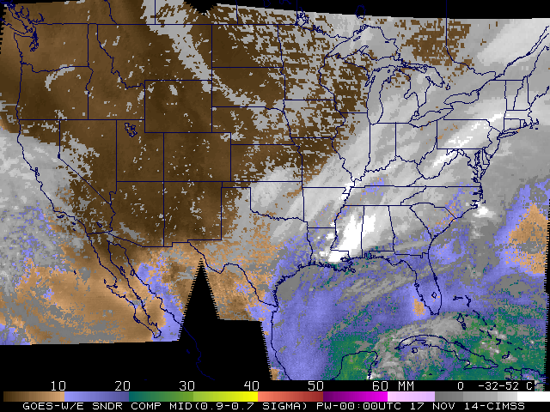
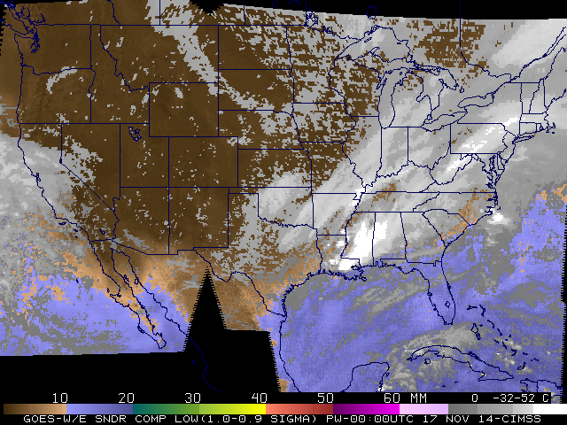
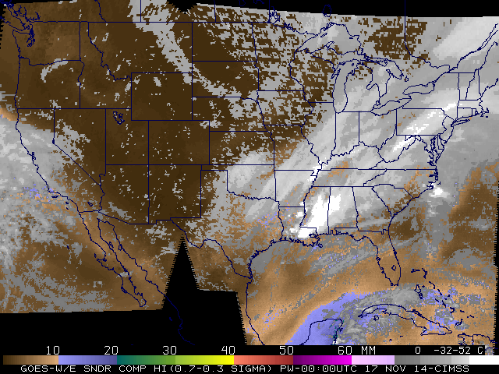
Comparison of CIMSS GOES Layer Precipitable Water (LPW) with CIRA Product
CIMSS LPW
CIRA LPW
Mostly CONUS &
offshore waters
GOES Sounder
data
Higher resolution, but trade-offs
Computer model dependent
Globe
Polar Microwave/ Near IR
Lower resolution,
but trade-offs
No computer model input
CIMSS
CIRA
00 UTC Nov 17, 2014 SFC-850 hPa
00 UTC Nov 17, 2014 1000-900 hPa
00 UTC Nov 17, 2014 850-700 hPa
00 UTC Nov 17, 2014 900-700 hPa
00 UTC Nov 17, 2014 700-500 hPa
00 UTC Nov 17, 2014 700-300 hPa
00 UTC Nov 17, 2014 500-300 hPa
9

Slide 10
LPW Strengths
Strengths
Vertical resolution to diagnose moisture distribution vs TPW whole column approach
Sounding coverage over data-sparse oceans several times per day
Spatial detail well beyond radiosonde network
Composite of many similar instruments
Use of microwave data over land
Microwave retrievals probe through clouds
Global areal coverage (beyond GOES sounder range)
10

Slide 11
LPW Weaknesses
Weaknesses
Discontinuities can occur due to time or instrument differences
Change in magnitude near land/ocean boundary possible
Less vertical detail than RAOBs or profilers
Satellite retrieval latency of 2-4 hours
AIRS retrievals (infrared) are somewhat different than microwave retrievals
Higher resolution has more detail (“noisy” variation)
Dry bias compared to other microwave instruments
Can retrieve over snow (Strength)
850–700 hPa Layer Precipitable Water
AIRS has more coverage over AK snow covered ground vs microwave over Canada
AIRS swath stands out as dry and has more variations
11

Slide 12
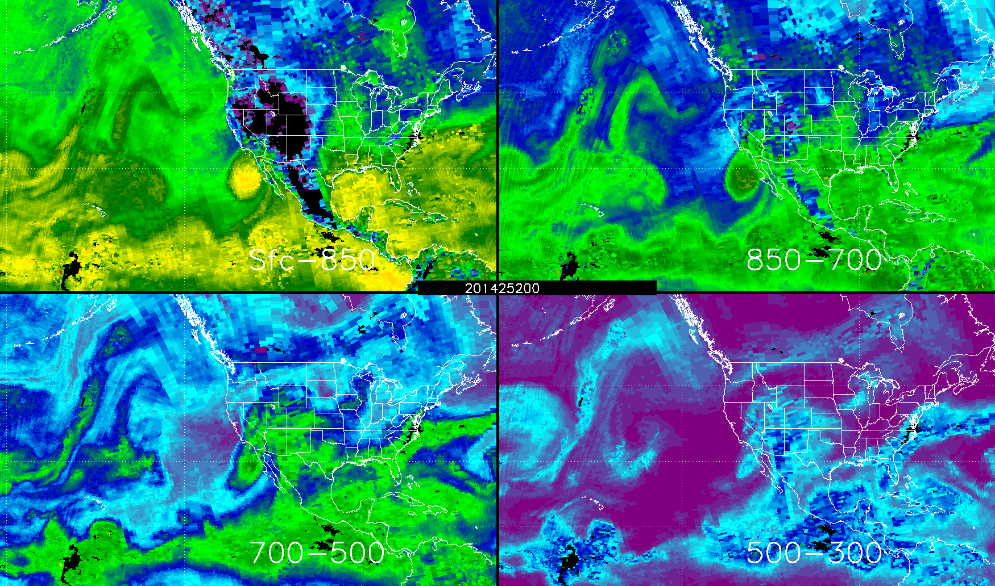
Case Study…Northern Missouri Heavy Rain/flooding Layer PW Loop 00 UTC Sep 9 to 21 UTC Sep 10, 2014
24hr rainfall ending 12 UTC Sep 10
12
Notes:
Dolly and Norbert’s moisture remnants combined and focused along a moist boundary over the middle of the country on Sep 9 into the morning of Sep 10 over northern Missouri.

Slide 13
LPW Applications
From WFO AFDs, these issues would benefit from LPW:
Verification of model short-term, vertical moisture distribution
Portland, OR ...MODELS CONTINUE TO INDICATE MOST OF THE LOW LEVEL MOISTURE GETTING WRUNG OUT BY ….
Monitoring of upper level moisture advection for clouds and atmospheric rivers
Phoenix, AZ ...GIVEN THE BROAD SWLY FLOW AND LIKELIHOOD OF TAPPING EXTENSIVE UPPER LEVEL SUBTROPICAL MOISTURE ONCE AGAIN...HAVE GENERALLY NARROWED THE FORECAST DIURNAL RANGE...ESPECIALLY WITH RESPECT TO HIGHS
Albuquerque, NM ...THE UPPER RIDGE FLATTENED-OUT OVERNIGHT AND WESTERLIES HAVE OVERTAKEN OUR AREA WITH PACIFIC MOISTURE ADVECTION IN THE MID AND UPPER LEVELS OF THE ATMOSPHERE RESULTING IN CLOUDS.
Analysis of 2-d moisture gradients aloft verses relying on point source data
San Diego, CA … THE 00Z MIRAMAR SOUNDING SHOWED A PW JUMP TO JUST OVER ONE-HALF INCH. THE MOIST LAYER WAS BETWEEN 8K AND 13K FT.
13

Slide 14
What Continues to be Evaluated in Operations
Which forecasting problems benefit most from having LPW information and how
How much the LPW information helps the forecast over having only TPW and GOES 6.7 μm data in operations
Ways to make the products more operationally useful, for example by selecting different layers, calculating different variables (e.g., RH), or comparing with climatology (e.g., percent of normal)
14

Slide 15
LPW Summary
Microwave Integrated Retrieval System (MIRS) provides soundings of specific humidity from a variety of instruments and is combined with AIRS infrared soundings to create a Layered Precipitable Water (LPW) composite product
The LPW provides vertical moisture information in the column instead of just upper levels via WV imagery, or a single column value via TPW products
LPW is created every 3 hours using the last 12 hours worth of data and has a delivery latency of 40 minutes.
Weaknesses include discontinuities in the composite
Strengths include seeing through clouds, over land usage, and greater spatial coverage of vertical moisture profiles
Applications of LPW include analysis of horizontal and vertical moisture gradients, verification of NWP moisture, and analysis of atmospheric rivers and other moisture advection.
Operational testbed is ongoing to determine viability of wider distribution
15

Slide 16
References
Forsythe, et al., 2014: Future Journal of Operational Meteorology paper now in review
Boukabara, S.-A., et al., 2011: MiRS: An All-Weather 1DVAR Satellite Data Assimilation and Retrieval System. IEEE Trans. Geosci. Remote Sens., 49, 3249-3272.
Rogers, C. D., 2000: Inverse Methods for Atmospheric Sounding: Theory and Practice. World Scientific, Singapore, 238 pp.
Jedlovec, G. J., 2000: A satelliite-derived Upper-Tropospheric Water Vapor Transport Index for Climate Studies. J. Appl. Meteor., 39, 15-41
16

Slide 17
Extra Slides

Slide 18
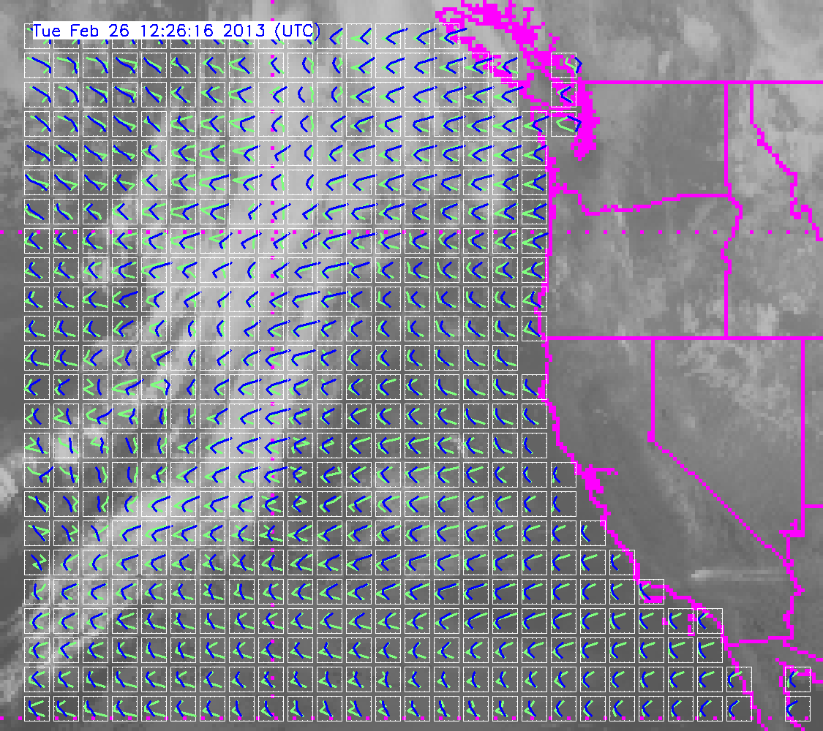
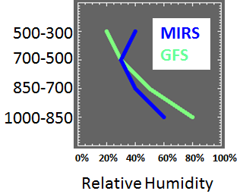
Example of potential product: Tropospheric relative humidity profiles from satellite and model forecasts.
Compare to what is available from radiosondes.
Model has higher humidity at lower levels compared to MIRS derived sounding
Near-realtime display at:
http://cat.cira.colostate.edu/sport/layered/blended/profile_zoom1.htm

