Slide 1
Stephen Ambrose
GOES-R Data Operations Manager (DOM)
OSPO/SPSD
GOES-R Ground Segment Project
Data Operations Support Team
System Validation Activities
Brief to NWS-NESDIS/SPSD Quarterly Meeting
March 12, 2013

Slide 2
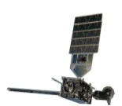
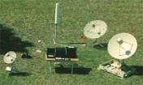
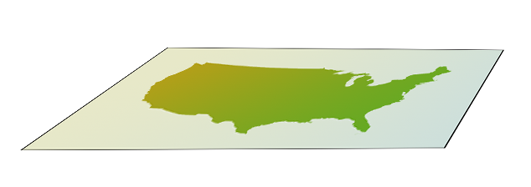






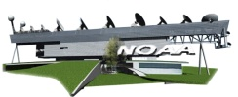






The GOES-R System-Operational View
137º
75º
HRIT/EMWIN, GRB
BEACONS
MM
EM
PG (L0, L1b, L2+ GLM,
GRB, KPP)
PD
GEOLUT
Fairmont, WV
Suitland, MD
MM
EM
PG
PD
Wallops, VA
SARSAT
WAN
WCDAS
LAN
DCPC
Data Collection Platforms (DCP)
RBU
NSOF
DCPR
DCS
L1b,
L0,
L2+ GLM,
GRB, KPP
LAN
Data and Products
LAN
DRGS
Produce
Products
DCS
L2+
Data and Products
Operate Satellites
Mission
Management
Product
Generation
Product Dist. & Access (PDA) (GOES-R Access Subsystem- GAS)
Data and Products
Operate Ground Seg
Enterprise Management
User Community
Product Distribution
MM: Mission Management
EM: Enterprise Management
PG: Product Generation
PD: Product Distribution
Maintain
Ground Seg

Slide 3
DOM/DOST “Mission”
DOM = Data Operations Manager
DOST = Data Operations Support Team
Prepare OSPO to operate the Core GS Data Processing and Distribution System (DPDS)
Validate that the Core GS “DPDS” is Mission Capable and Mission Ready
Facilitate Consumer System Readiness for GOES-R Data Operations
Accomplished by
  Procedure and CONOP Development
  Prototypes and Exercises
  Facilitation of Test Data
  Planning and Execution of two Pre-Launch “Data Operations Tests” (DOT)
  Support for Post-Launch Tests

Slide 4
Data Operations Tests
Two Pre-Launch Validation Opportunities
  DOT-1: Directly following GS Release One
  DOT-2: Directly after GS is complete (Release 1a and Release 2)
One month sustained data operations
  Continuous “Forecast Based” Level 1B
  Interrupts for special test cases
Facilitate readiness testing of downstream users

Slide 5
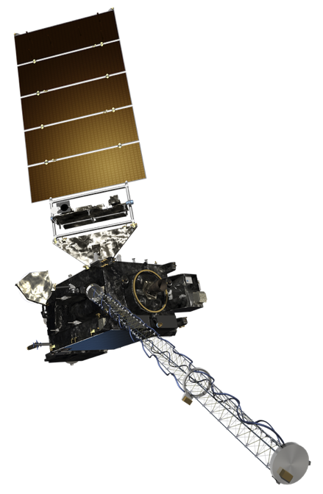
Data Flow through the GOES-R System
TNCF
WCDAS
BNCF
M
M
P
G
P
D
C
NOAAPort
Community
ANCF
Ancillary
Sources
Direct Broadcast
Community
NWS
Forecast Offices
NSOF
P
D
A
Operational
User Community
NOAA Centers, DOD, NCEP, International Partners
M
M
P
G
P
D
C
NCDC
RBU
M
M
P
G
P
D
Climate, Research, and Academia
C
NGDC
Validation Responsibility
Consumer System Readiness Support

Slide 6
Normal DOT Data Flow
Forecast
Based
Fixed Grid
L1b
TNCF
WCDAS
*
BNCF
M
M
P
G
P
D
C
NOAAPort
Community
ANCF
Direct Broadcast
Community
Ancillary
Sources
Pretend
Sat
NWS
Forecast Offices
NSOF
P
D
A
Operational
User Community
NOAA Centers, DOD, NCEP, International Partners
M
M
P
G
P
D
C
NCDC
RBU
M
M
P
G
P
D
Climate, Research, and Academia
C
NGDC
Forecast
Based
Fixed Grid
L1b
Validation Responsibility
Consumer System Readiness Support

Slide 7
Canned “End-to-End” Test during DOT-1
TNCF
WCDAS
Simulated
CCSDS
Packet Stream
BNCF
M
M
P
G
P
D
C
NOAAPort
Community
ANCF
Ancillary
Sources
Pretend
Sat
NWS
Forecast Offices
NSOF
P
D
A
Operational
User Community
NOAA Centers, DOD, NCEP, International Partners
M
M
P
G
P
D
C
NCDC
RBU
Climate, Research, and Academia
Simulated
CCSDS
Packet Stream
M
M
P
G
P
D
C
NGDC
Validation Responsibility
Consumer System Readiness Support

Slide 8
DOT Planning
V
Approaching with Systems Engineering Discipline
MRD
GRD
Validation
Objectives
Validation Assessment
Test
Objectives
Test Execution and Analysis
DOT-1
DOT-2
Test
Design
Development:
Test Procedures
Data and Component Simulators
Analysis Tools

Slide 9
Left Side of the V – Validation Objectives
Validation Objectives
  Validation is not a repeat of Verification
    Incorporate the People and Mission aspect
    Run in a “dirty” environment
    Interact with the real world
  Validation Objectives are to Validation
    …as Requirements are to Verification
    Decompose them like requirements
    Account for them like requirements
    But…
    V.O.s can be subjective, not necessarily pass/fail
    Use V.O.s to establish shared expectations with Stakeholders

Slide 10
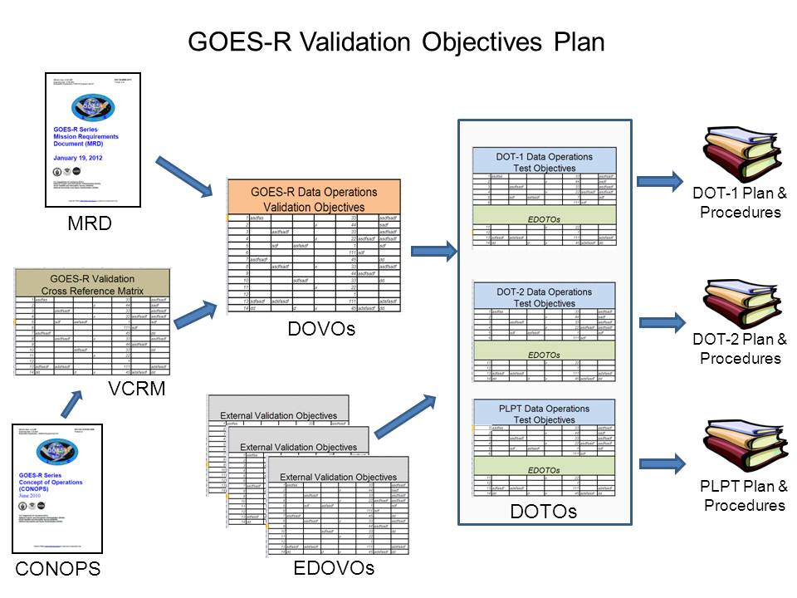
Artwork by NWS/AWIPS, courtesy Brian Gockel

Slide 11
DOST Project Overview
Phase One – Project Definition
  Completed
Phase Two – Preliminary Design
  Dec 2012 – Apr 2013
Phase Three – Detail Design
  Apr 2013 – Oct 2013
Phase Four – Implementation
  Nov 2013 – Apr 2014
Phase Five – Execution of Pre-Launch Testing
  May 2014- Apr 2015
Phase Six – Execution of Post-Launch Testing

Slide 12
Phase Two Overview
Validation Objectives Review
Validation Objective Decomposition
Development of Ops Procedure List
Preparation of Validation Plan version 1
Coordination of External Validation Objectives Development

Slide 13
Phase Three Overview
Validation Preliminary Design Review
Test Designs
Data Set and Simulator Specifications
Analysis Tool Specifications
Oversight of Ops Procedure Development
Preparation of Validation Plan rev 2
Coordination with External Validation Test Developments

Slide 14
Phase Four Overview
Validation Critical Design Review
Data Set and Generator Implementation
Tools Implementation
Test Procedure Development
Ops Procedure Evaluation and Development
Early Opportunity Testing

Slide 15
Phase Five Overview
DOT-1 Test Readiness Review
Execution of DOT-1
DOT-1 Analysis and Reporting
DOT-2 Test Readiness Review
Execution of DOT-2
DOT-2 Analysis and Reporting

Slide 16
DOST Top Level Schedule
December 31, 2012

Slide 17
Validation Testing Dependencies
January 31, 2013

Slide 18
Summary
DOM – Data Operations Manager
DOST – Data Operations Support Team
DOTS – Two One-Month Pre-Launch Shakedown Cruises
Focus: System Validation/Readiness of Data Processing & Distribution
DOVOs – Data Ops Validation Objectives
EDOVOs – External Stakeholder Data Ops Validation Objectives
Not “Re-Verification”
Not “Product Science Validation”

