Slide 1
NOAA NESDIS Satellite Operations Disaster Mitigation Presentation for NOAA Student Orientation May 30, 2013
www.facebook.com/NOAANESDIS
@NOAASatellites
Natalia Donoho
NESDIS/OSPO/Satellite Products and Services Division
Notes:
Satellite Products and Services Division
NOAA / NESDIS / OSPO

Slide 3
Outline
Product Example Overview
Hurricanes
Severe Weather
Significant Precipitation
Fires and Smoke
Volcanoes
Oil Spills
Direct Broadcast Services

Slide 4
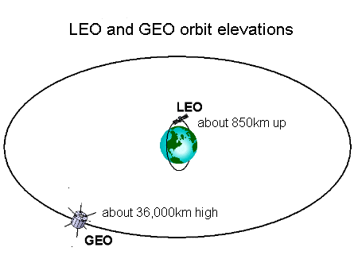
NOAA Satellites
Notes:
35,800 km high (approximately 1/10th the distance to the moon)
Two Satellite System continuously monitors the Western Hemisphere
Same geographic image over time
Northern Hemisphere Imaged every 15 minutes
Data obtained and shared with foreign partners
Primary use for constant weather monitoring, life and property forecasting, weather forecast model inputs
Global data necessary for medium and long-range weather prediction
Detection of significant environmental events (e.g., fires, oil spills, volcanic eruptions)
Measurement of climate variables
Ocean observations
Collection of data from surface platforms
Satellite-aided search and rescue
Two Satellite System: Each satellite covers the entire Earth twice per day
850 km high
Each orbit is 102 minutes
Images are global and include the poles
Polar data obtained and shared with partners
Department of Defense
NASA
International Community
Primary use for weather forecast model inputs, climate observations, ocean and land observations
Weather sentinel – constant monitoring of:
Hurricanes
Severe storms
Input to weather models, forecasts, and warnings
Sea surface temperature monitoring for fisheries and climate
Winds for aviation
Solar imagery for communication satellites, utility companies, and astronaut safety
Environmental data collection from buoys, stream gauges, etc.
Satellite-aided Search and Rescue
Future – GOES-R

Slide 5
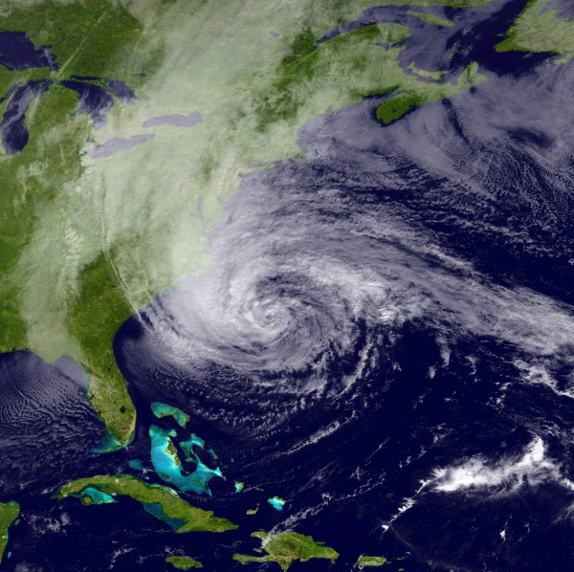
Tropical Storm Monitoring
Tracking of Tropical Cyclones Worldwide for Position and Intensity Estimates
Satellite Techniques Provide Rainfall Estimates for Landfalling Tropical Cyclones
Use of multiple worldwide satellites in various orbits
Supports NOAA’s Hurricane Center, Central Pacific Hurricane Center, DOD’s Joint Typhoon Warning Center and international partners
Information shared with FEMA and other local emergency managers for planning purposes
High resolution Satellite imagery and products displayed on NOAA web sites
http://www.ssd.noaa.gov/PS/TROP/
Hurricane Sandy on October 28 , 2012
Notes:
5

Slide 6
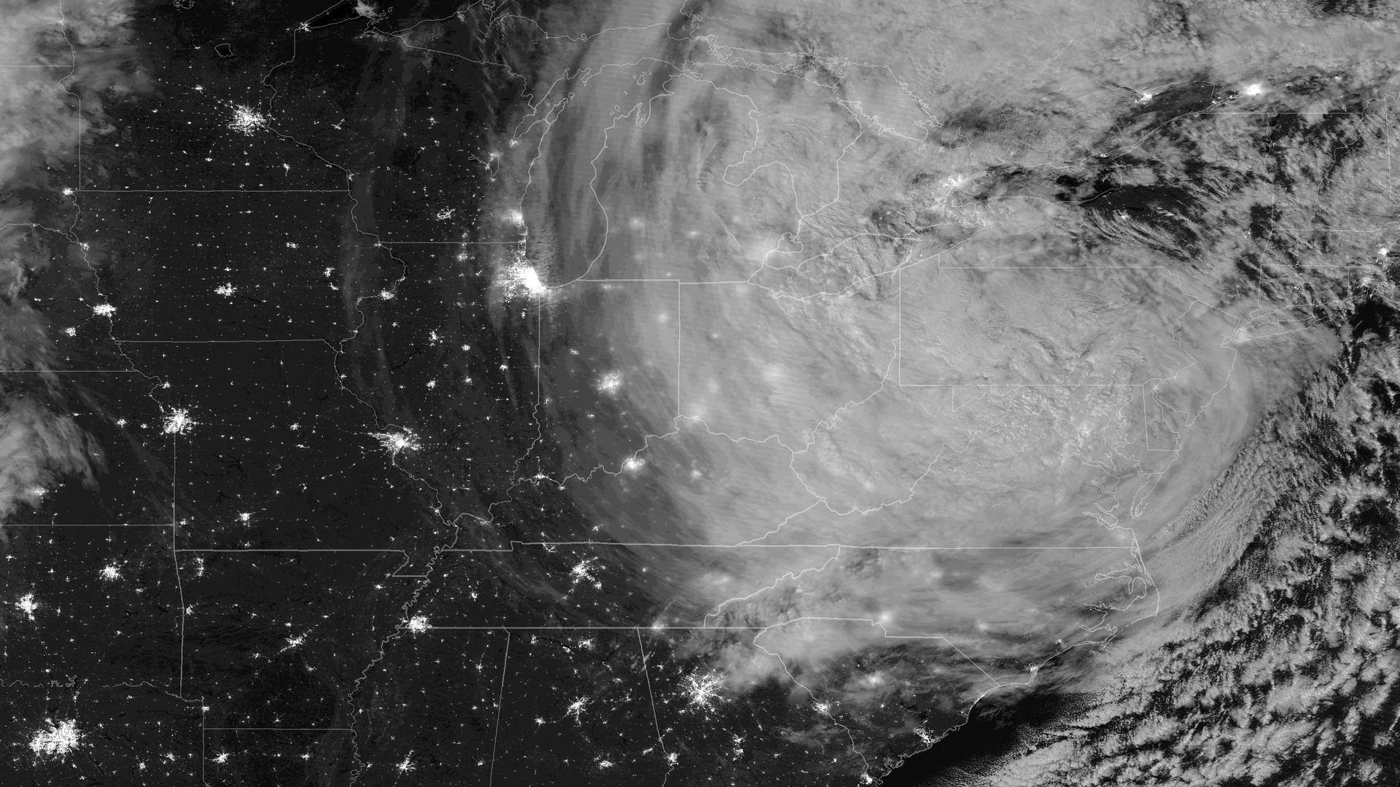
Tropical Storm Monitoring
Sandy, early morning, October 30, 2012
Notes:
6
This image shows Sandy as imaged by the NASA/NOAA Suomi NPP VIIRS instrument's day/night band. This band collects information from the ambient light radiated into space from human settlement and activities and also captures reflected moonlight from cloud structures. The full moon, which enhanced the storm surge that has inundated New York City and Atlantic City because of tidal forces, lit up the cloud tops of the storm in great detail. This image was taken around 0735Z on October 30, 2012.

Slide 7
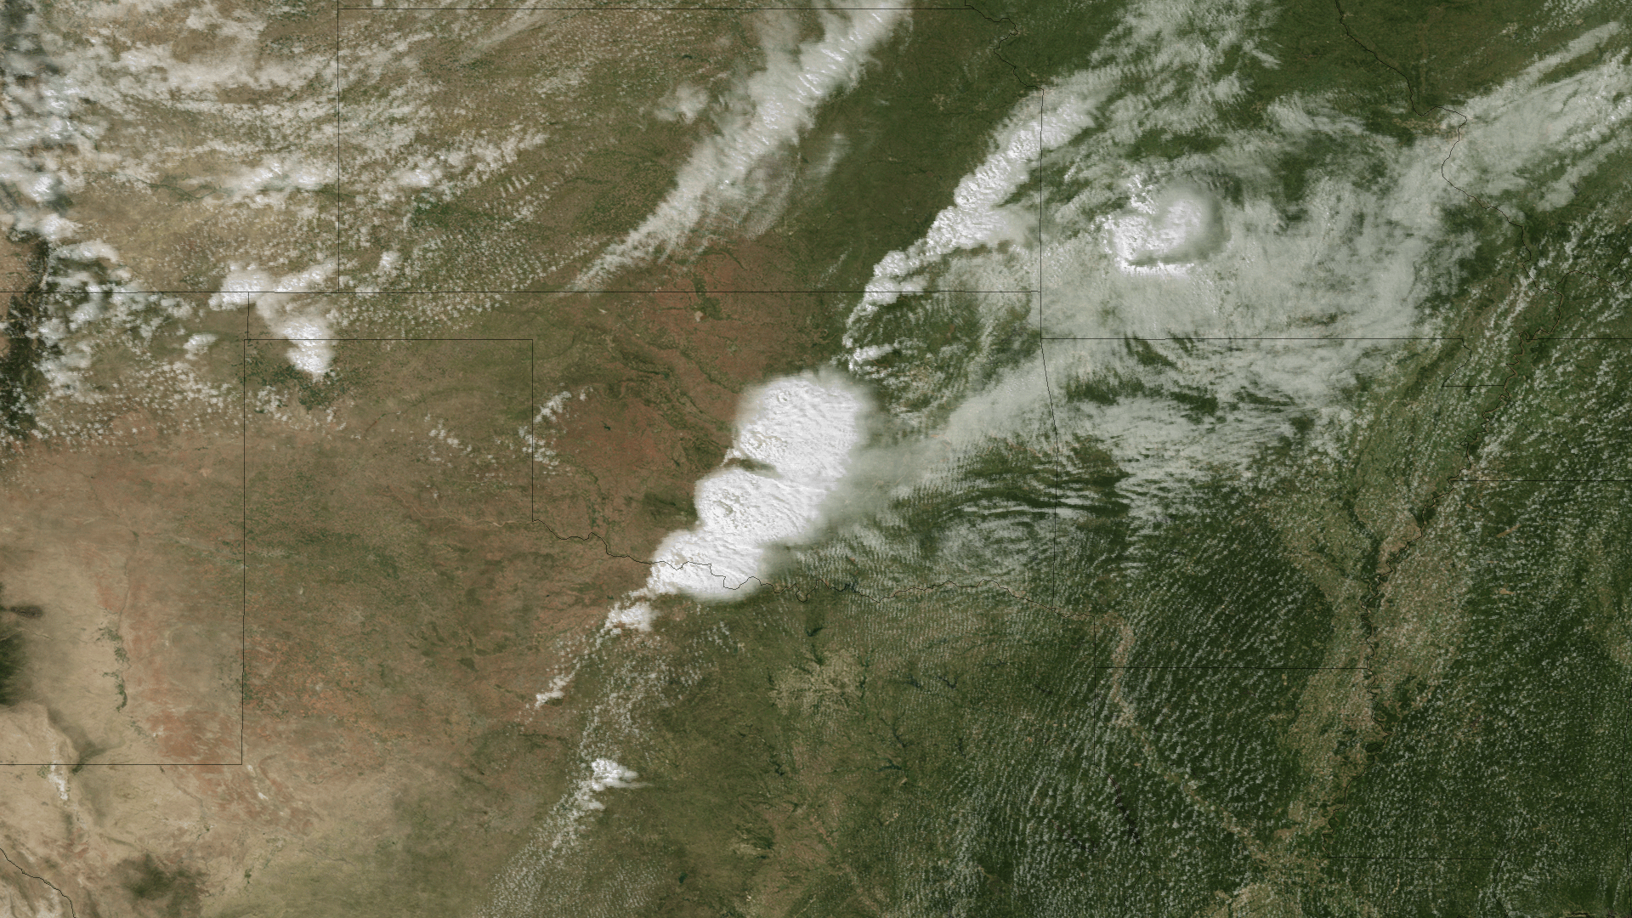
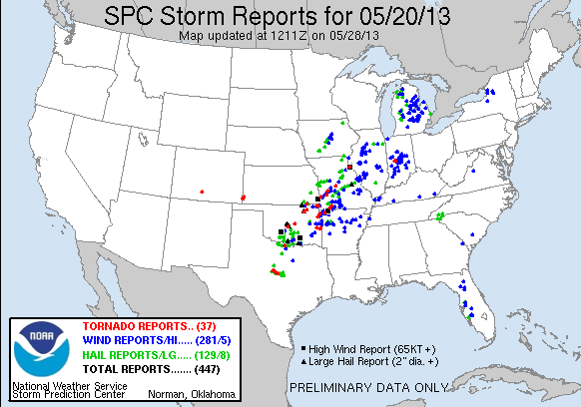
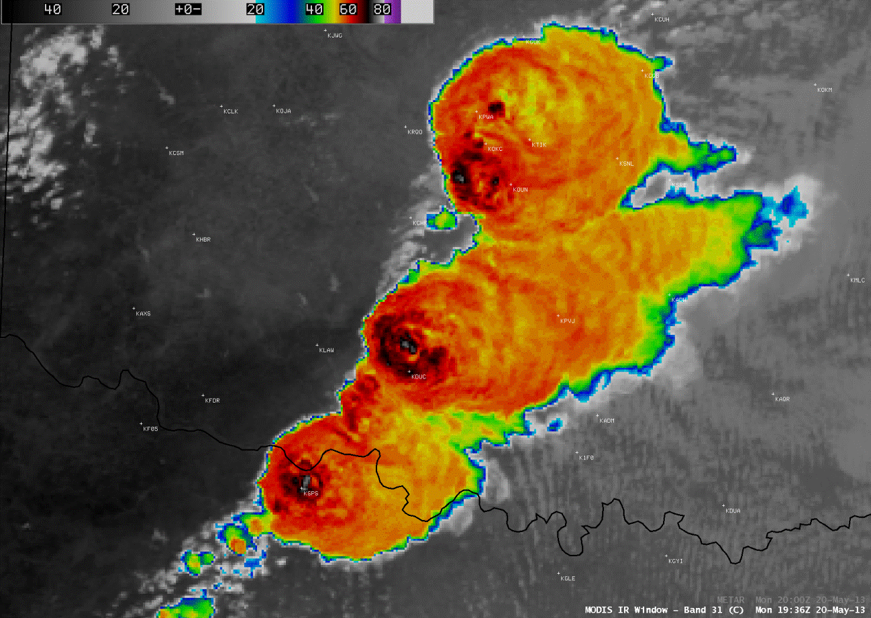
Moore, OK, Tornado May 20, 2013
Visible Imagery
Infrared Imagery
Notes:
NOAA satellites and products aid in the watch of storms and assist NOAA's National Weather Service Storm Prediction Center's (SPC) work. Not only do satellites provide the data that drive weather models, but they also provide rapidly updated information to SPC and other forecasters that update much faster than most weather models.

Slide 8
Observed Damage Paths from Satellite Imagery (April 2011)
Visible Imagery
NOAA Satellites are used to track and observe severe weather before, during, and after the event.
Vegetation Product
Notes:
One of the larger tornado damage tracks across northwestern Alabama was also apparent on GOES-13 0.63 µm visible channel imagery The animation helps to confirm that the feature is not a contrail or some other type of linear cloud feature (which would be moving in an animation, rather than stationary). While the north-south spatial resolution of the GOES imager visible detectors is 1.0 km at the satellite sub-point (over the Equator), with the larger geostationary satellite viewing angle the north-south spatial resolution over northern Alabama is about 1.38 km.
A Terra MODIS pass from late morning on April 29th shows the damage paths more clearly through central Alabama. As the churned-up vegetation within the damage path slowly browns, the contrast to undamaged vegetation outside the damage path should increase, allowing for a clearer picture of the damage path.
A few of the tornado damage paths across northern Alabama were also evident on the 1-km resolution MODIS Land Surface Temperature (LST) product. The LST values within the damage paths were in the low to middle 80s F (darker red color enhancement), compared to surrounding LST values in the upper 70s F (orange color enhancement), indicating that the damage paths with destroyed vegetation and tornado debris were able to heat up a few degrees more than the adjacent undisturbed vegetation. The urban areas of the cities of Tuscaloosa (KTCL) and Birmingham (KBHM) also exhibited warmer LST values (darker red) than the surrounding less urbanized, more densely forested areas.
Note – NPP, JPSS and GOES-R will have improved resolution in the future to more clearly see similar features.

Slide 9
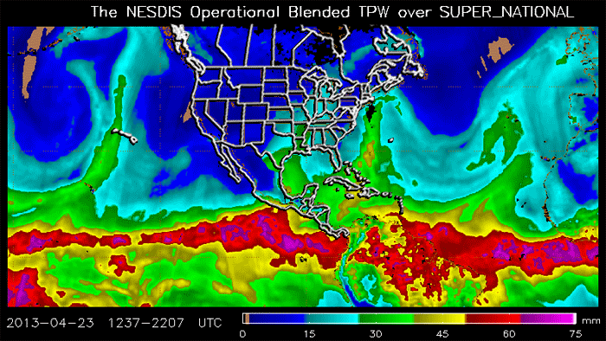
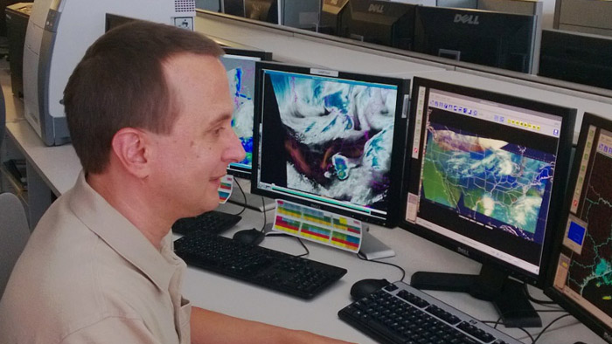
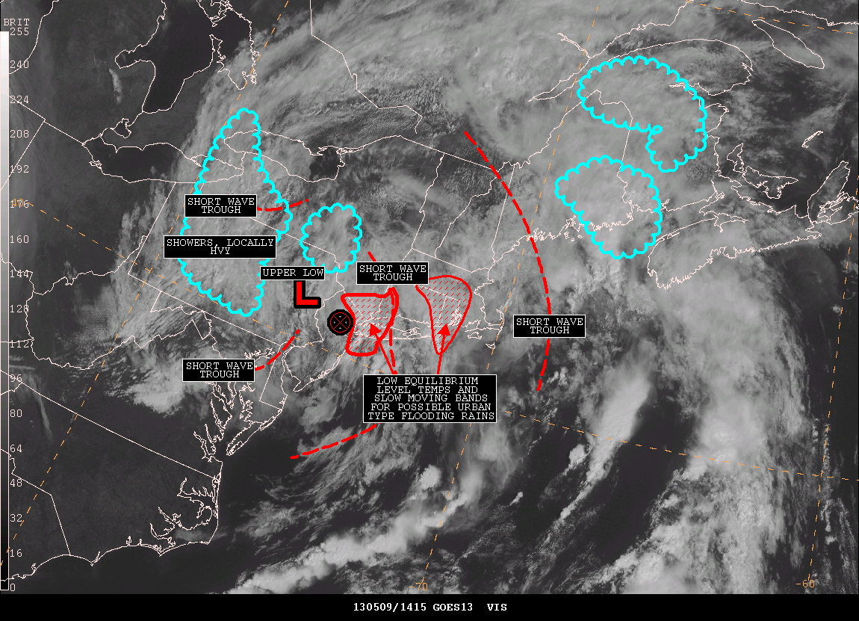
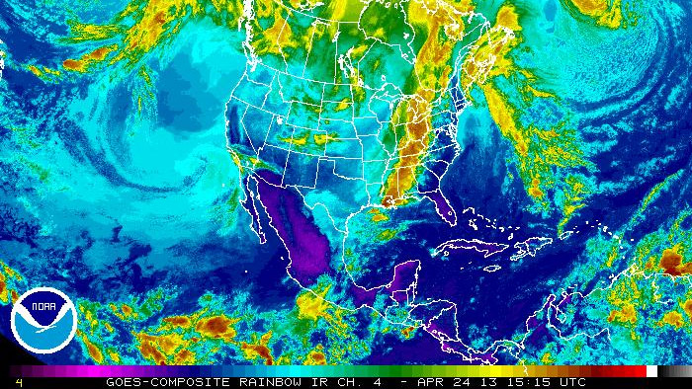
GOES Derived Product Imagery:
For Flooding and Severe Weather
Products from NOAA Satellites are used to observe atmospheric phenomena which may lead to severe weather or flash flooding.
Notes:
Shows deep moisture moving along the east coast, leading to heavy rains and flooding.
Products used extensively by NWS for information leading to potential flash flooding situations.
Follow on NPP, JPSS and GOES-R will aid in this continued product.
Satellite Precipitation Estimate (SPENES) In support of NOAA's mission to protect life and property, the Satellite Analysis Branch (SAB) provides satellite-based precipitation estimates and trends. These trends help guide the National Weather Service (NWS) to understand when heavy, circular rain could cause flash flooding. The SAB's precipitation estimates also play an important role in monitoring heavy rain and snow associated with winter storms and heavy lake effect snow. The estimates are a part of the Satellite Precipitation Estimate message (SPENES). In addition to the satellite precipitation estimates, the SPENES message includes a breakdown on related satellite based precipitation trends. In developing the SPENES message, satellite imagery is obtained from the NOAA Geostationary Operational Environmental Satellites (GOES). Precipitation Products /fourbox/04-29-13/images: http://www.ssd.noaa.gov/PS/PCPN/index.html
Total Precipitable Water (TPW):
Indication of amount of moisture in the atmosphere.
Used to help show areas of potential flood producing
rain.
GOES sounder products have been a very useful tool for the analysis and forecast of severe weather and heavy rains.
The NESDIS Satellite Analysis Branch (SAB) Satellite Precipitation Program is a 24x7 operation which combines satellite and meteorological analysis to provide guidance and outlooks for heavy precipitation to the National Weather Service (NWS). Precipitation team lead John Simko said that the most rewarding part of the job are the times when they are able to assist NWS forecasters, especially for major events.
GOES sounder products are made hourly 24x7 at 10km resolution. Similar products from POES are also created and are used primarily in forecast models.

Slide 10
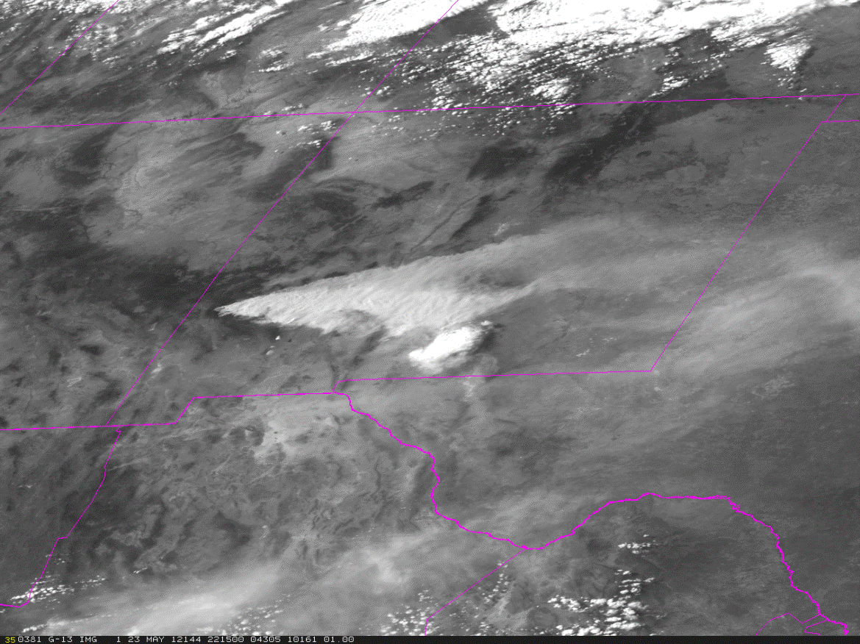
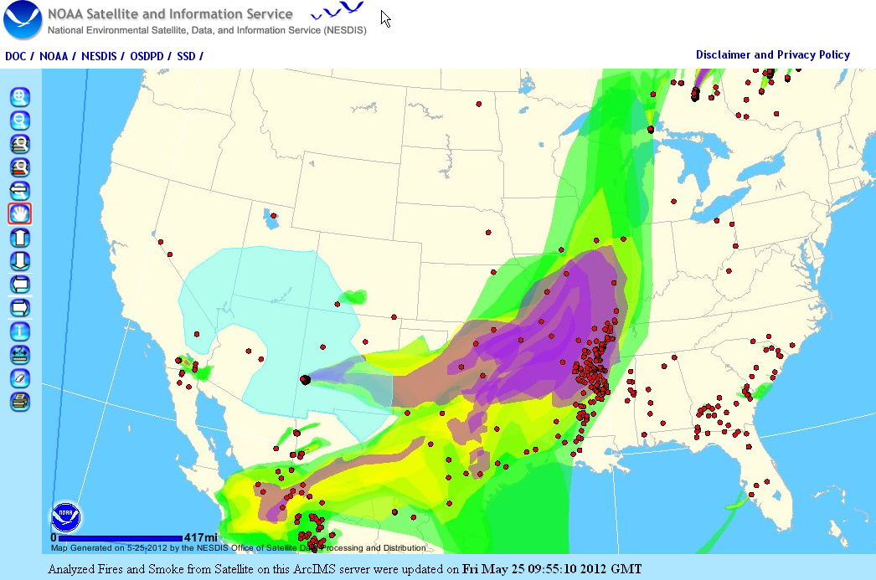
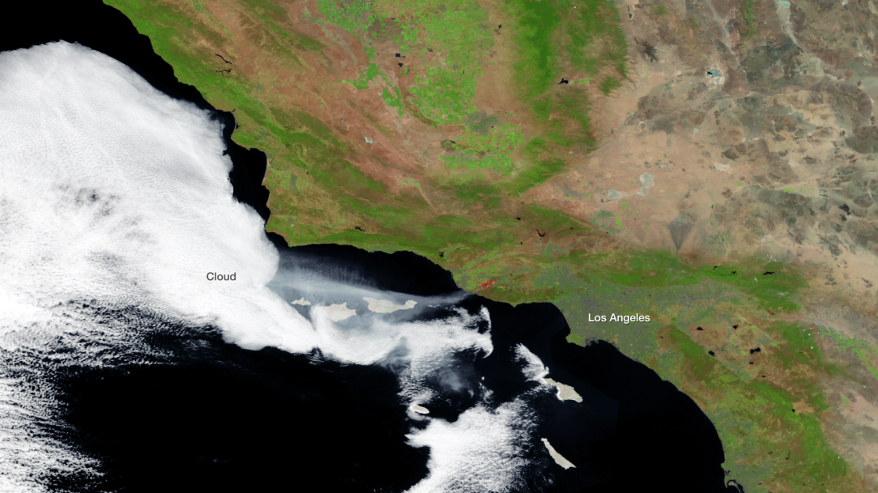
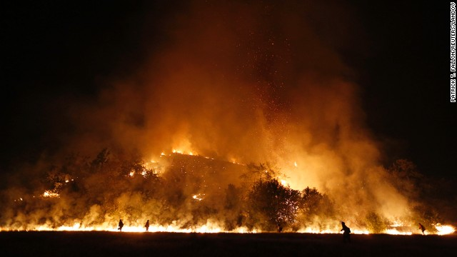
Smoke and Fire Products
Satellite Imagery
Daily Smoke Product
GOES-East loop of smoke emission on May 23, 2012
The recent Ventura County California Fire from space
Notes:
GOES-East loop of smoke emission from the Whitewater-Baldy Fire Complex in NM on May 23, 2012
Active wildfires throughout the Western U.S. have scorched thousands of acres of land resulting in the loss of property and human life. The recent Ventura County California Fire scorched more than 24,250 acres. Monitoring and mitigating starts with our environmental satellites. NOAA uses its environmental satellites to detect and monitor fires, as well as to help predict when and where wildfires occur.
Daily fire and smoke analysis for all of North America NESDIS Office of Satellite and Product Operations (OSPO) generates a daily fire and smoke analysis for all of North America utilizing 9 different polar and geostationary satellites which provide continuous monitoring capability. In addition to detecting fires and smoke, satellite analysts provide input that the National Weather Service uses to initialize a daily air quality smoke forecast. Image: Last year's graphic of analyzed fires and smoke from satellites (May 25, 2012). The red dots in the image represent fire locations and the green/yellow shaded regions are showing smoke extent and density.

Slide 11
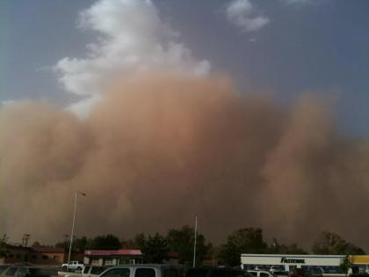
Dust Storms
Visible Imagery

Slide 12
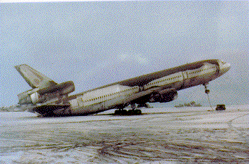
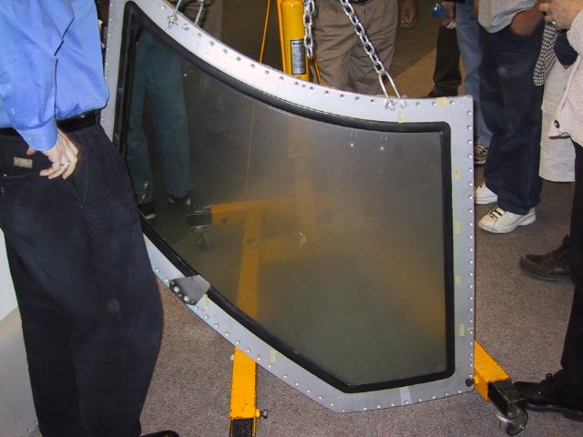
Volcanic Ash Monitoring
http://www.ssd.noaa.gov/VAAC/
To advise airlines to avoid flying through ash
clouds
Ash is severely abrasive to sensitive jet engine parts
Volcanic ash melts and consolidates on essential
aviation parts
Can lead to erroneous readings and potential
engine failure
Mount Redoubt, Alaska - 2009
Left: Damage done to windscreen of a plane that encountered ash. It is nearly opaque.
Right: Damage done to grounded plane. Not only did the ash weigh down the plane, but it also did heavy structural damage, as well
Notes:
Volcanic Ash: SAB has closely monitored global volcanic eruptions since 1982. GOES, POES, and ancillary data are monitored and advisories on recent eruptions are issued as text bulletins to Meteorological Watch Offices (MWOs) and civilian and military aviation interests. so that airlines can avoid flying through hazardous ash clouds. Ash is severely abrasive to sensitive jet engine parts. Volcanic ash also melts and consolidates on essential aviation parts and can lead to erroneous readings and potential engine failure.

Slide 13
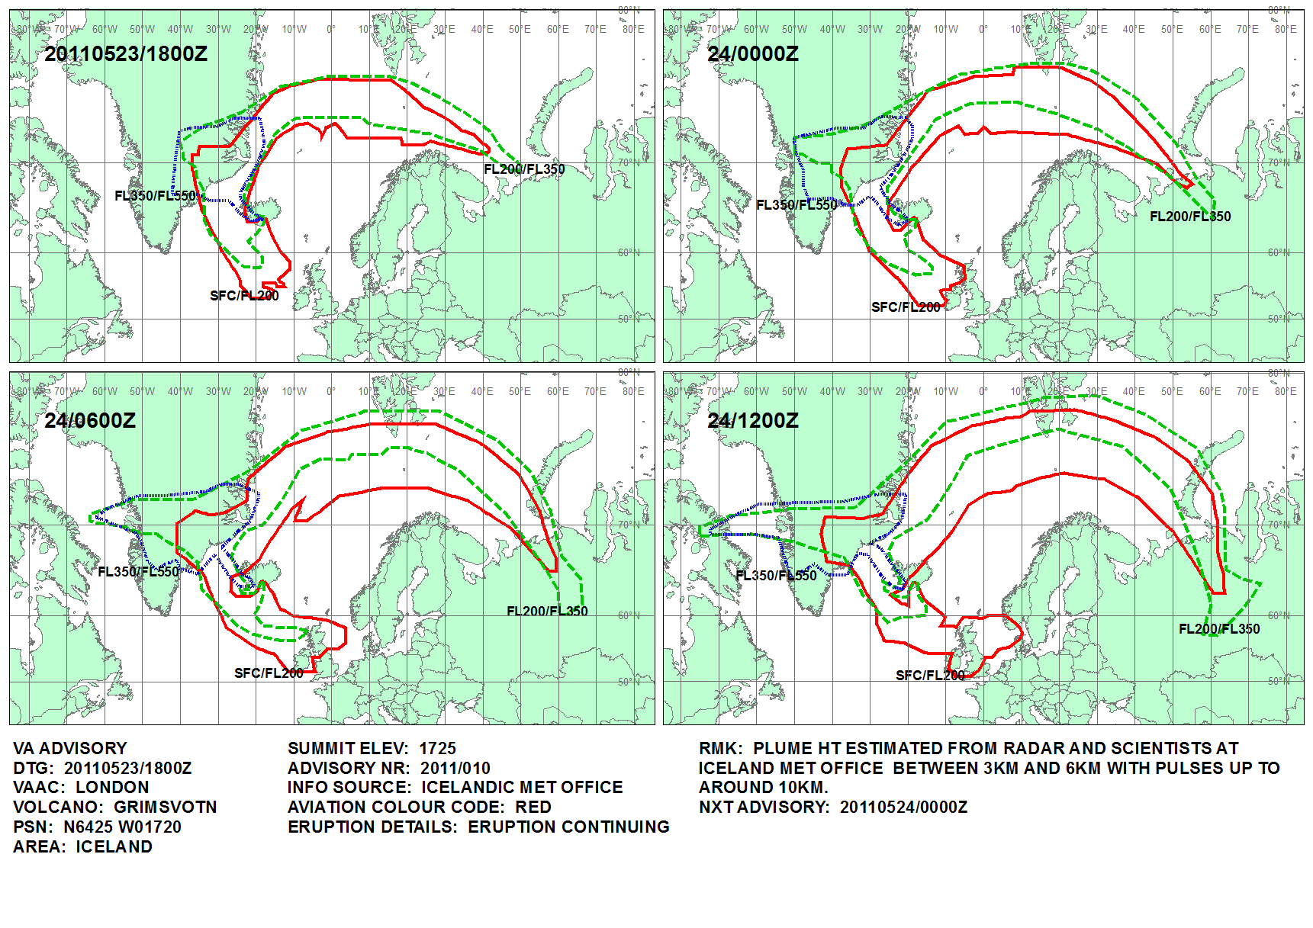
Eruption of the Grímsvötn Volcano in Iceland – May 21-22, 2011
From Europe’s Meteosat-9 satellite
GOES-13/GOES-14 story
From NOAA’s GOES-13 satellite
From Europe’s
Meteosat-9 satellite
Notes:
Eruption of the Grímsvötn volcano in Iceland
Meteosat-9 visible channel images (above) showed the volcanic eruption cloud emanating from the Grímsvötn volcano in Iceland on 21 May 2011 (images courtesy of Dave Santek, SSEC). According to the Icelandic Met Office, at 21:00 UTC the eruption plume had risen to an altitude of over 65,000 ft (~20 km). It is interesting to note that the London VAAC reported
EXTREME LIGHTNING ACTIVITY DETECTED BY ATDNET SYSTEM OF UK METOFFICE, 7000 BETWEEN 1900Z AND 0100Z

Slide 14
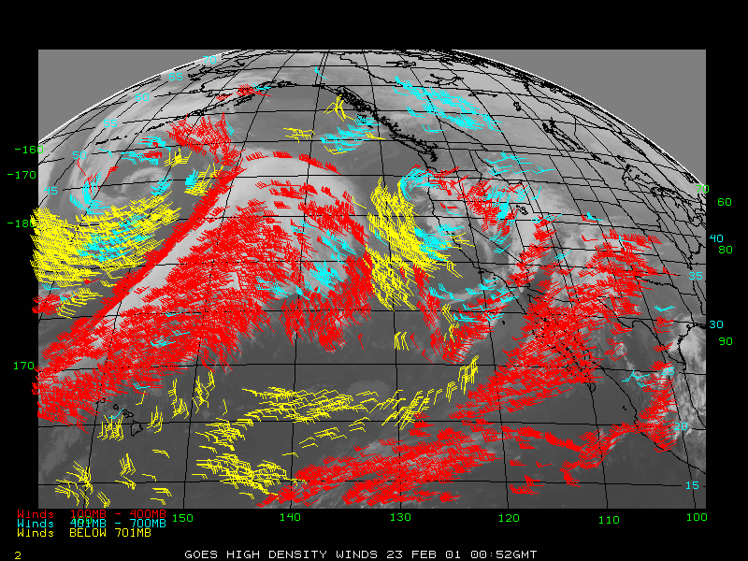
Transportation Products
Satellite Derived Winds
California Valley Fog
Used in Numerical Weather Forecast Predictions and in the Aviation Community
Used in Aviation and Transportation Communities
Notes:
Winds also made from polar satellites (MODIS from NASA’s EOS, AVHRR from NOAA POES) and foreign Geostationary satellites (MTSAT from Japan – aided in wind observations around nuclear plant in Japan).

Slide 15
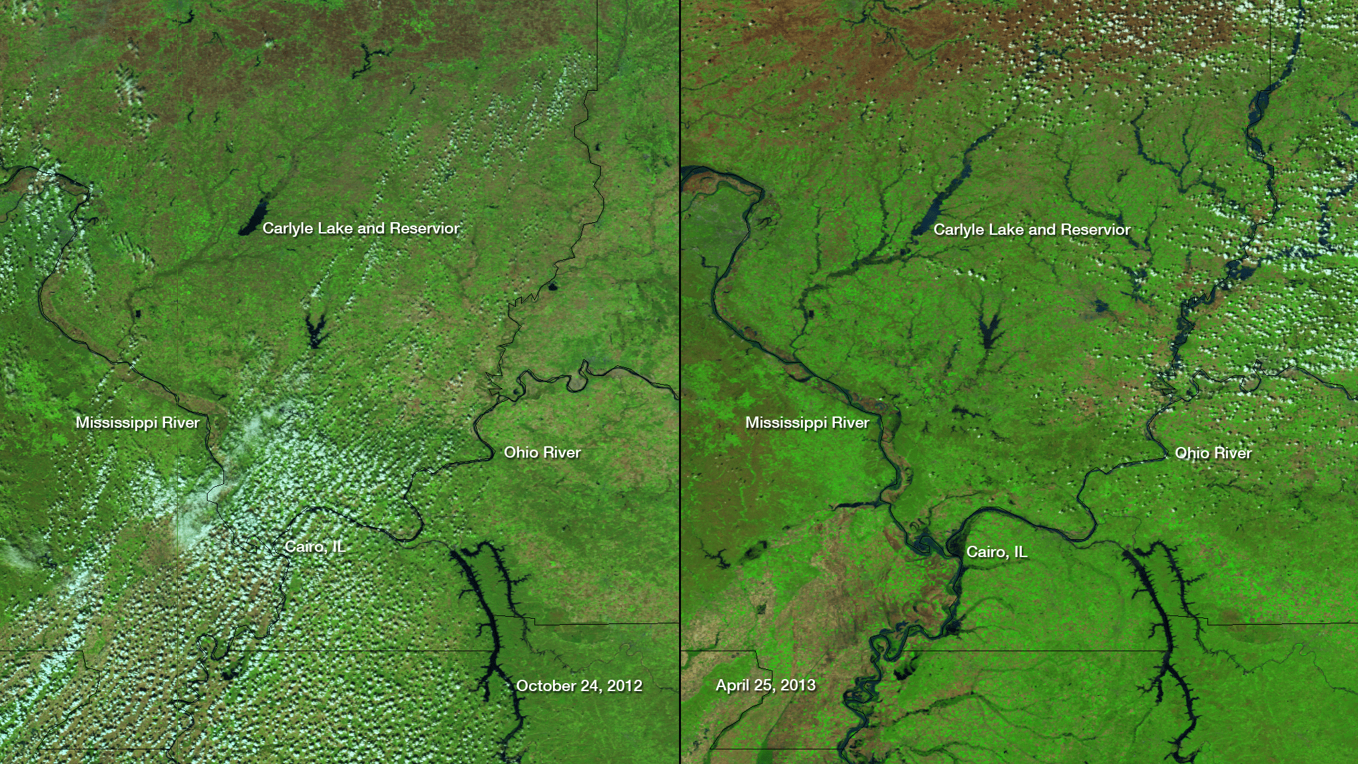
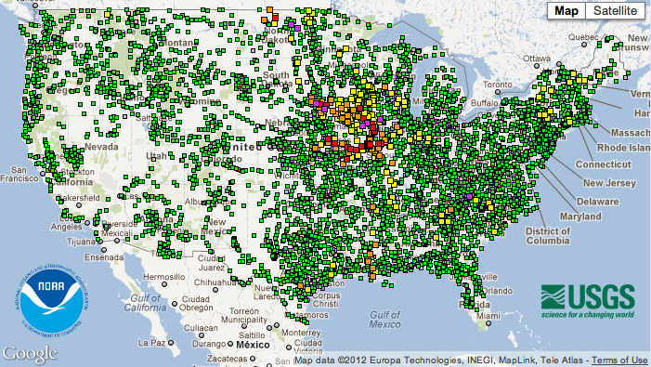
Major to Record Flooding in the North Central River Forecast Area
NOAA Satellites are used to transmit data from river and stream gages, estimate rainfall, observer snow cover, and deduce surface parameters.
Notes:
Gages – Purple: Major Flooding; Red: Moderate Flooding; Orange: Minor Flooding; Yellow: Near Flood stage; Green: no flooding
The NOAA National Weather Service River Forecast Office, North Central River Forecast Center is forecasting major, or soon to rise above major, flood levels in Illinois, Missouri, southeastern Iowa, southern Wisconsin, northern Indiana, North Dakota and western Minnesota. The flooding in the south is due primarily to the heavy rains and excessive runoff from last week. The flooding about to begin in the north is due primarily to the forecasted warm spell and significant snowmelt. This imagery from the NASA/NOAA Suomi satellite's VIIRS instrument from October 24, 2012 on the left, compared to April 25, 2013 on the right, shows significant flooding along the Mississippi and Ohio Rivers flanking Illinois.
An unlabeled version of this image can be found here.

Slide 16
NESDIS Experimental Oil Mapping Products
Experimental Daily Composite Product
Combined analysis of all relevant satellite passes that occurred during a given day
90 Daily Composite Reports Issued
Notes:
Total of 301 reports issued for every satellite image showing oil from singular satellite images.

Slide 17
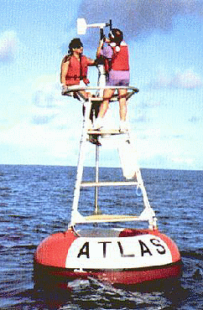
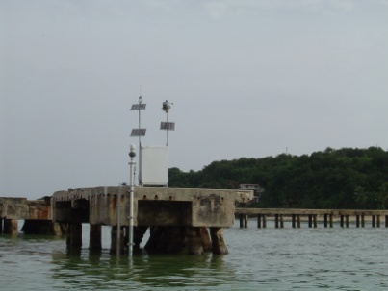
Direct Readout Services
GVAR (GOES Variable):
NOAA satellites broadcast imagery and sounder data to users in real time for life and property forecasts and warnings
Emergency Managers Weather Information Network (EMWIN) :
Specialized instruments on NOAA satellites relay critical information to users across the country. Emergency Managers can obtain weather information in near real time from a variety of sources, mostly from the National Weather Service.
Data Collection (DCS – GOES; ARGOS – POES):
NOAA satellites are used to collect and relay scientific data from around the globe. Instruments aboard remote platforms transmit environmental and other parameters.
Notes:
Other services include LRIT and MDL from GOES; APT, HRPT from POES

Slide 18
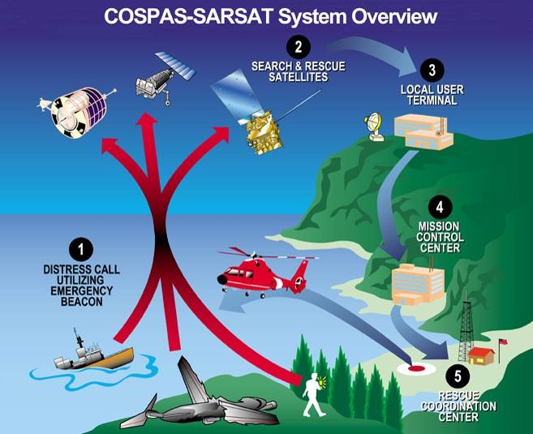
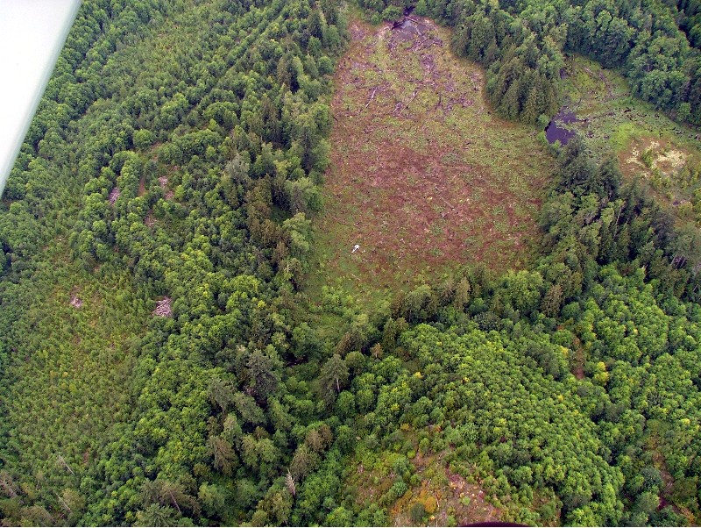
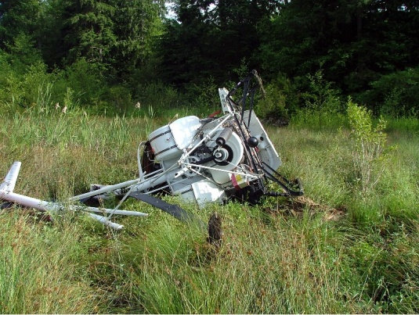
Direct Readout Services - SARSAT
Search and Rescue:
http://www.sarsat.noaa.gov/
NOAA satellites are used to relay
distress alerts from aviators, mariners
and land-based users
Approximately 250 persons are rescued
in the United States annually
Partnership between NASA, NOAA,
USAF and USCG. 38 countries participate in
Program internationally

Slide 19
Some advice
Never stop learning. Take classes, go to seminars, learn from people who share similar experiences.
Create a healthy balance between your professional and personal lives. Health and family support are vital to achieving overall success.
Be flexible, and consider different ways to connect with your passions. Don't be afraid to try new things or to change what you do.
No matter what career you choose, it's all about people skills.
Become the expert in something, and let folks know it.
Work faster, smarter and harder.
Dream Big!
Ask lots of questions!

