Slide 1
NOAA/NESDIS Satellite Products & Direct Readout Overview
Natalia Donoho, User Services Coordinator
Satellite Products and Services Division
NOAA/NESDIS Office of Satellite and Product Operations (OSPO)
College Park, MD
20th International Remote Sensing Conference, San Diego, CA
October 21-24, 2012

Slide 2
Thank you to my co-authors!
Marlin Perkins, Thomas Renkevens and Matt Seybold
Notes:
Tom is a Deputy Chief of Satellite Products and Services Division
Matt and I handle the user services roles.
SPSD is home to all of the R2O algorithm transition work in Ricky Irving’s Products Branch, Interpretive Analysis in Davida Street’s SAB, Chris O’Connors’ Direct Services, and User Services is on staff level.

Slide 3
NESDIS Office of Satellite and Product Operations (OSPO) Key Roles
Ground System Command & Control, Ingest, Product Generation and Distribution for the nation’s 17 environmental satellites
4 Geostationary (GOES) by NOAA
5 Polar-Orbiting (POES) by NOAA
6 Defense Meteorological Satellite Program (DMSP) operated by NOAA
1 OSTM Jason-2 (Ocean Surface Topography Mission) Joint NOAA, NASA, CNES, EUMETSAT effort
1 Suomi National Polar-orbiting Partnership (SNPP) by NOAA & NASA
NSOF
Pre-Launch and Post-Launch Testing
Operational Testing, Validation, and Verification
User Readiness
Long-Term Continuity of Products and Services
Notes:
The National Environmental Satellite Data and Information Service (NESDIS) produces and distributes many satellite products in near real-time to meet the needs of operational users.
This talk will provide an overview of NESDIS satellite data acquisition, processing, and distribution of all NESDIS satellite data and derived products. It will also emphasize the various direct readout capabilities available from NOAA satellites, which serve the users of environmental satellite direct broadcast data and those operating their own satellite data receiving stations. NOAA’s Geostationary Operational Environmental Satellites (GOES) and Polar-orbiting Operational Environmental Satellites (POES) customers will be informed of the innovative new changes in direct readout technologies and new applications with future satellite data.
Lastly, this presentation will address the special emphasis NOAA places on maintaining and increasing effective contacts with the users of direct readout data and derived products to ensure current and planned products are responsive to their needs. User Services and Outreach initiatives from the Satellite Products and Services Division will be highlighted.
~~~~~~~~~~~~~~~~~~~~~~~~~~~~~~~~~~~~~~~~~~~~~~~~~~~~~~~~~~~~~~~~~~~
OSPO is a NESDIS line office along with OSD, STaR, GOES-R, JPSS, Climate Offices, and Staff Offices
MOD – includes Command & Control at NSOF, satellite engineering, and systems support
The CDA (Command and Data Acquisition) sites are at Wallops, VA and Fairbanks, AK.
The National Ice Center is a joint Navy, NOAA, and Coast Guard office that resides at NSOF.

Slide 4
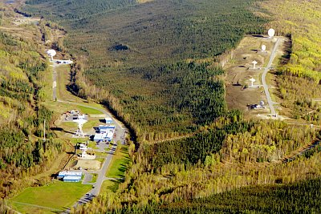
NESDIS Office of Satellite and Product Operations (OSPO)
Locations at four facilities housing 700 OSPO staff
NOAA Satellite Operations Facility (NSOF) in Suitland, MD - NSOF houses more than $50 million in high technology equipment, including 16 antennas, which control more than $4.7 billion in environmental satellites.
NOAA’s Center for Weather & Climate Prediction (NCWCP) in College Park, MD is the backbone of weather and climate prediction for the nation.
Fairbanks CDA
Wallops CDA
NCWCP
Notes:
NCWCP is home to NWS / NCEP (NCO, EMC, HPC, OPC); NWS / ARL; NESDIS / STaR & OSPO
The CDA (Command and Data Acquisition) sites are at Wallops, VA and Fairbanks, AK.

Slide 5
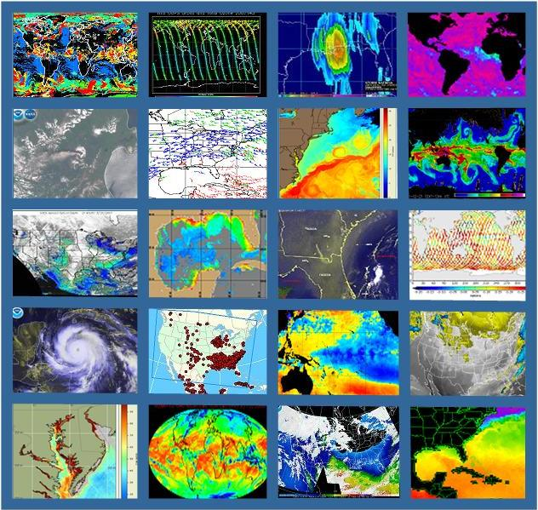
Products
Atmospheric Chemistry
Atmospheric Temperature
Fire and Smoke
Hurricane Intensity and Position
Imagery (e.g. Visible, IR, WV)
Land Cover – Ice, Snow, Vegetation
Ocean Color
Satellite Derived Winds (WS,WD,H)
Sea Surface Height & Temperature
Sounder Profiles and Imagery
Space Weather
Volcanic Ash and many more…
In 2012:
26 Requests for New Products
10 Promotions of New or Enhanced Products
Notes:
Here is a sample of satellite products (derived & interpretive) .
Satellite Imagery is the #1 tool of hurricane forecasters.

Slide 6
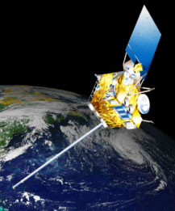
HOT! HOT! HOT!
GOES-13 Returned to Operational Service as GOES-East on October 18, 2012, at 10:44 EDT (1444 UTC)
GOES-14 Drift Stop Maneuver was executed Friday, October 19, 2012, at 9:56 EDT (1356 UTC)

Slide 7
GOES-13 Anomaly
Issues with the GOES-13 sounder filter wheel started in June 2012
Recovery activities had some success, but more noise in September, 2012
Sept 23, 2012 at 1126 UTC GOES-13 Sounder experienced fault trip and was taken out of service
Root cause of Sounder Anomaly: filter wheel vibration
Sept 23, 2012 at 2122 UTC GOES-13 Imager taken out of service
Root cause of Imager Anomaly: Sounder filter wheel vibration disturbance was transmitted to the Imager/Sounder optical bench & Imager scan mirror had an anomalous response
Notes:
See next slide for issues

Slide 8
GOES-13 Sounder
Notes:
Note the strange patterns being seen in the imagery for GOES-13 Sounder channels 13 -> 16!

Slide 9
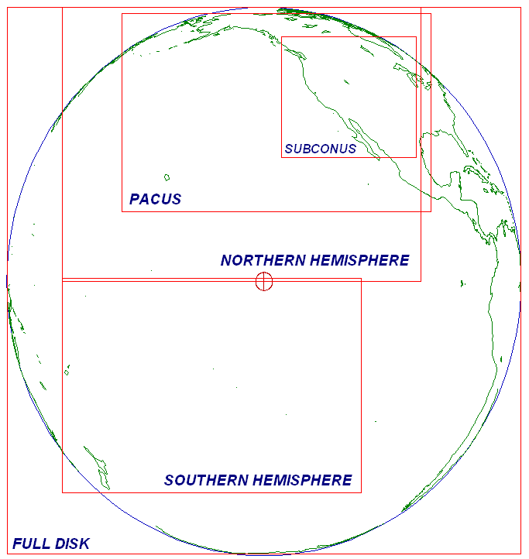
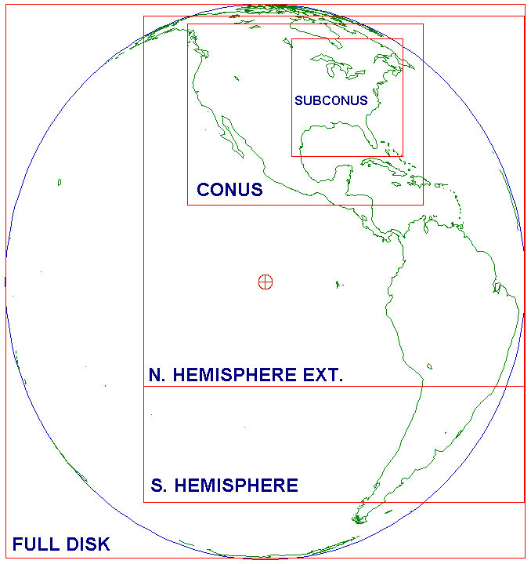
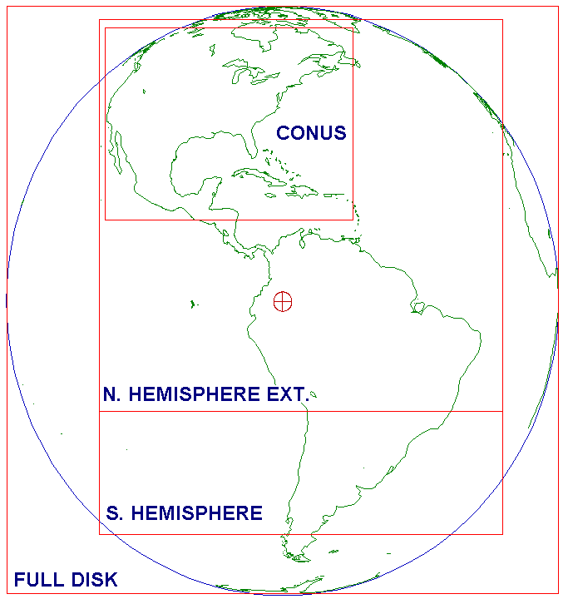
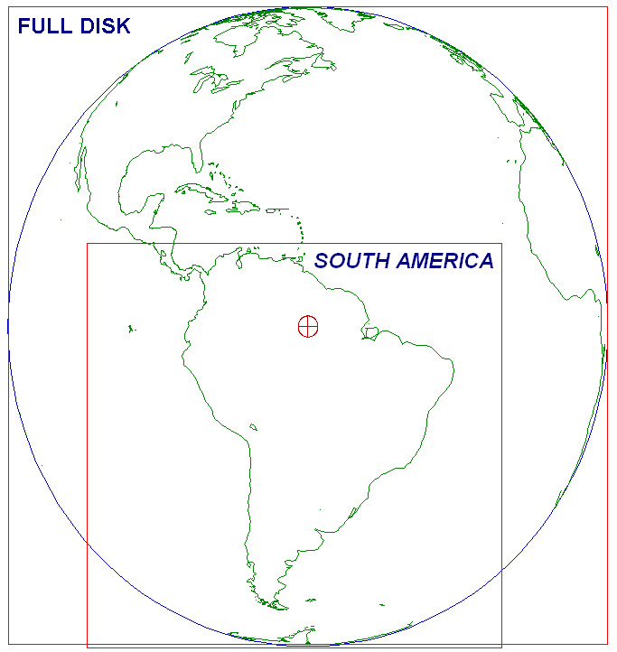
Prior to September 23, 2012 (Routine Schedule with 15 minute CONUS Coverage)
GOES-15
West
(135°W)
GOES-14
Standby
(105°W)
GOES-13
East
(75°W)
GOES-12
S. America
(60°W)
The next several slides illustrate the mitigating steps taken during the GOES-13 anomaly
The illustration shows only the Imager Routine schedules, although there was an impact across all GOES-13 instruments
Notes:
The following series of slides are intended to illustrate OSPO's contingency planning, readiness, and ability to implement controlled and safe, but dynamic changes to the constellation, product generation, and product distribution.
Satellite | Stray Light Algorithm Applied | Optimized Schedule Applied
-----------------------------------------------------------------------------------------
GOES-12 | No | No
GOES-13 | Yes | No
GOES-14 | No | No (was using the optimized schedule, until it replaced GOES-13)
GOES-15 | Yes | Yes

Slide 10
September 23, 2012 (GOES-15 is in full disk mode for both East and West)
GOES-15
West
(135°W)
GOES-14
Standby
(105°W)
GOES-13
Standby
(75°W)
GOES-12
S. America
(60°W)
Full Disk
--
Transmitted
to GOES-13
GVAR
Given the decision to place GOES-13 in standby mode, GOES-15 was set by standard protocol to a schedule of only full-disk scans to provide coverage of both the West and East domains

Slide 11
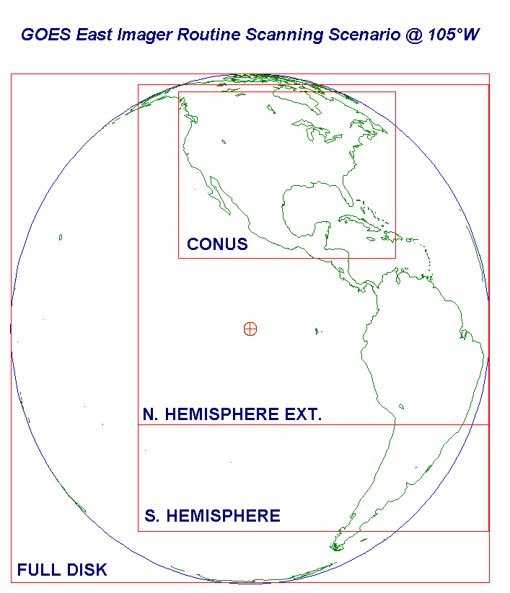
September 24, 2012 (Routine Schedule with 15 minute CONUS Coverage)
GOES-15
West
(135°W)
GOES-14
East
(105°W)
GOES-13
Standby
(75°W)
GOES-12
S. America
(60°W)
Rescheduled
--
Transmitted
to GOES-13
GVAR
Although GOES-14 was in standby, it was in normal operations mode for health & safety testing and was also being utilized for GOES-R tests & SRSO studies. GOES-14 was switched from Optimized Routine Schedule with SUBCONUS frames to GOES-13 Routine Schedule and transmitted through GOES-13 GVAR. GOES-15 was returned from Full Disk schedule to Routine schedule
Notes:
Within 24 hours of the problem the standby satellite – a critical component of our planned response - began providing data to NOAA’s National Weather Service and other users.
NESDIS was able to make the switch-over from GOES-13 to GOES-14 as the operational GOES-East satellite (in a matter of *hours*) -- it would have likely taken a day or two (or more?) had GOES-14 not already been activated and operating in a SRSOR test mode.

Slide 12
Drift Commenced October 1, 2012 (Routine Schedule with 15 minute CONUS Coverage)
GOES-15
West
(135°W)
GOES-14
East
(∆ 0.9 °E/day)
GOES-13
Standby
(75°W)
GOES-12
S. America
(60°W)
Frame Adjustments
Frame adjustments every Wednesday at 1900 UTC compensate for satellite drift and keep scans on target
At ~83°W, GOES-14 will observe CONUS frame including both CA & PR
GOES-14 is still being transmitted through GOES-13 GVAR
Notes:
Faster drift rate due to urgency than Dec. 2011 GOES-15 drift to GOES-West at 0.78 degrees/day.

Slide 13
Current Configuration
GOES-15
West
(135°W)
GOES-14
Standby
(89.5°W)
GOES-13
East
(75 W)
GOES-12
S. America
(60°W)
Schedule:
October 18 – GOES-13 returned to operations
October 19 – GOES-14 at 89.5 W

Slide 14
Notifications & Status
General Satellite Messages from ESPC: http://www.ssd.noaa.gov/PS/SATS/messages.html
WMO Bulletins on the GTS (Global Telecommunications System):
WMO header NOUS71 KNES (AWIPS ID ADANES) for urgent notices (e.g., outages or anomalies) http://www.weather.gov/view/validProds.php?prod=ADM&node=KNES
WMO header NOUS72 KNES (AWIPS ID ADMNES) for routine notices (e.g., eclipse schedule, RSO, etc.) http://www.weather.gov/view/validProds.php?prod=ADA&node=KNES
Non-Operational Sources:
Sat Ops Status: http://www.oso.noaa.gov/daily-news/index.asp
Twitter: http://twitter.com/noaasatellites
Facebook: https://www.facebook.com/NOAANESDIS
Press Releases:
http://www.nesdis.noaa.gov/news_archives/goes_reposition.html
http://www.nesdis.noaa.gov/news_archives/goes_resumes.html

Slide 15
Erroneous change to the GOES-13 CONUS frame coordinates
Since August 24 2012, users noticed that the CONUS sector has been missing data over the western US coast, most noticeably over California
A schedule was promoted into operations that contained erroneous frame coordinates on August 24 2012.
First fixed image at September 21, 2012 0102 UTC
Length of Impact: 28 days

Slide 16
Operational GOES Update

Slide 17
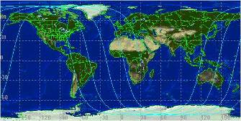
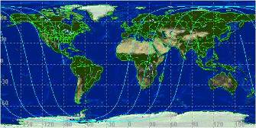
POES Constellation
10 am Orbit (Metop-A)
2 pm Orbit (NOAA-19)
Two polar operational satellites; one in morning and one in afternoon orbit. Each orbit is 102 minutes
Since May 2007, NOAA using EUMETSAT satellite operationally for mid-morning orbit through NOAA/EUMETSAT partnership
Each satellite provides world-wide coverage every 12 hours (6-hour global sampling for the pair)
Directly broadcasts data to global users
Continuity of operations since early 1960s

Slide 18
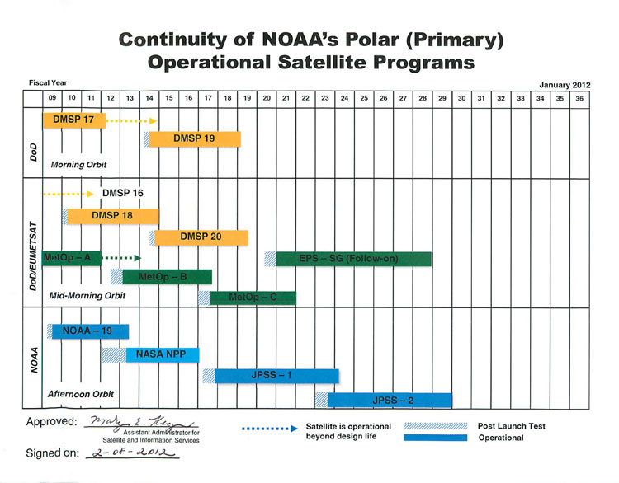
Operational POES Update

Slide 19
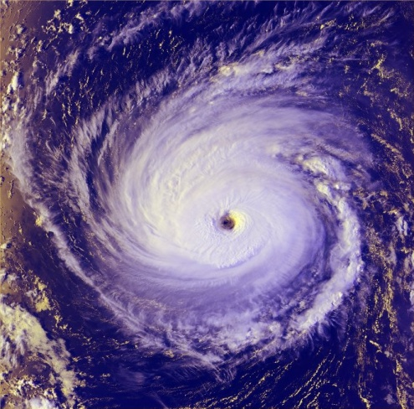
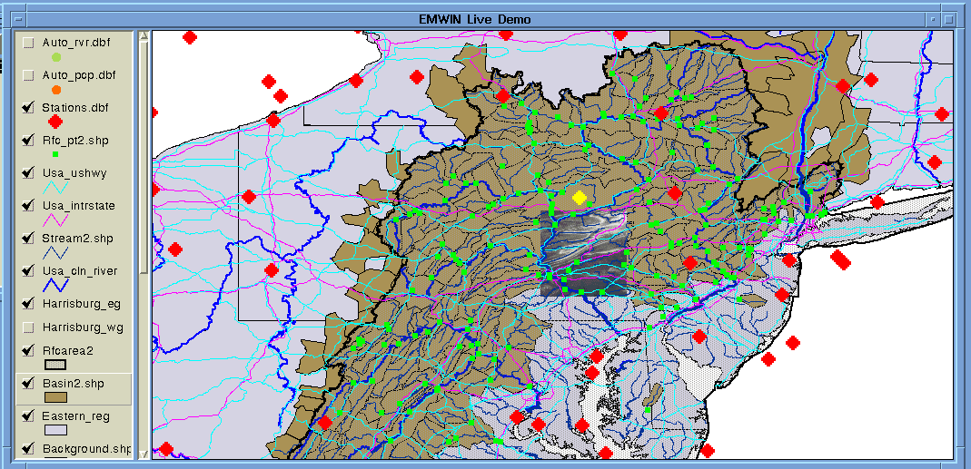
Direct Broadcast Services
SARSAT (Search and Rescue Satellite Aided Tracking)
Argos (Global Data Collection and Relay System)
GOES DCS (Data Collection System)
Broadcast Services
GEONETCast Americas
EMWIN (Emergency Managers Weather Information Network)
GVAR (GOES VARiable data transmission format)
and others… (e.g. International HRPT, GOES LRIT)
Notes:
The current direct readout services are derived from satellite sensor data from NOAA’s Geostationary Operational Environmental Satellite (GOES) and Polar orbiting Operational Environmental Satellite (POES) systems. NOAA’s GOES direct readout services include Low Rate Information Transmission (LRIT), Emergency Managers Weather Information Network (EMWIN), Data Collection System (DCS) and GOES VARiable (GVAR) broadcasts. The POES direct readout services include the analog Automated Picture Transmission (APT) and digital High Resolution Picture Transmission (HRPT) transmissions.
GVAR (GOES VARiable data transmission format)
LRIT (Low Rate Information Transmission)
EMWIN (Emergency Managers Weather Information Network)
DCS (Data Collection System)
Argos
SARSAT (Search and Rescue Satellite Aided Tracking)
Geonetcast
SARSAT Search and Rescue:
NOAA satellites are used to relay distress alerts from aviators, mariners and land-based users
http://www.sarsat.noaa.gov/
Argos and GOES Data Collection Systems:
NOAA satellites are used to collect and relay scientific data from around the globe.
http://www.noaasis.noaa.gov/DCS/ http://www.noaasis.noaa.gov/ARGOS/
Geonetcast Americas:
Data from NOAA for diverse societal benefits - agriculture, energy, health, climate, weather, disaster mitigation, biodiversity, water resources, and ecosystems.
http://www.geonetcastamericas.noaa.gov/index.html
Emergency Managers Weather Information Network (EMWIN):
NOAA satellites relay critical information to users across the country.
http://www.weather.gov/emwin/index.htm
Low Rate Information Transmission (LRIT):
NOAA geostationary satellites are used to relay satellite and weather products to users in remote locations that do not have landlines or internet connections.
http://www.noaasis.noaa.gov/LRIT/
HRPT (High Resolution Picture Transmission)

Slide 20
Service Transition
Over the next seven (7) years, direct readout and direct broadcast services will change significantly as the future spacecraft constellations become operational.
Several of the direct readout communities will not be supported on future NOAA environmental satellites. These groups will either have to upgrade to a new service or find an alternative method to acquire the data they need to support their mission.
The geostationary and polar-orbiting environmental satellite constellations will employ higher data rates, larger bandwidths, and new downlink frequency allocations.
Notes:
NOAA’s Direct Readout and Direct Broadcast services are managed by the Office of Satellite and Product Operations (OSPO). OSPO is a newly created Office formed by merging the Office of Satellite Data Processing and Distribution (OSDPD) and the Office of Satellite Operations (OSO). The Direct Services Branch (DSB) is responsible for administering the processes and procedures required to meet the environmental user needs and expectations. Planning and coordination of the data content, data quality, transmission schedules, and interface with the users and manufacturers are critical to the efficient performance of these services.
Over the next seven (7) years, direct readout and direct broadcast services will change significantly as the future spacecraft constellations become operational.
Transition to the new data formats and adjustments to accommodate the increased data volume are concerns that DSB will continue to address. DSB will continue to support current and future direct readout users. DSB will spearhead activities to address the new technology for data reception as well as alternative methods for data distribution. Future planning enables the DSB to coordinate the demise of the legacy services while preparing the user community for the new direct services. To improve customer relations and provide up-to-date information about the applications of the direct services, DSB will continue to support those services that are not a part of the future satellite constellations.

Slide 21
Transition activities at NOAA GOES Constellation
GOES VARiable (GVAR) broadcast will be replaced with GOES Re-Broadcast (GRB) service, requires new field terminal.
GOES LRIT will be combined with EMWIN and called HRIT/EMWIN for GOES-R at a new higher data rate and a new transmission frequency.
Notes:
As for talking points, you should focus on the High Rate Data (HRD) service on NPP and JPSS-1, the Low Rate Data (LRD) service planned for JPSS-2/4. You can touch on the transition from HRPT to LRD. This is the crossover from the current POES spacecrafts to JPSS-2/4. In addition, lets highlight the transition from GOES to GOES-R. We can talk about the changes in the LRIT, DCS and GVAR that will become the HRIT/EMWIN, an improved DCS service and the new GOES Re-Broadcast (GRB).

Slide 22
Transition activities at NOAA GOES-R Constellation
GOES ReBroadcast (GRB) will require a new L-band field terminal
HRIT/EMWIN services will require hardware/software upgrades or purchase new system.
The GOES-R instrument raw data downlink includes data from the imager, lightning mapper, and two space environmental instrument suites
To minimize the impact on the user, the GRB is expected to continue to be transmitted in L-band, but use an expanded bandwidth (1681 MHz -1692 MHz).
Service | Current Frequency Spectrum | Current Data Rate | Future Frequency Spectrum | Future Data Rate
GVAR/GRB | 1685.7 MHz | 2.11 mbps | 1686.6 MHz | 31 Mbps
LRIT→ HRIT | 1691 MHz | 128 kbps | 1694.1 MHz | 400 kbps*
EMWIN | 1692.7 MHz | 9.6 kbps | 1694.1 MHz | 400 kbps*
DCS/DCPR | 1694.5 MHz | 100/300/ 1200 bps | 1679.9 MHz | 300/1200 bps

Slide 23
Prepare for GOES-R transition to GOES Rebroadcast (GRB) (Replaces GVAR and will be tested during PLT)
 | GVAR | GOES Rebroadcast (GRB)
Full Disk Image | 30 minutes | 5 minutes (Mode 4)
 |  | 15 min (Mode 3)
Other modes | Rapid Scan, Super Rapid Scan | 3000 km x 5000 km CONUS: 5 min
 |  | 1000 km x 1000 km Mesoscale: 30 sec
Polarization | None | Dual circular polarized
Receive Center Frequency | 1685.7 MHz (L-band) | 1686.6 MHz (L-band)
Data Rate | 2.11 Mbps | ~30 Mbps
Antenna Coverage | Earth coverage to 5° | Earth coverage to 5°
Data Sources | Imager and Sounder | ABI (16 bands), GLM, SEISS, EXIS, SUVI, MAG
Space Weather | Non | ~2 Mbps
Lightning Data | None | ~0.5 Mbps
Notes:
Mention NWS plan to have NHC act as primary downlink, which will then distribute to other NWS Prediction Centers.

Slide 24
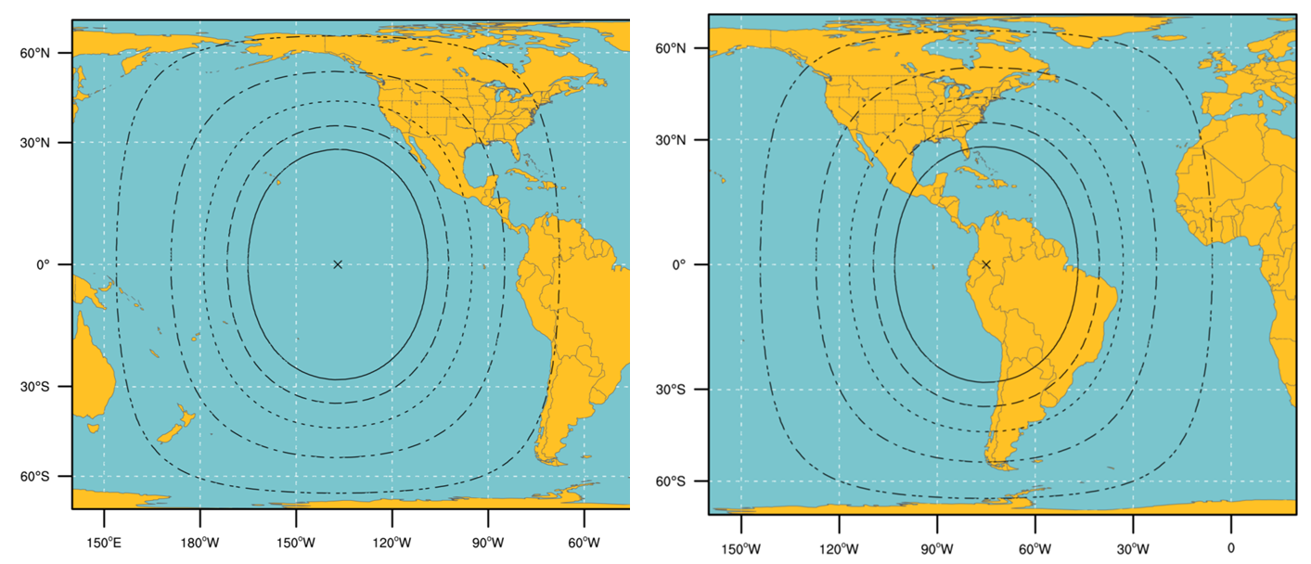
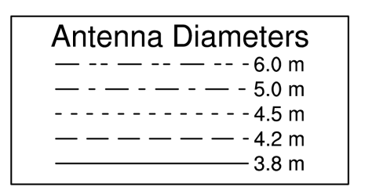
GRB Ground Antenna Sizes
NOTES:
Calculations based on available data as of May 2011
Each antenna size is usable within the indicated contour
Rain attenuations included are:
1.3/1.6/2.0/2.2/2.5 dB (3.8 to 6 m)
4. An operating margin of 2.5 dB is included as the dual polarization isolation is likely to vary within each antenna size area

Slide 25
GRB Downlink Characteristics
Input Center Frequency: 1690.0 MHz
Content (specified for each of two polarization channels: LHCP, RHCP)
L1b data, QC data and metadata: ABI, SUVI, EXIS, SEISS, MAG
L2 data, QC data, metadata: GLM
GRB Information Packets
Data rate
31 Mbps maximum data rate
15.5 Mbps instantaneous maximum for each polarization channel
Down link margin: 2.5 db
Compression - Lossless compression required
JPEG2000 and SZIP are candidates that are being considered/studies
Format
Inner Frame Format: CCSDS Space Packet
Outer Frame Format: DVB-S2
Coding
BCH + LDPC (2/3) for 8-PSK and LDPC (9/10) for QPSK
Modem Required C/No (dB-Hz): 78.6
Maximum Demodulator Required Eb/No (dB) for 1x10⁻¹⁰ BER: 4.8 dB/Hz
Minimum Antenna System G/T (dB/K) : 15.2
These specs should be considered preliminary and will be finalized in 2012

Slide 26
GRB Simulators
Purpose
On-site testing of user ingest and data handling systems, aka GRB field terminal sites
Simulates GRB downlink functionality by generating Consultative Committee for Space Data Systems (CCSDS) formatted GRB output data based on user-defined scenarios, test patterns, and proxy data files.
Available in 2013
Key Capabilities and Features
Transportable
Fully self contained
Configurable hardware units
Outputs simulated GRB
“Off-line Mode” to create and setup configurations and scenarios
Also, create test patterns and input proxy data
“On-line Mode” to continuously output GRB data stream at IF or baseband levels
Includes monitoring and logging of events

Slide 27
Transition activities at NOAA POES Constellation
Automated Picture Transmission (APT) – Frequency change in the 137.1 – 137.937 MHz frequency band NOAA-18 and NOAA-19 spacecraft
HRPT Service remains unchanged

Slide 28
Transition activities at NOAA METOP Constellation
APT service is not available
AHRPT format requires upgrades to existing HRPT field terminals or the purchase of a new station

Slide 29
Transition activities at NOAA S-NPP/JPSS Constellation
APT service will not available
HRPT will be replaced with the Low Rate Data (LRD) broadcast, requires L-band field terminal upgrade
LRD will not be available on S-NPP or JPSS-1
High data Rate (HRD) service requires a new X-band field terminal
Notes:
NOAA’s portion of JPSS will consist of platforms based on the Suomi NPP satellite. NASA launched the National Polar-orbiting Operational Environmental Satellite System Preparatory Project (NPP), on Oct. 28, 2011. On January 24, 2012, NPP was renamed Suomi National Polar-orbiting Partnership, or Suomi NPP. NASA renamed NPP in honor of the late Verner E. Suomi, a meteorologist at the University of Wisconsin who is recognized widely as "the father of satellite meteorology." The SNPP mission, launched in October 2011, is the bridge between the NASA Earth Observing System (EOS), NOAA POES constellation and the future JPSS satellites. JPSS is the civilian component of the former NPOESS program manager by NOAA.

Slide 30
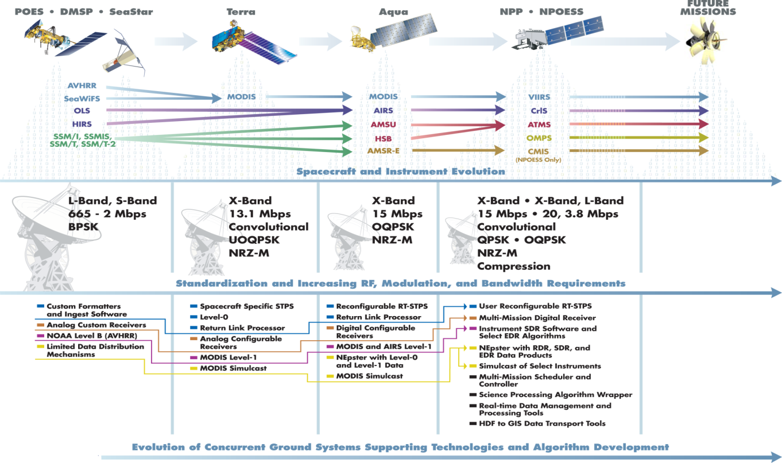
S-NPP/JPSS Direct Readout Continuity of Services
Notes:
These additional continuities will also exist: IASI -> CrIS, MHS -> ATMS, TOMS -> OMPS, SAGE -> OMPS-Limb
Significant progress has been made with the SNPP satellite launched on October 28, 2011. The five SNPP instruments trace their heritage to instruments on NASA's Terra, Aqua and Aura missions, on NOAA's POES spacecraft, and on DOD's Defense Meteorological Satellite Program (DMSP). The spacecraft directly transmits stored mission sensor data to a receiving station in Svalbard, Norway, and provides continuous direct broadcast of real-time sensor data. Mission data is routed from Svalbard to the United States
Once operational, SNPP and JPSS space crafts will replace the current POES constellation. The POES spacecraft revolutionized the way in which we observe and predict the weather. We are evolving the existing “weather” satellites into an integrated environmental observing system by expanding our capabilities to observe, assess, and predict the total Earth system – ocean, atmosphere, land, and the space environment. Data from advanced sensors will be available faster than today significantly improving NWP forecasts and serving data continuity requirements for improved global climate change assessment and prediction.

Slide 31
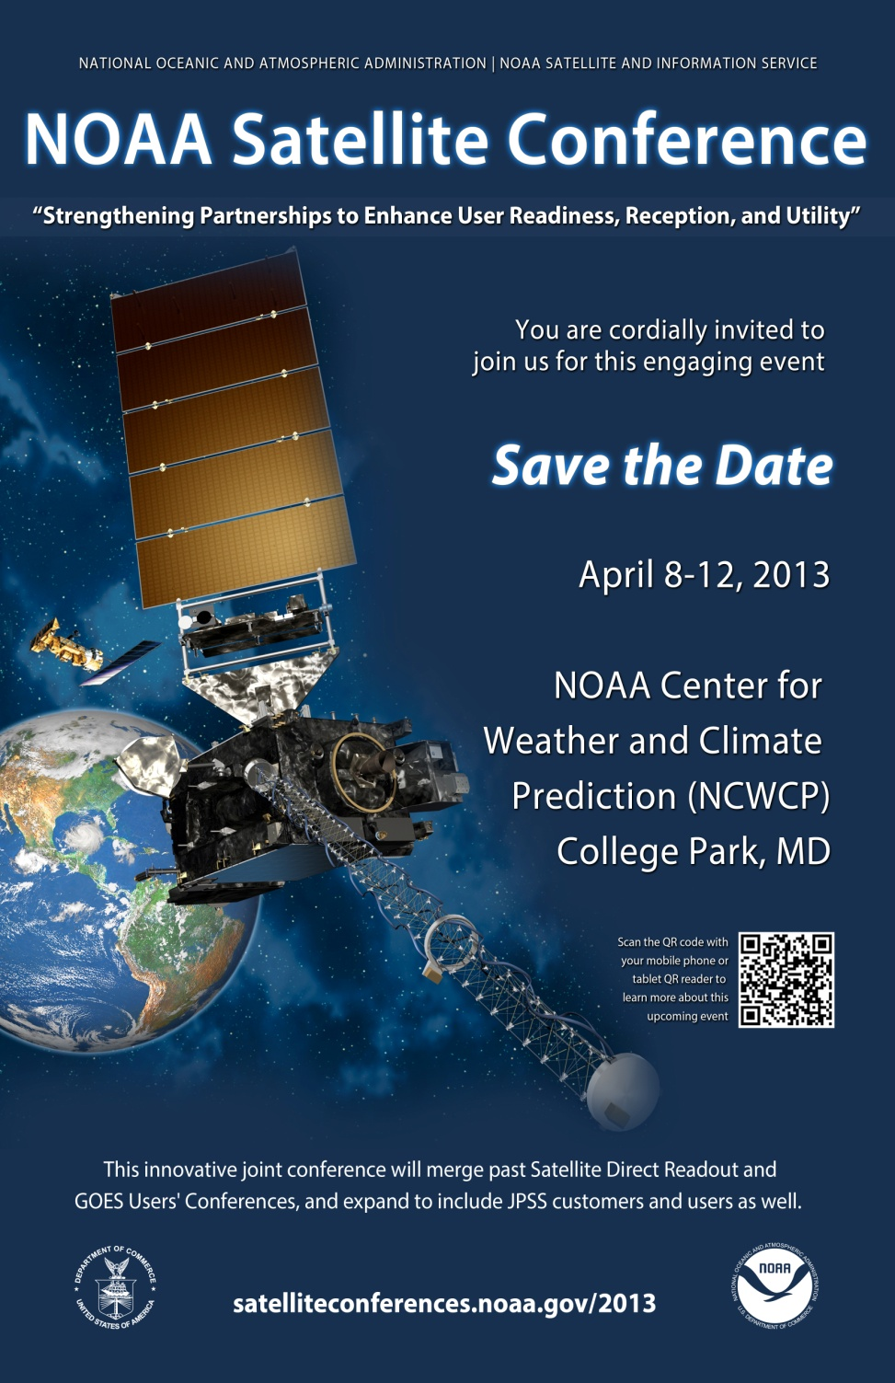
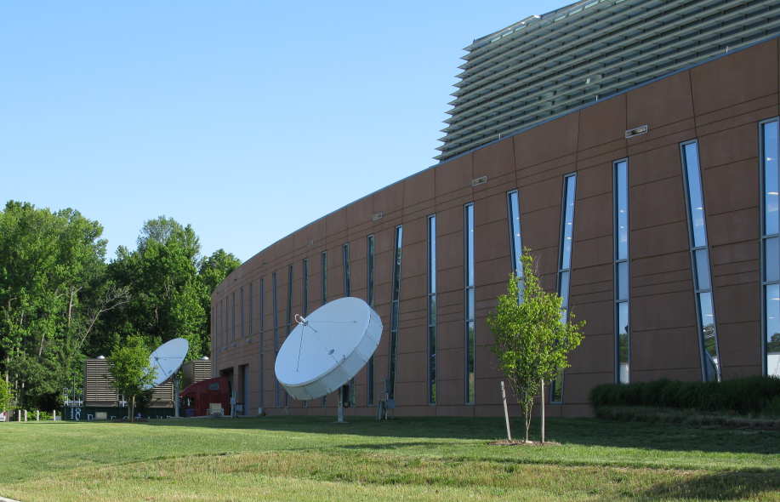
Notes:
Please mark your calendar!

Slide 32
Contact Information
24/7 Help Desk | ESPCOperations@noaa.gov
User Services | SPSD.UserServices@noaa.gov
Data Access | NESDIS.Data.Access@noaa.gov
Webmaster | SSDWebmaster@noaa.gov
Web | www.ospo.noaa.gov
 | www.facebook.com/NOAANESDIS
 | www.twitter.com/noaasatellites
Notes:
Thank you!
Should you have additional questions, please use the contact information listed on the slide.
Operational concerns, including outages and administrative information: ESPCOperations@noaa.gov
General comments and inquiries: SPSD.Userservices@noaa.gov

