Slide 1
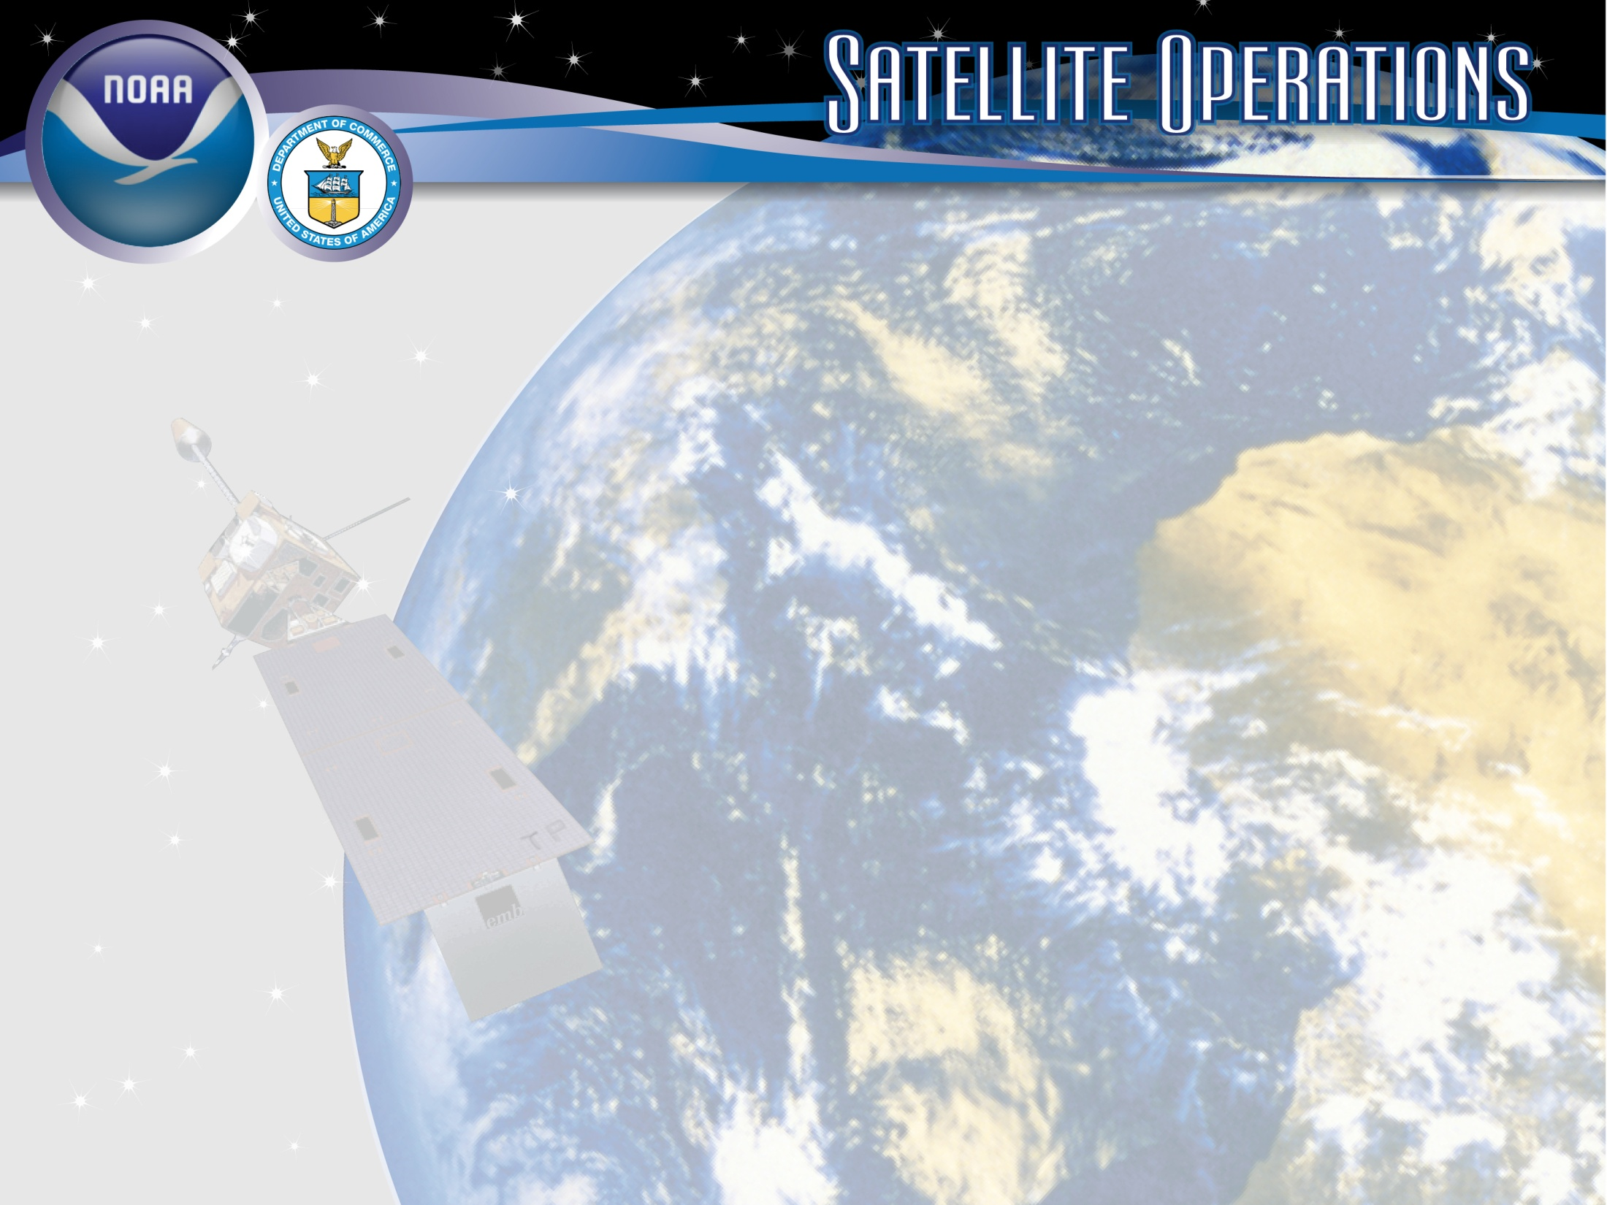
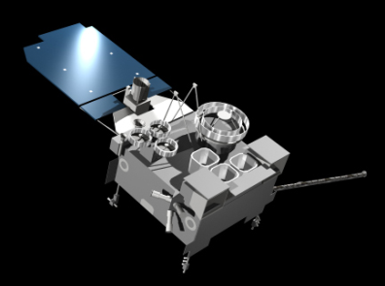
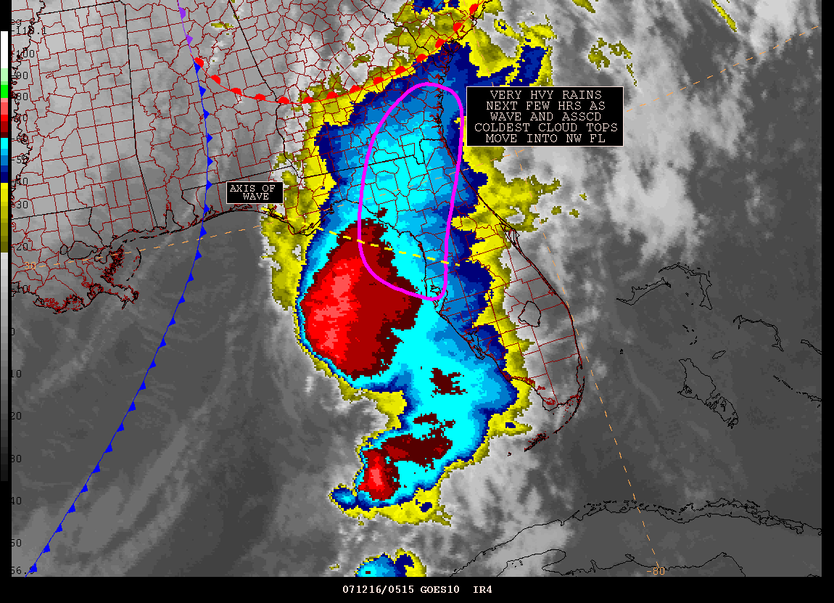
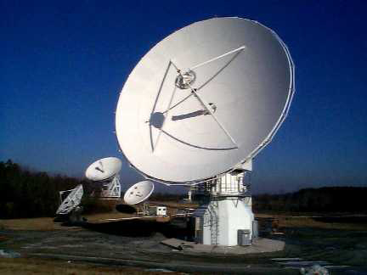
Joint NWS & NESDIS/OSPO/SPSD
Quarterly Meeting & Telecon
Tuesday, March 12, 2013
1700-1830 UTC (1:00-2:30 PM EDT)
Presented by Matthew Seybold
Location: NCWCP Conference Room 3552
Telephone: (877) 774-2087 Passcode: 237799#
WebEx: https://spsd.webex.com/spsd/onstage/g.php?t=a&d=731044755
Meeting Material:
ftp://satepsanone.nesdis.noaa.gov/Presentations/Joint_NWS-NESDIS_Quarterly/20130312
Notes:
As a U/S Coordinator, I work with the user community on anomaly impact assessments, operational transitions, future continuity planning.
Images
Satellite Image - GOES-13/14/15 (GOES-N/O/P)
Derived and Interpretive Products Image - Infrared Imagery with overlay of Heavy Precipitation (Rain & Snow) Interpretive Analysis from SAB (Satellite Analysis Branch)
Antennas at OSPO Wallops CDA (Command and Data Acquisition Station), symbolic of Direct Broadcast Services.
Title Slide Background and Banner were designed by TeddyPavlis@gmail.com

Slide 2
Thank you to Content Providers!
NESDIS / OSPO / MOD
Kevin Ludlum
John Tsui
Renee Smith
Dong Han
Chris Sisko
NESDIS / OSPO / SPSD
Natalia Donoho
John Paquette
Tom Renkevens
Antonio Irving
Hanjun Ding
Zhaohui Cheng
A.K. Sharma
Liqun Ma

Slide 3
Meeting Agenda
Contact Info
Goals
Existing Action Items
GOES Status
  Summer SRSOs
  RSO Review
  Meteosat-10
  Himawari-8/9
  Future GEO
POES Status
  NOAA-17 Decommissioning
  NPP / JPSS
  METOP-B
  GCOM-W1
  M-T, GPM, Others
CIP MPLS Failover
PATRON Software for ESPC Help Tickets and CRM
ESPC Product Requests and Promotions
GOES-R DOST, Steve Ambrose
Product Development
  Precipitation Products, M-T, GPM; Ralph Ferraro
Discussion
Notes:
Here is what we will be covering this afternoon.

Slide 4
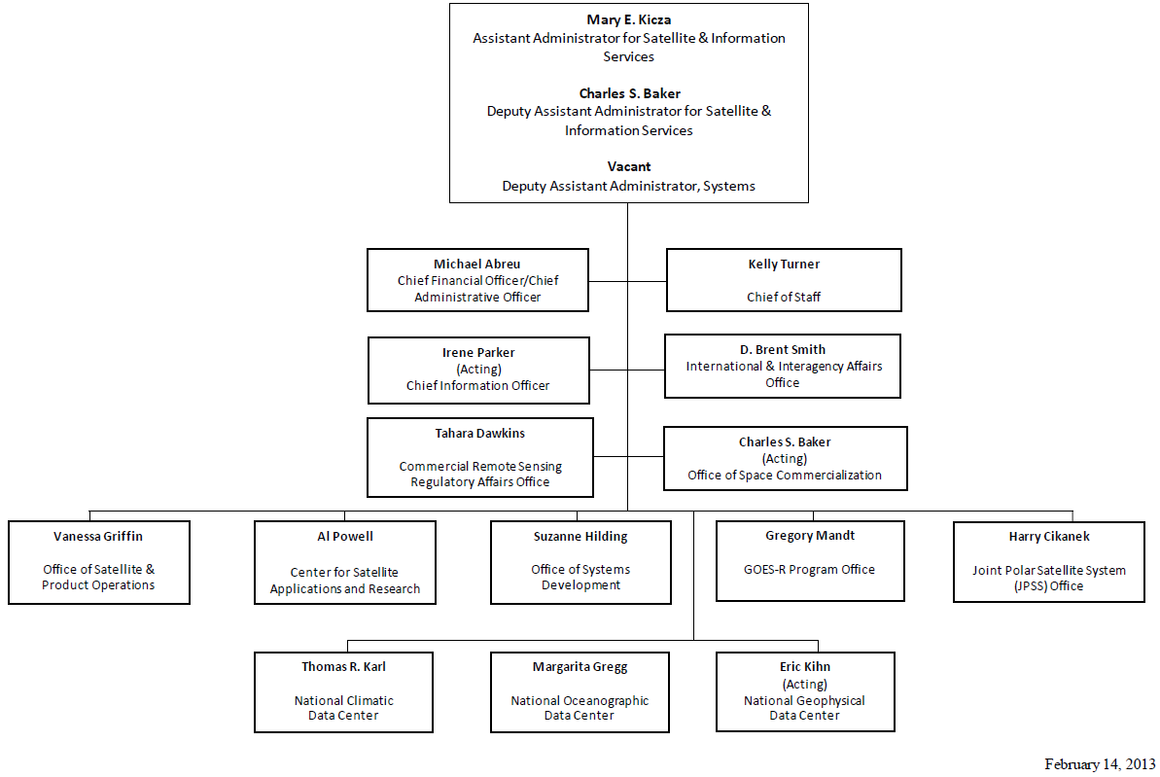
NESDIS

Slide 5
Office of Satellite and Product Operations (OSPO)
Director
Vanessa Griffin
Admin Officer
Linda Brown
Corporate
Services
Keith Amburgey
Special Projects Selina Nauman
Deputy Director
Deborah Barr (a)
MOD
Ron Mahmot
Wallops CDA
Doug Crawford
Fairbanks CDA
Larry Ledlow
National Ice Center
Sharolyn Young
SPSD
Dave Benner
Deputy: Linda Stathoplos
Deputy: Tom Renkevens
Operations
Al McMath
Acronyms
CDA – Command and Data Acquisition
MOD – Mission Operations Division
SPSD – Satellite Products and Services Division
Operations
Joe Perez (a)
Satellite Products
Ricky Irving
Support
Stephen Howard
Support
Mike Settles
Satellite Analysis
Davida Streett
Systems Engineering
Bob Clark
Systems
Alva Barnette
Direct Services
Chris O’Connors
SPSD User Services
Engineering
Bob Finson (a)
Matthew Seybold
Work: (301) 683-3248
Cell: (202) 557-4997
Matthew.Seybold@noaa.gov
Natalia Donoho
Work: (301) 683-3242
Cell: (202) 604-0734
Natalia.Donoho@noaa.gov
IT Services
Andre Hammond
Notes:
OSPO is a NESDIS line office along with OSD, STaR, GOES-R, JPSS, Climate Offices, and Staff Offices
MOD – includes Command & Control at NSOF, satellite engineering, and systems support
The CDA (Command and Data Acquisition) sites are at Wallops, VA and Fairbanks, AL.
The National Ice Center is a joint Navy, NOAA, and Coast Guard office that resides at NSOF.
SPSD is home to all of the R2O algorithm transition work in Ricky Irving’s Products Branch, Interpretive Analysis in Davida Street’s SAB, Chris O’Connors’ Direct Services, and User Services is on staff level.
Natalia and I are located with the products division under David Benner and Tom Renkevens.

Slide 6
Meeting Goals
Share status and updates
Improve communication
Provide an open forum for satellite customers to provide feedback to user services
Questions and discussion are encouraged!
Notes:
Goals… Hopefully in the process more clarity is provided and less confusion remains.

Slide 7
Existing Actions Items
Action Items from Prior meeting – October 17, 2012 are listed below
Action! User Services – Ken Johnson RE NPP – Is there a master list showing which models use which satellite radiance data?
  Michelle Mainelli says EMC has this information and will share with Natalia.
  Susan Callis – requests the same info from above.
  DONE

Slide 8
Satellite Data (Radiances) Used by Assimilation
Satellite | GFS | NAM | RAP
NOAA-15 (AMSU-A) | Yes | Yes | Yes
NOAA-15 RARS (AMSU-A) | Yes | No | NO
NOAA-17 (HIRS-3) | No | No | Yes
NOAA-18 (AMSU-A, MHS) | Yes | Yes | Yes
NOAA-19 (HIRS-4, AMSU-A, MHS) | Yes | Yes | No
METOP-A (HIRS-4, AMSU-1, MHS) | Yes | Yes | Yes
AQUA (AIRS, AMSU-A, IASI) | Yes | Yes | No
GOES-13 (SOUNDER) | Yes | No | No
GOES-15 (SOUNDER – over water only) | Yes | No | No
METEOSAT-9 (SEVIRI) | Yes | No | No
S-NPP (ATMS) | Yes | No | No

Slide 9
Satellite Data Retrieved Products/Ozone/Radar/GPSRO
Satellite | GFS | NAM | RAP
TRMM (TMI – rain rate, clw, cloud ice) | Yes | No | No
GOES-13 and GOES-15 (IMAGER – ctp, ctt, cloud fraction clw, cloud levels) | No | No | Yes
NOAA-17, -18, -19 (SBUV-2 – ozone) | Yes | No | No
AURA (OMI – ozone) | Yes | No | No
WSR-88D (Level 2 radial wind, level 2.5 radial wind superobs, level 3 (NIDS) radial wind superobs | No | Yes | No
WSR-88D – Reflectivity | No | No | Yes
COSMIC-1 to COSMIC-6, GRACE-A and METOP-2(A) - refraction/bending angle | Yes (b) | Yes (r) | No
SAC-C ,TerraSAR-X, and C/NOFS–bending angle | Yes | No | No

Slide 10
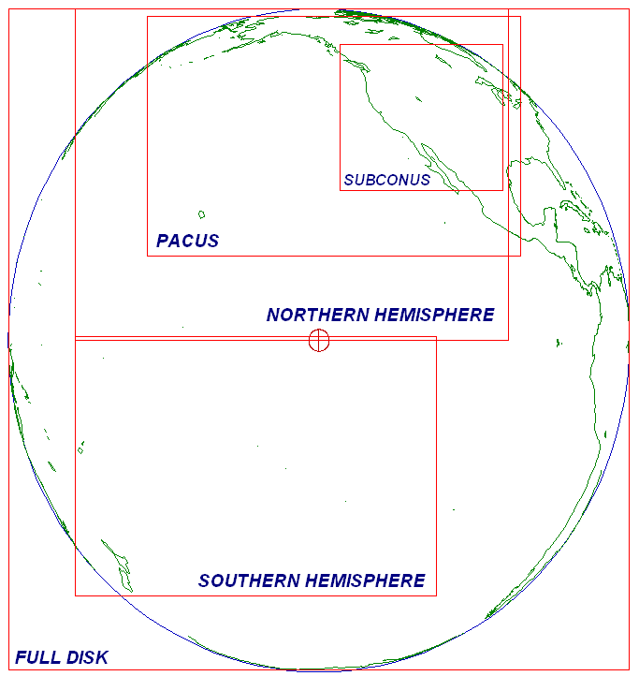
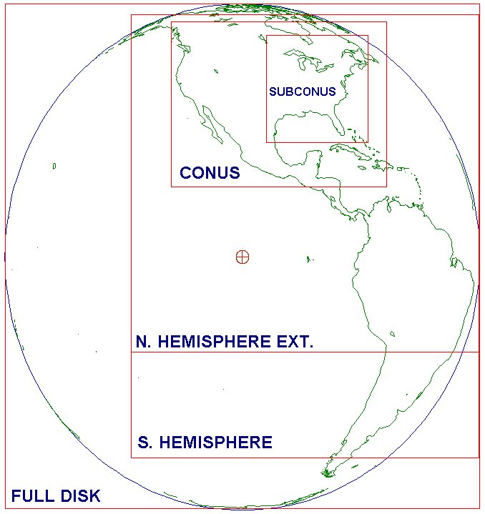
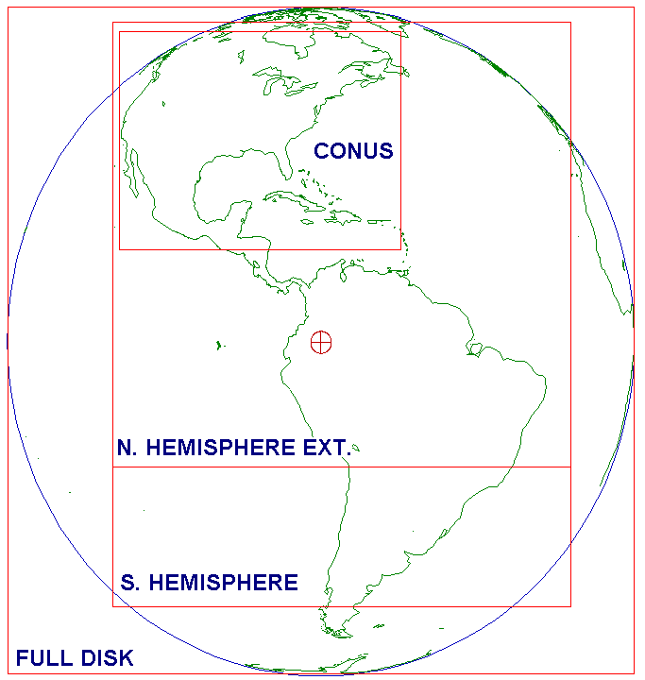
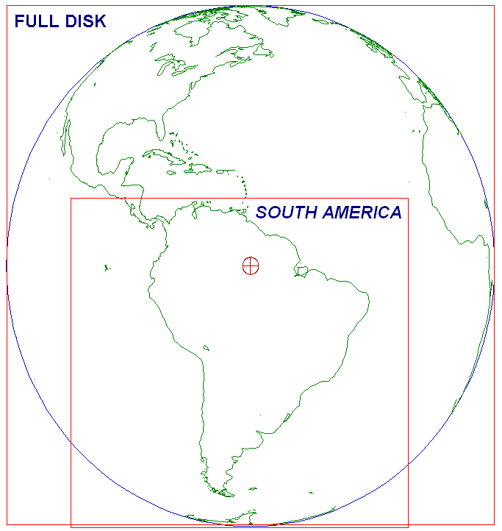
Present Status of GOES Constellation
(Imager Routine Schedules with 15 minute CONUS Coverage)
GOES-15
West
(135°W)
Stray Light Algorithm Applied
Optimized Schedule
GOES-14
Standby
(105°W)
Stray Light TB Applied at Activation
Optimized Schedule
GOES-13
East
(75°W)
Stray Light Algorithm Applied
Schedule TB Optimized ~May 2013
GOES-12
S. America
(60°W)
GOES-14: 2-3 weeks in August, 2013
  Normal operations mode for health & safety testing
  GOES-14 SRSO Plan will be reviewed by OSPO Director
http://www.ospo.noaa.gov/Operations/GOES/schedules.html

Slide 11
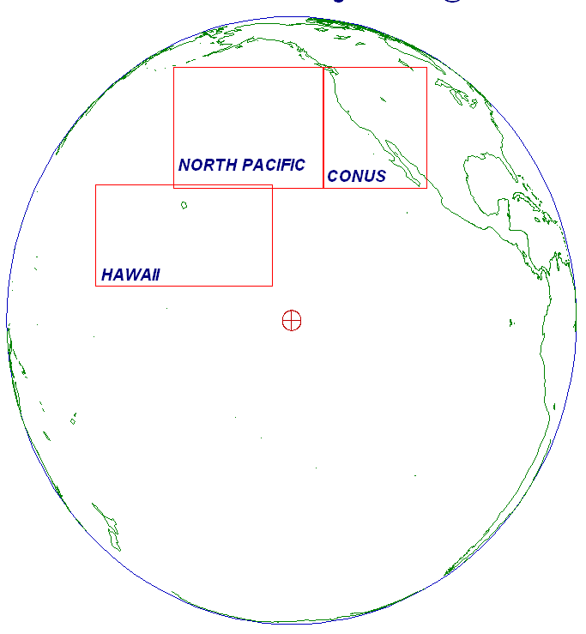
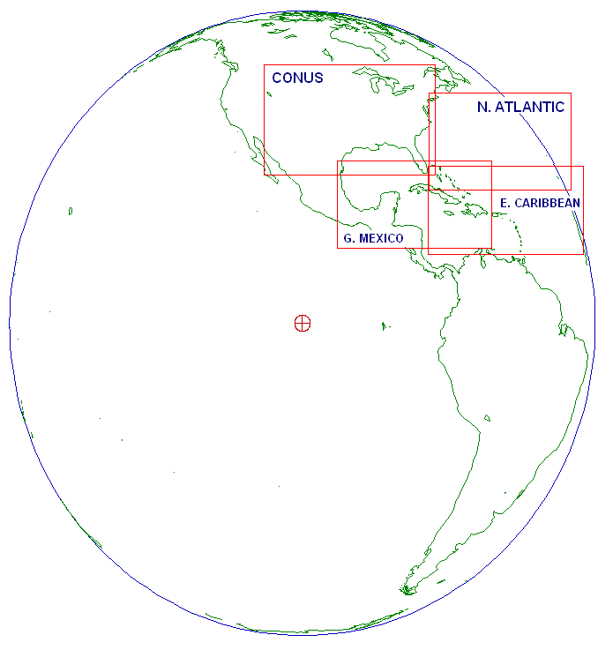
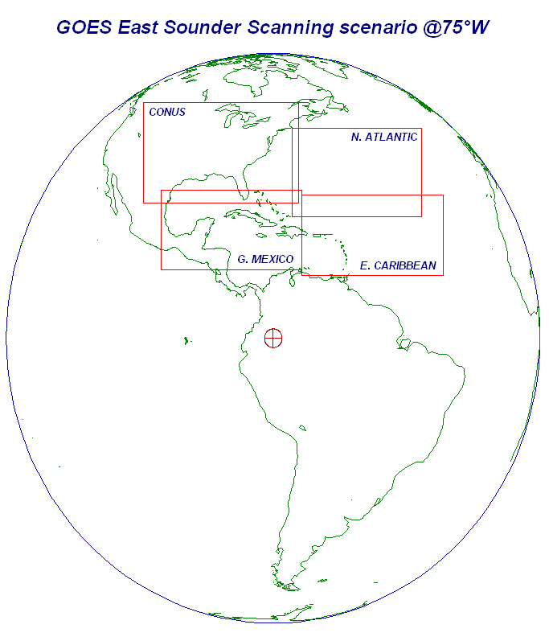
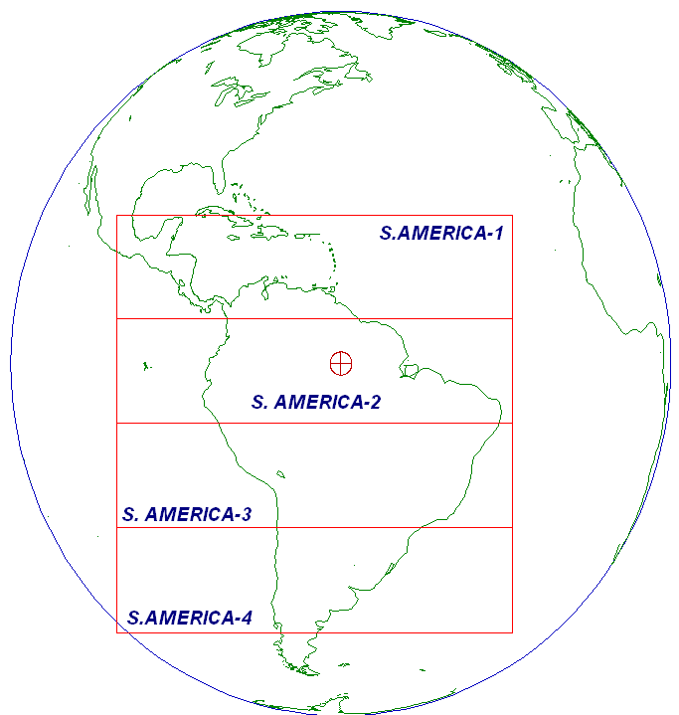
Present Status of GOES Constellation
(Sounder Routine Schedules)
GOES-15
West
(135°W)
GOES-14
Standby
(105°W)
GOES-13
East
(75°W)
GOES-12
S. America
(60°W)
GOES-14: 2-3 weeks in August, 2013
  Normal operations mode for health & safety testing
http://www.ospo.noaa.gov/Operations/GOES/schedules.html

Slide 12
GOES Status (March 1, 2013) http://www.oso.noaa.gov/goesstatus
Payload Instrument | GOES-12 (S. America) Launch: Jul 01 Activation: Apr 03 | GOES-13 (Standby) Launch: May 06 Activation: Apr 10 | GOES-14 (East) Launch: Jun 09 Activation: N/A | GOES-15 (West ) Launch: Mar 10 Activation: Dec 11
Imager | S/C (1) | G | G | G
Sounder | Y (2) | Y (15) | G | Y (11)
Energetic Particle Sensor (EPS) | Y (3) | G | G | G
Magnetometers | G | G | G | G
High Energy Proton and Alpha Detector (HEPAD) | G | G | G | G
X-Ray Sensor (XRS) | Y (4) | R (8) | G | G
Solar X-Ray Imager (SXI) | R (5) | Y (9) | G | S/C (12)
Spacecraft Subsystems
Telemetry, Command & Control | G | G | G | G
Attitude and Orbit Control | S/C (14) | G | G | G
Inclination Control | R (6) | G | G | G
Propulsion | Y (7) | S/C (10) | G | G
Mechanisms | G | G | G | G
Electrical Power | G | G | G | G
Thermal Control | G | G | G | G
Communications Payloads | G | G | G | S/C (13)
Key
Operational
Spacecraft issues but no user impacts
Operational with limitations
Non-operational
G
S/C
Y
R
Notes:
1

Slide 13
GOES Status (March 1, 2013) http://www.oso.noaa.gov/goesstatus
Payload Instrument | GOES-12 (S. America) Launch: Jul 01 Activation: Apr 03 | GOES-13 (Standby) Launch: May 06 Activation: Apr 10 | GOES-14 (East) Launch: Jun 09 Activation: N/A | GOES-15 (West ) Launch: Mar 10 Activation: Dec 11
Imager | S/C (1) | G | G | G
Sounder | Y (2) | Y (15) | G | Y (11)
Energetic Particle Sensor (EPS) | Y (3) | G | G | G
Magnetometers | G | G | G | G
High Energy Proton and Alpha Detector (HEPAD) | G | G | G | G
X-Ray Sensor (XRS) | Y (4) | R (8) | G | G
Solar X-Ray Imager (SXI) | R (5) | Y (9) | G | S/C (12)
Spacecraft Subsystems
Telemetry, Command & Control | G | G | G | G
Attitude and Orbit Control | S/C (14) | G | G | G
Inclination Control | R (6) | G | G | G
Propulsion | Y (7) | S/C (10) | G | G
Mechanisms | G | G | G | G
Electrical Power | G | G | G | G
Thermal Control | G | G | G | G
Communications Payloads | G | G | G | S/C (13)
Key
Operational
Spacecraft issues but no user impacts
Operational with limitations
Non-operational
Sounder short-wave channel noise. Operating with both windings on. Sounder out-gassing in October, 2012 improved noise levels.
G
GOES-15 Sounder temperature control blanket is raised. Yaw flip at Equinox to keep Sun angle below cooler plane. Data outage and degraded products during each yaw flip maneuver and 28 hours of INR recovery period.
GOES-12 X-ray Imager has failed. No recovery possible.
S/C
GOES-13 X-Ray Sensor Failed. No x-ray space measurements being collected.
GOES-12 Inclination Control is non-operational. No fuel remains for inclination control maneuvers. Code was loaded to mitigate image motion at slightly inclined orbit. XGOHI (eXtended GOES High Inclination.) Users should expect a 4 minute delay from the time actually imaged. As with the past GOES-10, users should also expect if there is a frame break during an image that the rest of the image will be lost. Without XGOHI, the growing satellite inclination would continue to cause loops with an ever increasing "wobble".
Y
SXI detector damage due to flare. User impact - 9 rows currently affected out of 512 total.
R
Notes:
1

Slide 14

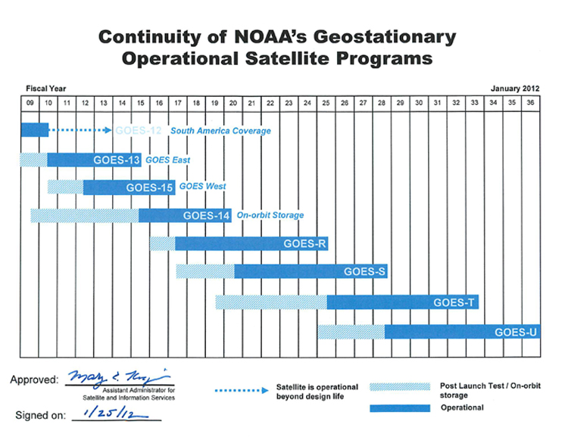
GOES Flyout Schedule
GOES-12 was launched in July, 2001
Original plan was to serve South America for three years ending in May, 2013
However, decommissioning is currently scheduled for August, 2013
http://www.nesdis.noaa.gov/FlyoutSchedules.html http://www.goes-r.gov
Notes:
GOES-R is the next generation of GOES satellites that will provide a major improvement in quality, quantity, and timeliness of data collected.
New and improved capabilities for:
decreased lead times for severe weather warnings
better storm tracking capabilities
solar, space weather, and climate analyses
advanced products for aviation, transportation, commerce

Slide 15
Review of RSOs & SRSOs
GOES-Variable (GVAR) RSO/SRSO Plan provides increased frequency of scan transmissions
RSOs double the quantity of routine scan transmissions over CONUS in a half hour period to four (~7.5 minute intervals). SRSOs (subset of RSOs) allow for 1 minute intervals. Full disk scans still occur every 3 hours on or near synoptic times.
Operational RSOs and Operational SRSOs (require approval from operational centers, including SAB) are submitted from requesting NWS users including SPC, NHC, HPC, CPHC, and NWS Forecast Offices through their regional focal points to the SDM, who submits request to ESPC Help Desk.
Research SRSOs (do not require approval from operational centers) are submitted from Field Campaign technical POCs (e.g. Tim Schmit, Dan Lindsey) to SAB, who submits request to ESPC Help Desk.
http://www.ospo.noaa.gov/Operations/GOES/schedules.html

Slide 16
Review of RSOs & SRSOs
In both cases, SAB's role is to provide input on potential impact to critical warning services, in-progress or anticipated critical operations ,and other ESPC operational concerns.
SRSO requests must include a lat/lon center point
There are automatic RSO triggers from SPC, TPC
RSO requests require 1 hour advance notice, except for "special sectors" (e.g., Hawaii, Alaska, Sitka), which require 2 hours notice. SRSOs require 2 hours as well.
It may take up to an hour to cancel an active RSO/SRSO.
http://www.ospo.noaa.gov/Operations/GOES/schedules.html

Slide 17
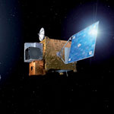
Eumetsat GEOs
Meteosat-10 Operational
On January 21, Meteosat-10 replaced Meteosat-9 as EUMETSAT’s primary geostationary satellite at 0 degrees
Prior to operations, Meteosat-10 data streaming tests (2-3 hours) were performed to validate users’ data ingest and processing systems
User notifications were set out by NESDIS prior to each test period
  During the first test on Dec. 13, 2012, NESDIS discovered a “bug” in decrypting M-10 data at user sites
    After encryption key code reconfiguration changes were made, another test was performed on January 17, 2012
      this test also failed
    To avert additional user impacts while the investigation continued, NESDIS coordinated with EUMETSAT to send in-the-clear (unencrypted) Meteosat-10 data starting January 21
      This configuration enabled users to receive the full data set without degradation

Slide 18
Eumetsat GEOs
Meteosat-10 Operational
On February 20 and 27, final encryption and user decryption validation tests were performed
  On February 27, Meteosat-10 standard rebroadcast via U.S. DOMSAT was restored
    All users reported successful decryption
Present
  Meteosat-10 and Meteosat-9 split primary duties at 0° and 3.5° East (backup status)
  Meteosat-8 is at 9.5° East
  Meteosat-7 is over Indian Ocean at 57.5° East
Future – Might switch 8 and 9 positions (next slide)

Slide 19
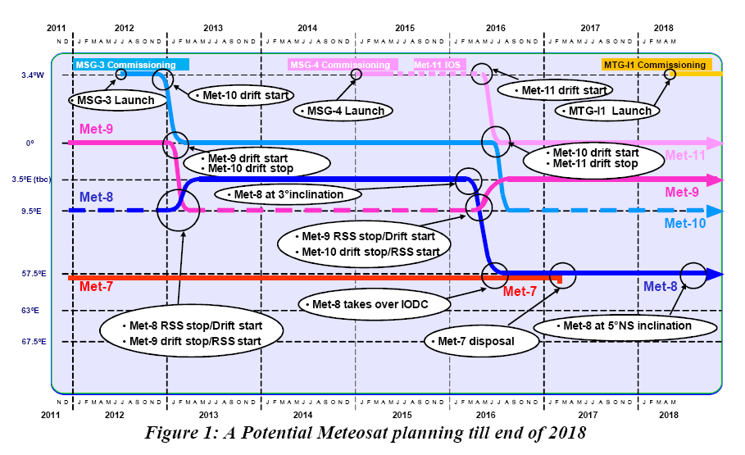
Eumetsat GEOs
Slide from AMS - June 2012
Meteosat-7 was supposed to reach end of life in 2014, but now extended 3 years.

Slide 20
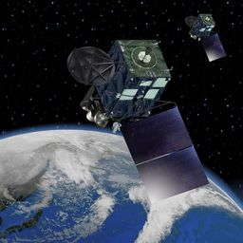
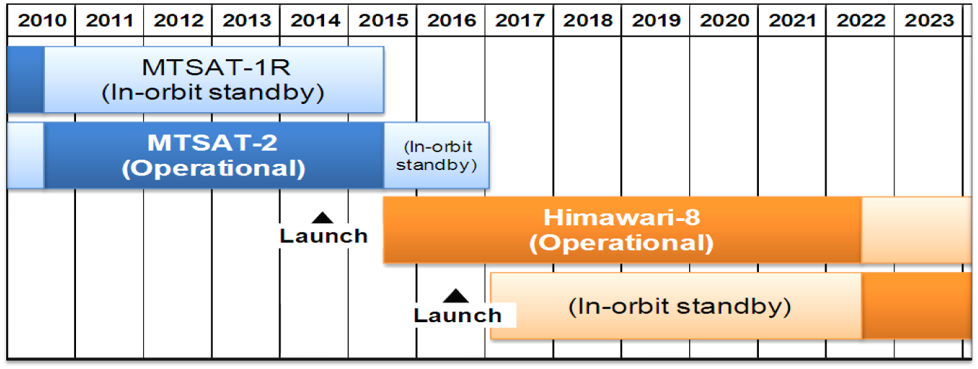
JMA GEOs
Himawari-8/9 (sunflower)
There is no L-band on these satellites. There is dialogue with JMA and COPC partners on if/how to get data back to the U.S.
JMA plans to launch Himawari-8 in 2014 and transition to operations in 2016
The launch of Himawari-9 for in-orbit standby is also scheduled in 2016
Himawari-8/9 will be in operation around 140 degrees East covering the East Asia and the Western Pacific

Slide 21
JMA GEOs
MTSAT-2 Transition to Himawari-8
Himawari-8 will replace MTSAT-2 operations at 140E in 2016
  H-8 is analogous to GOES-R having 16 spectral channels at the same and temporal resolutions
  However, H-8 will not have a transponder for DRO users
  In the absence of a transponder, JMA plans to provide the data set via the Internet to serve users
  Internet access being deemed unacceptable to support real-time data requirements, NOAA is investigating other communication options to retransmit real-time H-8 data from JMA to the U.S. including Guam and NWS PR:
    Using a provided COMSAT from JMA to rebroadcast an equivalent MTSAT spectral channel (current set available to users) from the Himawari-8 Advanced Himawari Imager (AHI)
      COMSAT testing scheduled by JMA for mid-March 2013
        Results will be relayed to NOAA/NESDIS
      FD scans will be available every 10 minutes versus the current hourly and NH every 30 minutes
    Using a dedicated link from JMA to NOAA/NESDIS to retransmit a sub-set or all spectral channels from AHI
      This is highest user priority conditional on availability of funds
  Bottom line – The situation is dynamic. There is a plan and desire to obtain all data; however, there may ultimately be some sacrifice… spatial, temporal, spectral.

Slide 22
POES Status (Mar 4, 2013)
http://www.oso.noaa.gov/poesstatus/index.asp
Operational | G
Spacecraft Issue but no User Impact | S/C
Operational with Limitation | Y
Non-Operational | R
Not Applicable | N/A
Spacecraft Subsystems | METOP-A | NOAA-19 | NOAA-18 | NOAA-17 | NOAA-16 | NOAA-15
Launch Date | Oct 2006 | Feb 2009 | May 2005 | Jun 2002 | Sep 2000 | May 1998
Operational Date | May 2007 | Jun 2009 | Aug 2005 | Oct 2002 | Mar 2001 | Dec 1998
Mission Data Category | Primary (AM) | Primary (PM) | Secondary (PM) | Secondary (AM) | Secondary (PM) | Secondary (AM)
Payload Instruments
AVHRR | G | G | G | R (11) | Y(13) | Y(20)
HIRS | G | G | Y (3) | Y (28) | Y(14) | R (6)
AMSU-A1 | Y(26) | G | G | R (4) | Y(15) | Y(21)
AMSU-A2 | G | G | G | G | G
AMSU-B | N/A | N/A | N/A | Y (9) | G | R (12)
MHS | G | Y (8) | G | N/A | N/A | N/A
SEM | G | G | G | G | G | G
SBUV | N/A | S/C (9) | R (29) | G | Y(16) | N/A
Spacecraft Subsystems
Telemetry, Command & Control | G | G | G | G | G | G
ADACS | G | G | Y (7) | Y (27) | Y(17) | Y(10)
EPS | G | G | G | Y(25) | G | G
Thermal Control | G | G | G | G | G | Y(22)
Communications | Y (1) | G | G | S/C (5) | G | Y(23)
APT/LRPT | R (2) | G | G | G | R(18) | G
DCS | N/A | N/A | G | G | G | G
ADCS | G | G | N/A | N/A | N/A | N/A
SAR | G | G | G | G | Y(19) | Y(24)

Slide 23
POES Status (Mar 4, 2013)
http://www.oso.noaa.gov/poesstatus/index.asp
Operational | G
Spacecraft Issue but no User Impact | S/C
Operational with Limitation | Y
Non-Operational | R
Not Applicable | N/A
Spacecraft Subsystems | METOP-A | NOAA-19 | NOAA-18 | NOAA-17 | NOAA-16 | NOAA-15
Launch Date | Oct 2006 | Feb 2009 | May 2005 | Jun 2002 | Sep 2000 | May 1998
Operational Date | May 2007 | Jun 2009 | Aug 2005 | Oct 2002 | Mar 2001 | Dec 1998
Mission Data Category | Primary (AM) | Primary (PM) | Secondary (PM) | Secondary (AM) | Secondary (PM) | Secondary (AM)
Payload Instruments
AVHRR | G | G | G | R (11) | Y(13) | Y(20)
HIRS | G | G | Y (3) | Y (28) | Y(14) | R (6)
AMSU-A1 | Y(26) | G | G | R (4) | Y(15) | Y(21)
AMSU-A2 | G | G | G | G | G
AMSU-B | N/A | N/A | N/A | Y (9) | G | R (12)
MHS | G | Y (8) | G | N/A | N/A | N/A
SEM | G | G | G | G | G | G
SBUV | N/A | S/C (9) | R (29) | G | Y(16) | N/A
Spacecraft Subsystems
Telemetry, Command & Control | G | G | G | G | G | G
ADACS | G | G | Y (7) | Y (27) | Y(17) | Y(10)
EPS | G | G | G | Y(25) | G | G
Thermal Control | G | G | G | G | G | Y(22)
Communications | Y (1) | G | G | S/C (5) | G | Y(23)
APT/LRPT | R (2) | G | G | G | R(18) | G
DCS | N/A | N/A | G | G | G | G
ADCS | G | G | N/A | N/A | N/A | N/A
SAR | G | G | G | G | Y(19) | Y(24)
AVHRR Scan Motor Failed
HIRS Filter Wheel Stalled, N17 & METOP-A still available to users
HIRS Longwave channel noise
*New - HIRS LW IR Channels 1-7 & 10 increased noise levels. Degraded data for products.
AMSU-B Antenna Scan Motor Failed, METOP-A MHS still available to users
AMSU –A1 Scan Motor Failed
N15 still available to users
*New - Chopper Motor Stalled. No usable data generated
Transmitter off, no LRPT
APT 1 & 2 Failed, N19 still available to users
Notes:
LRPT: Low Rate Picture Transmission
HIRS: High-resolution Infrared Radiation Sounder

Slide 24
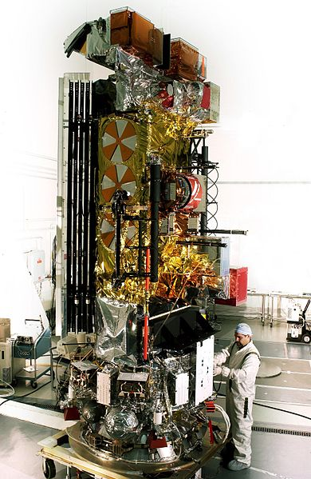
NOAA-17 Decommissioning
NOAA-17 (NOAA-M) was launched on June 24, 2002
After nearly 11 years of service NOAA-17 will be ready for decommissioning no sooner than March 20, 2013
The actual date of decommissioning is TBD because 15 day congressional notification is required
Decision based on evaluation of NOAA-17’s health, ability to provide meaningful data to the scientific and weather community, and resource demands in NESDIS/OSPO

Slide 25

Suomi NPP - Mission Status
Date | Activity
10 / 2011 | Launch
2 / 2012 | ECMWF is assimilating NPP ATMS
6 / 2012 | NCEP using ATMS radiances in the GFS model
10 / 2012 | AWIPS will add VIIRS imagery for Alaska
3 / 4-8 / 2013 | Testing of temperature/humidity soundings to TNCF
On-going | Testing with primary customers is well underway with the NDE group at NSOF testing with NCEP, AFWA, NAVO, FNMOC, EUMETSAT, and others
7 / 31 / 2013 | ESPC takes over with 24x7 product generation, monitoring, and notifications
10 / 2013 | Temperature/humidity soundings delivered to AWIPS2
2014 | NCEP planning to add CrIS radiances to operational model
At next quarterly, Chris Sisko (OSPO/MOD JPSS-DOM) will present slides on the Product Distribution and Access (PDA) system due in late 2014.
Notes:
All instruments remain in nominal operations mode with full science data production (VIIRS, CrIS, ATMS, OMPS, CERES)
OSD is providing 8 x 5 (and best effort) monitoring & notifications
Ongoing T2O meetings towards July, 2013 target and 24 x 7 monitoring

Slide 26

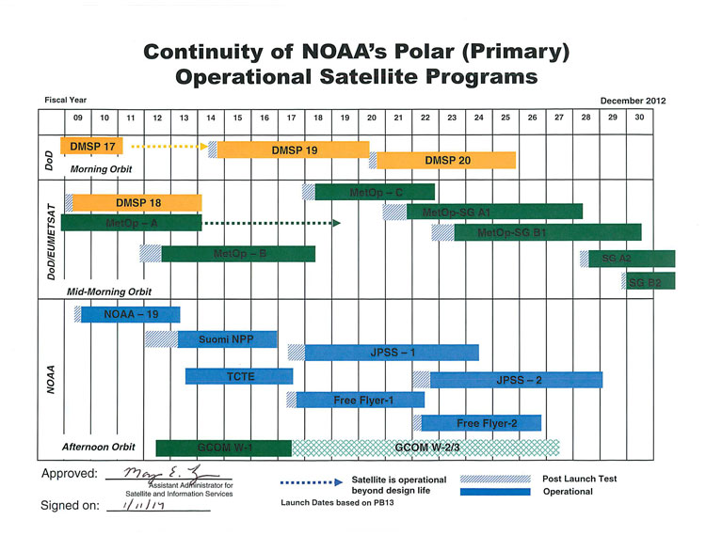
LEO Flyout Schedule
Free Flyer-1 & 2
Carry Argos-DCS, SARSAT, TSIS (Total Solar Irradiance Sensor)
TCTE
Total Solar Irradiance Calibration Transfer Experiment aboard STPSat-3
http://www.nesdis.noaa.gov/FlyoutSchedules.html http://www.jpss.noaa.gov
Notes:
NOAA responsibility for the JPSS satellites and ground systems operations after the launch, early orbit and activation phase, nominally 90 days after each launch.
What this means for OSPO:
Includes Operations at NOAA/NSOF by OSPO of JPSS and NPP satellites
Continue operations of DMSP
Capacity and flexibility to operate future DOD polar-orbiting satellites in morning orbit(s) on a cost reimbursement basis
Includes all hardware and software to process and disseminate NPP and JPSS data and products to NOAA and DOD Centrals, to NOAA’s Archives and to NASA’s SDS (for NPP)
NOAA will assume sustainment of the JPSS ground system one year after the launch of JPSS-1.

Slide 27
Aqua
NWS gap mitigation request for status of AMSU and MODIS on Aqua
Requests for information were all directed to a single POC, Wynn Watson
Project Manager
at GSFC’s Earth Science Mission Operations (ESMO) Project
Very little insight provided
Aqua doing very well with fuel to last through 2020
All systems nominal

Slide 28

EUMETSAT LEOs: Metop-B Status
Launched on September 17, 2012 (50 minutes behind Metop-A)
All instruments have passed cal/val and level 1b data are available through direct readout
NESDIS/OSPO/SPSD developing level 2 products from NOAA supplied instruments
  AVHRR/3
  HIRS
  AMSU-A1
  AMSU-A2
    Scheduled for operations ~April 24, 2013
Notes:
Metop-B Instruments & Products:
ASCAT – Winds
IASI, AMSU-A, HIRS/4 – Soundings
AVHRR – Fires
GOME-2 – Ozone
MHS – Cyclones
Searth & Rescue
SEM – Space Obs

Slide 29
EUMETSAT LEOs: Metop-B Status
EUMETSAT will implement product applications from their provided instruments around June 2013
EUMETSAT will make decision on whether Metop-A or Metop-B, both AM satellites, will become primary in June 2013
  Metop-B Instruments & Products:
  ASCAT – Winds
  IASI, AMSU-A, HIRS/4 – Soundings
  AVHRR – Fires
  GOME-2 – Ozone
  MHS – Cyclones
  Searth & Rescue
  SEM – Space Obs
Notes:
Metop-B Instruments & Products:
ASCAT – Winds
IASI, AMSU-A, HIRS/4 – Soundings
AVHRR – Fires
GOME-2 – Ozone
MHS – Cyclones
Searth & Rescue
SEM – Space Obs

Slide 30
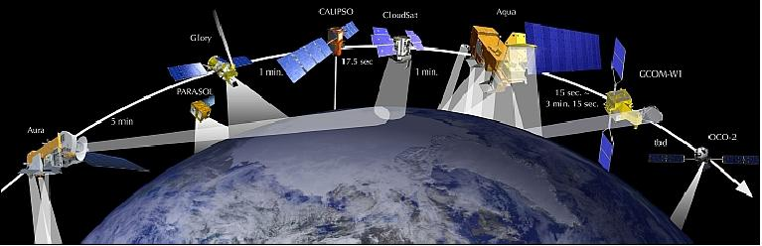
JAXA LEO: SHIZUKU GCOM-W1
- In afternoon “A-Train”
Carries AMSR-2
Focus on water obs
- Successor to Aqua and is part of the GEOSS (Global Earth Observation System of Systems)
- NESDIS is working closely with JAXA to prepare for JAXA AMSR2 executable code on NOAA systems to process AMSR2 data for level 1 products.
STAR is preparing to produce level 2 products operationally by September 2013.
…more on GCOM-W1 in Ralph Ferraro’s Slides
Notes:
The "Global Change Observation Mission" (GCOM) aims to construct, use, and verify systems that enable continuous global-scale observations (for 10 to 15 years) of effective geophysical parameters for elucidating global climate change and water circulation mechanisms.

Slide 31
More Future LEO Satellites
Year | Satellite
Early 2014 | Megha-Tropiques (M-T) Precipitation Products
2014 | NASA JPL's Soil Moisture Active Passive (SMAP)
2014 | NASA GSFC's Global Precipitation Measurement (GPM) (Follow-on to TRMM)
2016 | Joint Taiwan-U.S. FORMOSAT-7/COSMIC-2 (12 birds in this constellation!) GPS Radio Occultation micro satellites with high spatial/temporal resolution of temperature and moisture profiles used for climate studies, defense, and space weather models
…more on M-T & GPM in Ralph Ferraro’s Slides

Slide 32
Notifications & Status
General Satellite Messages from ESPC: http://www.ssd.noaa.gov/PS/SATS/messages.html
WMO Bulletins on the GTS (Global Telecommunications System):
  WMO header NOUS71 KNES (AWIPS ID ADANES) for urgent notices (e.g., outages or anomalies) http://www.weather.gov/view/validProds.php?prod=ADM&node=KNES
  WMO header NOUS72 KNES (AWIPS ID ADMNES) for routine notices (e.g., eclipse schedule, RSO, etc.) http://www.weather.gov/view/validProds.php?prod=ADA&node=KNES
Non-Operational Sources:
Sat Ops Status: http://www.oso.noaa.gov/daily-news/index.asp
Twitter: http://twitter.com/noaasatellites
Facebook: https://www.facebook.com/NOAANESDIS
Press Releases: http://www.nesdis.noaa.gov/news_archives/

Slide 33
Planned CIP Backup Exercise http://www.osdpd.noaa.gov/ml/cip.html http://www.osd.noaa.gov/Spacecraft%20Systems/Ground_Systems/CIP/cip.html
  This exercise will test the near-seamless fail-over to the CIP in the event NSOF is disabled (Last tested August 11 & 16, 2011)
  The MPLS (Multi-Protocol Label Switching) cloud serves as a common communications interface for both the CIP at Wallops and ESPC at NSOF
  Exercise is tentatively planned for April 16, 2013 for 6 hours
    Network Failover to ESPC/CIP: 1 hour (8:30-9:30 AM EDT, 1230-1330Z)
    Product Distribution/Network Sustainability: 4 hours
    Network switchback to ESPC/NSOF: 1 hour (1:30-2:30 PM EDT, 1730-1830Z)
  Should be transparent, except for non-CIP products (e.g. IASI, SFOV, NDE, MODIS)
  All products that will NOT be available will be listed on web site as well as email notification
Notes:
NCEP, NWSTG, AFWA, FNMOC, AWIPS will all be served.
This exercise will affect normal ESPC data distribution. ALL available ESPC data/products will be generated and distributed at the ESPC/CIP site. NO distribution will be available from ESPC/NSOF during this test.
It’s not a system swap or interchange
(Diamond for Diamond-CIP)
It’s not a component swap or interchange
(server / switch ie. AFEP for AFEP-CIP)
Its when you redirect specific users to retrieve data from CIP instead of NSOF

Slide 34
GOES-R News – PATRON
GOES-R Ground Segment Early Enterprise Management Project
PATRON (Product, Anomaly, Ticket, Related user Organization, and Notification tool)
PATRON is new software for ESPC Help Ticket Management and Customer Relationship Management (CRM)
Access is gained through the Harris Collaboration Portal (HCP) for GOES-R. The software went operational on January 31, 2013.
Implementing PATRON, now, gives OPSO an early use of the CMART (Configuration Management and Anomaly Reporting and Tracking) system coming to OSPO in the GOES-R era

Slide 35
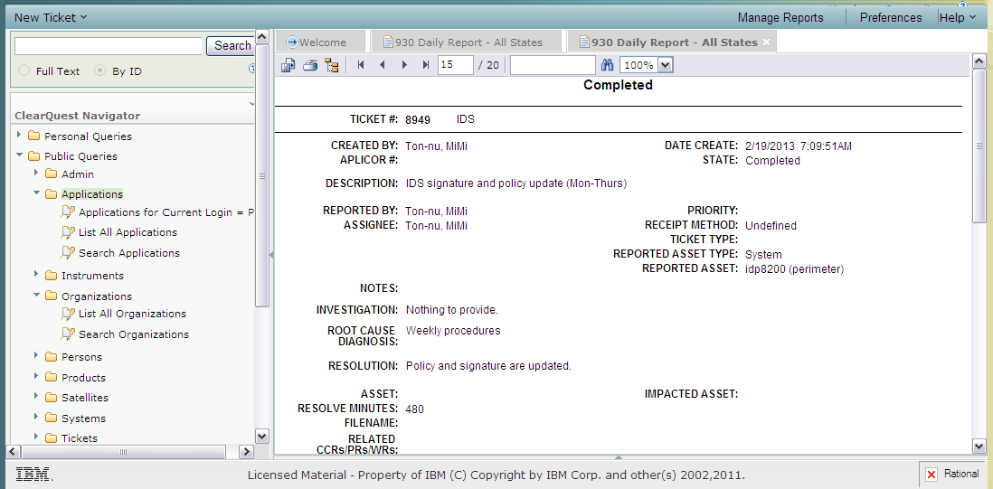
GOES-R News - PATRON
PATRON was configured in IBM Clearquest as a Microsoft SQL Database

Slide 36
PATRON CRM Metrics
35 Satellites carrying 182 instruments are used in
183 Applications to produce 1,065 end products¹
170 Servers conduct ingest, generation, distribution²
568 User organizations access the end products
~600 Users
A
B
C
D
E
~1,100 End Products
1
2
3
4
5
30,500+
Subscriptions
Plus Many Direct Readout Users!
¹ End products vary by satellite, instrument, region, format, resolution
² Frequency of data delivery varies by product (e.g. event-driven, 1/day, 6/day, 300/day)
Notes:
An Application is the image or science software running in ESPC that ingests satellite data & generates End Products.
An End Product is generated by an Application and may vary by satellite, instrument, region, format, resolution, etc.
Frequency of data delivery varies by product (e.g. event-driven, 1/day, 6/day, 300/day).

Slide 37
GOES-R News: PATRON
Future PATRON Builds will address…
Legacy ESPC
  CM system (RATS) connectivity
  CI Database hosting
  SOCC Command & Control Ticket management
  Documentation & Procedures Library
  ESPC Daily Logs
Connectivity to PDA (Product Distribution & Access)
Connectivity to NOSA (NOAA Observing Systems Architecture)
Connectivity to SPEEDS (Legacy Satellite Product Catalogue)
Subscription Service to ESPC Asset Notifications (User-Selected by Satellite, Instrument, System, Application, Product)

Slide 38
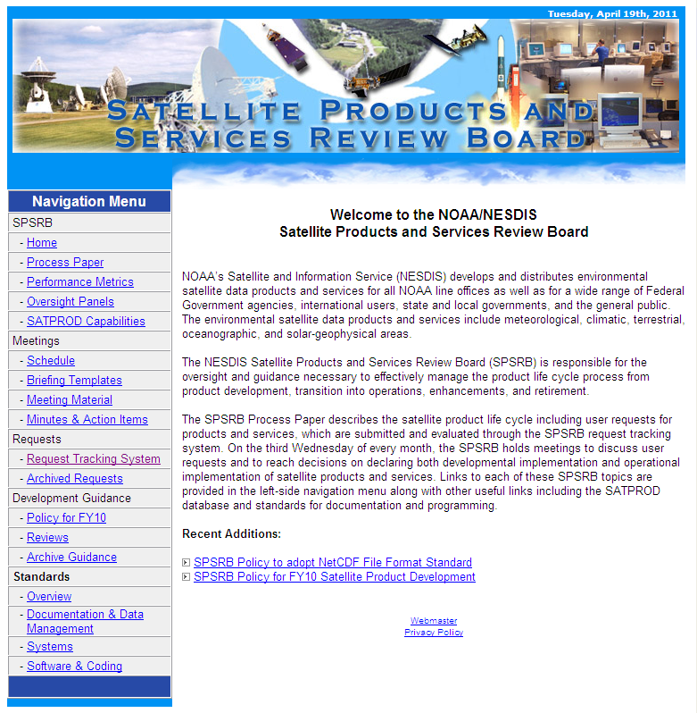
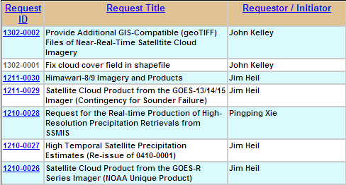
Product Requests via SPSRB
(Satellite Products & Services Review Board)
7 New Requests since October Quarterly!
… Cloud Imagery in geoTIFF format,
Himawari-8/9 Imagery & Products
GOES Satellite Cloud Product as a Sounder
Contingency
https://requesttracker.osd.noaa.gov/admin_login.asp
http://projects.osd.noaa.gov/spsrb
Notes:
For details on the entire SPSRB process, please refer to the SPSRB white paper which is available on the SPSRB web page (left panel).
Includes Development…
User Requests
Technical Assessments
Formation of Integrated Product Teams
Also includes Divestiture and Retirement of products and services being phased out.

Slide 39
New Products in Operations
Date | Product | Product Area Lead (PAL)
11 / 2012 | GOES Land Surface Temperature | Hanjun.Ding@noaa.gov
11 / 2012 | Vegetation Health | Hanjun.Ding@noaa.gov
2 / 2013 | MODIS Dust Mask | Liqun.Ma@noaa.gov
2 / 2013 | Product Quality Assurance & Science (PQAS-III) Support for Operational GOES Imager & Sounder Products | Awdhesh.Sharma@noaa.gov

Slide 40
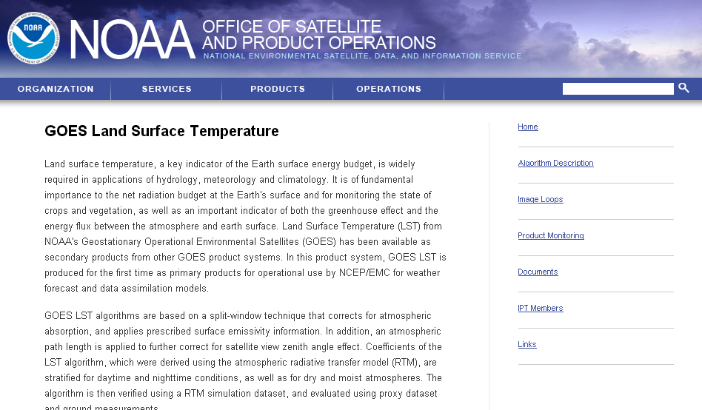
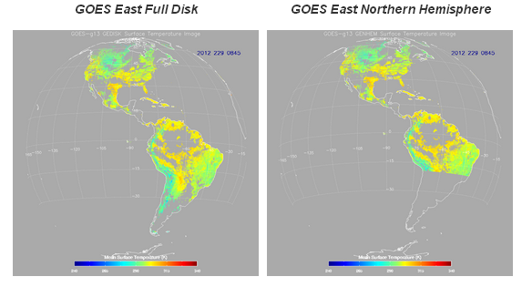
http://www.ospo.noaa.gov/Products/land/glst/index.html

Slide 41
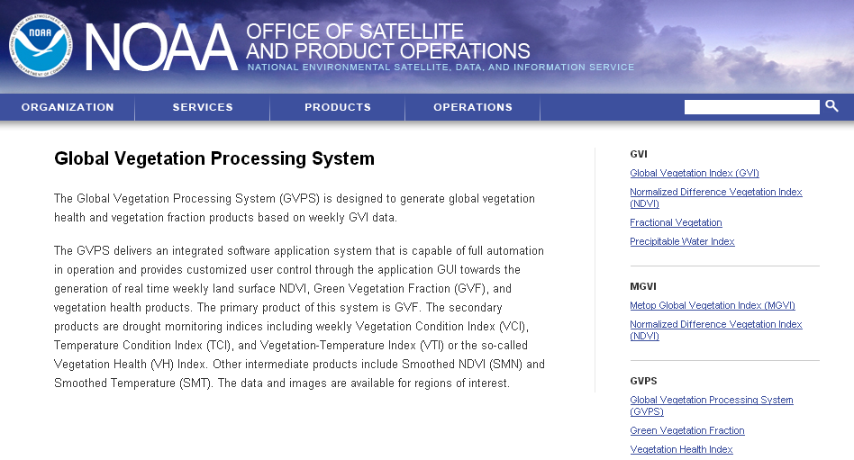
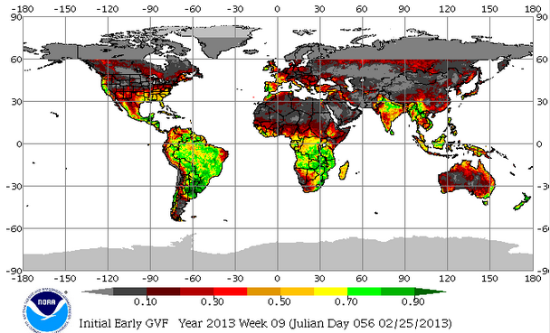
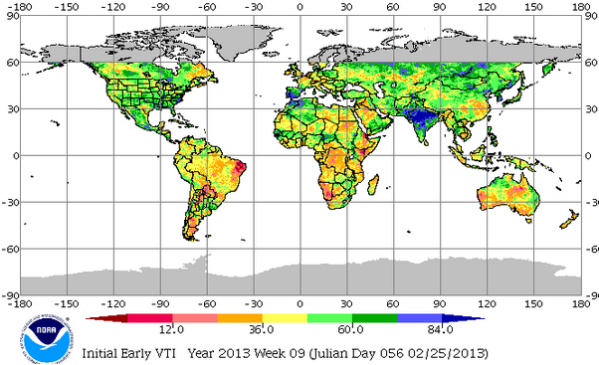
http://www.ospo.noaa.gov/Products/land/gvps/

Slide 42
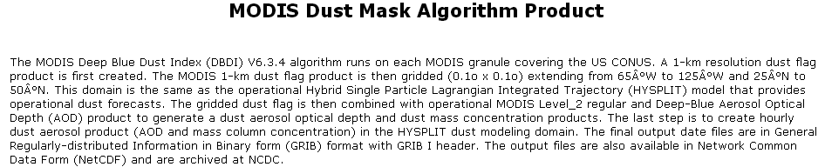
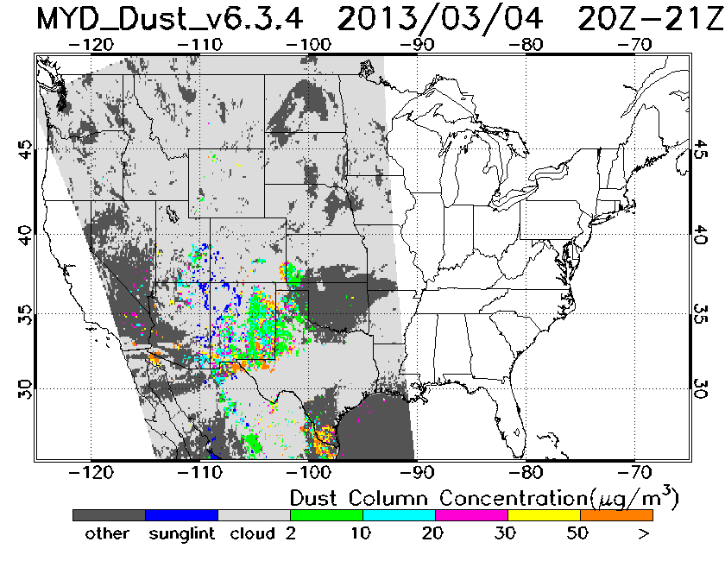
http://www.ssd.noaa.gov/PS/FIRE/DUST/dust.html

Slide 43
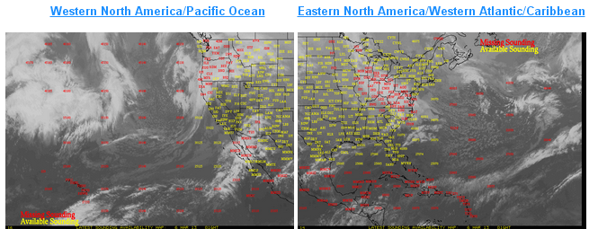
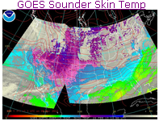
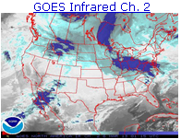
Product Quality Assurance & Science (PQAS-III) Support for Operational
GOES Imager & Sounder Products
A host of improvements: Bias corrections, Faster Timeliness, Improved Retrievals
http://www.osdpd.noaa.gov/skewt/
http://www.ssd.noaa.gov/PS/PCPN/pcpn-na.html
http://www.ospo.noaa.gov/Products/atmosphere/sounding/ggcp.html
http://www.ospo.noaa.gov/Products/atmosphere/soundings/index.html

Slide 44
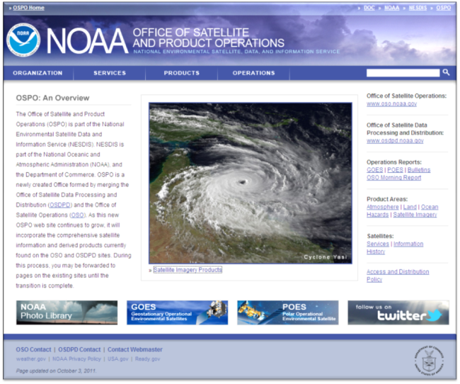
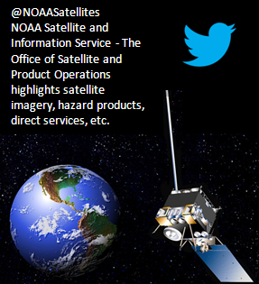

Contact Information
24/7 Help Desk | ESPCOperations@noaa.gov
User Services | SPSD.UserServices@noaa.gov
Data Access | NESDIS.Data.Access@noaa.gov
Webmaster | SSDWebmaster@noaa.gov
Web | www.ospo.noaa.gov
 | www.facebook.com/NOAANESDIS
 | www.twitter.com/noaasatellites

Slide 45

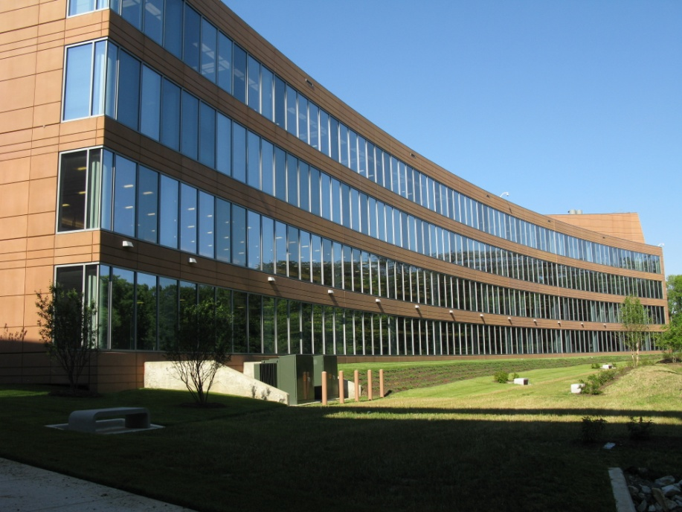
Is anyone on line who was planning to attend as part of Group Travel Request, but now cannot make it?
Agenda is Full - Maximum number of Talk and Poster Abstracts has been reached!
497 Registrants, 25 Exhibits
Deadline for registering is March 15, 2013
Deadline for Poster Presenter’s 1-Page Summaries is March 21, 2013!

Slide 46
Remaining Agenda Items
GOES-R DOST, Steve Ambrose
Product Development
  Precipitation Products, M-T, GPM; Ralph Ferraro
Discussion

Slide 47
BACKUP SLIDES

Slide 48
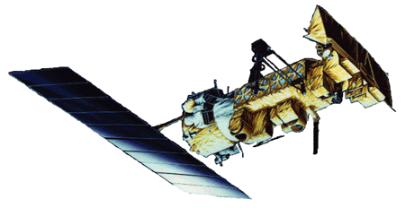
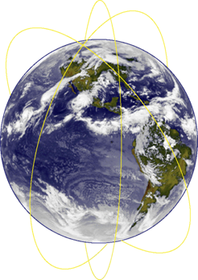
Polar-Orbiting Local Times
Metop-A – 0930 AM Primary
NOAA-19 – 1334 PM Primary
Metop-B – Launched 9/17
  Currently in PLT & Commissioning Phase
NOAA-18 – 1502 PM Secondary
NOAA-17 – 0656 AM Back-up
NOAA-16 – 2040 PM Secondary
NOAA-15 – 0444 AM Secondary

Slide 49




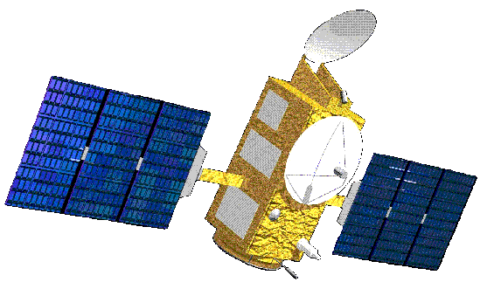


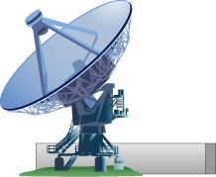
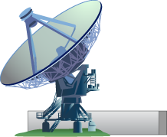
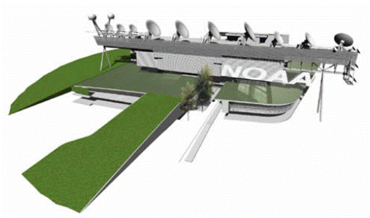


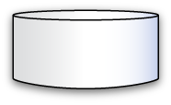

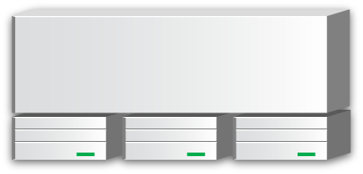
Satellite Information Flow
POES NOAA-19 (PM)
Center for Satellite Applications
and Research (STAR)
GOES-15 (West)
GOES-13 (East)
Non-NOAA
(Jason, DMSP, Meteosat, MTSAT,
EOS, COSMIC, others)
Product Development
Algorithm Development
Science Maintenance
METOP-A (AM)
Office of Satellite and Product Operations (OSPO)
Also:
GOES-14 (Standby)
GOES-12 (S.A.)
POES-18/17/16/15
Satellite Operations Control Center
Environmental Satellite Processing Center
Fairbanks Ground
Station - POES
Wallops Ground
Station - GOES
Command and Control
Process and Distribute
Office of Systems Development (OSD)
Data
Products
Customers
Ground Systems
IT Enterprise Architecture
Archive and Access
(CLASS)
NESDIS Data Centers
Notes:
GOES-12 is not received at ESPC, but does go to Wallops and NSOF for INR (Image Nav. & Registration), etc. Imagery obtained via CIMSS for SPSD.
Main functions of the ESPC operational system include:
Ingesting data from NOAA satellites and other sources (e.g., NSOF acquires data from ~20 non-NOAA satellites)
Processing the data to generate useful products
Distributing the products to users
Non-NOAA systems are leveraged through agreements which require no direct exchange of funds between NOAA and the inter-agency or international partner, except for Radarsat-2. Radarsat-2 is a public-private venture. NOAA pays for or leverages other Federal agency acquisitions of data from this system.
EUMETSAT - European Organisation for the Exploitation of Meteorological Satellites
JMA – Japan Meteorological Agency
CMA – China Meteorological Agency
CNES – French Space Agency
ESA – European Space Agency
ISRO - Indian Space Research Organization
CSA – Canadian Space Agency
NPSO - National SPace Organization (Taiwan)

Slide 50
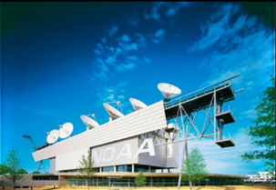
NESDIS Office of Satellite and Product Operations
(OSPO) Key Roles
Ground System Command & Control, Ingest, Product Generation and Distribution for the nation’s 17 environmental satellites
  4 Geostationary (GOES) by NOAA
  5 Polar-Orbiting (POES) by NOAA
  6 Defense Meteorological Satellite Program (DMSP) operated by NOAA
  1 OSTM Jason-2 (Ocean Surface Topography Mission) Joint NOAA, NASA, CNES, EUMETSAT effort
  1 Suomi National Polar-orbiting Partnership (NPP) by NOAA & NASA
NSOF
Pre-Launch and Post-Launch Testing
Operational Testing, Validation, and Verification
User Readiness
Long-Term Continuity of Products and Services
Notes:
OSPO is a NESDIS line office along with OSD, STaR, GOES-R, JPSS, Climate Offices, and Staff Offices
MOD – includes Command & Control at NSOF, satellite engineering, and systems support
The CDA (Command and Data Acquisition) sites are at Wallops, VA and Fairbanks, AK.
The National Ice Center is a joint Navy, NOAA, and Coast Guard office that resides at NSOF.
SPSD is home to all of the R2O algorithm transition work in Ricky Irving’s Products Branch, Interpretive Analysis in Davida Street’s SAB, Chris O’Connors’ Direct Services, and User Services is on staff level.
Natalia and I handle the user services roles.

Slide 51
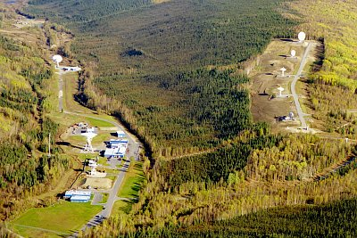
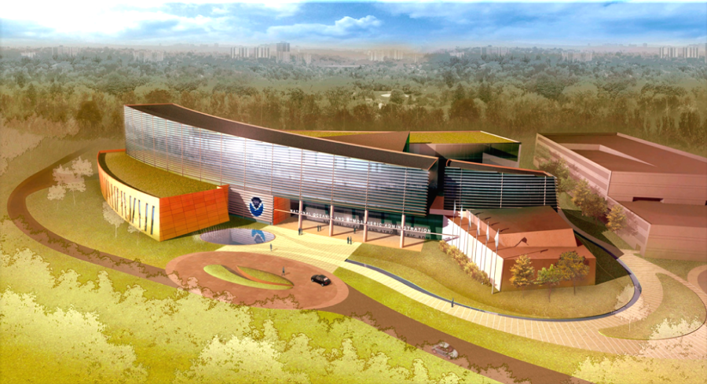
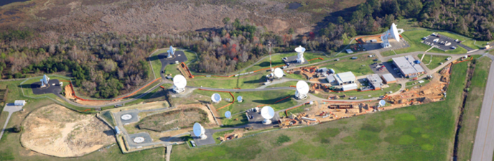
NESDIS Office of Satellite and Product Operations
(OSPO)
Locations at four facilities housing 700 OSPO staff
NOAA Satellite Operations Facility (NSOF) in Suitland, MD - $5B facility operating $5B of satellites
NOAA Center for Weather & Climate Prediction (NCWCP) in College Park, MD
Fairbanks CDA
NCWCP
Wallops CDA
Notes:
NCWCP is home to NWS / NCEP (NCO, EMC, HPC, OPC); NWS / ARL; NESDIS / STaR & OSPO
The CDA (Command and Data Acquisition) sites are at Wallops, VA and Fairbanks, AK.

Slide 52
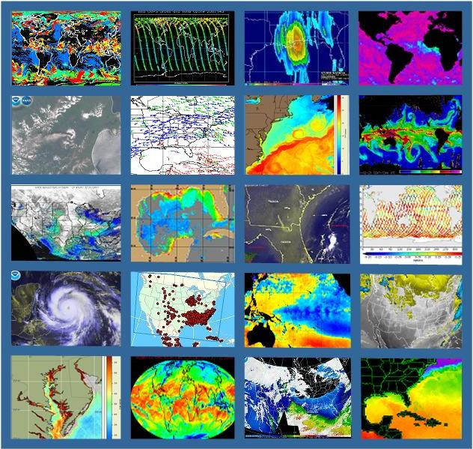
Products (Derived & Interpretive)
Atmospheric Chemistry
Atmospheric Temperature
Fire and Smoke
Hurricane Intensity and Position
Imagery (e.g. Visible, IR, WV)
Land Cover – Ice, Snow, Vegetation
Ocean Color
Satellite Derived Winds (WS,WD,H)
Sea Surface Height & Temperature
Sounder Profiles and Imagery
Space Weather
Volcanic Ash and many more…
In 2012:
26 Requests for New Products
10 Promotions of New or Enhanced Products
Notes:
Here is a sample of satellite products (derived & interpretive) .
Satellite Imagery is the #1 tool of hurricane forecasters.

Slide 53




Direct Broadcast Services
SARSAT (Search and Rescue Satellite Aided Tracking)
Argos (Global Data Collection and Relay System)
GOES DCS (Data Collection System)
Broadcast Services
  Geonetcast
  EMWIN (Emergency Managers Weather Information Network)
  GVAR (GOES VARiable data transmission format)
  and others… (e.g. International HRPT, GOES LRIT)
Notes:
GVAR (GOES VARiable data transmission format)
LRIT (Low Rate Information Transmission)
EMWIN (Emergency Managers Weather Information Network)
DCS (Data Collection System)
Argos
SARSAT (Search and Rescue Satellite Aided Tracking)
Geonetcast
SARSAT Search and Rescue:
NOAA satellites are used to relay distress alerts from aviators, mariners and
land-based users
http://www.sarsat.noaa.gov/
Argos and GOES Data Collection Systems:
NOAA satellites are used to collect and relay scientific data from around the globe.
http://www.noaasis.noaa.gov/DCS/ http://www.noaasis.noaa.gov/ARGOS/
Geonetcast Americas:
Data from NOAA for diverse societal benefits - agriculture, energy, health, climate,
weather, disaster mitigation, biodiversity, water resources, and ecosystems.
http://www.geonetcastamericas.noaa.gov/index.html
Emergency Managers Weather Information Network (EMWIN):
NOAA satellites relay critical information to users across the country.
http://www.weather.gov/emwin/index.htm
Low Rate Information Transmission (LRIT):
NOAA geostationary satellites are used to relay satellite and weather products to users in remote
locations, that do not have landlines or internet connections.
http://www.noaasis.noaa.gov/LRIT/
HRPT (High Resolution Picture Transmission)
Sept 22 – COSPAS-SARSAT detected Emergency Position Indicating Radio Beacon (EPIRB) East of Boston, Massachusetts. The EPIRB was activated when a fishing vessel began taking on water. Coast Guard District 1 (CGD01) received the SARSAT alert and communicated with the vessel by radio. A Coast Guard aircraft arrived at the SARSAT position and provided the vessel with an additional pump. The vessel's crew controlled the flooding, and turned off the beacon at the request of CGD01. 7 SARSAT RESCUES
Sept 22 - COSPAS-SARSAT system detected a 406 MHz Personal Locator Beacon (PLB) 140 nm south of Barrow, Alaska. Two men, who had been rescued previously on September 15 when their single-engine Cessna crashed when its landing gear collapsed during takeoff, took a charter plane to the crash site in order to repair the landing gear on the damaged aircraft and fly it home. The charter plane returned home due to poor weather and the two men stayed at the crash site. They could not repair the aircraft and activated their PLB. Alaska Rescue Coordination Center (AKRCC) received the SARSAT alert and sent it to North Slope Borough Search and Rescue (NSB). NSB requested assistance because of the poor weather. An Alaska Air National Guard HC-130 was dispatched to the SARSAT location, and dropped supplies and a radio to the stranded aviators. The two men said they would wait for the weather to clear enough for a helicopter to reach them, and would reactivate their PLB if another emergency occurred. Two days later, a North Slope Borough SAR helicopter picked up the 2 men and transported them to Barrow. 2 SARSAT RESCUES

Slide 54


Data Access Services
Current Access Services (in addition to Direct Broadcast)
  Data Distribution Service (DDS) - sFTP push/pull from secure accounts
  NWS Telecommunications Gateway - in BUFR (Binary Universal Format) format
  GINI (GOES Ingest and NOAAPORT Interface) / NOAAPORT for Advanced Weather Interactive Processing System (AWIPS)
  SATEPSDIST – GOES, POES, and Derived Products
  Websites
Archival
  NODC, NGDC, and NCDC archive data products using CLASS
Notes:
Note photo of customer antennas from one of the local companies – SSEC at U. of Wisconson-Madison.
The NOAAPORT broadcast system provides a one-way broadcast communication of NOAA environmental data and information in near-real time to NOAA and external users. This broadcast service is implemented by a commercial provider of satellite communications utilizing C-band.
The overall flow of the major operational components that feed data to NOAAPORT is shown in the figure below.
Consolidation of Future Access Services
Product Distribution and Access (PDA) – consolidates distribution functions for legacy systems, and enterprise distribution from GOES-R and NDE.
Customer Use of Servers…
GINI: NOAAPort/AWIPS, NWS, Unidata
Satepsdist: NWS/NCEP, DOD, STAR, SAB, Universities, Private Industry
DDS: NWS/NCEP/EMC, ECMWF, UKMET, STAR, DOD

Slide 55
User Community Data Access (1 of 2)
National Weather Service (NWS)
  National Centers for Environmental Prediction (NCEP)
    via N-AWIPS, AWIPS, Direct Broadcast, sFTP, Internet, ADDE (Abstract Data Distribution Environment)
  Weather Forecast Offices and River Forecast Centers
    via AWIPS (Advanced Weather Interactive Processing System) and Internet
National Ocean Service (NOS)
    via Internet and sFTP (secure File Transfer Protocol)
National Marine Fisheries Service (NMFS)
    via Internet and sFTP
Federal
  DoD, DoI, DoT, USDA, EPA, NASA, FEMA, NTSB, USGS, USFS
  via Shared Processing (DAPE), Internet, sFTP, Direct Broadcast, NOAAPORT, ADDE
International
  EUMETSAT, ECMWF, UKMET, JMA, KMA, CNES, ESA, ISRO, CMA, NPSO, CSA
    via Direct Broadcast, Internet, ADDE
Notes:
DAPE – Defense Acquisition Processing
ADDE - Man Computer Interactive Data Analysis System (McIDAS) Abstract Data Distribution Environment (ADDE)
DAPE – Data Acquisition Processing & Exchange Gateway for the Exchange of Environmental Satellite Data between DOD and Civilian Meteorological Agencies.
NOAAPORT - The NESDIS-managed GOES Ingest and NOAAPORT interface (GINI) uses NOAAPORT, the NWS-managed AWIPS Satellite Broadcast Network (SBN), to provide broadcast and reliable multicast data transmission to field sites. Transmitted data include: Centrally collected radar data, GOES imagery, NCEP model data, field observations, and watches and warnings.
ECMWF - Europe
UKMET - UK
Eumetsat – Europe
JMA -Japan
KMA - Korea
CNES - France
ESA - Europe
ISRO - India
CMA – Chinese Meteorological Agency
NPSO – Taiwan
CSA - Canadian Space Agency

Slide 56
User Community Data Access (2 of 2)
Private Industry
  Forecasters, Airlines, Research Organizations
    via Direct Broadcast, NOAAPORT, Internet, ADDE
Universities and Cooperative Institutes
    via Direct Broadcast, NOAAPORT, Internet, ADDE
International Meteorological Services
  Central and South America, New Zealand, France; Research institutions, Volcanic Ash Advisory Centers. Media and Private Users
    via Direct Broadcast, NOAAPORT, GeoNetCast
General Public
    via Internet, ADDE (with approved Data Access Request or via anonymous FTP servers or via McIDAS-V)
    Public demand for GOES imagery during a land falling hurricane can account for as much as 300 million web site “hits” per week, and over 10 Tb of data served!

Slide 57




Interpretive Analyses for Hazard Mitigation
Fire and Smoke Detection
Heavy Rain and Snow Advisories/Briefings
Tropical Position and Intensity Classification
Oil
© ESA 2010
Oil Spill and Marine Debris Detection
Volcanic Ash Detection and Forecast
Notes:
57
Operational products are staffed and supported 24 x 7 x 365 but Marine Debris is not (yet) an operational product. SAB is staffing marine debris only as a part time effort of 4 satellite analysts. However presence of SAB analysts around the clock assures that SAB can perform some marine debris related tasks 24 x 7 including requesting imagery in response to sightings.
Oil spill work is a close collaboration with USCG and NOS. Both accidental spills and illegal oil dumping from vessels are monitored. During Deepwater Horizon, 250 near real time oil analyses from SAB provided information to DOD, DOI, DOC, state and local responders, and daily oil analysis composites provided guidance for planners and the media.
Daily Briefings available to POTUS during Deepwater Horizon.
Support of Japan during Tsunami disaster and response to the Fukoshima Power Plant Shutdown.

Slide 58
Future GEO Plans
At this point, NESDIS is not pursuing COMS (Korea) or Elektro-L (Russia) GEO data
There are no validated operational user requirements for such data.
SSEC is working with KMA, so OSPO may be able to gain access to COMS from SSEC (similar to CMA FY2)

