Slide 1
GOES Evapotranspiration and Drought Product System (GET-D) Operational Readiness Review (ORR) February 3, 2016
Prepared By: Hanjun Ding (OSPO), Jerry Zhan (STAR), Rao Venkata(SGT) Zhengping Li (IMSG), Priyanka Roy (IMSG)

Slide 2
ORR Agenda
Introduction Ding
Risks and Actions Ding
System Requirements Roy
System Description Venkata
System Test Venkata
System Operational Readiness Ding
Summary Ding

Slide 3
Section 1 –
Introduction
Hanjun Ding

Slide 4
Project Objectives
ET and drought maps generated from the Atmosphere-Land Exchange Inversion model (ALEXI) for NCEP/NIDIS/USDA users
The products are generated from the brightness temperature (BT) of the GOES East and West Imagers
Coverage and resolution: North America at a spatial resolution of 8 km
ET product: Daily, over clear-sky pixels
Drought product: 2, 4, 8, 12-week composites updated daily
Output format: GRIB2, NetCDF and PNG

Slide 5
Integrated Product Team
IPT Lead: Xiwu (Jerry) Zhan (STAR)
IPT Backup Lead: Hanjun Ding (OSPO)
NESDIS Team:
STAR: Chris Hain, Li Fang, Zhengpeng Li , Priyanka Roy, Istvan Laszlo
OSPO: Hanjun Ding, Zhaohui Cheng, Ricky Irving
OSD: Tom Schott
Data Center: Phil Jones (NCDC)
Others: Venkata Rao Anne (SGT)
User Team
Lead: Mike Ek (NCEP-EMC)
Others:
NCEP-EMC: Youlong Xia
NCEP-CPC: Kingtze Mo, Jin Huang
NDMC-UNL: Brian Wardlow, Mark Svoboda
USDA: Martha Anderson (ARS), Zhengwei Yang (NASS), Curt Reynolds (FAS)
Oversight Panel (OP) lead: Land POP
Other OPs involved: ERBPOP

Slide 6
Project Stakeholders
NESDIS
STAR
OSPO
OSGS
NCEI
NDE
NWS/NCEP EMC
NWS/NCEP CPC
NDMC-UNL
USDA FAS

Slide 7
Project Plan (1)
Year 1 – Design and Development (2013 – 2014)
Develop Requirements Document
Identify ancillary data for the algorithms
Conduct CDR
Compute software development

Slide 8
Project Plan (2)
Year 2 –Transition to Pre-Operations (2014 – 2015)
Deliver initial DAP (Framework with pre-operational algorithms) to OSPO
Conduct Software Review
Update algorithms
Transition and test system within the OSPO environment
Perform test data flows
Conduct System Readiness Review
Deliver final DAP to OSPO
Notes:
Priyanka: Changed “Test Readiness Review” to “Algorithm Readiness Review”
Priyanka: Deleted slide Project Plan (3)

Slide 9
Project Timeline
ORR 02/03/16
Notes:
Priyanka 09/03/14: Updated

Slide 10
Project Milestones
Critical Design Review – 08/21/2014
Software Review – 7/17/2015 (October 2014)
System Readiness Review – 08/31/2015 (October 2014)
Operational Readiness Review – 02/03/2016 (September 2015)
SPSRB Briefing – 02/17/2016

Slide 11
ORR Entry Criteria
Requirements Document
SPSRB #0905-0007, “A GOES Thermal Observation Based Evapotranspiration (ET) Product”
Review Contents:
Requirements
Software Architecture
Algorithm Readiness
Risks and Actions

Slide 12
ORR Exit Criteria
GET-D ORR Report
The report will contain:
Actions
Comments
ARR presentation
Updated GET-D Review Item Disposition (RID) spreadsheet.
Updated GET-D Requirements Allocation Document (RAD)

Slide 13
Outline
Introduction
Risks and Actions
System Requirements
System Description
System Test
System Operational Readiness
Summary
13
Notes:
13
Priyanka: Changed
--“Project Plan” to “Introduction”
--“PDR Report to PDR Risks and Actions”

Slide 14
Section 2
Pre-ORR Risks and Actions
Hanjun Ding

Slide 15
CDR Risks and Actions
Risk # 1: Unavailability of optimal EVI data for input to the model that will eventually be used for creating the ESI climatology. Presently EVI is calculated from MODIS LAI product.
Impact: If a optimal EVI is not available, the quality of the drought product will be degraded.
Mitigation: A regression approach is being explored to estimate LAI from either:
VIIRS EVI
surface reflectance
Likelihood: Low
Severity: High
Assessment: Medium
Status: Closed
CONSEQUENCES
1
2
3
4
5
5
4
LIKELIHOOD
3
2
X
1

Slide 16
CDR Risks and Actions
Risk # 2: Project schedule will be impacted if the FY14 hardware purchase delay continues, since OSPO process for procuring hardware has changed with the new O&M contract.
Impact: Project Schedule.
Mitigation:
Likelihood: Medium
Severity: Medium
Assessment: Medium
Status: Closed
CONSEQUENCES
1
2
3
4
5
5
4
LIKELIHOOD
3
X
2
1

Slide 17
CDR Risks and Actions
Risk # 3: If the VIIRS Geolocation file (GITCO) is not included as an input to the GET-D System, the VIIRS VI EDR files will not be geolocated.
Impact: Product Quality.
Mitigation: Included GITCO file in the input
Likelihood: Low
Severity: High
Assessment: Medium
Status: Closed
CONSEQUENCES
1
2
3
4
5
5
4
LIKELIHOOD
3
2
X
1

Slide 18
CDR Risks and Actions
Risk # 4: If the plan to archive the product is not finalized, this product will not be archived.
Impact: Data archive.
Mitigation: The data submission agreement has already been submitted. Will follow up with NCDC and work with Phil Jones to finalize the process.
Likelihood: Medium
Severity: High
Assessment: High
Status: Open
CONSEQUENCES
1
2
3
4
5
5
4
X
LIKELIHOOD
3
2
1

Slide 19
CDR Risks and Actions
Risk # 5: Following OSPO's SMOMS contract situation, the project schedule may be impacted due to lack of SMOMS contract support.
Impact: Product Schedule.
Mitigation: PAL will work to ensure contract support is available.
Likelihood: Medium
Severity: High
Assessment: High
Status: Closed
CONSEQUENCES
1
2
3
4
5
5
4
LIKELIHOOD
3
X
2
1

Slide 20
CDR Risks and Actions
Risk # 6: There might be delay in testing if OSPO is not able to allot required disk storage for testing.
Impact: Product schedule.
Mitigation: STAR developers will provide am estimate of disk storage required for testing to OSPO.
Likelihood: Low
Severity: High
Assessment: Medium
Status: Closed
CONSEQUENCES
1
2
3
4
5
5
4
LIKELIHOOD
3
2
X
1

Slide 21
CDR Risks and Actions Summary
There were 6 CDR Risks and 5 are recommended to be closed
Open Risks Assessment: 1 High

Slide 22
ARR Risks and Actions
Review 1: Provide output file location and distribution information to user at least 1 week before data is sent out to allow time for making changes in scripts on the user side.
Mitigation: PAL will work with CPC user and OSPO’s product distribution team to provide the necessary information
Status: Closed

Slide 23
Risks and Actions Summary
Summary of Risks and Actions after ORR
1 CDR risk remain open
Open Risks Assessment: 1 High
Notes:
23

Slide 24
Outline
Introduction
Risks and Actions
System Requirements
System Description
System Test
System Operational Readiness
Summary
24
Notes:
24
Priyanka: Changed
--“Project Plan” to “Introduction”
--“PDR Report to PDR Risks and Actions”

Slide 25
Section 3 –
Requirements
Jerry Zhan Felix Kogan

Slide 26
Requirements Overview
All GET-D Project requirements are presented in this section.
All GET-D Project requirements are documented in a single RAD located in the project repository at:
Basic requirements are shown in all yellow text on a single slide.
Requirements which have been updated/added since the last review are in green.
Notes:
Changed, document name: “Joint Polar Satellite System (JPSS) Program Level 1 Requirements SUPPLEMENT – Final”

Slide 27
Basic Requirement 0
GET_D-R 0: The GOES Evapotranspiration and Drought (GET-D) Product System shall adopt the standard practices of the SPSRB Review Process
Driver: SPSRB transition to operations process

Slide 28
Basic Requirement 0.0
GET_D-R 0.1: The GET-D SPSRB reviews shall be tailored
This derived requirement has been adopted to mitigate schedule risk by eliminating the overhead of preparing review slide packages and reports. Details are in derived requirements 0.1.x.

Slide 29
Basic Requirement 0.0
GET_D-R 0.1.1: There shall be a Critical Design Review (CDR) (that contains information from a Requirements Review and the Preliminary Design Review) for GET-D.
This derived requirement has been adopted to mitigate schedule risk by eliminating the overhead of preparing a Requirements Review, PDR, and CDR slide packages separately. The Technical risk is assessed as Low because the CDR will be tailored to accomplish the standard objectives of a PDR and Requirements Review. Risks shall be tracked.

Slide 30
Basic Requirement 0.0
GET_D-R 0.1.2: The Critical Design Review Report (CDRR), a standard artifact of the SPSRB Process shall be compiled for the GET-D project.
The CDRR is one of the exit criteria for the CDR. The updated CDR slides will form the CDRR.
GET_D-R 0.1.3: There shall be a Software Code Review (SCR) for GET-D.
This derived requirement has been adopted for meeting OSPO coding and security standards.

Slide 31
Basic Requirement 0.0
GET_D-R 0.1.4: There shall be an System Readiness Review (SRR) for GET-D.
This derived requirement has been adopted from the SPSRB review process.
GET_D-R 0.1.5: The System Readiness Review Report (SRRR), a standard artifact of the SPSRB Process shall be compiled for the GET-D project.
The SRRR is an exit criteria for the SRR.

Slide 32
Basic Requirement 0.0
GET_D_R 0.1.6: There shall be an Operational Readiness Review (ORR) for GET-D.
This derived requirement has been adopted from the SPSRB review process.
GET_D_R 0.1.7: The Operational Readiness Review Report (ORRR), a standard artifact of the SPSRB Process shall be compiled for the GET-D project.
The ORRR is an exit criteria for the ORR.

Slide 33
Basic Requirement 0.0
GET_D-R 0.2: The Requirements Allocation Document (RAD) shall be created and maintained by the GET-D development team.
This derived requirement has been adopted from the SPSRB Review process. The RAD will follow document standards stated in EPL v3 process asset DG-6.2
GET_D-R 0.3: The Review Item Disposition (RID) spreadsheet shall be created and maintained by the GET-D development team.
This derived requirement has been adopted from the SPSRB Review process.

Slide 34
Basic Requirement 0.0
GET_D-R 0.4: Configuration Management shall be implemented for the GET-D software and documentation.
Project documents will be distributed through Google Drive. Code and test data will be distributed via ftp transfer.

Slide 35
Basic Requirement 1
GET_D-R 1: The GET-D system shall generate GOES Thermal observation based evapotranspiration (ET) and drought monitoring products.
Driver: This basic requirement is traced to user needs as stated in the SPSRB User request # 0905-0007, A GOES Thermal Observation Based Evapotranspiration (ET) Product: NCEP needs independent ET data from satellite for validating Noah land surface model output and satellite based drought data product for monthly drought briefing

Slide 36
Basic Requirement 1.0
GET_D-R 1.1: The GET-D evapotranspiration product shall be generated daily over clear sky conditions.
User Request.
GET_D-R 1.2: The GET-D drought product shall be generated as 2, 4, 8, 12 weeks composite drought maps updated daily.
Standard format for this user community.

Slide 37
Basic Requirement 1.0
GET_D-R 1.3: The GET-D output file shall include daily sensible heat flux (H), soil heat (G), net radiation Rn and its components (upward and downward longwave radiation fluxes and solar insolation).
Provided for users' convenience.
GET_D-R 1.4: The GET-D products shall have a full coverage of the North America region.
User Request. Current capabilities

Slide 38
Basic Requirement 1.0
GET_D-R 1.5: The GET-D product shall be a land surface product with a horizontal resolution of 10 km.
User Request. Current capabilities
GET_D-R 1.6: The GET-D products shall be in Lat/Lon projection.
User Request.

Slide 39
Basic Requirement 1.0
GET_D-R 1.7: The GET-D products shall have error less than 20%.
User Request.
GET_D-R 1.8: The GET-D products shall have a latency in the range 3 to 6 hours.
User Request.
GET_D-R 1.9: The GET-D products shall include quality information.
QC flags will be specified in the External Users Manual.

Slide 40
Basic Requirement 1.0
GET_D-R 1.10: The GET-D system shall write the Evapotranspiration and Drought Monitoring products into a single file written in NetCDF4
The NetCDF4 output will be for the archives.
GET_D-R 1.11: The GET-D system shall produce Evapotranspiration and Drought monitoring tailored products in GRIB2 and PNG formats.
User Request.

Slide 41
Basic Requirement 1.0
GET_D-R 1.12: The GET-D developers shall perform validation and verification of the GET-D products.
GET_D-R 1.12.1: The GET-D developers shall perform unit testing to verify functional performance of the code that produces the GET-D products.
Will be included in the unit tests and the system test described in the SRR.

Slide 42
Basic Requirement 1.0
GET_D-R 1.12.2: The GET-D developers shall verify the error handling capability of the pre-operational system.
Needed by OSPO for reliable operations.
GET_D-R 1.12.3: The GET-D developers shall produce and distribute the ET and Drought monitoring product files for evaluation by the user community.
Standard procedure for this user community.

Slide 43
Basic Requirement 1.0
GET_D-R 1.12.4: The GET-D system shall perform routine data range checks to flag anomalous values in the input data.
Anomalous values will be flagged. These checks will be included in the code and described in the SRR.
GET_D-R 1.12.5: The GET-D system shall perform routine data range checks to flag anomalous values in the ET and Drought Products.
Out-of-range values will be flagged. These checks will be included in the code.

Slide 44
Basic Requirement 2
GET_D-R 2: The GET-D system shall have data ingest capability.
Driver: This basic requirement is traced to algorithm input needs as documented in the GET-D ATBD.

Slide 45
Basic Requirement 2.0
GET_D-R 2.1: The GET-D system shall ingest GOES Brightness Temperature and solar insolation.
GET_D-R 2.2: The GET-D system shall ingest VIIRS EVI generated by IDPS.
Notes:
Priyanka 09/03/14: Updated

Slide 46
Basic Requirement 2.0
GET_D-R 2.3: The GET-D system shall ingest NOAA IMS Snow mask.
GET_D-R 2.4: The GET-D system shall ingest GFS meteorological fields.
GET_D-R 2.5: The GET-D system shall ingest VIIRS Geolocation file (GITCO).

Slide 47
Basic Requirement 3
GET_D-R 3: The GET-D system shall implement the ALEXI algorithm to generate the ET and drought monitoring products.
Driver: This basic requirement is traced to user needs for the GET-D products.

Slide 48
Basic Requirement 3.0
GET_D-R 3.1: The GET-D algorithms shall be implemented by processing codes written in Fortran 95.
GET_D-R 3.2: The GET-D processing code shall be able to run in the Development Environment at STAR.
Fortran code can run in this environment

Slide 49
Basic Requirement 3.0
GET_D-R 3.3: The GET-D processing code shall be able to run in the OSPO Test Environment.
Fortran code can run in this environment
GET_D-R 3.4: The GET-D processing code shall be able to run in the OSPO Operational Environment.
Fortran code can run in this environment
GET_D-R 3.5: The GET-D algorithm shall generate QC flags.

Slide 50
Basic Requirement 4
GET_D-R 4: The GET-D system shall generate metadata for retrieved product.
Driver: This basic requirement is traced to OSPO needs for monitoring and maintenance.

Slide 51
Basic Requirement 4.0
GET_D-R 4.1: The GET-D system shall write metadata text files associated with the retrieved products.
GET_D-R 4.2: The metadata shall include overall quality and summary level metadata.
GET_D-R 4.3: The metadata shall include Granule metadata.

Slide 52
Basic Requirement 5
GET_D-R 5: The GET-D system shall have QC monitoring capability
Driver: This basic requirement is traced to an OSPO need for QC monitoring.

Slide 53
Basic Requirement 5.0
GET_D-R 5.1: The GET-D system output shall include overall quality control flags and quality summary level metadata
Needed for distribution, archive, quality control and post-processing in the products files. GET-D code will generate metadata for this purpose.

Slide 54
Basic Requirement 5.0
GET_D-R 5.2: The GET-D system shall be capable of monitoring input data latency and overall quality
GET_D-R 5.3: The GET-D system shall be capable of monitoring product latency
Output GET-D processing time and output to status file

Slide 55
Basic Requirement 5.0
GET_D-R 5.4: The GET-D system shall produce real-time PNG imagery files for visual inspection of output data files
PNG files will be produced by the Product Output Processor Unit
GET_D-R 5.5: The GET-D system shall be capable of monitoring product distribution status to ensure that the data/products are successfully available for transfer to the user community
A product status file will be produced for each operational run

Slide 56
Basic Requirement 5.0
GET_D-R 5.6: The GET-D system shall generate log files for every run.
Needed to ensure the run was completed successfully.

Slide 57
Basic Requirement 5.0
GET_D-R 5.6.1: Each log file shall include all runtime error messages
Error messages will include system messages and error conditions written by the code
GET_D-R 5.6.2: The log file shall indicate whether or not the run was completed without error
Code will write this message. This indication will be the last message in the file, so that operators can find it easily

Slide 58
Basic Requirement 6
GET_D-R 6: The GET-D developers shall produce a fully functional pre-operational system in the STAR Development Environment
Driver: This basic requirement is traced to an OSPO need for a fully functional system ready for integration and system testing

Slide 59
Basic Requirement 6.0
GET_D-R 6.1: The Development Environment shall host the pre-operational system
Pre-operational system is to be developed in this environment
GET_D-R 6.1.1: The Development Environment shall include C, gcc, and gfortran compilers
Needed for the code

Slide 60
Basic Requirement 6.0
GET_D-R 6.1.2: The Development Environment shall have 4 GB of memory
Memory capacity requirement is based on experience with the GET-D R&D code
GET_D-R 6.1.3: The Development Environment shall have 1 TB of data storage
Data storage capacity requirement is based on experience with the GET-D R&D code

Slide 61
Basic Requirement 6.0
GET_D-R 6.1.4: The Development Environment shall include C, MATLAB, and HDF 4.2 libraries
Needed for running the code
GET_D-R 6.1.5: The Development Environment shall include Perl, IDL, bash shell, and C shell
Needed for running the code

Slide 62
Basic Requirement 6.0
GET_D-R 6.2: The Development Environment shall be capable of hosting unit tests
GET_D-R 6.2.1: The Development Environment shall have a link to SATEPSANONE server
Needed for ingest of GSIP data.

Slide 63
Basic Requirement 6.0
GET_D-R 6.2.3: The pre-operational system shall include all processing code and ancillary files needed to conduct unit tests
Complete unit test of each stage of the pre-operational system is expected before delivery to OSPO
GET_D-R 6.2.4: The pre-operational system shall include all input test data needed to conduct unit tests
Complete unit test of each stage of the pre-operational system is expected before delivery to OSPO

Slide 64
Basic Requirement 7
GET_D-R 7: The GET-D pre-operational system shall be transitioned from the STAR Development Environment to the OSPO Test Environment
Driver: This basic requirement is traced to an OSPO need for a fully functional system in its Test Environment.

Slide 65
Basic Requirement 7.0
GET_D-R 7.1: The pre-operational system shall include all processing code and ancillary files needed to reproduce the unit tests
For system testing. A complete system test of the integrated pre-operational system is expected before delivery to OSPO Test Environment

Slide 66
Basic Requirement 7.0
GET_D-R 7.2: The pre-operational system shall include all input test data needed to reproduce the unit tests
Complete system test of the pre-operational system is expected
GET_D-R 7.3: The pre-operational system shall include all intermediate files produced by the unit tests
Complete system test of the pre-operational system is expected

Slide 67
Basic Requirement 7.0
GET_D-R 7.4: The integrated pre-operational system shall include all output data produced by the unit tests
Needed by OSPO to verify the system tests in its Test Environment

Slide 68
Basic Requirement 7.0
GET_D-R 7.5: The GET-D development team shall set up an internal FTP site for transferring the pre-operational system to OSPO as a tar file on a STAR server that is accessible to OSPO
GET_D-R 7.5.1: The GET-D development team shall ensure that the OSPO PAL has the information needed to acquire the pre-operational system as a tar file

Slide 69
Basic Requirement 8
GET_D-R 8: The GET-D developers shall specify IT resource needs for operations
Driver: OSPO IT Capacity Planning

Slide 70
Basic Requirement 8.0
GET_D-R 8.1: The GET-D system shall be able to process data using 1 TB of data storage
GET_D-R 8.2: The GET-D system shall be able to process data using 4 GB of RAM
GET_D-R 8.3: The GET-D system shall be able to operate on VMWare Linux

Slide 71
Basic Requirement 8.0
GET_D-R 8.4: The GET-D system shall be able to process using C, gcc, g95 and gfortran compilers
Needed for the code
GET_D-R 8.5: The GET-D system shall be able to process using C, MATLAB, and HDF 4.2 libraries
Needed for running the code

Slide 72
Basic Requirement 8.0
GET_D-R 8.6: The GET-D system shall be able to process using Perl, IDL, bash shell, and C shell
Needed for running the code
GET_D-R 8.7: The GET-D system shall be able to process using GRADS
Needed for postprocessing

Slide 73
Basic Requirement 9
GET_D-R 9: The GET-D pre-operational system shall be delivered to OSPO for integration into their operational system as a Delivered Algorithm Package (DAP).

Slide 74
Basic Requirement 9.0
GET_D-R 9.1: The DAP shall contain science algorithm source code, including make files and scripts.
GET_D-R 9.2: The DAP shall contain test plans, test description, test procedures, and detailed performance testing results.

Slide 75
Basic Requirement 9.0
GET_D-R 9.3: The DAP shall contain test input data, temporary files, and expected output data.
GET_D-R 9.4: The DAP shall contain coefficient files and/or look-up tables.
GET_D-R 9.5: The DAP shall contain quality monitoring information (quality flags, quality flag values).

Slide 76
Basic Requirement 9.0
GET_D_R 9.6: The DAP shall contain product file specifications -- layout, content, and size.
GET_D_R 9.7: The DAP shall contain data flow diagrams.
GET_D_R 9.8: The DAP shall contain list of exit codes and their associated messages.
Notes:
Priyanka 09/03/14: Updated

Slide 77
Basic Requirement 9.0
GET_D-R 9.9: The DAP shall contain list of expected compiler warnings.
GET_D-R 9.10: The DAP shall contain estimates of resources required for execution.
GET_D-R 9.11: The DAP shall contain Algorithm Theoretical Basis Documents (ATBDs) or reference to where the ATBDs can be obtained.

Slide 78
Basic Requirement 9.0
GET_D-R 9.12: The DAP shall contain Delivery Memo.
GET_D-R 9.12.1: The delivery memo shall include the point(s) of contact for questions specific to the algorithm (include name, telephone, and e-mail address). At a minimum, include algorithm developer and PAL.

Slide 79
Basic Requirement 9.0
GET_D-R 9.12.2: The delivery memo shall include the list of delivery contents.
GET_D-R 9.12.3: The delivery memo shall include the purpose of the delivery (e.g. an initial release, modification).
GET_D-R 9.12.4: The delivery memo shall include the description of significant changed from previous version, if any.

Slide 80
Basic Requirement 9.0
GET_D-R 9.12.5: The delivery memo shall include the description of problem(s) resolved, if any, and method of resolution.
GET_D-R 9.12.6: The delivery memo shall include the list of documents updated/added/superseded, if any.
GET_D-R 9.12.7: The delivery memo shall include the list of known remaining defects.

Slide 81
Basic Requirement 9.0
GET_D-R 9.13: The DAP shall contain README text file.
GET_D-R 9.13.1: The README text shall include the DAP version number.
GET_D-R 9.13.2: The README text shall include the location of all required DAP contents.

Slide 82
Basic Requirement 9.0
GET_D-R 9.13.3: The README text shall include the target configuration for setup (directories and files after setup scripts have been executed). This is understood to be a list of where everything is located once the DAP has been unpacked.
GET_D-R 9.13.4: The README text shall include the other pertinent information as judged by the algorithm developer(s) (compiler settings, etc.)

Slide 83
Basic Requirement 10
GET_D-R 10: STAR shall deliver GET-D SPSRB documents to OSPO
Driver: This basic requirement is traced to an OSPO need for documentation to support operations, maintenance, and distribution

Slide 84
Basic Requirement 10.0
GET_D-R 10.1: The GET-D document package shall include an Algorithm Theoretical Basis Document (ATBD).
The ATBD will follow SPSRB Version 2 document standards

Slide 85
Basic Requirement 10.0
GET_D-R 10.2: The GET-D document package shall include a System Maintenance Manual (SMM).
The SMM will follow SPSRB Version 2 document standards
GET_D-R 10.3: The GET-D document package shall include a External Users Manual (EUM).
The EUM will follow SPSRB Version 2 document standards

Slide 86
Basic Requirement 11
GET_D-R 11: The GET-D system shall comply with OSPO Code Review Security check lists
Driver: OSPO code standards and OSPO security requirements

Slide 87
Basic Requirement 11.0
GET_D-R 11.1: The GET-D system shall comply with OSPO data integrity check list.
GET_D-R 11.2: The GET-D system shall comply with OSPO development security check list
OSPO development security check list is part of the OSPO Code Review Security check lists
GET_D-R 11.3:The GET-D system shall comply with OSPO code check list.
OSPO code check list is part of the OSPO Code Review Security check lists

Slide 88
GET-D System Requirements – Summary
The GET-D System Requirements have been established.
The Requirements have been documented in the Requirements Allocation Document (RAD).
The Requirements are traceable to drivers (customer needs or expectations) and other requirements.
Updated requirement has been reviewed.

Slide 89
Outline
Introduction
Risks and Actions
System Requirements
System Description
System Test
System Operational Readiness
Summary
89
Notes:
89
Priyanka: Changed
--“Project Plan” to “Introduction”
--“PDR Report to PDR Risks and Actions”

Slide 90
Section 4 –
System Description
Rao Venkata

Slide 91
Operations Concept
What is the product?
Why is this product being produced?
How should this product be produced (operational scenario)?
The operations concept refined by the Integrated Product Team (IPT) of GOES Evapotranspiration (ET) and Drought (GET-D) Product system, in consultation with customers/users, as the product solution and design are matured through the design development phase.

Slide 92
What is the Product?
The GET-D system produce a daily product that consists of two drought indices:
Evapotranspiration (ET)
Evaporative Stress Index (ESI)
Each index will be a North America gridded composite map in Lat/Lon projection with 10 km resolution at the equator.

Slide 93
Why Are The Products Being Produced?
NCEP needs independent ET data from satellite for validating Noah land surface model output and satellite based drought data product for monthly drought briefing
USDA ARS is contributing the drought monitoring product based on the Evaporative Stress Index (ESI) to the National Integrated Drought Information System (NIDIS), which requires an operational production system to generate composited ESI based on NOAA GOES satellite observations
The independent information of the ET and ESI based on GOES satellite observations is useful to the US and Work Crop forecasts that are mandates of USDA-NASS and USDA-FAS respectively.

Slide 94
How Should The Products Be Produced?
There will be three distinct environments
Development Environment (STAR)
Development and unit testing of pre-operational codes conducted on Redhat Linux OS in STAR
Test Environment (OSPO)
Pre-operational codes and documents (DAP) received from STAR implemented and tested on Linux machine (GSRDEV) and modified as needed before it is promoted to operations
Operations Environment (OSPO)
Operational DAP will be run on Linux machine (GSRPROD) and the products monitoring GUI will be posted on the intranet web server and accessed under ESPC VPN by operators, PALs and maintenance programmers

Slide 95
GET-D System Design
The GET-D system provides an infrastructure that will enable the implementation of the GET-D algorithms to meet requirements.

Slide 96
GET-D IT System Architecture

Slide 97
System Test Environment
The System tests are performed on gsrdev.espc.nesdis.noaa.gov – Red Hat Enterprise Linux Server 6.6).
This machine is located at NSOF and is maintained by OSPO IT.
6 CPUs
2.0 GHz
16 GB memory
2 TB disk space
GFORTRAN
The NetCDF, HDF4 and GRIB2 libraries are the stable versions:
netcdf-4.2-gfortran(GFortran77/90/95)
HDF5
GRIB2 1.4.0

Slide 98
GET-D Major Components
Meteorological Forcing Processor (MFP)
Type: Processing Unit
Description: Pre-Processor meteorological forcing datasets
Satellite Dataset Processor (SDP)
Type: Processing Unit
Description: Pre-Processor satellite datasets, including GOES BT, solar insolation from GSIP products, Vegetation index maps, real-time cloud mask and snow mask
Ancillary Dataset Processor (ADP)
Type: Processing Unit
Description: Pre-Processor ancillary datasets, including land cover map and satellite viewing geometry

Slide 99
GET-D Major Components
ALEXI core processor (ALEXI)
Type: Processing Unit
Description: Calculate daily ET and potential ET from inputs.
Quality Control Flags (QCF)
Type: Processing Unit
Description: Generate quality control flags for each pixel
Product Output Processor (POP)
Type: Processing Unit
Description: Output ET and drought products in required data formats (NetCDF, GRIB2 and PNG)

Slide 100
GET-D Context Layer Data Flow
External inputs
Software system
External outputs
ALEXI model
Satellite-based observations
Daily ET product with QC
Meteoro-logical data
Data processing unit
ESI product with QC
Ancillary data
Daily radiance and fluxes
With QC

Slide 101
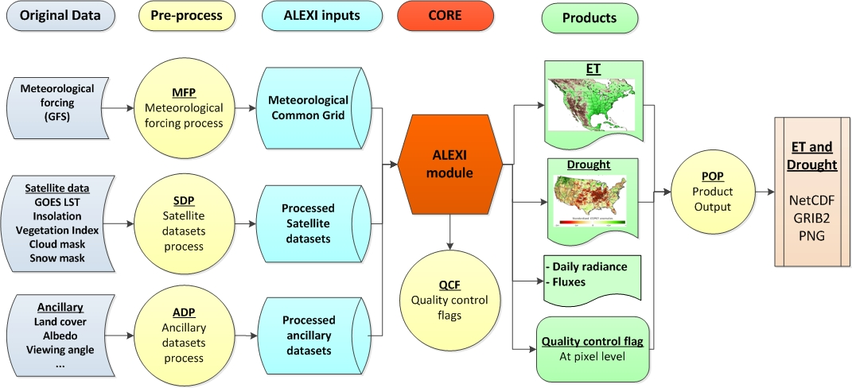
GET-D Data Flow

Slide 102
GET-D System Level - Input
Name | Category | Source | Description
Brightness temperature | Satellite observation | GOES | GOES East/West Imagery; 11micron/3.9 micron brightness temperature
Insolation | Satellite observation | GSIP | GSIP real time insolation
Vegetation Index | Satellite observation | VIIRS | VIIRS EVI
Snow mask | Satellite observation | NOAA IMS | IMS Daily Northern Hemisphere Snow and Ice Analysis
Air temperature | Meteorological data | CFS | Surface and pressure level profiles
Specific humidity | Meteorological data | CFS | Surface and pressure level profiles
Geopotential height | Meteorological data | CFS | Surface and pressure level profiles
Wind speed | Meteorological data | CFS | Surface
Downwelling longwave radiation | Meteorological data | CFS | Surface
Land Cover | Ancillary data | University of Maryland | Land cover classes in 1km resolution (static)
Albedo | Ancillary data | MODIS | Surface Albedo from MODIS (static)
Clear day insolation | Ancillary data | GSIP | Clear day insolation (static)

Slide 103
GET-D System Level - Outputs
Variables | Source | Spatial Domain | Spatial resolution | Description
ET product with QC | GET-D | North America | 8 km | Daily ET map
ESI products with QC | GET-D | North America | 8 km | 2,4,8, 12-week composite drought map
Flux products with QC | GET-D | North America | 8 km | Daily sensible heat and soil heat flux map
Radiance products with QC | GET-D | North America | 8 km | Daily short wave down, long wave down, long wave up and net radiation map

Slide 104
System Description Production
GETD generates one set of gridded data product over the North America domain per day:
Daily ET
2, 4, 8, 12-week ESI
Daily radiances and fluxes
Each product contains ET, ESI and other data layers with the QC flags for each grid.
Each product has file size of approximately 30 MB in raw binary data.

Slide 105
System Description Production - GRIB2
Layer | Data description | Number (In Section 4, octet 11) | Unit | Data type | Fill value | Valid range | Scale factor
1 | Daily ET | 6 | MJ m⁻² day⁻¹ | real | -9999 | 0 - 1000 | 1
2 | Daily ET QC | 231 | N/A | 1-byte integer | 256 | N/A | N/A
3 | 2, 4, 8, 12 -week ESI | 232, 234, 236, 238 | N/A | real | -9999 | -5 – 5 | 1
4 | 2, 4, 8, 12 -week ESI QC | 233, 235, 237, 239 | N/A | 1-byte integer | 256 | N/A | N/A
5 | SD, SNET, LWDN, LWUP | 240, 242, 244, 246 | MJ m⁻² day⁻¹ | real | -9999 | 0 – 1000 | 1
6 | SD, SNET, LWDN, LWUP QC | 241, 243, 245, 247 | N/A | 1-byte integer | 256 | N/A | N/A
7 | H, G | 248, 250 | MJ m⁻² day⁻¹ | real | -9999 | - 1000 – 1000 | 1
8 | H, G QC | 249, 251 | N/A | 1-byte integer | 256 | N/A | N/A

Slide 106
System Description Production – NetCDF4
Global attributes:
title = "GETD product"
Date = “2013-08-01”
Variables:
float Longitude(Longitude) ;
Longitude:units = "degrees_east" ;
float Latitude(Latitude) ;
Latitude:units = "degrees_north" ;
int ET(Latitude, Longitude) ;
ET:units = “MJ m⁻² day⁻¹“ ;
ET:scaling_factor = 100 ;
int ET_QC(Latitude, Longitude) ;
int ESI_2_WEEK(Latitude, Longitude) ;
ESI_2_WEEK:units = "none" ;
ESI_2_WEEK:scaling_factor = 100;
int ESI_2_WEEK_QC(Latitude, Longitude) ;

Slide 107
System Description Production – Output Data Files
GETDL3_zz_yyyyddd.vn.fff.gz
zz = domain name: NA (North America)
yyyy = four digit calendar year
ddd = day of year
vn= version number
fff = output format and valid values: grb2, nc or png
GETDL3_NA_2016006.v1.grb2.gz (ET, ESI and other products of North America in GRIB2 format for the version 1.0)
GETDL3_NA_2016006.v1.nc.gz (ET, ESI and other products of North America in NETCDF4 format for the version 1.0)
GETDL3_NA_2016006.v1.png.gz (ET, ESI and other products of North America in PNG format for the version 1.0)

Slide 108
System Description Production – Status report file
For each GETD run, a status report file is produced to indicate the Processing status of this run.
Each message line in the report file consists of 3 fields, namely the time (yyyymmddhhmmss) of the current message being reported, name of the subprogram that produced the message, and the detailed description of the message.
The detailed description of the message may start with “ERROR” or “WARNING”.
If “ERROR” appears in the description, the GETD run would be terminated and the final product will not be produced.
If “WARNING” appears in the description, the GETD run will still continue but the quality of the final product might be affected by fact specified in the warning message.

Slide 109
System Description Production – Status report
1) % of overall product quality bit in the QF being 1 (not retrieved): If 100%, no retrievals were obtained.
2) % of GOES data availability bit in the QF being 1 (bad data): If 100%, GOES input had problem;
3) mean daily ET of the domain: its time series should be relatively smooth (no abrupt rise or drop);
Note that due to the variations in the GOES inputs and ALEXI model valid outputs, daily ET values could have higher variations than composited ESI values.
4) mean rolling 8day ESI of the domain: its time series should be relatively smooth;
Example of the content in GETDL3_QF2014182.txt:
GETD QF INFO ON: 2014183
GOES valid(%): 33.25
ET valid(%): 32.87
Mean ET(MJ m-2 day-1): 110.13204
Mean ESI 2-week : 0.893
……
Mean ESI 12-week : 1.094

Slide 110
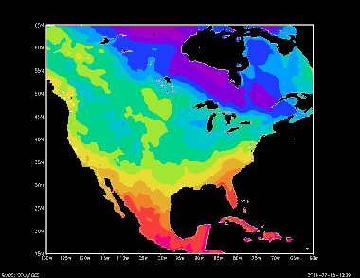
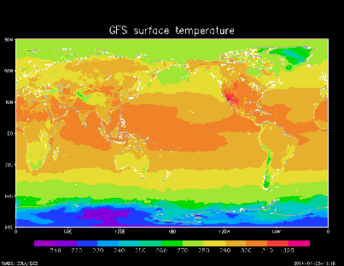
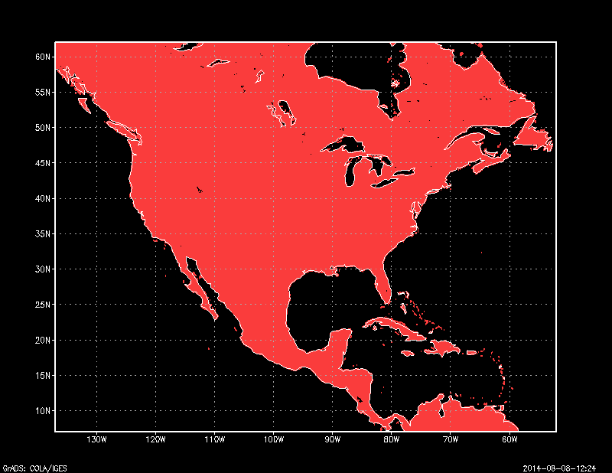
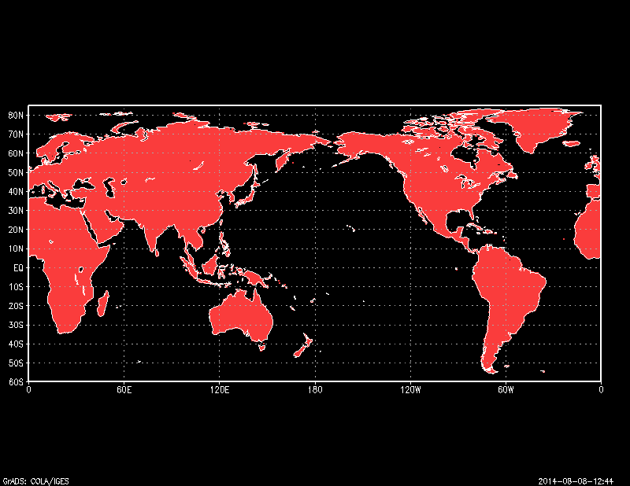
System Description Unit - Meteorological Forcing Processor
CGMP-CFS
Binary data in Alexi domain
CFS in GRIB2
Temperature
Pressure
Wind speed
……
CGLMP
UMD global land mask

Slide 111
System Description Unit - Satellite Dataset Processor
GDP
Binary data in Alexi domain
GOES AREA files
BT 3.9 & 11
CMP
GSIP L2 netcdf4 data
INSO-GSIP L2
BT (3.9 &11)
Solar insolation
Cloud mask
EVI/NDVI
Snow mask
VIIRS EVI/NDVI
VIP-VIIRS
Snow mask
SMP

Slide 112
System Description Unit - Ancillary Dataset Processor
Binary data in Alexi domain
CIP
Clear sky insolation data
AP
Clear sky Solar insolation
Albedo
Land cover
Albedo data
LCPP
UMD land cover

Slide 113
System Description Unit - ALEXI Core Processor
Binary inputs
APM
Binary outputs
Outputs
ET
ESI
Radiances and fluxes
ET QC
ESI QC
Radiances and fluxes QC
Temperature
Pressure
Wind speed
…...
Solar insolation
……
EVI/NDVI
Snow mask
RIP
ROP
QCF

Slide 114
System Description Unit - Product Output Processor
Binary outputs
Output GRIB2 file
Outputs
ET
ESI
Radiances and fluxes
ET QC
ESI QC
Radiances and fluxes QC
Output NETCDF4 file
POP
Output PNG files
Status report file

Slide 115
Outline
Introduction
Risks and Actions
System Requirements
System Description
System Test
System Operational Readiness
Summary
115
Notes:
115
Priyanka: Changed
--“Project Plan” to “Introduction”
--“PDR Report to PDR Risks and Actions”

Slide 116
Section 5 –
System Test
Rao Venkata

Slide 117
System Test Objectives
Ensure that all requirements specified for the product processing system and products are satisfied, and the products meet the users’ needs and expectations.

Slide 118
System Test Description
Each test has been done following the scenario
Describe the test item
Show scheduled execution times (cron schedule)
Show directory listing of output files indicating the file creation time is consistent with the scheduled execution time

Slide 119
System Test Test Environment
The system test was done at OSPO
6 CPUs
2.0 GHz
16 GB memory
400 GB additional disk space
gcc
PERL
NetCDF, GRIB2 and HDF5 lib were installed
NetCDF version 4.2
HDF5 version 1.8.7
HDF4

Slide 120
System Test Software installation
The GET-D software was written in FORTRAN 90
To install the source codes, copy the following directories (delivered as a tar file)
GETD/src
GETD/script_files
GETD/lib_packages
GETD/IDL
Install the libraries
Follow the instructions in the GETD/lib_packages/README to install all the libraries needed for GETD.
Compile the source codes
cd GETD/src/make
Change the paths of libraries in “Makefile”
Run command “make” from directory “GETD/src/make”
The executables will be under “/data2/Pgetd/run”

Slide 121
System Test Software installation
Run the scripts
Modify the paths of libraries and input/output data in CSHELL scripts under “~/GETD/script_files/”.
Scripts for daily procedure “run_GETD_by_doy.csh” should be run under “/data2/Pgetd/run” directory.

Slide 122
System Test Test Items
Daily GETD processing procedures
Generate the meteorological inputs for the CFS inputs.
Generate the clear sky morning land surface temperatures from GOES inputs.
Generate the daily insolation from GSIP inputs.
Generate the daily LAI from VIIRS inputs.
Generate the daily Snowmask from IMS inputs.
Genreate the daily ET and fPET from all the inputs.
Genreate the daily 2, 4, 8, 12 weekly composite ESI from daily fPET and climatology data.

Slide 123
System Test Test Items
Daily inputs
8 daily CFS GRIB2 files for two days.
Daily GOES EAST and WEST image files from 3 bands.
24 daily GSIP L2 NETCDF files for two days.
VIIRS granules/GVF_EVI data files.
1 snow mask file from IMS.
Climatology files.
Daily outputs
1 NETCDF file
1 GRIB2 file
1 Ascii file contains the statistics for the output variables
4 PNG files for comparison

Slide 124
System Test Daily Procedure
OSPO
Driven by cron job.
Determine working day by computer time.
Find paths from CSHELL scripts and
configure files.
Get other parameters from configure files.
Process the input data.
Generate the daily ET and fPET data.
Produce the composite weekly ESI outputs . Tranfer the outputs to DDS and SATEPSANON.
STAR
Driven by cron job.
Determine working day by computer time.
Find paths from CSHELL scripts and
configure files.
Get other parameters from configure files.
Process the input data.
Generate the daily ET and fPET data.
Produce the composite weekly ESI outputs.

Slide 125
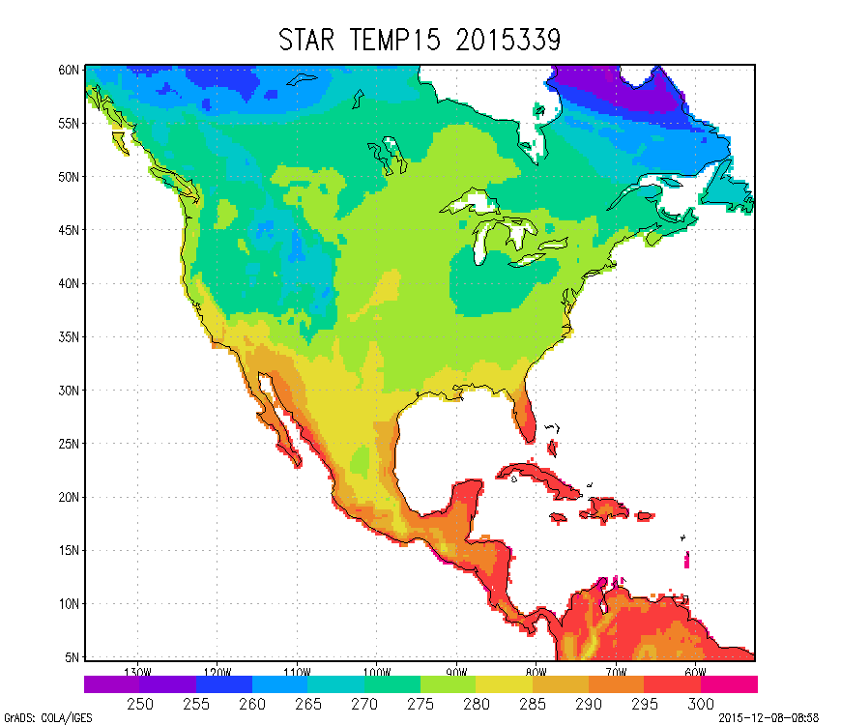
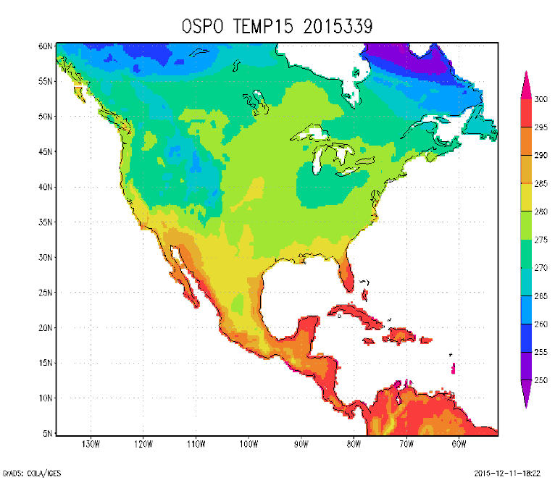
System Test
CGMP-CFS
run_daily_CFS_STEP1.csh 2015 339
run_daily_CFS_STEP2.csh 2015 339
STAR OSPO

Slide 126
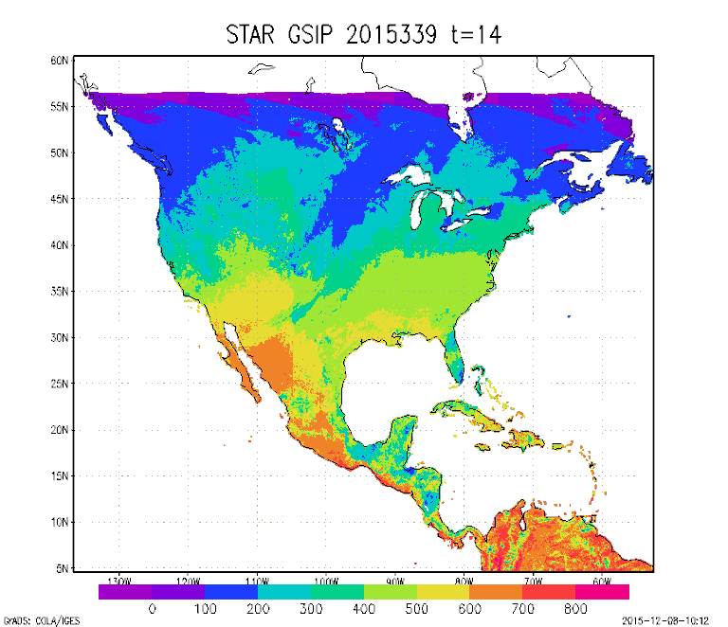
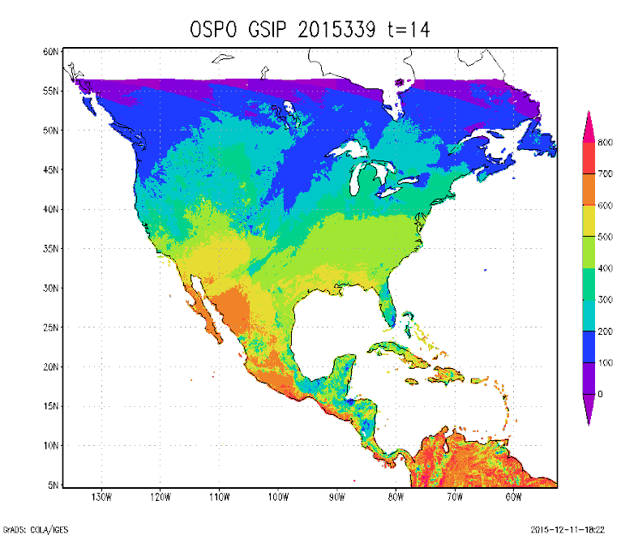
System Test
INSO-GSIPL2
run_daily_GSIP_STEP1_2.csh 2015 182
run_daily_GSIP_STEP3.csh
STAR OSPO

Slide 127
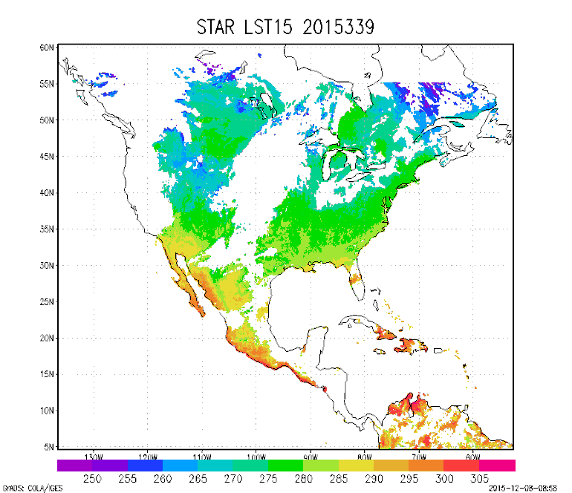
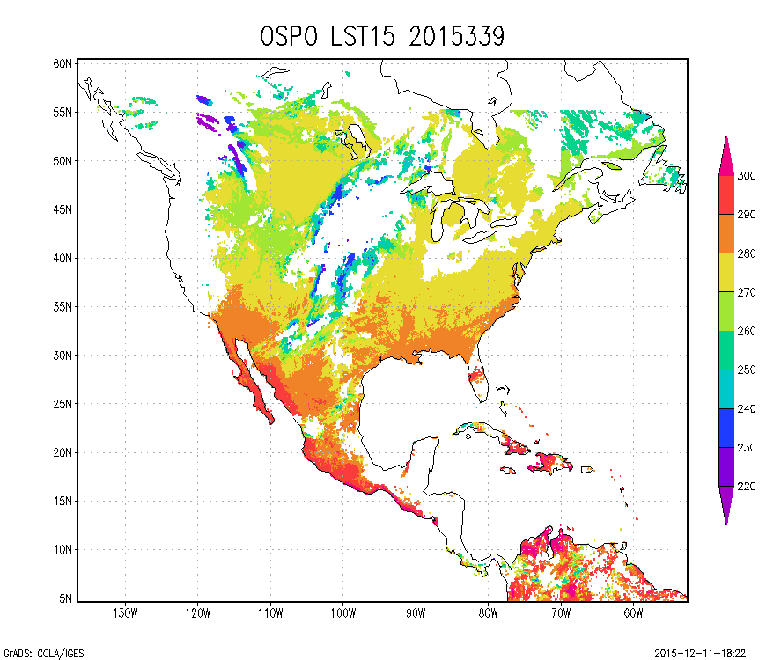
System Test
GOES Data Processor (GDP)
run_daily_GOES_STEP1.csh 2015 339
run_daily_GOES_STEP2.csh 2015 339
run_daily_GOES_STEP3.csh 2015 339
STAR OSPO

Slide 128
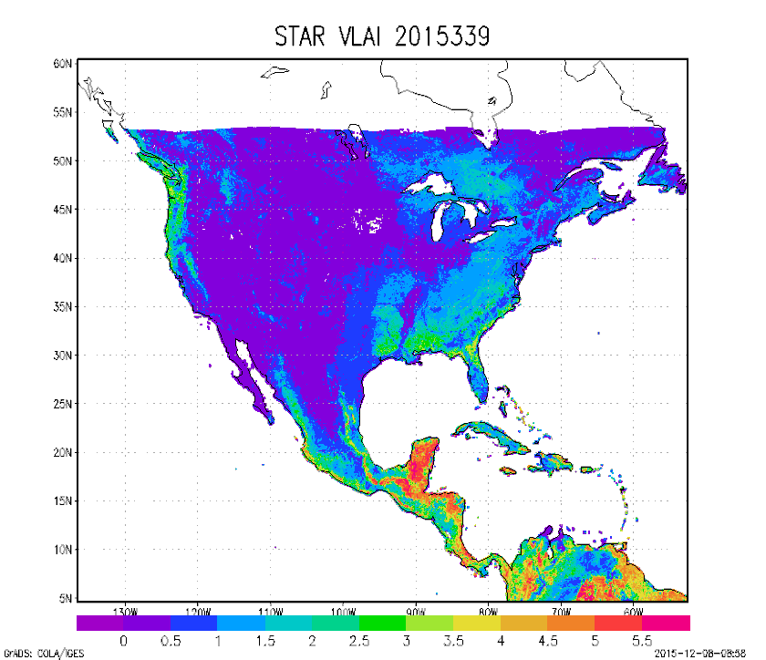
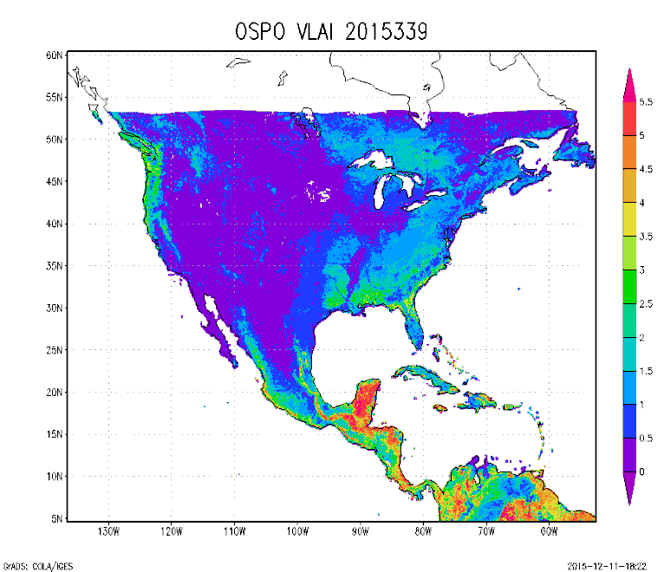
System Test
VIP-VIIRS
run_daily_aggEVI.csh
run_daily_VIIRS_EVI.csh 2015 339
run_daily_VIIRS_LAI.csh 2015 339
STAR OSPO

Slide 129
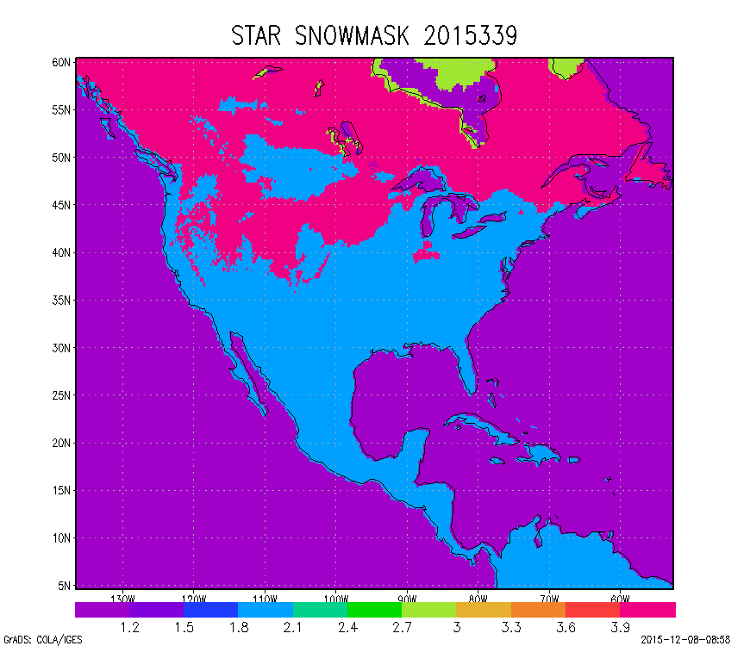
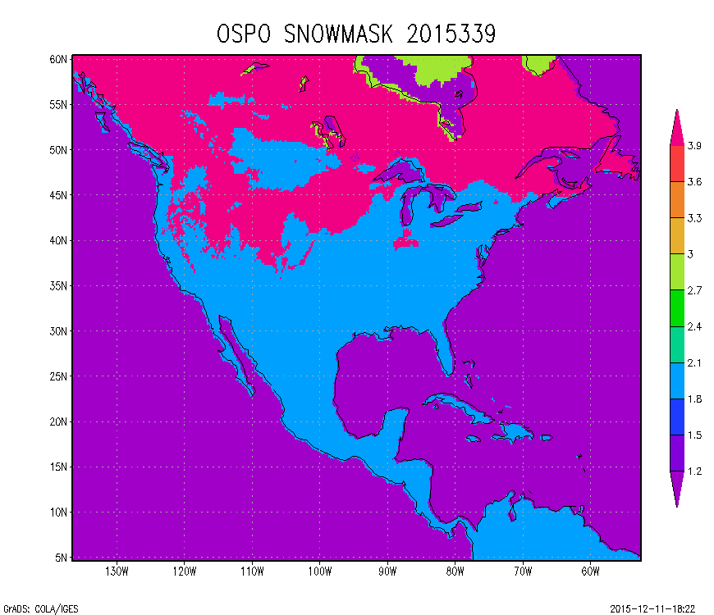
System Test
SMP
run_daily_SNOWMASK.csh 2015 339
STAR OSPO

Slide 130
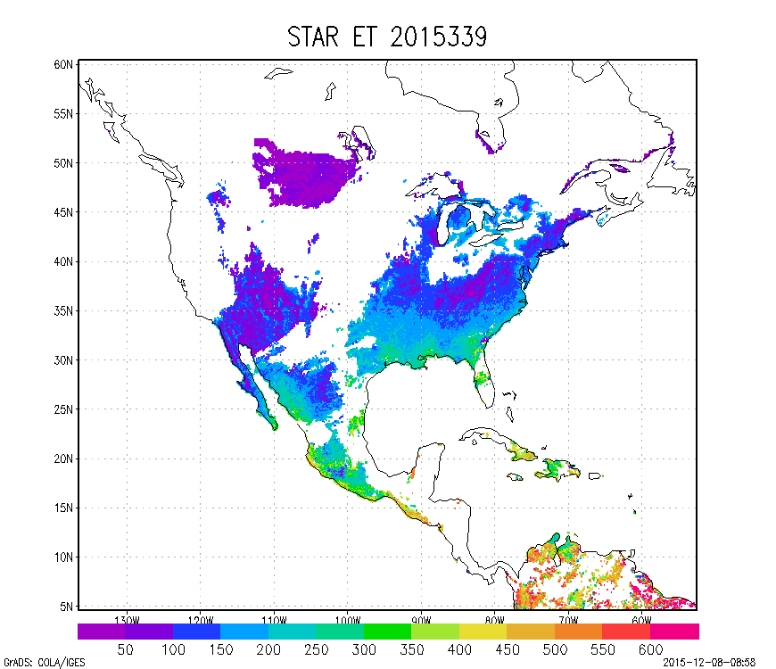
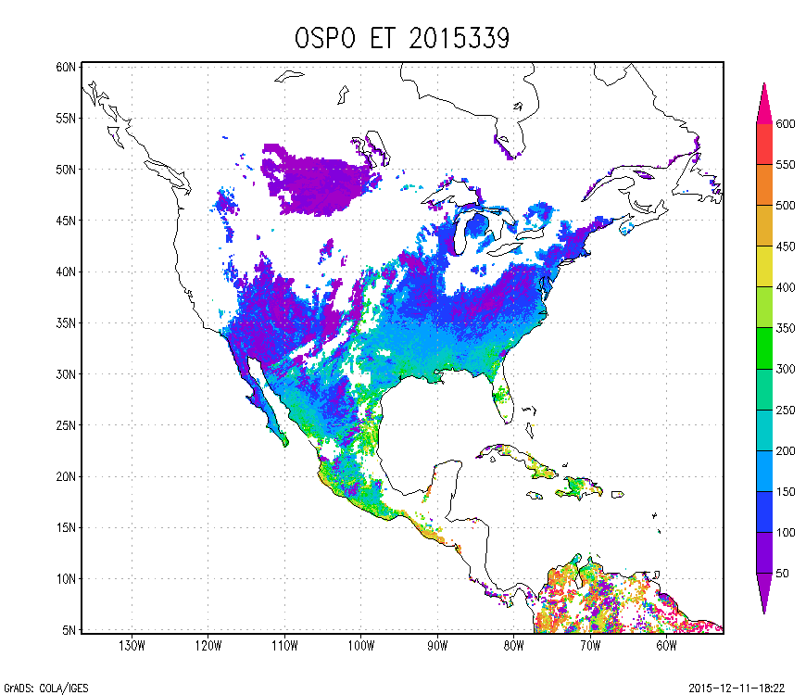
System Test
ROP
run_VLAI_ALEXI.csh 2015 339
STAR OSPO

Slide 131
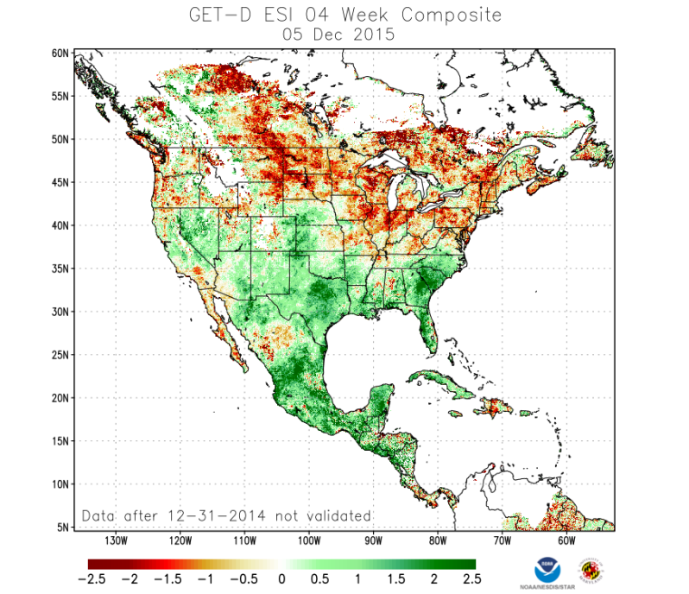
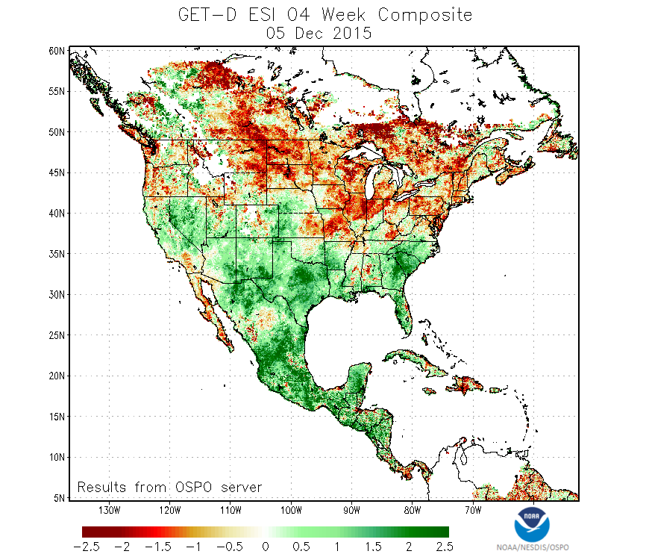
System Test
ROP
run_daily_ESI_compute.csh 2015 339
run_daily_ESI_smooth.csh 2015 339
run_daily_ESI_composite.csh 2015 339
run_gen_images.csh 2015 339
STAR OSPO

Slide 132
System Test sampled products
/data2/Pgetd/data/product/
GETDL3_NA_2015339.v1.grb2
GETDL3_NA_2015339.v1.nc
GETDL3_QF2015339.txt

Slide 133
System Test Verification of Operational Implementation
GETD products generated at STAR are compared with those produced at OSPO.
The products from STAR and OSPO are very close.
From STAR From OSPO
Notes:
133

Slide 134
Outline
Introduction
Risks and Actions
System Requirements
System Description
System Test
System Operational Readiness
Summary
134
Notes:
134
Priyanka: Changed
--“Project Plan” to “Introduction”
--“PDR Report to PDR Risks and Actions”

Slide 135
Section 6 –
Operational Readiness Presented by Hanjun Ding

Slide 136
System Operational Readiness Production Environment
Two LINUX Servers for GET-D – GSRDEV and GSRPROD
Development and Backup – GSRDEV
Development and testing on GSRDEV
Pre-operational code received from STAR has been well tested.
Production – GSRPROD
GET-D will be run to generate the operational products on GSRPROD
The products will be distributed to users through ESPC Data Distribution System (DDS) and SATEPSANON

Slide 137
System Operational Readiness Input Data Sources
GOES East/West Imagery
GSIP Insolation
VIIRS EVI from NDE GVF
Ancillary Data for Product Generation
CFS from NCEP
Snow mask from NOAA IMS
Land cover from UMCP
Albedo from MODIS

Slide 138
System Operational Readiness Input Data Sources
Name | Category | Source | FORMATS | Description
Brightness temperature | Satellite observation | GOES | McIDAS | GOES East/West Imagery; 11micron/3.9 micron brightness temperature
Insolation | Satellite observation | GSIP | NetCDF4 | GSIP real time insolation
Vegetation Index | Satellite observation | VIIRS | HDF5 | VIIRS EVI
Snow mask | Satellite observation | NOAA IMS | ASCII | IMS Daily Northern Hemisphere Snow and Ice Analysis
Air temperature | Meteorological data | CFS | GRIB2 | Surface and pressure level profiles
Specific humidity | Meteorological data | CFS | GRIB2 | Surface and pressure level profiles
Geopotential height | Meteorological data | CFS | GRIB2 | Surface and pressure level profiles
Wind speed | Meteorological data | CFS | GRIB2 | Surface
Downwelling longwave radiation | Meteorological data | CFS | GRIB2 | Surface
Land Cover | Ancillary data | University of Maryland | BIN | Land cover classes in 1km resolution (static)
Albedo | Ancillary data | MODIS | BIN | Surface Albedo from MODIS (static)
Clear day insolation | Ancillary data | GSIP | NetCDF4 | Clear day insolation (static)

Slide 139
System Operational Readiness System Outputs
Variables | Source | Spatial Domain | RESOLUTION / FORMATS | Description
ET Product with QC | GET_D | Northern America | 8 km NetCDF, GRIB2 | Daily ET Map
ESI Products with QC | GET-D | Northern America | 8 km NetCDF, GRIB2 | 2, 4, 8, 12-week Composite Drought map
Flux Products with QC | GET-D | Northern America | 8 km NetCDF, GRIB2 | Daily Sensible Heat and Soil Heat Flux Map
Radiance Products with QC | GET-D | Northern America | 8 km NetCDF, GRIB2 | Daily Short Wave Down; Long wave Down, Long wave Up and Net Radiation Map

Slide 140
System Operational Readiness Data Flow Diagram
GEODIST2/3 (GOES)
NDE Server (EVI)
GSRPROD(GSIP)
NCEP/EMC
(ET)
NCEP/CPC
(ESI)
GSRPROD Production
GET-D products in netCDF4 and GRIB2
DDS/satepsanon
GET-D products in
netCDF4 and GRIB2
USDA
NDMC/NIDIS
(ESI)
DDS
Ancillary data
OTHER USERS
Production Zone
Development Zone
*: PE - Production Environment
Distribution Zone (DMZ)
External User Zone
Notes:
Grouped and SmartArt version

Slide 141
System Operational Readiness IT System Architecture

Slide 142
System Operational Readiness Users of Products
NWS/NCEP EMC POC (ET): Mike Ek, Youlong Xia
NWS/NCEP CPC POC (ESI): Kingtze Mo, Jin Huang
NDMC-UNL POC (ESI): Brain Wardlow, Mark Svoboda
USDA POC (ESI): Marth Anderson (ARS)
Zhengwei Yang (NASS)
Curt Reynolds (FAS)

Slide 143
System Operational Readiness Production
The GET-D product system is running in VMWare Linux system.
GET-D products (ET and ESI) will be generated from GSRPROD.
GOES East/West Imagery will be pulled from GEODIST2/3; VIIRS EVI will be pulled from NDE server; Iosolation will be pulled from GSRPROD.
CFS, Snow mask, Land cover, Albedo and Clear day Insolation will be pulled from DDS.
The products are in netCDF4 and GRIB2 formats.

Slide 144
System Operational Readiness Dissemination
DDS for real time users
GET-D products in NetCDF4 and GRIB2 formats
Satepsanone
GET-D products in NetCDF4 format

Slide 145
System Operational Readiness Monitoring
Quality Monitoring
The GET-D Product files include overall quality control flags and quality summary level metadata
ESPC Monitoring project includes GET-D and it will be available soon.
Performance Monitoring
GET-D is running in VMWare Linux system (GSRdev & GSRprod). The running status is monitored by ESPC maintenance personnel in 24x7.

Slide 146
System Operational Readiness Maintenance (1/3)
OSPO Products Area Lead – Hanjun Ding
OSPO QA Lead – Zhaohui Cheng
OSPO ESPC Operation Lead - Donna McNamara
OSPO O&M Team
Rao Venkata
Bob Potash
STAR Science Maintenance Team
Jerry Zhan
Zhengpeng Li

Slide 147
System Operational Readiness Maintenance (2/3)
O&M Procedures
Operation Procedure and System Maintenance Manual will follow ESPC O&M procedures.
GET-D operation system will follow ESPC CM and security procedures.
The primary and backup maintenance personnel have been identified to cover normal maintenance needs.
The PAL will work with STAR scientists for any science maintenance needs when identified.
Operation Support
ESPC Operational Support Team

Slide 148
System Operational Readiness Maintenance (3/3)
Maintenance Supports
Processing failures due to machines problems such as disk storage or over loaded CPU.
Processing terminated (or hung up) abnormally such as delayed or problematic inputs, bugs.
Product dissemination problems
Product degradation due to channel/sensor/satellite problems, …etc.
Adding or deleting satellite data according to availability.
Algorithm updates/enhancements implementation
Emergency Recovery Capability
GET-D may not be run at the CIP (Critical Infrastructure Protection) facility when it is operational.

Slide 149
System Operational Readiness QA – Code Standards
The GET-D has passed through Code Review
OSPO leads the Code Review for coding standards and security
All the open items from code review have been closed
Results have been documented in Code Review Report
The code review report, as a ORR review artifact, can be found at: ftp://satepsanone.nesdis.noaa.gov/GET-D/

Slide 150
System Operational Readiness QA – CM and IT security
Product implementation
Implementation on parallel test environment is tasked and managed by Change Requests (CCR3234, Title: Implementation of GOES ET and Drought Products (GET-D)).
Software CM follows ESPC Software Configuration Management Process and Procedures Manual.
Security Procedures
SIA (CCR3234) has been performed for GET-D before the system is promoted into operation.
Documents will be under the CM control at OSPO

Slide 151
System Operational Readiness QA – Documentation
SPSRB Required Docs
Completed the draft User Manuals, System Maintenance Manual, ATBD
Need be finalized before the GET-D is operational

Slide 152
System Operational Readiness Archive
GET-D Products Archive
An initial request has be submitted to NCEI/CLASS through its online Advanced Tracking and Resource Tool (ATRAC) in January 2014
The request was denied in February 2015.
Still working with NCEI management to get the request approved.

Slide 153
System Operational Readiness User Readiness (1/2)
Data Access
GET-D products will be put on DDS for real time users.
Non-real time users will get the products from ESPC ftp site ftp://satepsanone.nesdis.noaa.gov/GETD/TEST.
Real-time data will be sent to DDS for NCDC CLASS.
Acceptance of Product
Already use GET-D product generated from NCEP.
Already reviewed test data.

Slide 154
System Operational Readiness User Readiness (2/2)
Training
User manuals will be made available to all users
No specific training from OSPO is planned. Products are in self-descripted NetCDF format.
ESPC Operator
GET-D will be monitored by ESPC help desk. No training is needed.

Slide 155
System Operational Readiness Summary
The system is ready for operations
The documentation will be completed by the time the GET-D is officially declared operational (final touches need to be done to the documents)
The users are ready to receive and use the data

Slide 156
Outline
Introduction
Risks and Actions
System Requirements
System Description
System Test
System Operational Readiness
Summary
156
Notes:
156
Priyanka: Changed
--“Project Plan” to “Introduction”
--“PDR Report to PDR Risks and Actions”

Slide 157
Summary
Risk and Actions have been reviewed
Requirements and their Allocations have been reviewed
System Description and Test have been reviewed
Products Quality Readiness have been reviewed
Operation Readiness has been reviewed
User Readiness has been reviewed
157
Notes:
157
Priyanka: Changed
--“Project Plan” to “Introduction”
--“PDR Report to PDR Risks and Actions”

Slide 158
Next Step
Operational Phase
SPSRB Decision Briefing: February 17, 2016
Operational Commencement: March 31, 2016
158
Notes:
158
Priyanka: Changed
--“Project Plan” to “Introduction”
--“PDR Report to PDR Risks and Actions”

Slide 159
Open Discussion
The review is now open for free discussion
159
Notes:
159
Priyanka: Changed
--“Project Plan” to “Introduction”
--“PDR Report to PDR Risks and Actions”

