Slide 1






GOES Evapotranspiration and Drought Product System (GET-D)
NESDIS SPSRB Critical Design Review (CDR)
Prepared by
GET-D Integrated Product Team
August 21, 2014

Slide 2
Agenda
1. Introduction | Jerry Zhan | 9:00 – 9:05
2. Requirements Review | Priyanka Roy | 9:05 – 9:30
3. Concept Of Operations | Hanjun Ding | 9:30 – 9:40
4. Algorithm Theoretical Basis | Chris Hain | 9:40 – 9:50
5. Software Architecture and Interface | Zhengpeng Li | 9:50 – 10:10
6. Detailed Design | Zhengpeng Li | 10:10 – 10:20
7. Unit Tests Plan | Li Fang | 10:20 – 10:30
8. Algorithm Package | Li Fang | 10:30 – 10:35
9. Quality Assurance | Priyanka Roy | 10:35 – 10:45
10. Risks and Actions | Priyanka Roy | 10:45 – 10:50
11. Review Summary and Discussion | Jerry Zhan | 10:50 – 11:30

Slide 3
Section 1 –
Introduction
Presented by
Jerry Zhan (STAR)
GET-D Development Lead

Slide 4
Introduction
Integrated Product Team (IPT)
Background
Objectives
Project plan
Milestones
CDR entry and exit criteria

Slide 5
Integrated Product Team (IPT)
IPT Lead: Xiwu (Jerry) Zhan (STAR)
IPT Backup Lead: Hanjun Ding (OSPO)
NESDIS Team:
  STAR: Chris Hain, Li Fang, Zhengpeng Li , Priyanka Roy, Istvan Laszlo
  OSPO: Hanjun Ding, Zhaohui Cheng, Ricky Irving
  OSD: Tom Schott
  Data Center: Phil Jones (NCDC)
  Others: Venkata Rao Anne (SGT)
User Team
  Lead: Mike Ek (NCEP-EMC)
  Others:
    NCEP-EMC: Youlong Xia
    NCEP-CPC: Kingtze Mo, Jin Huang
    NDMC-UNL: Brian Wardlow, Mark Svoboda
    USDA: Martha Anderson (ARS), Zhengwei Yang (NASS), Curt Reynolds (FAS)
Oversight Panel (OP) lead: Land POP
Other OPs involved: ERBPOP

Slide 6
Background/History
Monitoring evapotranspiration (ET) and the extent and severity of agricultural drought is an important component of food and water security and world crop market assessment.
Currently, no spatially distributed land surface ET product is available routinely from satellite observations.
2008 M. Anderson & W. Kustas visited STAR on ALEXI app.
2010 GIMPAP GOES ET project approved, C. Hain came on board and L. Fang was hired in 2012.
2013 PSDI GET-D project approved and Z. Li was hired.

Slide 7
Objectives
ET and drought maps generated from the Atmosphere-Land Exchange Inversion model (ALEXI) for NCEP/NIDIS/USDA users
The products are estimated from the brightness temperature (BT) of the GOES East and West Imagers
Coverage and resolution: North America at a spatial resolution of 10 km
ET product: Daily, over clear-sky pixels
Drought product: 2, 4, 8, 12-week composites updated daily
Output format: GRIB2, NetCDF and PNG

Slide 8
Project Plan
Year 1 – Design and Development (2013 – 2014)
  Develop Requirements Document
  Identify ancillary data for the algorithms
  Software architecture defined
  Algorithm development started
  Unit test planned
  Conduct CDR
  System test planned

Slide 9
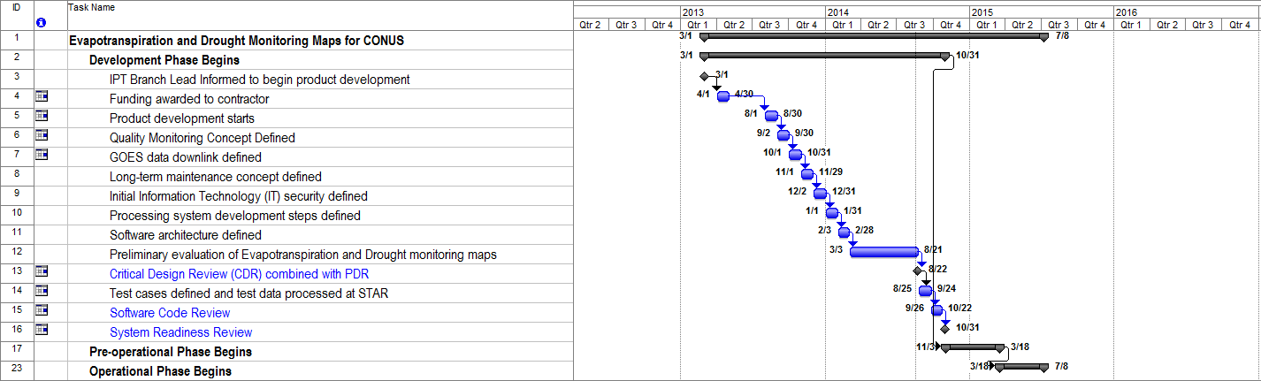
Project Timeline - Year 1
CDR 08/21/14

Slide 10
Project Plan
Year 2 –Transition to Operations (2014 – 2015)
  Deliver initial DAP (Framework with pre-operational algorithms) to OSPO
  Conduct Software Code Review (SCR)
  Test system within the OSPO environment
  Perform test data flows
  Conduct System Readiness Review (SRR)
  Deliver final DAP to OSPO
  Assist OSPO Operational Readiness Review (ORR)
  Declare GET-D operational@OSPO

Slide 11
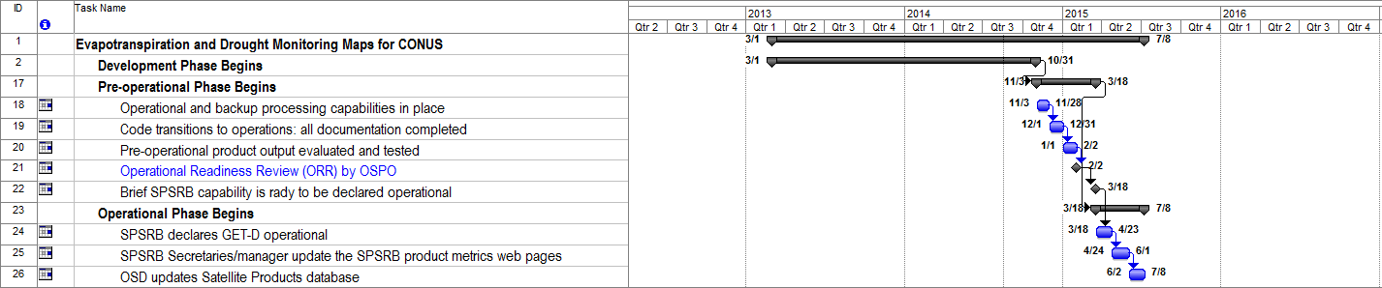
Project Timeline - Year 2

Slide 12
Project Milestones
Critical Design Review – 08/21/2014
Software Review – October 2014
System Readiness Review – October 2014
Operational Readiness Review – February 2015

Slide 13
CDR Entry Criteria
Requirements Document
Review of Project:
  Requirements
  Operations Concept
  Algorithm Theoretical Basis
  Software Architecture
  Detailed Design
  Quality Assurance
  Risks and Actions

Slide 14
CDR Exit Criteria
GET-D CDR Report
  The report will contain:
    Actions
    Comments
    CDR presentation
Updated GET-D Review Item Deposition(RID)
Updated GET-D Requirement Allocation Document (RAD)

Slide 15
Section 2 –
Requirements Review
Presented by
Priyanka Roy (STAR)

Slide 16
General Description of Requirement Slides
All GET-D Project requirements are presented in this section.
All GET-D Project requirements are documented in a single RAD located in the project repository at:
Basic requirements are shown in all purple text on a single slide.
Requirements which have been updated/added since the last review are in green.

Slide 17
Basic Requirement 0
GET_D-R 0: The GOES Evapotranspiration and Drought (GET-D) Product System shall adopt the standard practices of the SPSRB Review Process
  Driver: SPSRB transition to operations process

Slide 18
Basic Requirement 0.0
GET_D-R 0.1: The GET-D SPSRB reviews shall be tailored
  This derived requirement has been adopted to mitigate schedule risk by eliminating the overhead of preparing review slide packages and reports. Details are in derived requirements 0.1.x.

Slide 19
Basic Requirement 0.0
GET_D-R 0.1.1: There shall be a Critical Design Review (CDR) (that contains information from a Requirements Review and the Preliminary Design Review) for GET-D.
  This derived requirement has been adopted to mitigate schedule risk by eliminating the overhead of preparing a Requirements Review, PDR, and CDR slide packages separately. The Technical risk is assessed as Low because the CDR will be tailored to accomplish the standard objectives of a PDR and Requirements Review. Risks shall be tracked.

Slide 20
Basic Requirement 0.0
GET_D-R 0.1.2: The Critical Design Review Report (CDRR), a standard artifact of the SPSRB Process shall be compiled for the GET-D project.
  The CDRR is one of the exit criteria for the CDR. The updated CDR slides will form the CDRR.
GET_D-R 0.1.3: There shall be a Software Code Review (SCR) for GET-D.
  This derived requirement has been adopted for meeting OSPO coding and security standards.

Slide 21
Basic Requirement 0.0
GET_D-R 0.1.4: There shall be an System Readiness Review (SRR) for GET-D.
  This derived requirement has been adopted from the SPSRB review process.
GET_D-R 0.1.5: The System Readiness Review Report (SRRR), a standard artifact of the SPSRB Process shall be compiled for the GET-D project.
  The SRRR is an exit criteria for the SRR.

Slide 22
Basic Requirement 0.0
GET_D_R 0.1.6: There shall be an Operational Readiness Review (ORR) for GET-D.
  This derived requirement has been adopted from the SPSRB review process.
GET_D_R 0.1.7: The Operational Readiness Review Report (ORRR), a standard artifact of the SPSRB Process shall be compiled for the GET-D project.
  The ORRR is an exit criteria for the ORR.

Slide 23
Basic Requirement 0.0
GET_D-R 0.2: The Requirements Allocation Document (RAD) shall be created and maintained by the GET-D development team.
  This derived requirement has been adopted from the SPSRB Review process. The RAD will follow document standards stated in EPL v3 process asset DG-6.2
GET_D-R 0.3: The Review Item Disposition (RID) spreadsheet shall be created and maintained by the GET-D development team.
  This derived requirement has been adopted from the SPSRB Review process.

Slide 24
Basic Requirement 0.0
GET_D-R 0.4: Configuration Management shall be implemented for the GET-D software and documentation.
  Project documents will be distributed through Google Drive. Code and test data will be distributed via ftp transfer.

Slide 25
Basic Requirement 1
GET_D-R 1: The GET-D system shall generate GOES Thermal observation based evapotranspiration (ET) and drought monitoring products.
  Driver: This basic requirement is traced to user needs as stated in the SPSRB User request # 0905-0007, A GOES Thermal Observation Based Evapotranspiration (ET) Product: NCEP needs independent ET data from satellite for validating Noah land surface model output and satellite based drought data product for monthly drought briefing

Slide 26
Basic Requirement 1.0
GET_D-R 1.1: The GET-D evapotranspiration product shall be generated daily over clear sky conditions.
  User Request.
GET_D-R 1.2: The GET-D drought product shall be generated as 2, 4, 8, 12 weeks composite drought maps updated daily.
  Standard format for this user community.

Slide 27
Basic Requirement 1.0
GET_D-R 1.3: The GET-D output file shall include daily sensible heat flux (H), soil heat (G), net radiation Rn and its components (upward and downward longwave radiation fluxes and solar insolation).
  Provided for users' convenience.
GET_D-R 1.4: The GET-D products shall have a full coverage of the North America region.
  User Request. Current capabilities

Slide 28
Basic Requirement 1.0
GET_D-R 1.5: The GET-D product shall be a land surface product with a horizontal resolution of 10 km.
  User Request. Current capabilities
GET_D-R 1.6: The GET-D products shall be in Lat/Lon projection.
  User Request.

Slide 29
Basic Requirement 1.0
GET_D-R 1.7: The GET-D products shall have error less than 20%.
  User Request.
GET_D-R 1.8: The GET-D products shall have a latency in the range 3 to 6 hours.
  User Request.
GET_D-R 1.9: The GET-D products shall include quality information.
  QC flags will be specified in the External Users Manual.

Slide 30
Basic Requirement 1.0
GET_D-R 1.10: The GET-D system shall write the Evapotranspiration and Drought Monitoring products into a single file written in NetCDF4
  The NetCDF4 output will be for the archives.
GET_D-R 1.11: The GET-D system shall produce Evapotranspiration and Drought monitoring tailored products in GRIB2 and PNG formats.
  User Request.

Slide 31
Basic Requirement 1.0
GET_D-R 1.12: The GET-D developers shall perform validation and verification of the GET-D products.
GET_D-R 1.12.1: The GET-D developers shall perform unit testing to verify functional performance of the code that produces the GET-D products.
  Will be included in the unit tests and the system test described in the SRR.

Slide 32
Basic Requirement 1.0
GET_D-R 1.12.2: The GET-D developers shall verify the error handling capability of the pre-operational system.
  Needed by OSPO for reliable operations.
GET_D-R 1.12.3: The GET-D developers shall produce and distribute the ET and Drought monitoring product files for evaluation by the user community.
  Standard procedure for this user community.

Slide 33
Basic Requirement 1.0
GET_D-R 1.12.4: The GET-D system shall perform routine data range checks to flag anomalous values in the input data.
  Anomalous values will be flagged. These checks will be included in the code and described in the SRR.
GET_D-R 1.12.5: The GET-D system shall perform routine data range checks to flag anomalous values in the ET and Drought Products.
  Out-of-range values will be flagged. These checks will be included in the code.

Slide 34
Basic Requirement 2
GET_D-R 2: The GET-D system shall have data ingest capability.
  Driver: This basic requirement is traced to algorithm input needs as documented in the GET-D ATBD.

Slide 35
Basic Requirement 2.0
GET_D-R 2.1: The GET-D system shall ingest GOES Brightness Temperature and solar insolation.
GET_D-R 2.2: The GET-D system shall ingest VIIRS EVI/NDVI.

Slide 36
Basic Requirement 2.0
GET_D-R 2.3: The GET-D system shall ingest NOAA IMS Snow mask.
GET_D-R 2.4: The GET-D system shall ingest GFS meteorological fields.

Slide 37
Basic Requirement 3
GET_D-R 3: The GET-D system shall implement the ALEXI algorithm to generate the ET and drought monitoring products.
  Driver: This basic requirement is traced to user needs for the GET-D products.

Slide 38
Basic Requirement 3.0
GET_D-R 3.1: The GET-D algorithms shall be implemented by processing codes written in Fortran 95.
GET_D-R 3.2: The GET-D processing code shall be able to run in the Development Environment at STAR.
  Fortran code can run in this environment

Slide 39
Basic Requirement 3.0
GET_D-R 3.3: The GET-D processing code shall be able to run in the OSPO Test Environment.
  Fortran code can run in this environment
GET_D-R 3.4: The GET-D processing code shall be able to run in the OSPO Operational Environment.
  Fortran code can run in this environment
GET_D-R 3.5: The GET-D algorithm shall generate QC flags.

Slide 40
Basic Requirement 4
GET_D-R 4: The GET-D system shall generate metadata for retrieved product.
  Driver: This basic requirement is traced to OSPO needs for monitoring and maintenance.

Slide 41
Basic Requirement 4.0
GET_D-R 4.1: The GET-D system shall write metadata text files associated with the retrieved products.
GET_D-R 4.2: The metadata shall include overall quality and summary level metadata.
GET_D-R 4.3: The metadata shall include Granule metadata.

Slide 42
Basic Requirement 5
GET_D-R 5: The GET-D system shall have QC monitoring capability
  Driver: This basic requirement is traced to an OSPO need for QC monitoring.

Slide 43
Basic Requirement 5.0
GET_D-R 5.1: The GET-D system output shall include overall quality control flags and quality summary level metadata
  Needed for distribution, archive, quality control and post-processing in the products files. GET-D code will generate metadata for this purpose.

Slide 44
Basic Requirement 5.0
GET_D-R 5.2: The GET-D system shall be capable of monitoring input data latency and overall quality
GET_D-R 5.3: The GET-D system shall be capable of monitoring product latency
  Output GET-D processing time and output to status file

Slide 45
Basic Requirement 5.0
GET_D-R 5.4: The GET-D system shall produce real-time PNG imagery files for visual inspection of output data files
  PNG files will be produced by the Product Output Processor Unit
GET_D-R 5.5: The GET-D system shall be capable of monitoring product distribution status to ensure that the data/products are successfully available for transfer to the user community
  A product status file will be produced for each operational run

Slide 46
Basic Requirement 5.0
GET_D-R 5.6: The GET-D system shall generate log files for every run.
  Needed to ensure the run was completed successfully.

Slide 47
Basic Requirement 5.0
GET_D-R 5.6.1: Each log file shall include all runtime error messages
  Error messages will include system messages and error conditions written by the code
GET_D-R 5.6.2: The log file shall indicate whether or not the run was completed without error
  Code will write this message. This indication will be the last message in the file, so that operators can find it easily

Slide 48
Basic Requirement 6
GET_D-R 6: The GET-D developers shall produce a fully functional pre-operational system in the STAR Development Environment
  Driver: This basic requirement is traced to an OSPO need for a fully functional system ready for integration and system testing

Slide 49
Basic Requirement 6.0
GET_D-R 6.1: The Development Environment shall host the pre-operational system
  Pre-operational system is to be developed in this environment
GET_D-R 6.1.1: The Development Environment shall include C, gcc, g95 and gfortran compilers
  Needed for the code

Slide 50
Basic Requirement 6.0
GET_D-R 6.1.2: The Development Environment shall have 4 GB of memory
  Memory capacity requirement is based on experience with the GET-D R&D code
GET_D-R 6.1.3: The Development Environment shall have 1 TB of data storage
  Data storage capacity requirement is based on experience with the GET-D R&D code

Slide 51
Basic Requirement 6.0
GET_D-R 6.1.4: The Development Environment shall include C, MATLAB, and HDF 4.2 libraries
  Needed for running the code
GET_D-R 6.1.5: The Development Environment shall include Perl, IDL, bash shell, and C shell
  Needed for running the code

Slide 52
Basic Requirement 6.0
GET_D-R 6.2: The Development Environment shall be capable of hosting unit tests
GET_D-R 6.2.1: The Development Environment shall have a link to SATEPSANONE server
  Needed for ingest of satellite data and ancillary data

Slide 53
Basic Requirement 6.0
GET_D-R 6.2.3: The pre-operational system shall include all processing code and ancillary files needed to conduct unit tests
  Complete unit test of each stage of the pre-operational system is expected before delivery to OSPO
GET_D-R 6.2.4: The pre-operational system shall include all input test data needed to conduct unit tests
  Complete unit test of each stage of the pre-operational system is expected before delivery to OSPO

Slide 54
Basic Requirement 7
GET_D-R 7: The GET-D pre-operational system shall be transitioned from the STAR Development Environment to the OSPO Test Environment
  Driver: This basic requirement is traced to an OSPO need for a fully functional system in its Test Environment.

Slide 55
Basic Requirement 7.0
GET_D-R 7.1: The pre-operational system shall include all processing code and ancillary files needed to reproduce the unit tests
  For system testing. A complete system test of the integrated pre-operational system is expected before delivery to OSPO Test Environment

Slide 56
Basic Requirement 7.0
GET_D-R 7.2: The pre-operational system shall include all input test data needed to reproduce the unit tests
  Complete system test of the pre-operational system is expected
GET_D-R 7.3: The pre-operational system shall include all intermediate files produced by the unit tests
  Complete system test of the pre-operational system is expected

Slide 57
Basic Requirement 7.0
GET_D-R 7.4: The integrated pre-operational system shall include all output data produced by the unit tests
  Needed by OSPO to verify the system tests in its Test Environment

Slide 58
Basic Requirement 7.0
GET_D-R 7.5: The GET-D development team shall set up an internal FTP site for transferring the pre-operational system to OSPO as a tar file on a STAR server that is accessible to OSPO
GET_D-R 7.5.1: The GET-D development team shall ensure that the OSPO PAL has the information needed to acquire the pre-operational system as a tar file

Slide 59
Basic Requirement 8
GET_D-R 8: The GET-D developers shall specify IT resource needs for operations
  Driver: OSPO IT Capacity Planning

Slide 60
Basic Requirement 8.0
GET_D-R 8.1: The GET-D system shall be able to process data using 1 TB of data storage
GET_D-R 8.2: The GET-D system shall be able to process data using 4 GB of RAM
GET_D-R 8.3: The GET-D system shall be able to operate on VMWare Linux

Slide 61
Basic Requirement 8.0
GET_D-R 8.4: The GET-D system shall be able to process using C, gcc, g95 and gfortran compilers
  Needed for the code
GET_D-R 8.5: The GET-D system shall be able to process using C, MATLAB, and HDF 4.2 libraries
  Needed for running the code

Slide 62
Basic Requirement 8.0
GET_D-R 8.6: The GET-D system shall be able to process using Perl, IDL, bash shell, and C shell
  Needed for running the code
GET_D-R 8.7: The GET-D system shall be able to process using GRADS
  Needed for postprocessing

Slide 63
Basic Requirement 9
GET_D-R 9: The GET-D pre-operational system shall be delivered to OSPO for integration into their operational system as a Delivered Algorithm Package (DAP).

Slide 64
Basic Requirement 9.0
GET_D-R 9.1: The DAP shall contain science algorithm source code, including make files and scripts.
GET_D-R 9.2: The DAP shall contain test plans, test description, test procedures, and detailed performance testing results.

Slide 65
Basic Requirement 9.0
GET_D-R 9.3: The DAP shall contain test input data, temporary files, and expected output data.
GET_D-R 9.4: The DAP shall contain coefficient files and/or look-up tables.
GET_D-R 9.5: The DAP shall contain quality monitoring information (quality flags, quality flag values).

Slide 66
Basic Requirement 9.0
GET_D_R 9.6: The DAP shall contain production rule-set definitions.
GET_D_R 9.7: The DAP shall contain product file specifications -- layout, content, and size.
GET_D_R 9.8: The DAP shall contain data flow diagrams.
GET_D_R 9.9: The DAP shall contain list of exit codes and their associated messages.

Slide 67
Basic Requirement 9.0
GET_D-R 9.10: The DAP shall contain list of expected compiler warnings.
GET_D-R 9.11: The DAP shall contain estimates of resources required for execution.
GET_D-R 9.12: The DAP shall contain Algorithm Theoretical Basis Documents (ATBDs) or reference to where the ATBDs can be obtained.

Slide 68
Basic Requirement 9.0
GET_D-R 9.13: The DAP shall contain Delivery Memo.
GET_D-R 9.13.1: The delivery memo shall include the point(s) of contact for questions specific to the algorithm (include name, telephone, and e-mail address). At a minimum, include algorithm developer and PAL.

Slide 69
Basic Requirement 9.0
GET_D-R 9.13.2: The delivery memo shall include the list of delivery contents.
GET_D-R 9.13.3: The delivery memo shall include the purpose of the delivery (e.g. an initial release, modification).
GET_D-R 9.13.4: The delivery memo shall include the description of significant changed from previous version, if any.

Slide 70
Basic Requirement 9.0
GET_D-R 9.13.5: The delivery memo shall include the description of problem(s) resolved, if any, and method of resolution.
GET_D-R 9.13.6: The delivery memo shall include the list of documents updated/added/superseded, if any.
GET_D-R 9.13.7: The delivery memo shall include the list of known remaining defects.

Slide 71
Basic Requirement 9.0
GET_D-R 9.14: The DAP shall contain README text file.
GET_D-R 9.14.1: The README text shall include the DAP version number.
GET_D-R 9.14.2: The README text shall include the location of all required DAP contents.

Slide 72
Basic Requirement 9.0
GET_D-R 9.14.3: The README text shall include the target configuration for setup (directories and files after setup scripts have been executed). This is understood to be a list of where everything is located once the DAP has been unpacked.
GET_D-R 9.14.4: The README text shall include the other pertinent information as judged by the algorithm developer(s) (compiler settings, etc.)

Slide 73
Basic Requirement 10
GET_D-R 10: STAR shall deliver GET-D SPSRB documents to OSPO
  Driver: This basic requirement is traced to an OSPO need for documentation to support operations, maintenance, and distribution

Slide 74
Basic Requirement 10.0
GET_D-R 10.1: The GET-D document package shall include an Algorithm Theoretical Basis Document (ATBD).
  The ATBD will follow SPSRB Version 2 document standards

Slide 75
Basic Requirement 10.0
GET_D-R 10.2: The GET-D document package shall include a System Maintenance Manual (SMM).
  The SMM will follow SPSRB Version 2 document standards
GET_D-R 10.3: The GET-D document package shall include a External Users Manual (EUM).
  The EUM will follow SPSRB Version 2 document standards

Slide 76
Basic Requirement 11
GET_D-R 11: The GET-D system shall comply with OSPO Code Review Security check lists
  Driver: OSPO code standards and OSPO security requirements

Slide 77
Basic Requirement 11.0
GET_D-R 11.1: The GET-D system shall comply with OSPO data integrity check list.
GET_D-R 11.2: The GET-D system shall comply with OSPO development security check list
  OSPO development security check list is part of the OSPO Code Review Security check lists
GET_D-R 11.3:The GET-D system shall comply with OSPO code check list.
  OSPO code check list is part of the OSPO Code Review Security check lists

Slide 78
GET-D System Requirements – Summary
The GET-D System Requirements have been established.
The Requirements have been documented in the Requirements Allocation Document (RAD).
The Requirements are traceable to drivers (customer needs or expectations) and other requirements.

Slide 79
Section 3 –
Concept of Operations
Presented by
Hanjun Ding(OSPO)
GET-D Development PAL

Slide 80
Operations Concept - Overview
Identify intentions of the customers/users of the products
Review the answers to the following questions based on customer/user needs and expectations and production constraints
  What is the product?
  Why is this product being produced?
  How will this product be used?
  How should this product be produced (operational scenario)?
The operations concept will be refined by the Integrated Product Team (IPT) of GOES Evapotranspiration (ET) and Drought (GET-D) Product system, in consultation with customers/users, as the product solution and design are matured through the design development phase.

Slide 81
What is the Product?
The GET-D system will produce a daily product that consists of two drought indices:
  Evapotranspiration (ET)
  Evaporative Stress Index (ESI)
Each index will be a North America gridded composite map in Lat/Lon projection with 10 km resolution at the equator.
Specific product requirements, based on SPSRB User Request, will be discussed later in this CDR

Slide 82
What is the Product - Product Deliverable Details
 |  |  |  |  | Product Type and Number
Fiscal Year (FY) | Product Delivery/Tracking Name | Environmental Observational Parameters | Satellites | Sensors | N # | E # | R # | T # | O # | Tailoring Options or Comments
FY15 | Evapotranspiration and Drought Monitoring Maps | Evapotranspiration | GOES East and West | Imagers | 1 |  |  | 5 |  | Formats: GRIB2, NetCDF, PNG Coverage areas: North America Resolutions: 10km Update cycle: daily
FY15 | Evapotranspiration and Drought Monitoring Maps | Drought Map | GOES East and West | Imagers | 1 |  |  | 5 |  | Formats: GRIB2, NetCDF, PNG Coverage areas: North America Resolutions: 10km Update cycle: daily

Slide 83
Why Are The Products Being Produced?
NCEP needs independent ET data from satellite for validating Noah land surface model output and satellite based drought data product for monthly drought briefing
USDA ARS is contributing the drought monitoring product based on the Evaporative Stress Index (ESI) to the National Integrated Drought Information System (NIDIS), which requires an operational production system to generate composited ESI based on NOAA GOES satellite observations
The independent information of the ET and ESI based on GOES satellite observations is useful to the US and Work Crop forecasts that are mandates of USDA-NASS and USDA-FAS respectively.

Slide 84
How Will The Products Be Used?
  NCEP/EMC needs independent ET data from thermal infrared satellite observations for validating Noah Land Surface Model output
  NCEP/CPC needs satellite based Evaporative Stress Index drought data product for their monthly drought briefing.
  NCEP, NIDIS and other users will acquire GET-D directly via ftp pull from the NDE Distribution Servers moving to PDA
  Daily composite netCDF4 files at 10-km resolution
  Daily composite GRIB2 file at 10-km resolution
  PNG file is also desired for monitoring and displaying

Slide 85
How Should The Products Be Produced?
There will be three distinct environments
  Development Environment (STAR)
    Development and unit testing of pre-operational codes will be conducted on Redhat Linux OS in STAR
  Test Environment (OSPO)
    Pre-operational codes and documents (DAP) received from STAR will be implemented and tested on GEODEV and modified as needed before it is promoted to operations
  Operations Environment (OSPO)
    Operational DAP will be run on GEOPROD Linux machine and the products monitoring GUI will be posted on the intranet web server and accessed under ESPC VPN by operators, PALs and maintenance programmers

Slide 86
How Should The Products Be Produced?
Production and Delivery Scenarios
  The GET-D product system will collect the satellite inputs and required ancillary data to run the GET-D algorithms
  The generated daily GET-D outputs are written to output files in the required formats (netCDF4, GRIB2, PNG).
  The products in NetCDF4 will be distributed to CLASS for archive purpose
  The GET-D metadata will be provided to the product monitoring tool system
  The product users will be granted access to the ESPC distribution system through the data access request submission Processor
  ESPC will handle the distribution of GET-D products

Slide 87
Development Environment – Function
A development system will be established on a Linux server in the STAR Collaborative Environment (CE)
Science code will be adapted into pre-operational software units that implement the GET-D algorithm in accordance with the system design.
Unit tests will be conducted to ensure that the software units function as designed, producing expected outputs from defined inputs.
Code will be modified as needed to achieve successful completion of the unit tests.
Following successful unit testing, software units will be integrated into an integrated pre-operational system
A system test will be conducted to ensure that the integrated pre-operational system meets all requirements

Slide 88
GET-D IT System Architecture
ESPC Production
Internet
gp5
Met Input
Geoprod
GET-D
Linux
Geotest
QC/VAL
Linux
Intranet
Sandia
BT & Q
ET & Drought Products
NCEP
DDS,
SATEP
SANONE
CLASS
NCEP &
Other
USERS
BT & Q
STAR
Met Input
GET-D
Linux
ET & Drought
Products
Internet
Input Data: BT & solar insolation from GOES imagers, Met forcing from NCEP models via NLDAS

Slide 89
Research and Operational System Environments
Project Name: | GET-D
IT Item | Research | Operations
Agency | STAR | OSPO (ESPC)
Platform(s) * and need dates | 1 Dell PowerEdge server w/ 4 Gigs of RAM 1 Dell PowerEdge server w/ 8 Gigs of RAM May 2013 | VMWare Linux Servers w/ 4 Gigs of RAM 2014
Operating Systems ** | Red Hat Linux | Linux
Programming languages/compilers *** | FORTRAN, C, C++, IDL, C-shell | FORTRAN, C, C++, IDL, C-shell
Scripting languages | C-SHELL | C-SHELL
Graphical/Imaging programs, COTS S/W, other tools, libraries, etc | GrADS | GrADS
Helpdesk Monitoring Tool (standardized tool or customized tool?) | TBD | TBD
Other platforms needed for monitoring/imaging/graphics (specify platform & operating system) | None | None
Other (tools, shareware, libraries, critical non-static ancillary data, etc) | GRIB/GRIB2/NetCDF/HDF | GRIB/GRIB2/NetCDF/HDF
Red font indicates new IT resource requirements for this project
Blue font indicates existing IT resources will be used for this project

Slide 90
Operational Agency System Requirements
Project Name: | GET-D
 |  |  | Back-up Operations
IT Item | Development | Operations | On-Site | Off-Site
Agency | STAR | OSPO (ESPC) | (TBD)
Platform(s) and need dates (include secondary platforms for monitoring, imagery or graphics, if necessary) | One Dell PowerEdge Linux servers with 4GB RAM | VMWare Linux Server w/ 4 Gigs of RAM on Apr 2014 | VMWare Linux w/ 4 Gigs of RAM on Apr 2014
Storage required on systems | 1 TB | 1 TB | 11 TB
How often does system run (granule time, orbital, daily); event or schedule driven? | daily | daily | daily
Memory used at run time | 4 GB | 4 GB | 4 GB
Input data volume and input data sources | 4 GB per day | 4 GB per day | 4 GB per day
Data volume for distribution; planned distribution server; specific push users & volumes | N/A | N/A | N/A
Communication Requirements/Protocol | Internet | Internet | Internet
Days to retain input and output data | 10 | 10(TBR) | 10(TBR)
Red font indicates new IT resource requirements for this project
Blue font indicates existing IT resources will be used for this project

Slide 91
Development and Operational System Maintenance Resources
Jerry Zhan (STAR) – Development Readiness and Quality Control support
Chris Hain, Li Fang, Zhengpeng Li (STAR) – Development support
  Venkata Rao Anne (OSPO) – Operational Maintenance support
Hanjun Ding (OSPO) – Operational Readiness and Quality control support

Slide 92
Distribution Environment –Capabilities and Resources
Data Distribution System
  The ESPC DDS will serve as the gateway to distribute the ET and drought products to users under a 24/7/365 base.
Personnel
  DDS Personnel
  Donna McNamara (OSPO) – Distribution Lead

Slide 93
Production Scenarios – Monitoring and Maintenance
The GET-D system will provide the product monitoring capability for maintaining the integrity and quality of the generated operational ET and ESI products.
The capability will cover the following aspects:
  Automated email notification for product generation and distribution anomalies
  Web-based monitoring for product generation and QC statistics
OSPO PAL and STAR Scientists will perform routine validation of the GET-D products

Slide 94
GET-D System Requirements
The GET-D System Requirements have been established.
The Requirements have been documented in the Requirements Allocation Document (RAD).
The Requirements are traceable to drivers (customer needs or expectations) and other requirements.

Slide 95
Production Scenarios – Archive Product
An Archive Product of daily ET will be produced for the CLASS archive.
The Archive Product will be the output netCDF4 files that are produced by the daily Production run.
Delivery may also include metadata files and supporting documentation.

Slide 96
User Interaction
The ESPC help desk will serve as the operational point of contact to provide 24/7 service support for users
  Provides information about the GET-D data products to the user community
  Resolves user issues through coordination with the GET-D PAL (Products Area Lead).
The GET-D PAL will coordinate further with the STAR scientists for any product quality issues when identified and communicate with users.

Slide 97
Summary
  OSPO will run GET-D system to produce ET and ESI.
  GET-D products will be sent to CLASS for archive and web server for product monitoring and displaying
  OPSO PAL and STAR scientists will perform product validation.
  NCEP and USDA will use GET-D products within their models and applications.

Slide 98
Section 4 –
Algorithm Theoretical Basis
Presented by
Chris Hain (STAR/CICS)

Slide 99
Algorithm Theoretical Basis
Algorithm theoretical description
  ALEXI model
Validation
  Validation of ET
  Validation of ESI
Assumptions and limitations

Slide 100
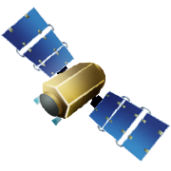
Algorithm Theoretical Description
SURFACE TEMPERATURE
PRECIPITATION
SURFACE TEMPERATURE
T_{soil} & T_{veg}
transpiration &
evaporation
transpiration &
evaporation
Veg stress parms
T_{veg}
Bare soil evap parms
runoff
soil evaporation
Sfc moisture
T_{Soil}
soil evaporation
infiltration
Soil hydraulic parms
Soil moisture
holding capacity
Given known radiative energy inputs, how much water loss is required to keep the soil and vegetation at the observed temperatures?
Rootzone moisture
Root uptake
drainage
Root distribution parms
WATER BALANCE APPROACH
REMOTE SENSING APPROACH
(“forward modeling”)
(“inverse modeling”)

Slide 101
Algorithm Theoretical Description
Evaporative stress index – ESI
Potential ET (PET) is calculated using the observed temperature, wind speed, and net radiation at the surface.
Actual ET is estimated by the ALEXI model.
Drought severity can then be inferred through reductions in the ratio of the actual to potential ET, as represented by the ESI.
The ESI represents standardized anomalies in the ET/PET ratio:
  Negative anomalies indicate drier than normal conditions, whereas positive anomalies indicate wetter conditions
Because the ESI relies on thermal infrared satellite imagery, it can only be computed for locations that remain clear during the morning integration period used by the ALEXI model.
To remedy this problem, composite anomalies are computed using clear-sky data from longer time periods (2, 4, 8 and 12 weeks).

Slide 102
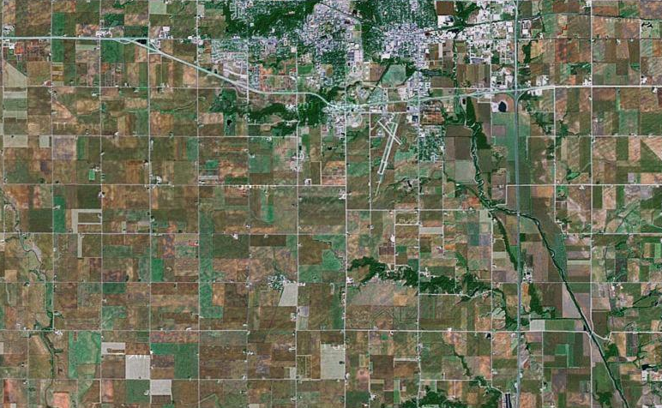
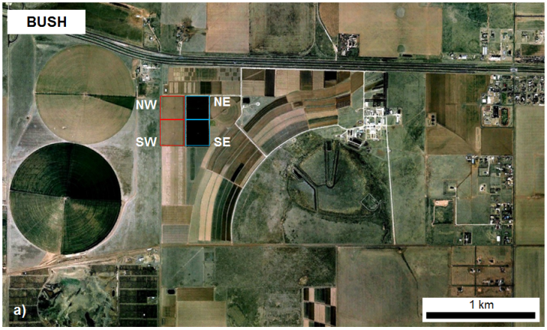
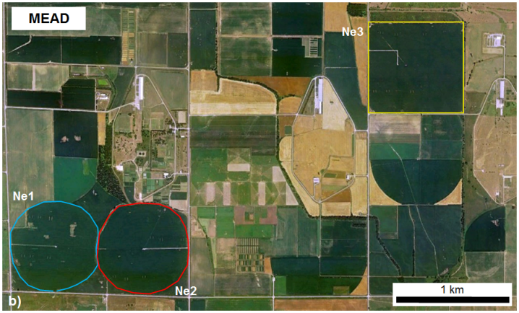
Validation results (ET)
SMEX02
SMEX02
Soil Moisture Experiment 2002
Ames, Iowa
Rainfed corn and soybean
4 km
BEAREX08
Bushland ET and Remote sensing Experiment 2008
Bushland, Texas
Rainfed and irrigated cotton
MEAD
Ameriflux site (S. Verma)
Mead, NE
Rainfed and irrigation corn and soybean

Slide 103
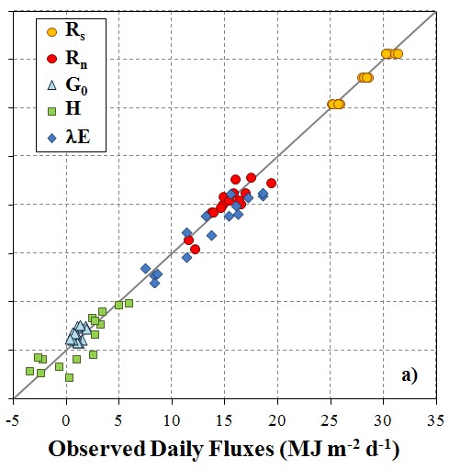
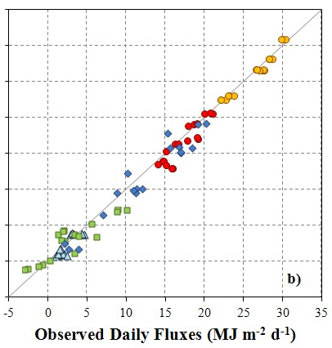
Validation Results (ET)
SMEX02
BEAREX08
MEAD
MAE:
RE:
1.08 MJ m⁻² d⁻¹
8%
1.3 MJ m⁻² d⁻¹
10%
1.3 MJ m⁻² d⁻¹
11%
Notes:
MAE (Mean Absolute Error); RE (Relative Error)

Slide 104
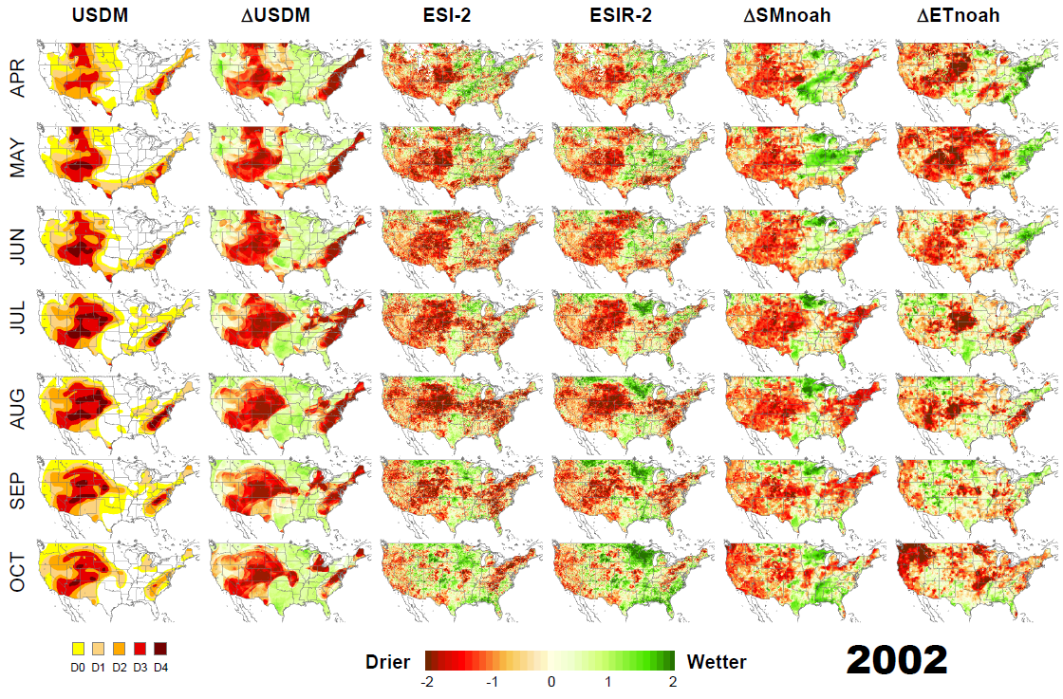
Validation results (ESI)
US Drought Monitor (USDM) USDM Anomaly ESI 2-month ESI (Penman) 2-month NLDAS SM Anomaly NLDAS ET Anomaly

Slide 105
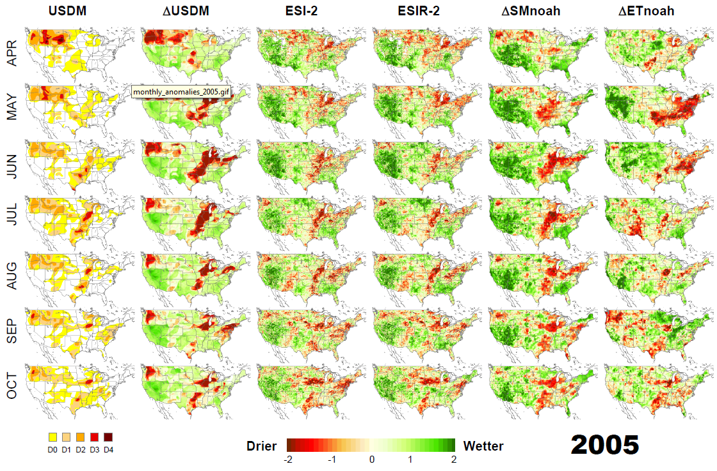
Validation results (ESI)
US Drought Monitor (USDM) USDM Anomaly ESI 2-month ESI (Penman) 2-month NLDAS SM Anomaly NLDAS ET Anomaly

Slide 106
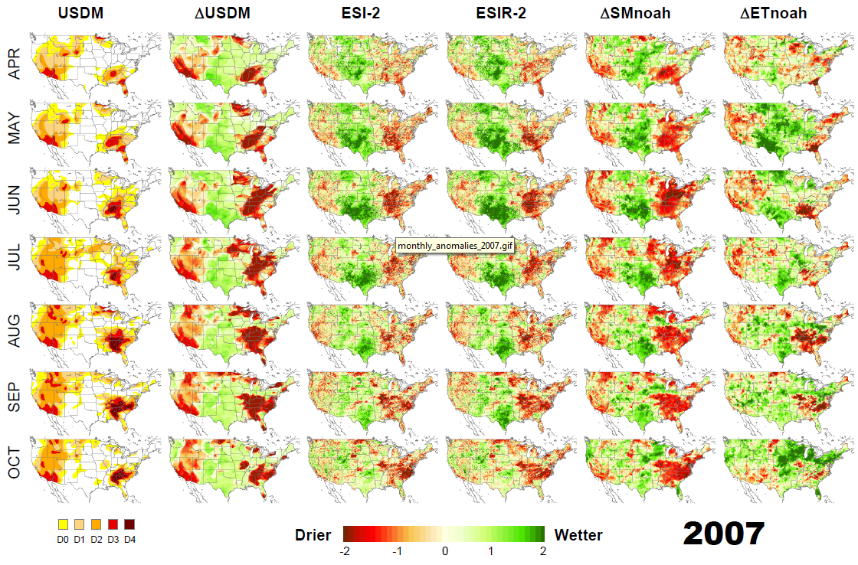
Validation results (ESI)
US Drought Monitor (USDM) USDM Anomaly ESI 2-month ESI (Penman) 2-month NLDAS SM Anomaly NLDAS ET Anomaly

Slide 107
Validation results (ESI)

Slide 108
Assumptions and Limitations
It is assumed that following data are available before the ET and drought products are performed:
  GOES thermal observations
  Meteorological data
  VIIRS EVI/NDVI data
GETD ET products will only be available for land pixels that are:
  Snow free
  Cloud free

Slide 109
Summary - Algorithm Theoretical Basis
Theoretical description of ALEXI model is given in detail in ATBD
ALEXI ET estimates have been rigorously evaluated in comparison with ground-based data
ALEXI ESI shows good correspondence with standard drought metrics and antecedent precipitation, but can be generated at significantly higher spatial resolution

Slide 110
Section 5 –
Software Architecture and Interface
Presented by
Zhengpeng Li (STAR/CICS)

Slide 111
Software Architecture and Interface
Software architecture
System overview
  System design
  System input/output

Slide 112
Software Architecture
Software architecture
External input data
Software elements
(code)
Output products

Slide 113
Software Architecture
Context Layer - 0
External Interfaces
System Layer - 1
Flows Between Units
Unit Layer - 2
Flows Within Units
Sub-Unit Layer - 3
Flows Within Sub-Units
Notes:
113

Slide 114
Context Layer Data Flow
External inputs
Software system
External outputs
ALEXI model
Satellite-based observations
Daily ET product with QC
Meteoro-logical data
Data processing unit
ESI product with QC
Ancillary data
Daily radiance and fluxes
With QC

Slide 115
System Overview – System Inputs
Name | Category | Source | Description
Brightness temperature | Satellite observation | GOES | GOES East/West Imagery; 11micron/3.9 micron brightness temperature
Insolation | Satellite observation | GSIP | GSIP real time insolation
Vegetation Index | Satellite observation | VIIRS | VIIRS NDVI and EVI
Snow mask | Satellite observation | NOAA IMS | IMS Daily Northern Hemisphere Snow and Ice Analysis
Air temperature | Meteorological data | GFS | Surface and pressure level profiles
Specific humidity | Meteorological data | GFS | Surface and pressure level profiles
Geopotential height | Meteorological data | GFS | Surface and pressure level profiles
Wind speed | Meteorological data | GFS | Surface
Downwelling longwave radiation | Meteorological data | GFS | Surface
Land Cover | Ancillary data | University of Maryland | Land cover classes in 1km resolution (static)
Albedo | Ancillary data | MODIS | Surface Albedo from MODIS (static)
Clear day insolation | Ancillary data | GSIP | Clear day insolation (static)

Slide 116
System Overview – System Outputs
Variables | Source | Spatial Domain | Spatial resolution | Description
ET product with QC | GET-D | North America | 10 km | Daily ET map
ESI products with QC | GET-D | North America | 10 km | 2,4,8, 12-week composite drought map
Flux products with QC | GET-D | North America | 10 km | Daily sensible heat and soil heat flux map
Radiance products with QC | GET-D | North America | 10 km | Daily short wave down, long wave down, long wave up and net radiation map

Slide 117
System Overview – QC
Bit | Source | Descriptions
0 | Overall Product Quality | 00=retrieved, 01= not retrieved,
1 | Land cover | 0 = land, 1 = water/sea
2 | GOES Data Availability | 0=normal, 1=bad data
3 | View Angle | 0=normal, 1=large view angle (LZA>55 deg)
4 | Meteorological Data | 0=normal, 1=bad data
5 | Vegetation Data Availability | 0=normal, 1=bad data
6 | Cloud | 0=clear, 1=clear
7 | Snow | 0=snow free, 1=snow contamination

Slide 118
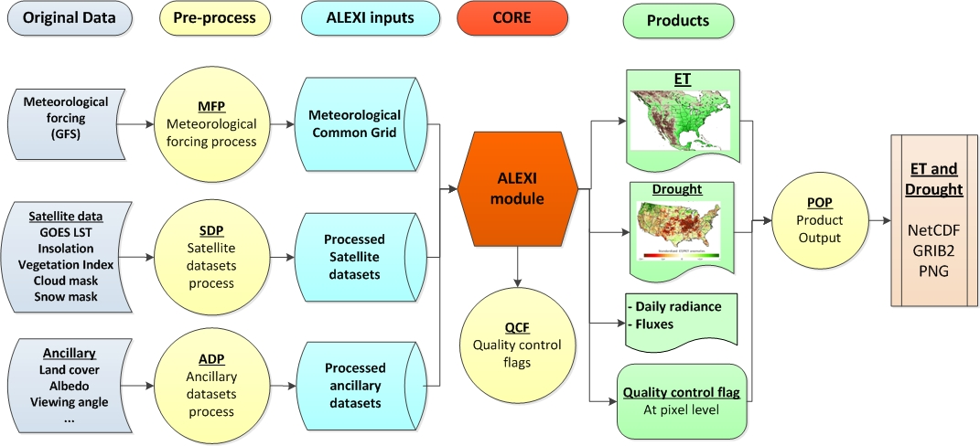
System Layer Data Flows

Slide 119
System Layer Components
Meteorological Forcing Processor (MFP)
  Type: Processing Unit
  Description: Pre-Processor meteorological forcing datasets
Satellite Dataset Processor (SDP)
  Type: Processing Unit
  Description: Pre-Processor satellite datasets, including GOES BT, solar insolation from GSIP products, Vegetation index maps, real-time cloud mask and snow mask
Ancillary Dataset Processor (ADP)
  Type: Processing Unit
  Description: Pre-Processor ancillary datasets, including land cover map and satellite viewing geometry
ALEXI core processor (ALEXI)
  Type: Processing Unit
  Description: Calculate daily ET and potential ET from inputs.
Quality Control Flags (QCF)
  Type: Processing Unit
  Description: Generate quality control flags for each pixel
Product Output Processor (POP)
  Type: Processing Unit
  Description: Output ET and drought products in required data formats (NetCDF, GRIB2 and PNG)

Slide 120
Summary
GET-D context layer contains 3 system layers
  External inputs
  Software system
  External outputs
GET-D software system contains 6 Unit layers
  Meteorological Forcing Processor (MFP)
  Satellite Dataset Processor (SDP)
  Ancillary Dataset Processor (ADP)
  ALEXI core processor (ALEXI)
  Quality Control Flags (QCF)
  Product Output Processor (POP)

Slide 121
Section 6 –
Detailed Design
Presented by
Zhengpeng Li (STAR/CICS)

Slide 122
Software Detailed Design
Unit Descriptions
Sub-Unit Descriptions
File Descriptions

Slide 123
Unit Layer
Meteorological Forcing Processor (MFP)
  Common Grids Land Mask Processor (CGLMP)
  Common Grids Meteorological Processor for GFS (CGMP-GFS)
Satellite Dataset Processor (SDP)
  GOES Data Processor (GDP)
  Real time insolation for GSIP L2 inputs (INSO-GSIPL2)
  Cloud Mask Processor (CMP)
  Vegetation Index Processor for VIIRS EVI/NDVI (VIP-VIIRS)
  Snow Map Processor (SMP)
Ancillary Dataset Processor (ADP)
  Clear day insolation Processor (CIP)
  Albedo Processor (AP)
  Land cover parameter Processor (LCPP)
ALEXI core processor (ALEXI)
  Regional Inputs Processor (RIP)
  ALEXI Point Model (APM)
  Regional Outputs Processor (ROP)
Quality Control Flags (QCF) – Quality Control Flag
Product Output Processor (POP) -- Product output Processor

Slide 124
Sub-Unit Layers
Common Grids Land Mask Processor (CGLMP)
Common Grids Meteorological Processor for GFS (CGMP-GFS)
GOES Data Processor (GDP)
Insolation Processor (INSO-GSIPL2)
Vegetation Index Processor for VIIRS EVI/NDVI (VIP-VIIRS)
Cloud Mask Processor (CMP)
Snow Map Processor (SMP)
Cloud Mask Processor (CMP)
Clear day insolation Processor (CIP)
Albedo Processor (AP)
Land Cover Parameter Processor (LCPP)
Regional Inputs Processor (RIP)
ALEXI Point Model (APM)
Regional Outputs Processor (ROP)
Quality Control Flag (QCF)
Product Output Processor (POP)

Slide 125
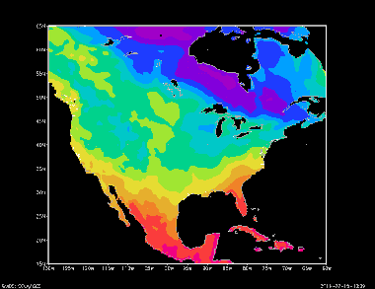
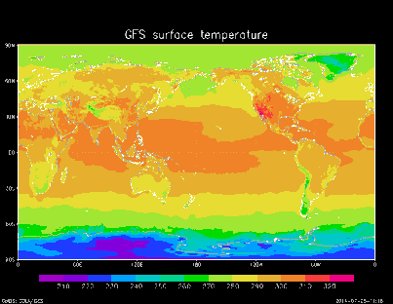
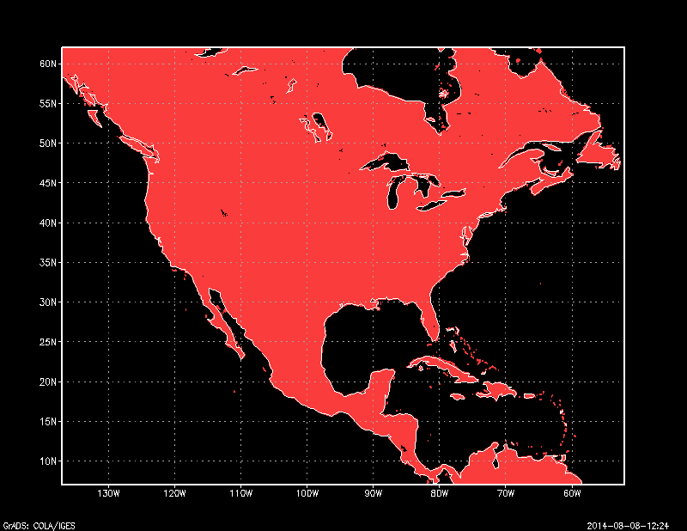
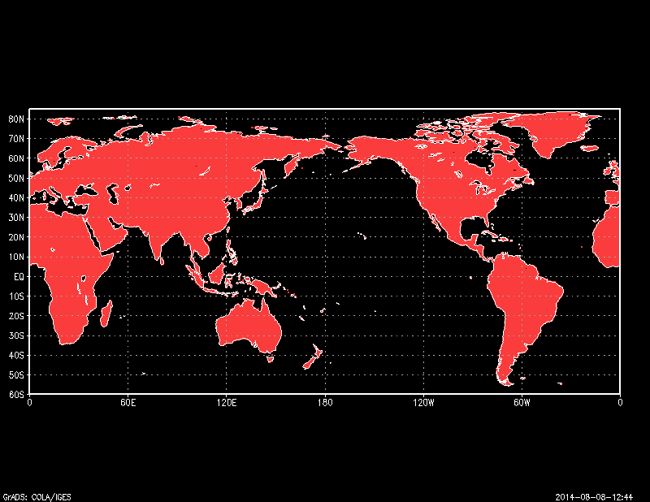
Meteorological Forcing Processor Data Flows
Binary data in Alexi domain
GFS in GRIB2
CGMP-GFS
Temperature
Pressure
Wind speed
……
CGLMP
UMD global land mask

Slide 126
Satellite Dataset Processor Data Flows
GDP
Binary data in Alexi domain
GOES AREA files
BT 3.9 & 11
CMP
BT (3.9 &11)
Solar insolation
Cloud mask
EVI/NDVI
Snow mask
GSIP L2 netcdf4 data
INSO-GSIP L2
VIIRS EVI/NDVI
VIP-VIIRS
Snow mask
SMP

Slide 127
Ancillary Dataset Processor Data Flows
Binary data in Alexi domain
CIP
Clear sky insolation data
AP
Clear sky Solar insolation
Albedo
Land cover
Albedo data
LCPP
UMD land cover

Slide 128
ALEXI Core Processor and Quality Control Flag Data Flows
Binary inputs
APM
Binary outputs
Outputs
ET
ESI
Radiances and fluxes
ET QC
ESI QC
Radiances and fluxes QC
Temperature
Pressure
Wind speed
…...
Solar insolation
……
EVI/NDVI
Snow mask
RIP
ROP
QCF

Slide 129
Product Output Processor Data Flows
Binary outputs
Output GRIB2 file
Outputs
ET
ESI
Radiances and fluxes
ET QC
ESI QC
Radiances and fluxes QC
Output NETCDF4 file
POP
Output PNG files
Status report file

Slide 130
File Descriptions
Control Files
Parameter Files
Meteorological Input Data Files
Satellite Input Data files
Ancillary Data Files
Intermediate Data Files
Output Data Files

Slide 131
Control Files
GETD control File
  Spatial domain
  Input/output data file information
  Control flags
Meteorological data control file
Satellite data control file
Ancillary data control file

Slide 132
Parameter Files
Land cover parameter file
  Parameters vary according to land cover class.
  Including the Seasonal Maximum and Minimum Canopy Heights, Leaf Absorptivity in the Visible, NIR, and TIR Bands, and Nominal Leaf Size.

Slide 133
Meteorological Input Data Files
Meteorological data
 | Forecast hour 00 | Forecast 03
File name | gfs.tccz.pgrb2f00 | gfs.tccz.pgrb2f03
Time interval (hours) | 6 | 3
Number of records | 276 | 319
File size (MB) | ~60 | ~60
Daily files number | 4 | 4
Notes:
Daily meteorological variables will be 3 hours interval to the ALEXI model.

Slide 134
Satellite Input Data Files
Data Source | Specifications | Resolution | Format | Example File Names | Size
GOES East and West | Band 02 | 4km | McIDAS | 1350954623.goes13.2014.001.061520.BAND_02 | ~25 MB
GOES East and West | Band 04 | 4km | McIDAS | 1350954623.goes13.2014.001.061520.BAND_04 | ~25 MB
GSIP | L2 product | 4km | NetCDF | gsipL2_goes13_GENHEM_2014198_1145.nc.gz gsipL2_goes15_GWNHEM_2014198_1400.nc.gz | ~20-30 MB
VIIRS | Global NDVI and EVI | 375m | HDF5 | GVF-ASEVI-P2_s20120726_e20120801_h00v01.h5 | ~ 800 MB
IMS | Daily Northern Hemisphere Snow and Ice Analysis | 24 km | ASCII | ims2014017_24km.asc | ~1 MB

Slide 135
Ancillary Data Files
Data Source | Format | Resolution | File Name | Size
Clear day insolation | Plain binary | 10km | Clear_day_insolation.bin | 2MB
Surface Albedo | Plain binary | 10km | Albedo.bin | 2 MB
UMD Land cover | Plain binary | 1 Km | landcover_UMD.1gd4r | 2160 MB
UMD Land mask | Plain binary | 1 Km | landmask_UMD.1gd4r | 2160 MB

Slide 136
Intermediate Data Files
Past 84 days ET/PET
  Contains the ET/PET ratio that is used to calculate the ESI.
Land index in ALEXI domain
  Contains the land pixels locations in the domain.
Data Source | Format | File Name | Size
ET/PET | Binary | Et_pet_ratio.bin | ~160MB
Land index in ALEXI domain | Binary | common_land_index.bin | 20MB

Slide 137
Output Data Files
GETD generates one set of gridded data product over the North America domain per day:
  Daily ET
  2, 4, 8, 12-week ESI
  Daily radiances and fluxes
Each product contains ET, ESI and other data layers with the QC flags for each grid.
Each product has file size of approximately 30 MB in raw binary data.

Slide 138
GRIB2 File Content
Layer | Data description | Number (In Section 4, octet 11) | Unit | Data type | Fill value | Valid range | Scale factor
1 | Daily ET | 6 | MJ m⁻² day⁻¹ | real | -9999 | 0 - 1000 | 1
2 | Daily ET QC | 231 | N/A | 1-byte integer | 256 | N/A | N/A
3 | 2, 4, 8, 12 -week ESI | 232, 234, 236, 238 | N/A | real | -9999 | -5 – 5 | 1
4 | 2, 4, 8, 12 -week ESI QC | 233, 235, 237, 239 | N/A | 1-byte integer | 256 | N/A | N/A
5 | SD, SNET, LWDN, LWUP | 240, 242, 244, 246 | MJ m⁻² day⁻¹ | real | -9999 | 0 – 1000 | 1
6 | SD, SNET, LWDN, LWUP QC | 241, 243, 245, 247 | N/A | 1-byte integer | 256 | N/A | N/A
7 | H, G | 248, 250 | MJ m⁻² day⁻¹ | real | -9999 | - 1000 – 1000 | 1
8 | H, G QC | 249, 251 | N/A | 1-byte integer | 256 | N/A | N/A

Slide 139
NETCDF4 File Content
Global attributes:
  title = "GETD product"
  Date = “2013-08-01”
Variables:
  float Longitude(Longitude) ;
  Longitude:units = "degrees_east" ;
  float Latitude(Latitude) ;
  Latitude:units = "degrees_north" ;
  int ET(Latitude, Longitude) ;
  ET:units = “MJ m⁻² day⁻¹“ ;
  ET:scaling_factor = 100 ;
  int ET_QC(Latitude, Longitude) ;
  int ESI_2_WEEK(Latitude, Longitude) ;
  ESI_2_WEEK:units = "none" ;
  ESI_2_WEEK:scaling_factor = 100;
  int ESI_2_WEEK_QC(Latitude, Longitude) ;
  ……

Slide 140
Output Data Files
GET-D_zz_yyyyddd_vvv.vv.fff.gz
zz = domain name: NA (North America)
yyyy = four digit calendar year
ddd = day of year
vvv.vv = version number
fff = output format and valid values: grb2, nc or png
GET-D_NA_2007182_001.00.grb2.gz (ET, ESI and other products of North America in GRIB2 format for the version 1.00)
GET-D_NA_2007182_001.00.nc.gz (ET, ESI and other products of North America in NETCDF4 format for the version 1.00)
GET-D_NA_2007182_001.00.png.gz (ET, ESI and other products of North America in PNG format for the version 1.00)

Slide 141
Output Data Files
Status report file
For each GETD run, a status report file is produced to indicate the Processing status of this run.
Each message line in the report file consists of 3 fields, namely the time (yyyymmddhhmmss) of the current message being reported, name of the subprogram that produced the message, and the detailed description of the message.
The detailed description of the message may start with “ERROR” or “WARNING”.
  If “ERROR” appears in the description, the GETD run would be terminated and the final product will not be produced.
  If “WARNING” appears in the description, the GETD run will still continue but the quality of the final product might be affected by fact specified in the warning message.
Notes:
141

Slide 142
Summary
GET-D contains 6 unit layers
GET-D contains 16 sub-unit layers
GET-D files
  4 Control input files
  1 Land parameter input file
  8 Meteorological data input files
  5 Satellite data input files
  4 Ancillary data input files
  2 Intermediate data files
  3 Output data files
  1 Output status report file

Slide 143
Section 7 –
Unit Tests Plan
Presented by
Li Fang (STAR/CICS)

Slide 144
GET-D Test Environment
The development and tests are performed on orbit254l.star1.nesdis.noaa.gov – IBM P6.
This machine is located at STAR and is maintained by STAR IT.
  8 CPUs
  3.1 GHzq
  8 GB memory
  9.6 TB disk space
  GFORTRAN
  G95
The NetCDF, HDF4 and GRIB2 libraries are the stable versions:
  netcdf-4.2-gfortran(GFortran77/90/95)
  HDF5
  GRIB2 1.4.0

Slide 145
GET-D Test Data Sets
GFS GRIB2 data set
GOES AREA files (BT at 3.9 and 11 microns)
GSIP L2 NetCDF data set (Insolation)
VIIRS EVI/NDVI data set
IMS Daily Northern Hemisphere Snow and Ice Analysis
Static ancillary data sets (Clear Sky Insolation, Land cover, Albedo)
Control Files and Parameter Files

Slide 146
Common Grids Land Mask Processor (CGLMP)
Purpose: Read 1 km land mask and produce a list of land pixels at the ALEXI domain at 10km.
Program
  GETD_set_UMD_land_mask
Test Sequence
  Output remapped land cover mask
  Test output file size (coverage & resolution)
  Check the correctness of output values at several sample pixels
  Error control (Format error, missing file…)
  Record the status of process (success or failure) in log file

Slide 147
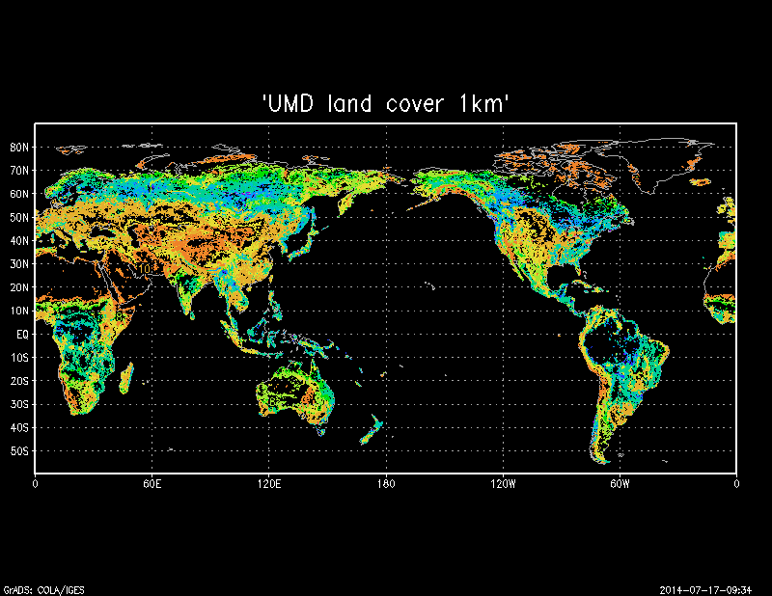
Land Cover Processor (LCPP)
Purpose: Read 1 km land cover (13 classes) and calculate surface spectral parameters for the land pixels in the domain.
Program
  Program GETD_set_Land_Cover
Test Sequence
  Output remapped land cover types
  Test the surface spectral parameters
  Test output spatial pattern and the file size (coverage & resolution)
  Error control (Format error, missing file…)
  Record the status of process (success or failure) in log file

Slide 148
Common Grids Meteorological Processor for GFS (CGMP-GFS)
Purpose: extract the meteorological data for the ALEXI domain
Program: GETD –m (configuration file)
Test Sequence
  Output remapped meteorological variables
  Test output spatial pattern and the file size (coverage & resolution)
  Check the correctness of output values at several sample pixels
  Error control
  Record the status of process (success or failure) in log file
Meteorological | Spatial coverage | Resolution | Image Size | Longitude | Latitude
Original Domain | Global | 0.5 degree | 720 * 361 | -180 – 180 | -90 – 90
Common Grid domain | North America | 0.25 degree | 720 * 360 | -180 – 0 | 0 – 90

Slide 149
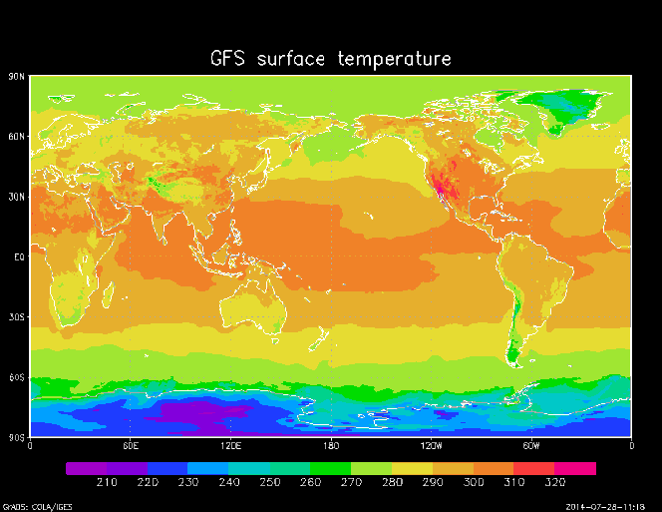
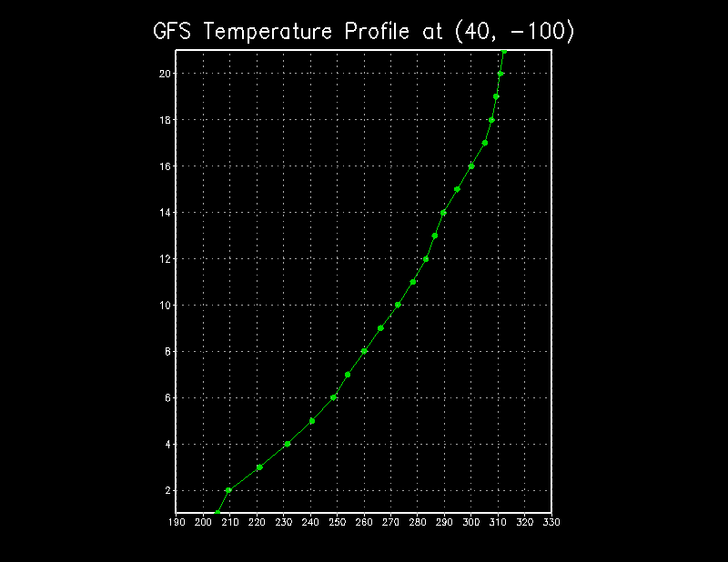
Common Grids Meteorological Processor for GFS
(CGMP-GFS)
2D meteorological variables extracted from GFS
  Surface temperature
  Surface pressure
  Surface specific humidity
  Surface wind speed
  Surface long wave down net radiance
  3D meteorological variables extracted from GFS
  Temperature
  Pressure
  Specific humidity
  Height from surface
Original GFS global surface temperature (top)
Pressure level temperatures at 21 layers (bottom)

Slide 150
GOES Data Processor (GDP)
Purpose: Read GOES dataset in McIDSA format and extract BT at 3.9 and 11 microns for common grid
Program: GETD_get_BT(string input, float* BT39, float*BT11)
Test Sequence
  Output remapped BT variables
  Test output spatial pattern and the file size (coverage & resolution)
  Check the correctness of output values at several sample pixels
  Error control
  Record the status of process (success or failure) in log file
Satellite | Location | Longitude | Byte swap | Original Image Size | Original Image Resolution | Processed Image Equal grid size | Processed Image Resolution | Bottom-left
GOES-13 | East | 105°W | No | 3464*1826 | Pixel resolution 4km | 2400*1720 | 0.05 Deg | -132W, -20S
GOES-15 | West | 135°W | No | 3312*1354 | Pixel resolution 4km | 2400*1320 | 0.05 Deg | -180W, 0S

Slide 151
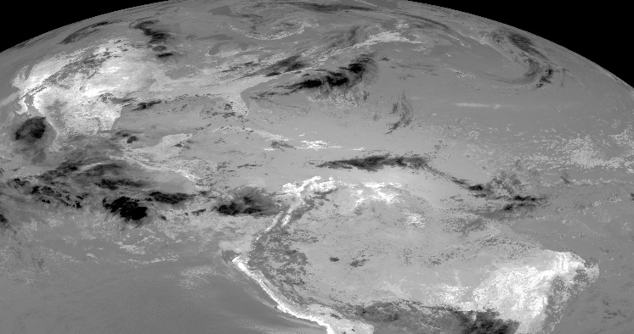
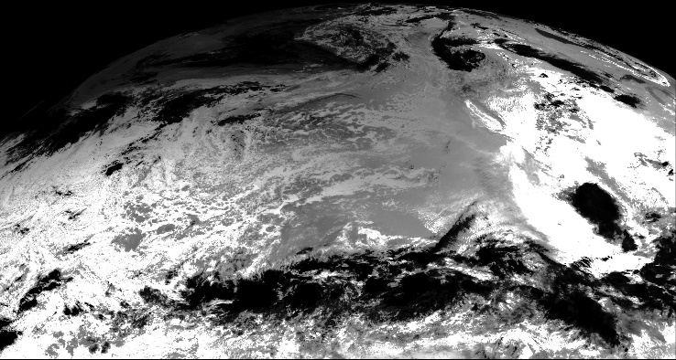
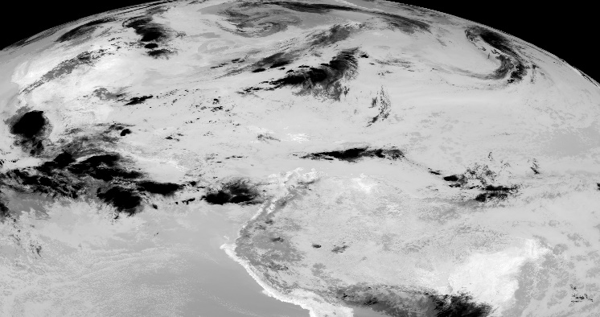
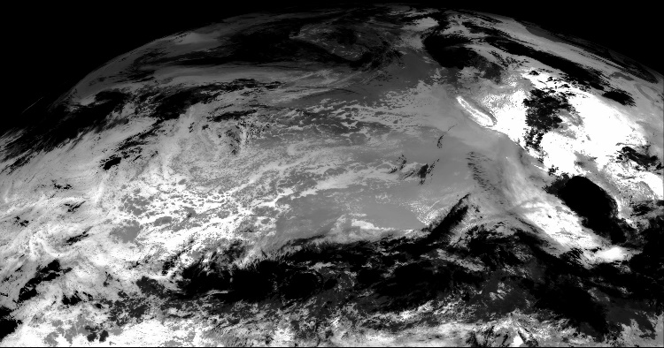
GOES Data Processor (GDP)
 | GOES East | GOES West
BT3.9
BT11
Notes:
Examples of original input GOES images

Slide 152
Insolation Processor (INSO-GSIPL2)
Purpose: Read GSIP L2 product in NETCDF format and extract insolation variables for common grid
Program: GETD_get_inso_GSIP(string inputfn, float* inso)
Test Sequence
  Output remapped insolation variables
  Test output spatial pattern and the file size (coverage & resolution)
  Check the correctness of output values at several sample pixels
  Error control
  Record the status of process (success or failure) in log file

Slide 153
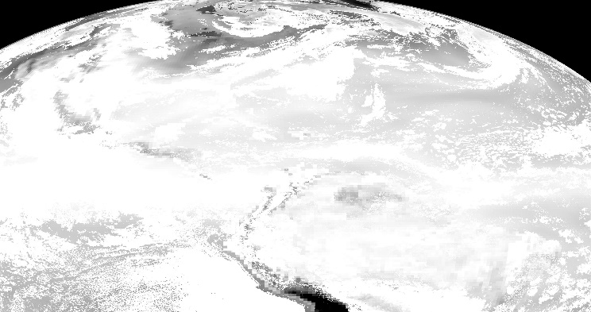
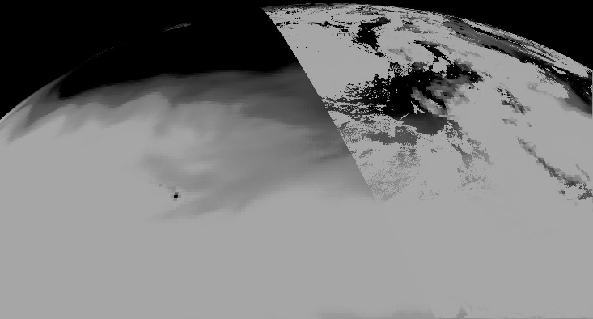
Insolation Processor (INSO-GSIPL2)
Satellite | Location | Longitude | Byte swap | Original Image Size | Original Image Resolution | Processed Image Equal grid size | Processed Image Resolution | Bottom-left
GOES-13 | East | 105°W | No | 3464*1826 | Pixel resolution 4km | 2400*1720 | 0.05 Deg | -132W, -20S
GOES-15 | West | 135°W | No | 3312*1354 | Pixel resolution 4km | 2400*1320 | 0.05 Deg | -180W, 0S
 | GOES East | GOES West
INSO
Notes:
Examples of original GSIP insolation images

Slide 154
Cloud Mask Processor (CMP)
Purpose: Reads the processed BT at 3.9 um and calculate the cloud mask
Program: GETD_set_cloud_mask(float* BT39, float* cld)
Test Sequence
  Output cloud mask
  Check the spatial pattern of cloud mask
  Check pixel values at several sample points
  Test output file size (coverage & resolution)
  Error control
  Record the status of process (success or failure) in log file

Slide 155
Vegetation Index Processor for VIIRS EVI/NDVI
(VIP-VIIRS)
Purpose: Read the VIIRS EVI/NDVI data in HDF5 and compute the vegetation fraction index for ALEXI model
Program
  -- GETD_VegIndexReader(float* NDVI, float* EVI)
Test Sequence
  Output remapped vegetation fraction maps
  Check the spatial pattern of VI
  Test output file size (coverage & resolution)
  Check the correctness of output values at several sample pixels
  Error control (Format error, missing file…)
  Record the status of process (success or failure) in log file

Slide 156
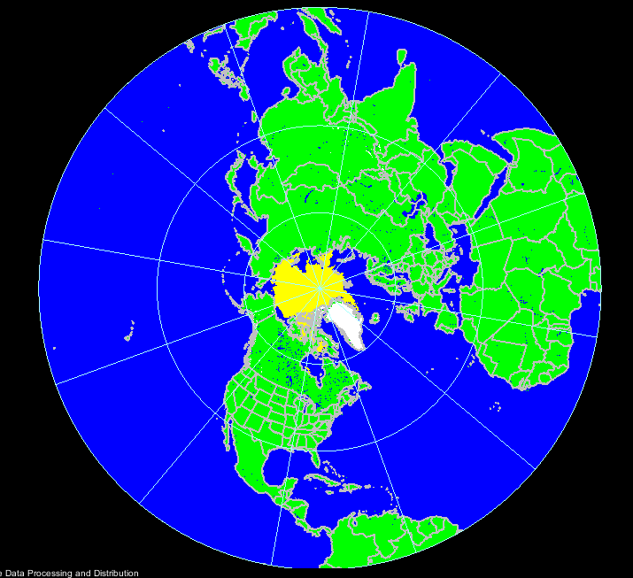
Snow Map Processor (SMP)
Purpose: Read the snow mask in binary format and set the snow mask for the land pixels.
Program
  Program GETD_set_SnowMask(string inputfn, float* snowmask)
Test Sequence
  Output remapped snow mask
  Test output spatial pattern and the file size (coverage & resolution)
  Error control (Format error, missing file…)
  Record the status of process (success or failure) in log file

Slide 157
Clear Sky Insolation Processor (CIP)
Purpose: Read the clear sky insolation data and extract the information for the ALEXI domain.
Program
  Program GETD_Inso_clear_Reader(string inputfn, float* inso_clear)
Test Sequence
  Output clear sky insolation map
  Test output spatial pattern and the file size (coverage & resolution)
  Error control (Format error, missing file…)
  Record the status of process (success or failure) in log file

Slide 158
Albedo Processor (AP)
Purpose: Read the Albedo map and extract the information for the ALEXI domain.
Program
  Program GETD_Albedo_Reader (string inputfn, float* alb)
Test Sequence
  Output albedo map
  Test output spatial pattern and the file size (coverage & resolution)
  Error control (Format error, missing file…)
  Record the status of process (success or failure) in log file

Slide 159
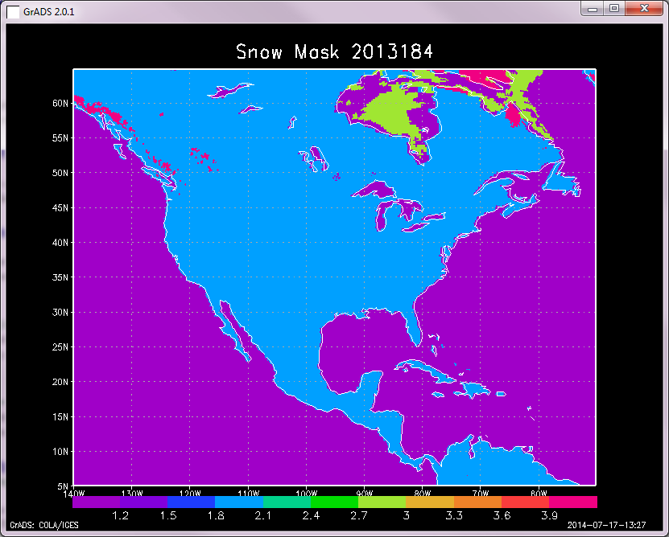
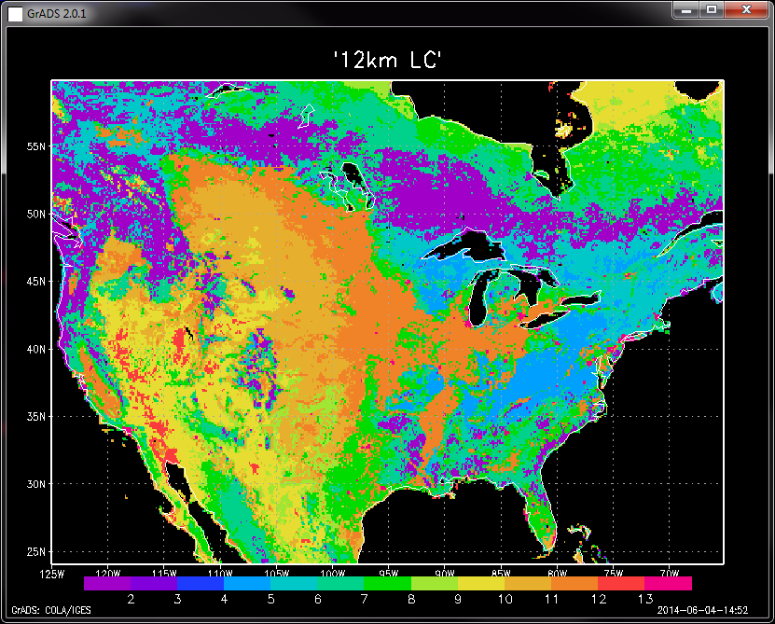
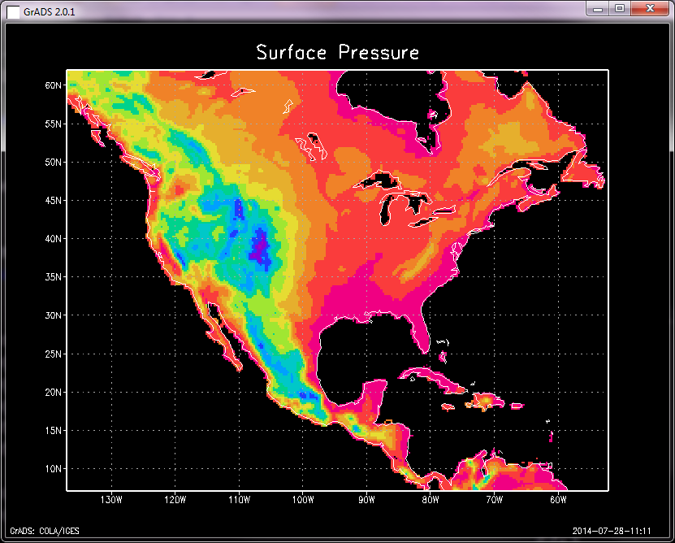
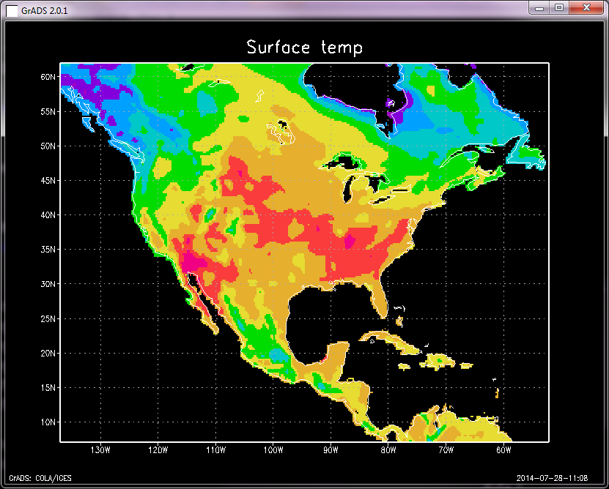
Regional Inputs Processor (RIP)
Purpose: Read all the input variables required in ALEXI model at single pixel from all the input data sets
Program: GETD_set_RIP()
ALEXI loc | -90.05 | 36.15
Date | 2013 | 183
Vegetation | 1.69
GOES view angel | 41.26
Obs time 1 and 2 (UTC) | 12.42 | 16.42
Brightness temperature | 19.37 | 29.55
… | … | …

Slide 160
ALEXI Point Model (APM)
Purpose: Run ALEXI at single pixel where all the input variables are valid and outputs ALEXI retrievals
Program
  ALEXI_run_point(landcover_filename, indata_filename, run_mode, input_flag, istate)
Test Sequence
  Output pixel ALEXI retrievals (Radiation RN, Sensible H, Soil heat flux G, Total ET, Soil ET, Canopy ET, P-M reference ET and short wave down SDN)
  Check the correctness of output values at several sample pixels
  Record the status of process (success or failure) in log file
Inputs
ALEXI run at : -90.85 36.15 on : 2013 183 Vegetation lai NDVI: 1.69 1.00 GOES view angel: 41.26 UTC Time 1 and 2 : 12.42 16.42 GOES observed temp(k): 19.37 29.55 GOES observed sdn(k) : 196.37 843.93 Long wave down(w): 348.68 387.09 Wind speed (m-2 s-1) : 1.68 2.22 Air temperature(k): 17.21 23.40 Surface pressure(Pa) : 994.65 995.74 ……

Slide 161
Regional Outputs Processor (ROP)
Purpose: Calculate the daily ET and 2, 4, 8, 12 week composite ESI from ALEXI point outputs to the output buffer
Program
  GETD_ALEXI_run_region()
Test Sequence
  Output Daily ET (ET.bin, ET_QC.bin).
  Output ESI composites (ESI_*week.bin, ESI_*week_QC.bin).
  Output daily radiances and fluxes (SD, SNET, LWDN, LWUP, H, G)
  Test output spatial pattern and the file size (coverage & resolution)
  Check the correctness of output values at several sample pixels
  Record the status of process (success or failure) in log file

Slide 162
Quality control flags (QCF)
Purpose: Setup QCF for each pixel based on the quality of all the input variables and ALEXI retrievals
Program: GETD_set_QCF()
Test Sequence
  Output : pixel based QCF for ET and ESI
  Check the correctness of output values at several sample pixels
  Record the status of process (success or failure) in log file

Slide 163
Product Output Processor (POP)
Purpose: Write the ET/ESI and QC information in the output buffer to desired output format
Program
  GETD_pop()
Test Sequence
  Convert ET/ESI maps in binary format to NetCDF, GRIB2 and PNG formats
  Open ET/ESI maps in NetCDF, GRIB2 and PNG in ENVI/PanolyWin/wgrib2 and compare with the original binary files
  Record the status of process (success or failure) in log file

Slide 164
Error Handling
It is assumed that the input test data are free of errors, so that the Processing will run to completion without error.
To test the system’s ability to handle errors, additional Processing runs will be performed with induced errors.
There will be a separate test run for each induced error.
The unit test includes 10 induced errors
Condition | Affected Units | Expected result
Number of command arguments less than 3 | GETD_main | Exit with Usage message
Unrecognized Processor mode | GETD_main | Exit with Error message
Wrong configure file | GETD_main | Exit with Error message
Missing land mask file | GETD_load_land_data | Exit with Error message
Missing GFS file | GETD_Processor_meteorological_data | Exit with Error message
Missing GOES file | GETD_Processor_GOES_data | Exit with Error message
Missing GSIP file | GETD_Processor_GSIP_data | Exit with Error message
Missing EVI/NDVI file | GETD_Processor_EVI/NDVI_data | Exit with Error message
Missing Land cover file | GETD_Processor_land_cover | Exit with Error message
Missing Snow mask file | GETD_Processor_snow_mask | Exit with Error message
Notes:
164
164

Slide 165
Summary
Test plans for 16 sub-units
10 Error handlings

Slide 166
Section 8 –
Algorithm Package
Presented by
Li Fang(STAR/CICS)

Slide 167
GET-D DAP
The DAP shall contain:
  Science algorithm source code, including make files and scripts.
  Test plans, test description, test procedures, and detailed performance testing results.
  Test input data, temporary files, and expected output data.
  Coefficient files and/or look-up tables.
  Quality monitoring information (quality flags, quality flag values).
  Production rule-set definitions.
  Product file specifications – layout, content, and size.
  Data flow diagrams.
  List of exit codes and their associated messages.
  List of expected compiler warnings.
  Estimates of resources required for execution.
  Algorithm Theoretical Basis Documents (ATBDs) or reference to where the ATBDs can be obtained.
  Delivery Memo.
  README text file.

Slide 168
GET-D DAP
Delivery memo will contain:
  Point(s) of contact for questions specific to the algorithm (include name, telephone, e-mail address).
  List of delivery contents.
  Purpose of the delivery, e.g. an initial release, modification, etc.
  Description of problem(s) resolved, if any, and method of resolution.
  Description of significant changes from previous version, if any.
  List of documents updated/added/superseded, if any.
  List of known remaining defects.
The README text file in the DAP must contain:
  Location of all required DAP contents.
  DAP version number.
  Supporting COTS/Open Source software package requirements.
  Target configuration for setup (directories and files after setup scripts have been executed). This is understood to be a list of where everything is located once the DAP has been unpacked.
  Other pertinent information as judged by the algorithm developer(s) (e.g. compiler settings, etc.).

Slide 169
Section 9 –
Quality Assurance
Presented by
Priyanka Roy (STAR)

Slide 170
Quality Assurance Background
STAR has used the Enterprise Process Lifecycle (EPL) process to improve processes and practices for development and the transfer of research to operations.
The GET-D project will follow the updated SPSRB process that has been influenced by the STAR EPL process.

Slide 171
Quality Assurance – Project
Critical Design Review (August 2014)
  To finalize requirements and to verify that the chosen design is able to meet those requirements.
Software Review (Oct 2014)
  Will be conducted to ensure that the GET-D software is able to fulfill the functional software requirements.
Unit Test Review Combined with System/Algorithm Readiness Review (Oct 2014)
  Will show that the GET-D system is ready to be transitioned to operations.
Operational Readiness Review (February 2015)
  Will show that the GET-D system is ready to be declared operational.

Slide 172
Configuration Management (CM)
STAR CM Tool (Subversion)
  Open source.
OSPO CM Tool – Subversion
  Open source
CM personnel have been identified.
CM training:
  Administrator training completed.
  If required, developers will be trained by the CM administrator.

Slide 173
SPSRB Coding Standards
Coding standards guidelines and quick references are available.
Provide a common list of abbreviations.
Adhere to the standards throughout the development life cycle.
Code is checked for compliance during the software review.

Slide 174
Quality Assurance – Software
The GET-D software will be delivered incrementally as part of the series of algorithm package deliveries.
  Preliminary DAP – Sept 2014
  Final DAP – Nov 2014
This will allow system testing of the code within OSPO.

Slide 175
Quality Assurance – Software
All code development is being conducted on a platform that is nearly identical to the test and production target platforms using the same compilers and operating system.
The status of all system calls and intrinsic functions are checked.
Unit tests will be conducted for each product individually.
  The PALs will have access to test data products to verify that values appear reasonable.

Slide 176
Quality Assurance – Software
An official algorithm package will be delivered:
  All Product Monitoring code and system files
  Test plans
  Test data sets
  Error messaging/handling
  Configuration files
  Production rules
  Database specifications
  Data flow diagrams
  Estimates of resource usage
  Delivery memo

Slide 177
Quality Assurance – Products
GET-D developers will work with:
  The algorithm developers to ensure that the implemented algorithms are producing the correct results
  The PALs to ensure that the system has been implemented correctly
  The users to ensure that the products are what the users require

Slide 178
Quality Assurance – Archive and Maintenance
Archive Plan
  Currently no plan to archive any of the products
Long Term Maintenance Plan
  The Product Monitoring System will be maintained by the OSPO staff
  STAR system developers will be available

Slide 179
Quality Assurance – Documentation and Metadata
Documentation/Metadata Plan
  The Documentation will include the SPRSB documents along with the RAD and RID
  Metadata associated with these products are the variables that may be used for product monitoring

Slide 180
Quality Assurance – Summary
Quality assurance plan will consist of:
  Project reviews at which stakeholders are encouraged to participate.
  Ongoing interaction with algorithm developers and OSPO PALs.
  Adhering to SPSRB software standards and use of standard libraries only.
  Software unit tests shall be presented in the UTR.
  Documentation of the code operation, production rules, and software tests will be in the algorithm package.
  Documentation of requirements will be in the GET-D RAD.
  Early release of software will allow for early system implementation.

Slide 181
Section 10 –
Risks and Actions
Presented by
Priyanka Roy (STAR)

Slide 182
Risks and Actions
Risk # 1: Unavailability of optimal EVI data for input to the model that will eventually be used for creating the ESI climatology. Presently EVI is calculated from MODIS LAI product.
Impact: If a optimal EVI is not available, the quality of the drought product will be degraded.
Mitigation: A regression approach is being explored to estimate LAI from either:
  VIIRS EVI
  surface reflectance
Likelihood: Low
Severity: High
CONSEQUENCES
1
2
3
4
5
5
LIKELIHOOD
4
3
2
X
1

Slide 183
Risk and Action Summary
There is 1 CDR Risk that was discussed during the review and it will remain open with risk assessments of Medium

Slide 184
Section 11 –
Review Summary
Presented by
Xiwu Zhan (STAR)

Slide 185
Review Objectives Have Been Addressed
The Project Mission and Schedule has been reviewed.
The Project Requirements have been reviewed
The Theoretical bases of the algorithms and initial validation of products have been reviewed
Software architecture, hardware, data, and interfaces have been reviewed.
Plans for quality assurance have been reviewed.
Risks and Actions have been reviewed.

Slide 186
Current Status
The GET-D system algorithm test case has been implemented on the STAR development machine.
The RAD is at Version 1.0.
The ATBDs are ready for conversion to project formats.
Notes:
May be updated.

Slide 187
Next Steps
Code Development/Transfer Phase
Software Review – October 2014
System/Algorithm Readiness Review – October 2014

Slide 188
Open Discussion
The review is now open for free discussion

