Slide 1






GOES Evapotranspiration and Drought Product System (GET-D)
Algorithm Readiness Review
NESDIS SPSRB Algorithm Readiness Review (ARR)
Prepared by
GET-D Integrated Product Team
August 31st, 2015

Slide 2
Agenda
Introduction Jerry Zhan
Pre ARR Risks and Actions Priyanka Roy
Requirements Priyanka Roy
System Architecture Zhengpeng Li
Algorithm Readiness Zhengpeng Li/Chris Hain
Delivered Algorithm Package Li Fang
Quality Assurance Priyanka Roy
Risk and Action Summary Priyanka Roy
Summary and Conclusion Jerry Zhan

Slide 3
Outline
Introduction
Pre ARR Risks and Actions
Requirements
System Architecture
Algorithm Readiness
Delivered Algorithm Package
Quality Assurance
Risk and Action Summary
Summary and Conclusion

Slide 4
Section 1 –
Introduction
Presented by
Jerry Zhan (STAR)
GET-D Development Lead

Slide 5
Introduction
Integrated Product Team (IPT)
Background
Objectives
Project plan
Milestones
ARR entry and exit criteria

Slide 6
Integrated Product Team (IPT)
IPT Lead: Xiwu (Jerry) Zhan (STAR)
IPT Backup Lead: Hanjun Ding (OSPO)
NESDIS Team:
  STAR: Chris Hain, Li Fang, Zhengpeng Li , Priyanka Roy, Istvan Laszlo
  OSPO: Hanjun Ding, Zhaohui Cheng, Ricky Irving
  OSGS: Tom Schott
  Data Center: Phil Jones (NCEI)
  Others: Venkata Rao Anne (SGT)
User Team
  Lead: Mike Ek (NCEP-EMC)
  Others:
    NCEP-EMC: Youlong Xia
    NCEP-CPC: Kingtze Mo, Jin Huang
    NDMC-UNL: Brian Wardlow, Mark Svoboda
    USDA: Martha Anderson (ARS), Zhengwei Yang (NASS), Curt Reynolds (FAS)
Oversight Panel (OP) lead: Land POP
Other OPs involved: ERBPOP

Slide 7
Background
Importance:
  Evapotranspiration (ET) for EMC model validation
  Drought for food and water security and world crop market assessment.
Uniqueness:
  No ET or drought products based on satellite thermal infrared observations
User request:
  NCEP filed a request for ET and drought from thermal infrared sensing of satellites such as GOES
  A GIMPAP project proved ALEXI model using GOES data could provide the data products users requested

Slide 8
Objectives
ET and drought maps generated from the Atmosphere-Land Exchange Inversion model (ALEXI) for NCEP/NIDIS/USDA users
The products are generated from the brightness temperature (BT) of the GOES East and West Imagers
Coverage and resolution: North America at a spatial resolution of 8 km
ET product: Daily, over clear-sky pixels
Drought product: 2, 4, 8, 12-week composites updated daily
Output format: GRIB2, NetCDF and PNG

Slide 9
Project Plan
Year 1 – Design and Development (2013 – 2014)
  Develop Requirements Document
  Identify ancillary data for the algorithms
  Conduct CDR
  Compute software development

Slide 10
Project Plan
Year 2 –Transition to Pre-Operations (2014 – 2015)
  Deliver initial DAP (Framework with pre-operational algorithms) to OSPO
  Conduct Software Review
  Update algorithms
  Transition and test system within the OSPO environment
  Perform test data flows
  Conduct System Readiness Review
  Deliver final DAP to OSPO

Slide 11
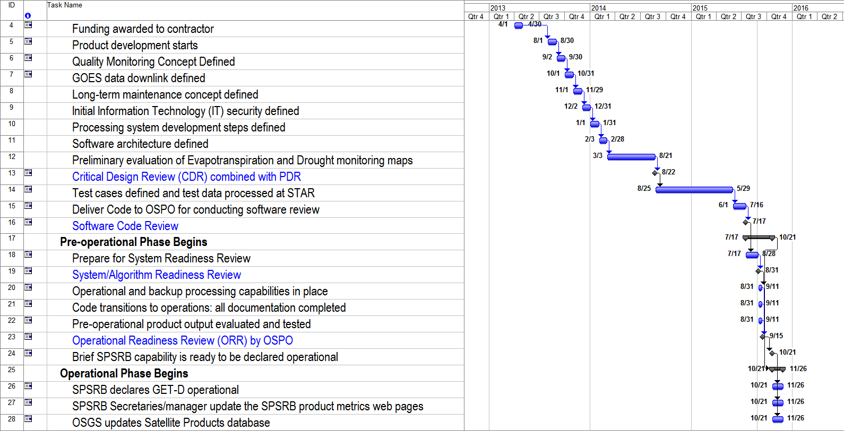
Project Timeline
ARR 08/31/15
Notes:
Priyanka 09/03/14: Updated

Slide 12
Project Milestones
Critical Design Review – 08/21/2014
Software Review – 7/17/2015 (October 2014)
System Readiness Review – 08/31/2015 (October 2014)
Operational Readiness Review – 09/15/2015 (February 2015)
SPSRB Briefing – 10/21/2015

Slide 13
ARR Entry Criteria
Requirements Document
  SPSRB #0905-0007, “A GOES Thermal Observation Based Evapotranspiration (ET) Product”
  Requirements have been document in the Requirements Allocation Document
Review Contents:
  Requirements
  Software Architecture
  Algorithm Readiness
  Risks and Actions

Slide 14
ARR Exit Criteria
GET-D ARR Report
  The report will contain:
    Actions
    Comments
    ARR presentation
Updated GET-D Review Item Disposition (RID) spreadsheet.
Updated GET-D Requirements Allocation Document (RAD)

Slide 15
Outline
Introduction
Pre ARR Risks and Actions
Requirements
System Architecture
Algorithm Readiness
Delivered Algorithm Package
Quality Assurance
Risk and Action Summary
Summary and Conclusion

Slide 16
Section 2 –
Pre ARR Risks and Actions
Presented by
Priyanka Roy (STAR)
GET-D Quality Assurance

Slide 17
Risks and Actions
Risk # 1: Unavailability of optimal EVI data for input to the model that will eventually be used for creating the ESI climatology. Presently EVI is calculated from MODIS LAI product.
Impact: If a optimal EVI is not available, the quality of the drought product will be degraded.
Mitigation: A regression approach is being explored to estimate LAI from either:
  VIIRS EVI
  surface reflectance
Likelihood: Low
Severity: High
Assessment: Medium
Status: Closed
CONSEQUENCES
1
2
3
4
5
5
LIKELIHOOD
4
3
2
X
1

Slide 18
Risks and Actions
Risk # 2: Project schedule will be impacted if the FY14 hardware purchase delay continues, since OSPO process for procuring hardware has changed with the new O&M contract.
Impact: Project Schedule.
Mitigation: Memory will be added to the existing GSR server and that will be enough for running GET-D
Likelihood: Medium
Severity: Medium
Assessment: Medium
Status: Closed
CONSEQUENCES
1
2
3
4
5
5
LIKELIHOOD
4
3
X
2
1
Notes:
Priyanka: Closed at ARR.

Slide 19
Risks and Actions
Risk # 3: If the VIIRS Geolocation file (GITCO) is not included as an input to the GET-D System, the VIIRS VI EDR files will not be geolocated.
Impact: Product Quality.
Mitigation: Included GITCO file in the input
Likelihood: Low
Severity: High
Assessment: Medium
Status: Closed
CONSEQUENCES
1
2
3
4
5
5
LIKELIHOOD
4
3
2
X
1

Slide 20
Risks and Actions
Risk # 4: If the plan to archive the product is not finalized, this product will not be archived.
Impact: Data archive.
Mitigation:
  Update- OSPO made the decision in Dec 2014 to not archive this product.
Likelihood: Medium
Severity: High
Assessment: High
Status: Closed
CONSEQUENCES
1
2
3
4
5
5
4
X
LIKELIHOOD
3
2
1
Notes:
Priyanka: Closed at ARR.

Slide 21
Risks and Actions
Risk # 5: Following OSPO's SMOMS contract situation, the project schedule may be impacted due to lack of SMOMS contract support.
Impact: Product Schedule.
Mitigation:
  Contractor support has been assigned.
Likelihood: Medium
Severity: High
Assessment: High
Status: Open
CONSEQUENCES
1
2
3
4
5
5
LIKELIHOOD
4
3
X
2
1
Notes:
Priyanka: Updated Mitigation plan

Slide 22
Risks and Actions
Risk # 6: There might be delay in testing if OSPO is not able to allot required disk storage for testing.
Impact: Product schedule.
Mitigation: STAR developers will provide am estimate of disk storage required for testing to OSPO.
Likelihood: Low
Severity: High
Assessment: Medium
Status: Closed
CONSEQUENCES
1
2
3
4
5
5
LIKELIHOOD
4
3
2
X
1

Slide 23
Risk and Action Summary
There were 6 CDR Risks and 5 are recommended to be closed
Open Risks Assessment: 1 High
Notes:
Priyanka: Updated summary

Slide 24
Outline
Introduction
Pre ARR Risks and Actions
Requirements
System Architecture
Algorithm Readiness
Delivered Algorithm Package
Quality Assurance
Risk and Action Summary
Summary and Conclusion

Slide 25
Section 3 –
Requirements Review
Presented by
Priyanka Roy (STAR)

Slide 26
General Requirement Description Slide
All GET-D Project requirements are presented in this section.
All GET-D Project requirements are documented in a single RAD located in the project repository at:
Basic requirements are shown in all purple text on a single slide.
Requirements which have been updated/added since the last review are in green.

Slide 27
Basic Requirement 0
GET_D-R 0: The GOES Evapotranspiration and Drought (GET-D) Product System shall adopt the standard practices of the SPSRB Review Process
  Driver: SPSRB transition to operations process

Slide 28
Basic Requirement 0.0
GET_D-R 0.1: The GET-D SPSRB reviews shall be tailored
  This derived requirement has been adopted to mitigate schedule risk by eliminating the overhead of preparing review slide packages and reports. Details are in derived requirements 0.1.x.

Slide 29
Basic Requirement 0.0
GET_D-R 0.1.1: There shall be a Critical Design Review (CDR) (that contains information from a Requirements Review and the Preliminary Design Review) for GET-D.
  This derived requirement has been adopted to mitigate schedule risk by eliminating the overhead of preparing a Requirements Review, PDR, and CDR slide packages separately. The Technical risk is assessed as Low because the CDR will be tailored to accomplish the standard objectives of a PDR and Requirements Review. Risks shall be tracked.

Slide 30
Basic Requirement 0.0
GET_D-R 0.1.2: The Critical Design Review Report (CDRR), a standard artifact of the SPSRB Process shall be compiled for the GET-D project.
  The CDRR is one of the exit criteria for the CDR. The updated CDR slides will form the CDRR.
GET_D-R 0.1.3: There shall be a Software Code Review (SCR) for GET-D.
  This derived requirement has been adopted for meeting OSPO coding and security standards.

Slide 31
Basic Requirement 0.0
GET_D-R 0.1.4: There shall be an System Readiness Review (SRR) for GET-D.
  This derived requirement has been adopted from the SPSRB review process.
GET_D-R 0.1.5: The System Readiness Review Report (SRRR), a standard artifact of the SPSRB Process shall be compiled for the GET-D project.
  The SRRR is an exit criteria for the SRR.

Slide 32
Basic Requirement 0.0
GET_D_R 0.1.6: There shall be an Operational Readiness Review (ORR) for GET-D.
  This derived requirement has been adopted from the SPSRB review process.
GET_D_R 0.1.7: The Operational Readiness Review Report (ORRR), a standard artifact of the SPSRB Process shall be compiled for the GET-D project.
  The ORRR is an exit criteria for the ORR.

Slide 33
Basic Requirement 0.0
GET_D-R 0.2: The Requirements Allocation Document (RAD) shall be created and maintained by the GET-D development team.
  This derived requirement has been adopted from the SPSRB Review process. The RAD will follow document standards stated in EPL v3 process asset DG-6.2
GET_D-R 0.3: The Review Item Disposition (RID) spreadsheet shall be created and maintained by the GET-D development team.
  This derived requirement has been adopted from the SPSRB Review process.

Slide 34
Basic Requirement 0.0
GET_D-R 0.4: Configuration Management shall be implemented for the GET-D software and documentation.
  Project documents will be distributed through Google Drive. Code and test data will be distributed via ftp transfer.

Slide 35
Basic Requirement 1
GET_D-R 1: The GET-D system shall generate GOES Thermal observation based evapotranspiration (ET) and drought monitoring products.
  Driver: This basic requirement is traced to user needs as stated in the SPSRB User request # 0905-0007, A GOES Thermal Observation Based Evapotranspiration (ET) Product: NCEP needs independent ET data from satellite for validating Noah land surface model output and satellite based drought data product for monthly drought briefing

Slide 36
Basic Requirement 1.0
GET_D-R 1.1: The GET-D evapotranspiration product shall be generated daily over clear sky conditions.
  User Request.
GET_D-R 1.2: The GET-D drought product shall be generated as 2, 4, 8, 12 weeks composite drought maps updated daily.
  Standard format for this user community.

Slide 37
Basic Requirement 1.0
GET_D-R 1.3: The GET-D output file shall include daily sensible heat flux (H), soil heat (G), net radiation Rn and its components (upward and downward longwave radiation fluxes and solar insolation).
  Provided for users' convenience.
GET_D-R 1.4: The GET-D products shall have a full coverage of the North America region.
  User Request. Current capabilities

Slide 38
Basic Requirement 1.0
GET_D-R 1.5: The GET-D product shall be a land surface product with a horizontal resolution of 10 km.
  User Request. Current capabilities
GET_D-R 1.6: The GET-D products shall be in Lat/Lon projection.
  User Request.

Slide 39
Basic Requirement 1.0
GET_D-R 1.7: The GET-D products shall have error less than 20%.
  User Request.
GET_D-R 1.8: The GET-D products shall have a latency in the range 3 to 6 hours.
  User Request.
GET_D-R 1.9: The GET-D products shall include quality information.
  QC flags will be specified in the External Users Manual.

Slide 40
Basic Requirement 1.0
GET_D-R 1.10: The GET-D system shall write the Evapotranspiration and Drought Monitoring products into a single file written in NetCDF4
  The NetCDF4 output will be for the archives.
GET_D-R 1.11: The GET-D system shall produce Evapotranspiration and Drought monitoring tailored products in GRIB2 and PNG formats.
  User Request.

Slide 41
Basic Requirement 1.0
GET_D-R 1.12: The GET-D developers shall perform validation and verification of the GET-D products.
GET_D-R 1.12.1: The GET-D developers shall perform unit testing to verify functional performance of the code that produces the GET-D products.
  Will be included in the unit tests and the system test described in the SRR.

Slide 42
Basic Requirement 1.0
GET_D-R 1.12.2: The GET-D developers shall verify the error handling capability of the pre-operational system.
  Needed by OSPO for reliable operations.
GET_D-R 1.12.3: The GET-D developers shall produce and distribute the ET and Drought monitoring product files for evaluation by the user community.
  Standard procedure for this user community.

Slide 43
Basic Requirement 1.0
GET_D-R 1.12.4: The GET-D system shall perform routine data range checks to flag anomalous values in the input data.
  Anomalous values will be flagged. These checks will be included in the code and described in the SRR.
GET_D-R 1.12.5: The GET-D system shall perform routine data range checks to flag anomalous values in the ET and Drought Products.
  Out-of-range values will be flagged. These checks will be included in the code.

Slide 44
Basic Requirement 2
GET_D-R 2: The GET-D system shall have data ingest capability.
  Driver: This basic requirement is traced to algorithm input needs as documented in the GET-D ATBD.

Slide 45
Basic Requirement 2.0
GET_D-R 2.1: The GET-D system shall ingest GOES Brightness Temperature and solar insolation.
GET_D-R 2.2: The GET-D system shall ingest the EVI generated as an intermediate product by the Green Vegetation Fraction (GVF) algorithm at NDE.
Notes:
Priyanka 09/03/14: Updated

Slide 46
Basic Requirement 2.0
GET_D-R 2.3: The GET-D system shall ingest NOAA IMS Snow mask.
GET_D-R 2.4: The GET-D system shall ingest CFS meteorological fields.
GET_D-R 2.5: The GET-D system shall ingest VIIRS Geolocation file (GITCO).

Slide 47
Basic Requirement 3
GET_D-R 3: The GET-D system shall implement the ALEXI algorithm to generate the ET and drought monitoring products.
  Driver: This basic requirement is traced to user needs for the GET-D products.

Slide 48
Basic Requirement 3.0
GET_D-R 3.1: The GET-D algorithms shall be implemented by processing codes written in Fortran 95.
GET_D-R 3.2: The GET-D processing code shall be able to run in the Development Environment at STAR.
  Fortran code can run in this environment

Slide 49
Basic Requirement 3.0
GET_D-R 3.3: The GET-D processing code shall be able to run in the OSPO Test Environment.
  Fortran code can run in this environment
GET_D-R 3.4: The GET-D processing code shall be able to run in the OSPO Operational Environment- GeoProd.
  Fortran code can run in this environment
GET_D-R 3.5: The GET-D algorithm shall generate QC flags.

Slide 50
Basic Requirement 4
GET_D-R 4: The GET-D system shall generate metadata for retrieved product.
  Driver: This basic requirement is traced to OSPO needs for monitoring and maintenance.

Slide 51
Basic Requirement 4.0
GET_D-R 4.1: The GET-D system shall write metadata text files associated with the retrieved products.
GET_D-R 4.2: The metadata shall include overall quality and summary level metadata.
GET_D-R 4.3: The metadata shall include Granule metadata.

Slide 52
Basic Requirement 5
GET_D-R 5: The GET-D system shall have QC monitoring capability
  Driver: This basic requirement is traced to an OSPO need for QC monitoring.

Slide 53
Basic Requirement 5.0
GET_D-R 5.1: The GET-D system output shall include overall quality control flags and quality summary level metadata
  Needed for distribution, archive, quality control and post-processing in the products files. GET-D code will generate metadata for this purpose.

Slide 54
Basic Requirement 5.0
GET_D-R 5.2: The GET-D system shall be capable of monitoring input data latency and overall quality
GET_D-R 5.3: The GET-D system shall be capable of monitoring product latency
  Output GET-D processing time and output to status file

Slide 55
Basic Requirement 5.0
GET_D-R 5.4: The GET-D system shall produce real-time PNG imagery files for visual inspection of output data files
  PNG files will be produced by the Product Output Processor Unit
GET_D-R 5.5: The GET-D system shall be capable of monitoring product distribution status to ensure that the data/products are successfully available for transfer to the user community
  A product status file will be produced for each operational run

Slide 56
Basic Requirement 5.0
GET_D-R 5.6: The GET-D system shall generate log files for every run.
  Needed to ensure the run was completed successfully.

Slide 57
Basic Requirement 5.0
GET_D-R 5.6.1: Each log file shall include all runtime error messages
  Error messages will include system messages and error conditions written by the code
GET_D-R 5.6.2: The log file shall indicate whether or not the run was completed without error
  Code will write this message. This indication will be the last message in the file, so that operators can find it easily

Slide 58
Basic Requirement 6
GET_D-R 6: The GET-D developers shall produce a fully functional pre-operational system in the STAR Development Environment
  Driver: This basic requirement is traced to an OSPO need for a fully functional system ready for integration and system testing

Slide 59
Basic Requirement 6.0
GET_D-R 6.1: The Development Environment shall host the pre-operational system
  Pre-operational system is to be developed in this environment
GET_D-R 6.1.1: The Development Environment shall include C, gcc, and gfortran compilers
  Needed for the code

Slide 60
Basic Requirement 6.0
GET_D-R 6.1.2: The Development Environment shall have 4 GB of memory
  Memory capacity requirement is based on experience with the GET-D R&D code
GET_D-R 6.1.3: The Development Environment shall have 1 TB of data storage
  Data storage capacity requirement is based on experience with the GET-D R&D code

Slide 61
Basic Requirement 6.0
GET_D-R 6.1.4: The Development Environment shall include C, MATLAB, and HDF 4.2 libraries
  Needed for running the code
GET_D-R 6.1.5: The Development Environment shall include Perl, IDL, bash shell, and C shell
  Needed for running the code

Slide 62
Basic Requirement 6.0
GET_D-R 6.2: The Development Environment shall be capable of hosting unit tests
GET_D-R 6.2.1: The Development Environment shall have a link to SATEPSANONE server
  Needed for ingest of GSIP data.

Slide 63
Basic Requirement 6.0
GET_D-R 6.2.3: The pre-operational system shall include all processing code and ancillary files needed to conduct unit tests
  Complete unit test of each stage of the pre-operational system is expected before delivery to OSPO
GET_D-R 6.2.4: The pre-operational system shall include all input test data needed to conduct unit tests
  Complete unit test of each stage of the pre-operational system is expected before delivery to OSPO

Slide 64
Basic Requirement 7
GET_D-R 7: The GET-D pre-operational system shall be transitioned from the STAR Development Environment to the OSPO Test Environment
  Driver: This basic requirement is traced to an OSPO need for a fully functional system in its Test Environment.

Slide 65
Basic Requirement 7.0
GET_D-R 7.1: The pre-operational system shall include all processing code and ancillary files needed to reproduce the unit tests
  For system testing. A complete system test of the integrated pre-operational system is expected before delivery to OSPO Test Environment

Slide 66
Basic Requirement 7.0
GET_D-R 7.2: The pre-operational system shall include all input test data needed to reproduce the unit tests
  Complete system test of the pre-operational system is expected
GET_D-R 7.3: The pre-operational system shall include all intermediate files produced by the unit tests
  Complete system test of the pre-operational system is expected

Slide 67
Basic Requirement 7.0
GET_D-R 7.4: The integrated pre-operational system shall include all output data produced by the unit tests
  Needed by OSPO to verify the system tests in its Test Environment

Slide 68
Basic Requirement 7.0
GET_D-R 7.5: The GET-D development team shall set up an internal FTP site for transferring the pre-operational system to OSPO as a tar file on a STAR server that is accessible to OSPO
GET_D-R 7.5.1: The GET-D development team shall ensure that the OSPO PAL has the information needed to acquire the pre-operational system as a tar file

Slide 69
Basic Requirement 8
GET_D-R 8: The GET-D developers shall specify IT resource needs for operations
  Driver: OSPO IT Capacity Planning

Slide 70
Basic Requirement 8.0
GET_D-R 8.1: The GET-D system shall be able to process data using 1 TB of data storage
GET_D-R 8.2: The GET-D system shall be able to process data using 4 GB of RAM
GET_D-R 8.3: The GET-D system shall be able to operate on VMWare Linux

Slide 71
Basic Requirement 8.0
GET_D-R 8.4: The GET-D system shall be able to process using C, gcc, g95 and gfortran compilers
  Needed for the code
GET_D-R 8.5: The GET-D system shall be able to process using C, MATLAB, and HDF 4.2 libraries
  Needed for running the code

Slide 72
Basic Requirement 8.0
GET_D-R 8.6: The GET-D system shall be able to process using Perl, IDL, bash shell, and C shell
  Needed for running the code
GET_D-R 8.7: The GET-D system shall be able to process using GRADS
  Needed for postprocessing

Slide 73
Basic Requirement 9
GET_D-R 9: The GET-D pre-operational system shall be delivered to OSPO for integration into their operational system as a Delivered Algorithm Package (DAP).

Slide 74
Basic Requirement 9.0
GET_D-R 9.1: The DAP shall contain science algorithm source code, including make files and scripts.
GET_D-R 9.2: The DAP shall contain test plans, test description, test procedures, and detailed performance testing results.

Slide 75
Basic Requirement 9.0
GET_D-R 9.3: The DAP shall contain test input data, temporary files, and expected output data.
GET_D-R 9.4: The DAP shall contain coefficient files and/or look-up tables.
GET_D-R 9.5: The DAP shall contain quality monitoring information (quality flags, quality flag values).

Slide 76
Basic Requirement 9.0
GET_D_R 9.6: The DAP shall contain product file specifications -- layout, content, and size.
GET_D_R 9.7: The DAP shall contain data flow diagrams.
GET_D_R 9.8: The DAP shall contain list of exit codes and their associated messages.
Notes:
Priyanka 09/03/14: Updated

Slide 77
Basic Requirement 9.0
GET_D-R 9.9: The DAP shall contain list of expected compiler warnings.
GET_D-R 9.10: The DAP shall contain estimates of resources required for execution.
GET_D-R 9.11: The DAP shall contain Algorithm Theoretical Basis Documents (ATBDs) or reference to where the ATBDs can be obtained.

Slide 78
Basic Requirement 9.0
GET_D-R 9.12: The DAP shall contain Delivery Memo.
GET_D-R 9.12.1: The delivery memo shall include the point(s) of contact for questions specific to the algorithm (include name, telephone, and e-mail address). At a minimum, include algorithm developer and PAL.

Slide 79
Basic Requirement 9.0
GET_D-R 9.12.2: The delivery memo shall include the list of delivery contents.
GET_D-R 9.12.3: The delivery memo shall include the purpose of the delivery (e.g. an initial release, modification).
GET_D-R 9.12.4: The delivery memo shall include the description of significant changed from previous version, if any.

Slide 80
Basic Requirement 9.0
GET_D-R 9.12.5: The delivery memo shall include the description of problem(s) resolved, if any, and method of resolution.
GET_D-R 9.12.6: The delivery memo shall include the list of documents updated/added/superseded, if any.
GET_D-R 9.12.7: The delivery memo shall include the list of known remaining defects.

Slide 81
Basic Requirement 9.0
GET_D-R 9.13: The DAP shall contain README text file.
GET_D-R 9.13.1: The README text shall include the DAP version number.
GET_D-R 9.13.2: The README text shall include the location of all required DAP contents.

Slide 82
Basic Requirement 9.0
GET_D-R 9.13.3: The README text shall include the target configuration for setup (directories and files after setup scripts have been executed). This is understood to be a list of where everything is located once the DAP has been unpacked.
GET_D-R 9.13.4: The README text shall include the other pertinent information as judged by the algorithm developer(s) (compiler settings, etc.)

Slide 83
Basic Requirement 10
GET_D-R 10: STAR shall deliver GET-D SPSRB documents to OSPO
  Driver: This basic requirement is traced to an OSPO need for documentation to support operations, maintenance, and distribution

Slide 84
Basic Requirement 10.0
GET_D-R 10.1: The GET-D document package shall include an Algorithm Theoretical Basis Document (ATBD).
  The ATBD will follow SPSRB Version 2 document standards

Slide 85
Basic Requirement 10.0
GET_D-R 10.2: The GET-D document package shall include a System Maintenance Manual (SMM).
  The SMM will follow SPSRB Version 2 document standards
GET_D-R 10.3: The GET-D document package shall include a External Users Manual (EUM).
  The EUM will follow SPSRB Version 2 document standards

Slide 86
Basic Requirement 11
GET_D-R 11: The GET-D system shall comply with OSPO Code Review Security check lists
  Driver: OSPO code standards and OSPO security requirements

Slide 87
Basic Requirement 11.0
GET_D-R 11.1: The GET-D system shall comply with OSPO data integrity check list.
GET_D-R 11.2: The GET-D system shall comply with OSPO development security check list
  OSPO development security check list is part of the OSPO Code Review Security check lists
GET_D-R 11.3:The GET-D system shall comply with OSPO code check list.
  OSPO code check list is part of the OSPO Code Review Security check lists

Slide 88
GET-D System Requirements – Summary
The GET-D System Requirements have been established.
The Requirements have been documented in the Requirements Allocation Document (RAD).
The Requirements are traceable to drivers (customer needs or expectations) and other requirements.
Updated requirement has been reviewed.

Slide 89
Outline
Introduction
Pre ARR Risks and Actions
Requirements
System Architecture
Algorithm Readiness
Delivered Algorithm Package
Quality Assurance
Risk and Action Summary
Summary and Conclusion

Slide 90
Section 4
System Architecture
Presented by
Zhengpeng Li (STAR/CICS)

Slide 91
GET-D IT System Architecture
ESPC Production
NDE
EVI Input
Internet
gp5
Met input
GET-D
Linux
QC/VAL
Linux
Intranet
Sandia
BT & Q
ET & Drought Products
GOES-
Imager
OSPO Shared File System
NCEP
SATEP
SANONE
NCEP &
Other
USERS
BT & Q
STAR
Met Input
STAR GVF Algorithm
GET-D
Linux
ET & Drought
Products
EVI Input
Internet
Input Data: BT & solar insolation from GOES imagers, Met forcing from NCEP CFS, EVI from IDPS VIIRS EDRs
Notes:
Priyanka- Updated slide following discussion at ARR. Removed CLASS archive, added NDE as source for EVI input data for Ops and STAR GVF processing for STAR Dev

Slide 92
Software Architecture
Software architecture
External input data
Software elements
(code)
Output products

Slide 93
Software Elements
Context Layer - 0
External Interfaces
System Layer - 1
Flows Between Units
Unit Layer - 2
Flows Within Units
Sub-Unit Layer - 3
Flows Within Sub-Units
Notes:
93

Slide 94
Context Layer Data Flow
External inputs
Software system
External outputs
ALEXI model
Satellite-based observations
Daily ET product with QC
Meteoro-logical data
Data processing unit
ESI product with QC
Ancillary data
Daily radiance and fluxes
With QC

Slide 95
External Inputs
Name | Category | Source | Description
Brightness temperature | Satellite observation | GOES | GOES East/West Imagery; 11micron/3.9 micron brightness temperature
Insolation | Satellite observation | GSIP | GSIP real time insolation
Vegetation Index | Satellite observation | VIIRS | VIIRS EVI
Snow mask | Satellite observation | NOAA IMS | IMS Daily Northern Hemisphere Snow and Ice Analysis
Air temperature | Meteorological data | CFS | Surface and pressure level profiles
Specific humidity | Meteorological data | CFS | Surface and pressure level profiles
Geopotential height | Meteorological data | CFS | Surface and pressure level profiles
Wind speed | Meteorological data | CFS | Surface
Downwelling longwave radiation | Meteorological data | CFS | Surface
Land Cover | Ancillary data | University of Maryland | Land cover classes in 1km resolution (static)
Albedo | Ancillary data | MODIS | Surface Albedo from MODIS (static)
Clear day insolation | Ancillary data | GSIP | Clear day insolation (static)

Slide 96
External Outputs
Output Filename | Format | Variables included | Spatial Domain | Spatial resolution | Description | Users
GETDL3_DAL_NA_YYYYDDD.v1.grb2.gz* | GRIB2 | Daily ET, H, G, SD, SDNET, LWDN, LWUP, 2, 4, 8, 12 week composite ESI, QC flags for all the variables | North America | 8 km | GRIB2 file contains all the variables | NCEP-EMC NCEP-CPC NDMC-UNL USDA
GETDL3_DAL_NA_YYYYDDD.V1.nc.gz | NetCDF4 | Daily ET, H, G, SD, SDNET, LWDN, LWUP, 2, 4, 8, 12 week composite ESI, QC flags for all the variables | North America | 8 km | NETCDF4 file contains all the variables | NCEP-EMC NCEP-CPC NDMC-UNL USDA
GETDL3_DAL_NA_YYYYDDD.v1.png.gz | Png | Daily ET, H, G, SD, SDNET, LWDN, LWUP, 2, 4, 8, 12 week composite ESI | North America | 8 km | PNG image files send to web server | NCEP-EMC NCEP-CPC NDMC-UNL USDA
* YYYY=year, DDD=julianday and V1=version 1

Slide 97
Quality Control Flags
Bit | Source | Descriptions
0 | Overall Product Quality | 00=retrieved, 01= not retrieved,
1 | Land cover | 0 = land, 1 = water/sea
2 | GOES Data Availability | 0=normal, 1=bad data
3 | View Angle | 0=normal, 1=large view angle (LZA>55 deg)
4 | Meteorological Data | 0=normal, 1=bad data
5 | Vegetation Data Availability | 0=normal, 1=bad data
6 | Cloud | 0=clear, 1= not clear
7 | Snow | 0=snow free, 1=snow contamination

Slide 98
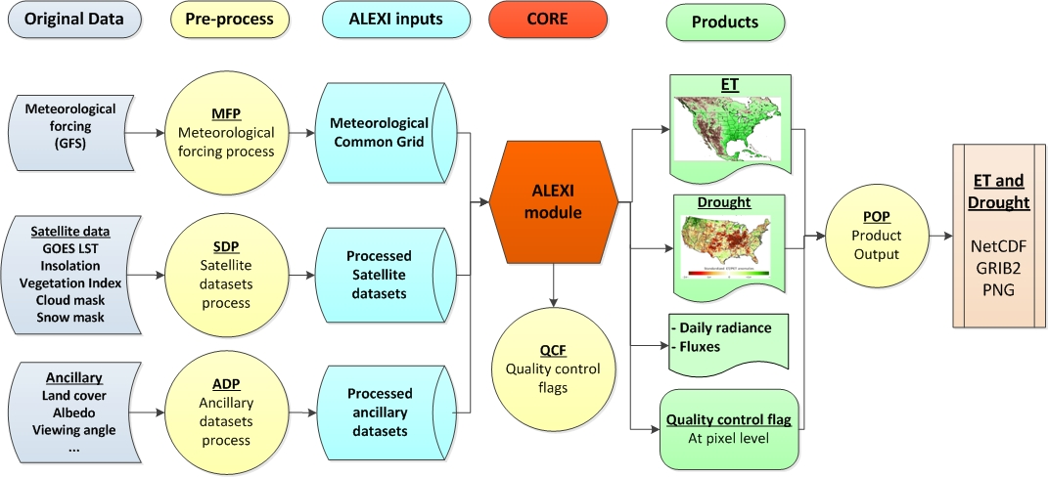
System Layer Data Flows

Slide 99
System Layer Components
Meteorological Forcing Processor (MFP)
  Type: Processing Unit
  Description: Pre-Processor meteorological forcing datasets
Satellite Dataset Processor (SDP)
  Type: Processing Unit
  Description: Pre-Processor satellite datasets, including GOES BT, solar insolation from GSIP products, Vegetation index maps, real-time cloud mask and snow mask
Ancillary Dataset Processor (ADP)
  Type: Processing Unit
  Description: Pre-Processor ancillary datasets, including land cover map and satellite viewing geometry
ALEXI core processor (ALEXI)
  Type: Processing Unit
  Description: Calculate daily ET and potential ET from inputs.
Quality Control Flags (QCF)
  Type: Processing Unit
  Description: Generate quality control flags for each pixel
Product Output Processor (POP)
  Type: Processing Unit
  Description: Output ET and drought products in required data formats (NetCDF, GRIB2 and PNG)

Slide 100
File Descriptions
Control Files
Parameter Files
Meteorological Input Data Files
Satellite Input Data files
Ancillary Data Files
Intermediate Data Files
Output Data Files

Slide 101
Control Files
GETD control File
  Spatial domain
  Input/output data file information
  Control flags
Meteorological data control file
Satellite data control file
Ancillary data control file

Slide 102
Parameter Files
Land cover parameter file
  Parameters vary according to land cover class.
  Including the Seasonal Maximum and Minimum Canopy Heights, Leaf Absorptivity in the Visible, NIR, and TIR Bands, and Nominal Leaf Size.

Slide 103
Meteorological Input Data Files
Meteorological data
 | Forecast hour 00 | Forecast 03
File name | cdas1.t00z.pgrbh00.grib2 | cdas1.t00z.pgrbh03.grib2
Time interval (hours) | 6 | 3
Number of records | 609 | 611
File size (MB) | ~90 | ~90
Daily files number | 4 | 4
Notes:
Daily meteorological variables will be 3 hours interval to the ALEXI model.

Slide 104
Satellite Input Data Files
Data Source | Specifications | Resolution | Format | Example File Names | Size (Daily)
GOES East | Band 01, 02, 04 | 4km | McIDAS | goes13.2015.182.081518.BAND_01 goes13.2015.182.081518.BAND_02 goes13.2015.182.081518.BAND_04 | ~500 MB
GOES West | Band 01, 02, 04 | 4km | McIDAS | goes15.2015.182.103018.BAND_01 goes15.2015.182.103018.BAND_02 goes15.2015.182.103018.BAND_04 | ~500 MB
GSIP | L2 product | 4km | NetCDF | gsipL2_goes13_GENHEM_2015182_1145.nc.gz gsipL2_goes15_GWNHEM_2015182_1400.nc.gz | ~20GB
VIIRS | Global reflectance data (IVISR, GITCO ) | 375m | HDF5 | GITCO_npp_d20150815_t1626048_e1627290_b19682_c20150815223640391804_noaa_ops.h5 IVISR_npp_d20150515_t2355206_e2356448_b18381_c20150516015145766971_noaa_ops.h5 | ~ 300GB
IMS | Daily Northern Hemisphere Snow and Ice Analysis | 24 km | ASCII | ims2015182_24km.asc | ~1 MB

Slide 105
Ancillary Data Files
Data Source | Format | Resolution | File Name | Size
Clear day insolation | Plain binary | 8km | alexi_insol55_smth _[yyyy][doy].dat | 2.0 GB
Surface Albedo | Plain binary | 8km | MIN_ALBEDO_SMTH_[yyyy][doy]_ [hh][mm].dat | 50 GB
Climatology | Plain binary | 8km | NEGATIVE_DIFF[yyyydoy_hhmm] POSITIVE_DIFF[yyyydoy_hhmm] MAX_TB11[yyyydoy_hhmm] | 300GB
UMD Land cover | Plain binary | 1 Km | landcover_UMD.1gd4r | 2.1 GB
UMD Land mask | Plain binary | 1 Km | landmask_UMD.1gd4r | 2.1 GB

Slide 106
Intermediate Data Files
Past 365 days ET/PET
  Contains the ET/PET ratio that is used to smooth the daily ET/PET and create the final ESI.
Land index in ALEXI domain
  Contains the land pixels locations in the domain.
Data Source | Format | File Name | Size
ET/PET | Binary | fPET.bin | ~700MB
Land index in ALEXI domain | Binary | common_land_index.bin | 20MB

Slide 107
Output Data Files
GETD generates one set of gridded data product over the North America domain per day:
  Daily ET
  2, 4, 8, 12-week ESI
  Daily fluxes (G, H, SNET, SDUP, LWDNUP, LWDNDOWN)
Each product contains ET, ESI and other data layers with the QC flags for each grid.
Each product has file size of approximately 30 MB in raw binary data.

Slide 108
GRIB2 File Content
Layer | Data description | Number (In Section 4, octet 11) | Unit | Data type | Fill value | Valid range | Scale factor
1 | Daily ET | 6 | MJ m⁻² day⁻¹ | real | -9999 | 0 - 1000 | 1
2 | Daily ET QC | 231 | N/A | 1-byte integer | 256 | N/A | N/A
3 | 2, 4, 8, 12 -week ESI | 232, 234, 236, 238 | N/A | real | -9999 | -5 – 5 | 1
4 | 2, 4, 8, 12 -week ESI QC | 233, 235, 237, 239 | N/A | 1-byte integer | 256 | N/A | N/A
5 | SD, SNET, LWDN, LWUP | 240, 242, 244, 246 | MJ m⁻² day⁻¹ | real | -9999 | 0 – 1000 | 1
6 | SD, SNET, LWDN, LWUP QC | 241, 243, 245, 247 | N/A | 1-byte integer | 256 | N/A | N/A
7 | H, G | 248, 250 | MJ m⁻² day⁻¹ | real | -9999 | - 1000 – 1000 | 1
8 | H, G QC | 249, 251 | N/A | 1-byte integer | 256 | N/A | N/A
Notes:
Single message with multiple fields
GRIB2 - TABLE 4.2-2-0 (http://www.nco.ncep.noaa.gov/pmb/docs/grib2/grib2_table4-2-2-0.shtml)
PARAMETERS FOR DISCIPLINE 2 CATEGORY 0
0 - Vegetation/Biomass category
6 - Evapotranspiration, Unit: kg-2 s-1, Abbrev:EVAPT

Slide 109
NETCDF4 File Content
Global attributes:
  title = "GETD product"
  Date = “2015-06-24”
Variables:
  float Longitude(Longitude) ;
  Longitude:units = "degrees_east" ;
  float Latitude(Latitude) ;
  Latitude:units = "degrees_north" ;
  int ET(Latitude, Longitude) ;
  ET:units = “MJ m⁻² day⁻¹“ ;
  ET:scaling_factor = 100 ;
  int ET_QC(Latitude, Longitude) ;
  int ESI_2_WEEK(Latitude, Longitude) ;
  ESI_2_WEEK:units = "none" ;
  ESI_2_WEEK:scaling_factor = 100;
  int ESI_2_WEEK_QC(Latitude, Longitude) ;
  ……

Slide 110
Output Data Files
GET-D_zz_yyyyddd_vvv.vv.fff.gz
zz = domain name: NA (North America)
yyyy = four digit calendar year
ddd = day of year
vvv.vv = version number
fff = output format and valid values: grb2, nc or png
GET-D_NA_2007182_001.00.grb2.gz (ET, ESI and other products of North America in GRIB2 format for the version 1.00)
GET-D_NA_2007182_001.00.nc.gz (ET, ESI and other products of North America in NETCDF4 format for the version 1.00)
GET-D_NA_2007182_001.00.png.gz (ET, ESI and other products of North America in PNG format for the version 1.00)

Slide 111
Output Data Files
Status report file
For each GETD run, a status report file is produced to indicate the Processing status of this run.
Each message line in the report file consists of 3 fields, namely the time (yyyymmddhhmmss) of the current message being reported, name of the subprogram that produced the message, and the detailed description of the message.
The detailed description of the message may start with “ERROR” or “WARNING”.
  If “ERROR” appears in the description, the GETD run would be terminated and the final product will not be produced.
  If “WARNING” appears in the description, the GETD run will still continue but the quality of the final product might be affected by fact specified in the warning message.
Notes:
111

Slide 112
Status report
1) % of overall product quality bit in the QF being 1 (not retrieved): If 100%, no retrievals were obtained.
2) % of GOES data availability bit in the QF being 1 (bad data): If 100%, GOES input had problem;
3) mean daily ET of the domain: its time series should be relatively smooth (no abrupt rise or drop);
Note that due to the variations in the GOES inputs and ALEXI model valid outputs, daily ET values could have higher variations than composited ESI values.
4) mean rolling 8day ESI of the domain: its time series should be relatively smooth;
Example of the content in GETD_QF2015175.txt:
GETD QF INFO ON: 2015175
GOES valid(%): 33.25
ET valid(%): 32.87
Mean ET(MJ m-2 day-1): 110.13204
Mean ESI 2-week : 0.893
Mean ESI 4-week : 0.958
Mean ESI 8-week : 0.990
Mean ESI 12-week : 1.094

Slide 113
GOES Evapotranspiration (ET) and Drought Products (GET-D)
The GET-D system utilized GOES Imager data from both the GOES-East and GOES-West satellites. Northern Hemisphere Extended domains are acquired every hour.
 |  | GEODIST2 GEODIST3
 | The CSIP L2 (NC) data from both GOES-East and GOES- West satellites Northern Hemisphere Extended domains are acquired every hour.
- Daily ET
- 2,4,8,12-week ESI
- Daily radiances and fluxes (nc, grip2,png)
Product Distribution Server
GET-D
GSRPROD
Linux
FTP Push
/SCP Push
GOES-E Bands 1,2, 4
GOES-W Bands 1,2,4
DDS/SATEPSANON
FTP Push
GSRPROD
/SCP Push
GET-D
GSRDEV
Linux
SCP Push
GSIP (L2)
gsrdev/gsrprod server
GSRDEV
SCP Push
Monitoring status files PNG image files Web Server
Visible Infrared Imaging Radiometer Suite (VIIRS) Global Reflectance Granules
VIIRS (GITCO, IVISR)
SFTP Pull
CM Repository
Linux
gp5/gp50
NDA server
Climate Forecast System (CFS) forecast fields. Two files every six hours.
CM-ESPC
CFS 6-hr
FTP Pull
DDS server
Interactive Multisensor Snow & Ice Mapping System (IMS) data file (24km spatial resolution) downloaded once per day.
IMS Snow
SFTP Pull
Data Flow Diagram Legend
Production Zone
Development Zone
Distribution Zone (DMZ)
External User Zone
Private NSOF Network
WWB Zone
DDS server
Unique Port connections: None
OSPO/ESPC-ATMO-GET-D31-01-V1.7
Baseline Date: August 11, 2011
Revised: August 26, 2015
Arrow indicates direction of connection

Slide 114
System Architecture Summary
GET-D contains 6 unit layers
GET-D contains 16 sub-unit layers
GET-D daily files
  24 Control input files
  1 Land parameter input file
  8 Meteorological data input files
  Over 200 Satellite data input files
  Over 100 Ancillary data input files
  Over 100 Intermediate data files
  3 Output data files
  1 Output status report file

Slide 115
Outline
Introduction
Pre ARR Risks and Actions
Requirements
System Architecture
Algorithm Readiness
Delivered Algorithm Package
Quality Assurance
Risk and Action Summary
Summary and Conclusion

Slide 116
Section 5 –
Algorithm Readiness
Presented by
Zhengpeng Li/Chris Hain (STAR/CICS)

Slide 117
Algorithm Readiness Outline
Product Overview and Requirements
Unit Test Results
System Test Results
Algorithm Basis and System Results Validation

Slide 118
Product Overview and Requirements
The GET-D system will produce a daily product that consists of two drought indices:
  Evapotranspiration (ET)
  Evaporative Stress Index (ESI)
Each index will be a North America gridded composite map in Lat/Lon projection with 8 km resolution at the equator.
  Daily composite netCDF4 files at 8-km resolution
  Daily composite GRIB2 file at 8-km resolution
  PNG files are also desired for monitoring and displaying
  Metadata contains the QC information

Slide 119
Validation Summary
GET-D ET estimates have been rigorously evaluated in comparison with ground-based data.
GET-D ESI shows good correspondence with standard drought metrics and antecedent precipitation, but can be generated at significantly higher spatial resolution.

Slide 120
Unit Test Results
GET-D Test Environment
GET-D Test Data Sets

Slide 121
GET-D Test Environment
The development and tests are performed on rhw1094.star1.nesdis.noaa.gov – IBM P6.
This machine is located at STAR and is maintained by STAR IT.
  80 CPUs
  2.4 GHzq
  128 GB memory
  17 TB disk space
  GFORTRAN
The NetCDF, HDF4 and GRIB2 libraries are the stable versions:
  netcdf-4.2-gfortran(GFortran77/90/95)
  HDF5
  GRIB2 1.4.0

Slide 122
GET-D Test Data Sets
CFS GRIB2 data set
GOES AREA files (BT at 3.9 and 11 microns)
GSIP L2 NetCDF data set (Insolation)
VIIRS Reflectance/EVI data set
IMS Daily Northern Hemisphere Snow and Ice Analysis
Static ancillary data sets (Clear Sky Insolation, Land cover, Albedo)
Control Files and Parameter Files

Slide 123
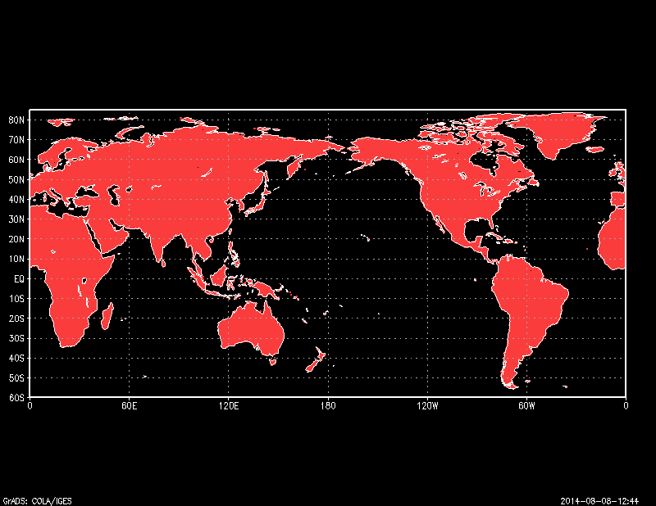
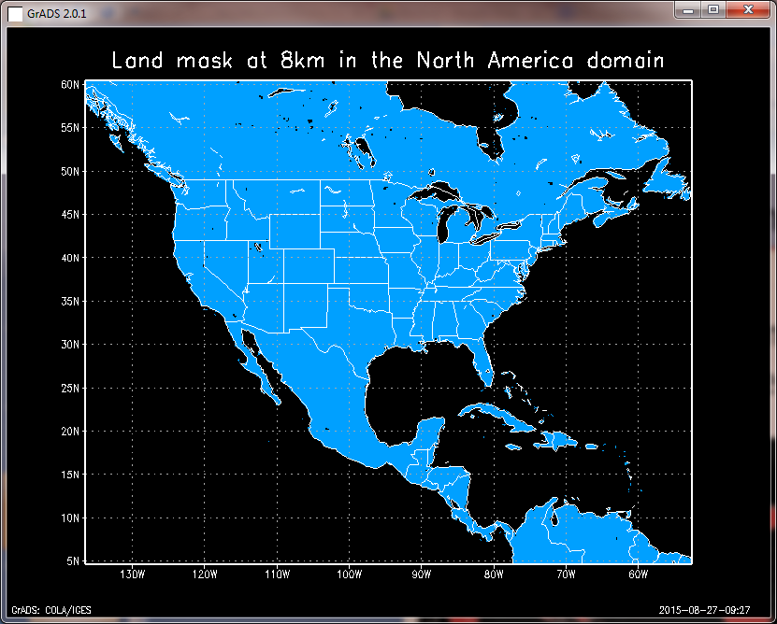
Common Grids Land Mask Processor (CGLMP)
Purpose: Read 1 km land mask and produce a list of land pixels at the North America domain at 8km.

Slide 124
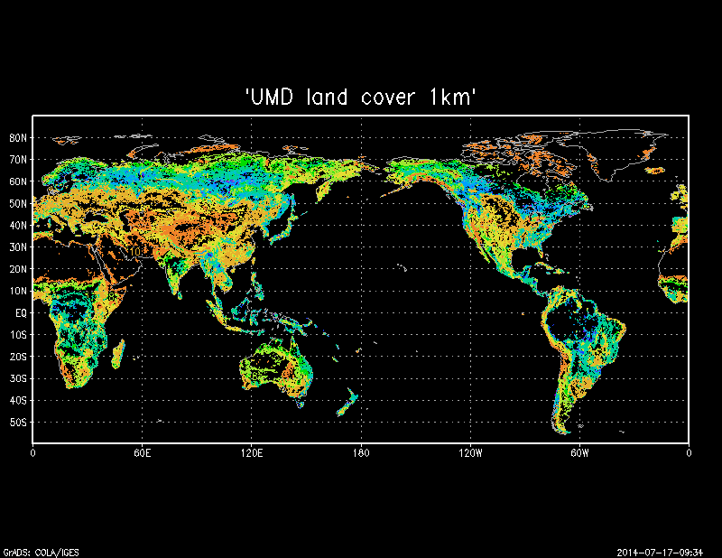
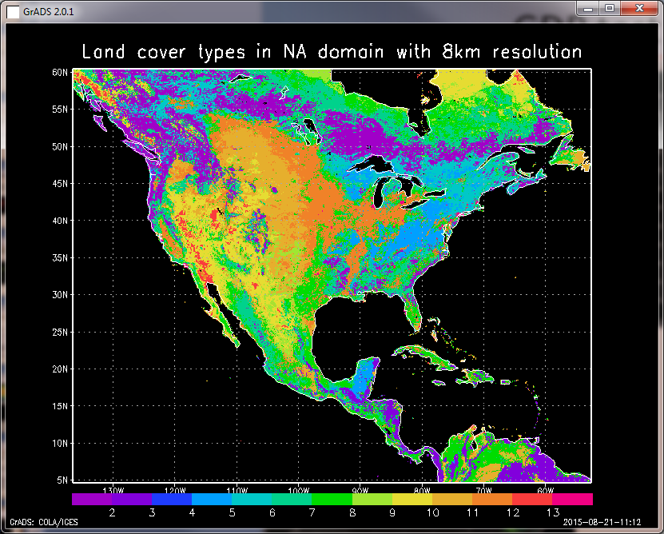
Land Cover Processor (LCPP)
Purpose: Read 1 km land cover (13 classes) and calculate surface spectral parameters for the land pixels in the domain.

Slide 125
Common Grids Meteorological Processor for CFS (CGMP-CFS)
Purpose: extract the meteorological data for the ALEXI domain
Program: GETD –m [configuration file] [yyyy] [doy]
Test Sequence
  Output remapped meteorological variables
  Test output spatial pattern and the file size (coverage & resolution)
  Check the correctness of output values at several sample pixels
  Error control
  Record the status of process (success or failure) in log file
Meteorological | Spatial coverage | Resolution | Image Size | Longitude | Latitude
Original Domain | Global | 0.5 degree | 720 * 361 | -180 – 180 | -90 – 90
Common Grid domain | North America | 0.25 degree | 720 * 360 | -180 – 0 | 0 – 90

Slide 126
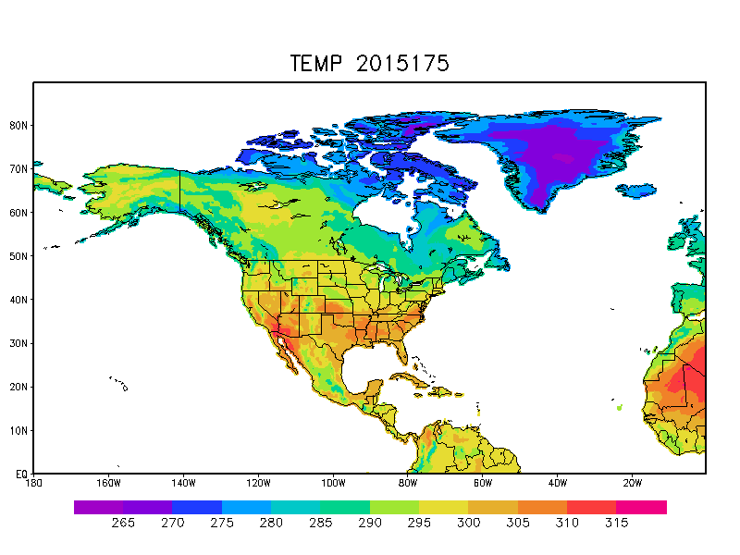
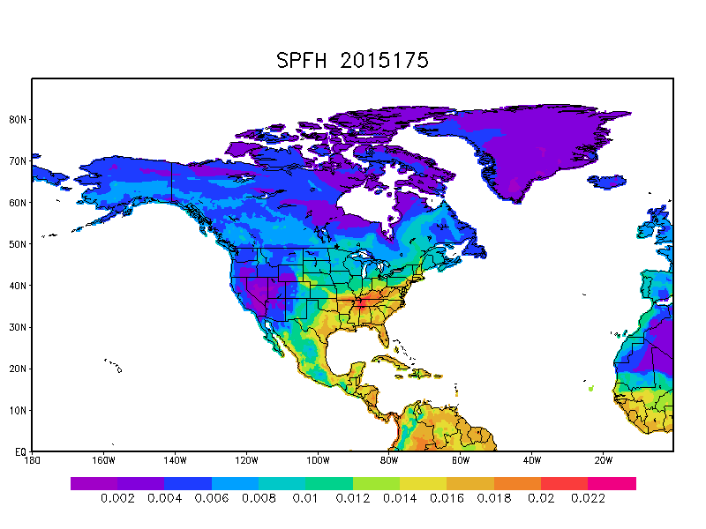
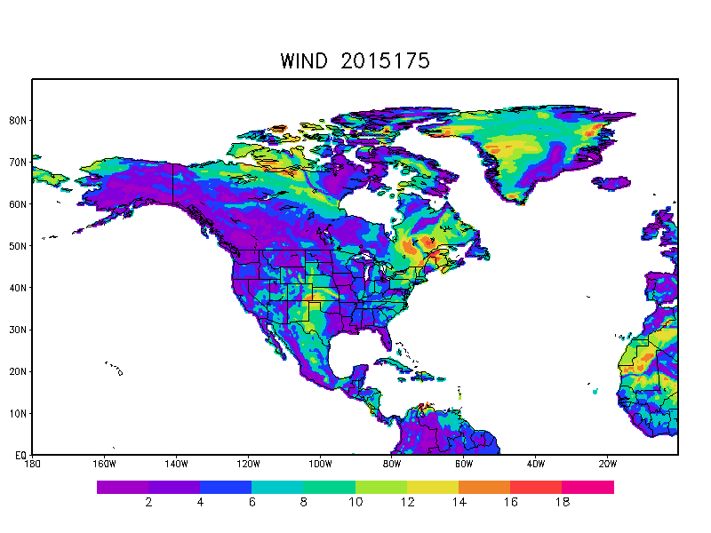
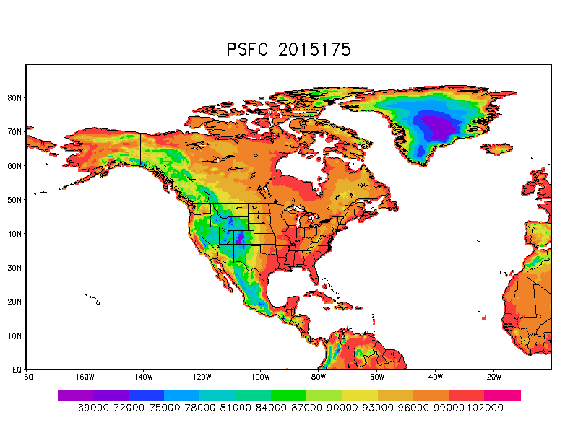
Common Grids Meteorological Processor for CFS
(CGMP-CFS)

Slide 127
GOES Data Processor (GDP)
Purpose: Read hourly GOES dataset in McIDAS format and extract BT at 3.9 and 11 microns for GOES EAST and WEST.
Satellite | Location | Longitude | Byte swap | Original Image Size | Original Image Resolution | Processed Image Equal grid size | Processed Image Resolution | Bottom-left
GOES-13 | East | 105°W | No | 3464*1826 | Pixel resolution 4km | 2400*1720 | 0.05 Deg | -132W, -20S
GOES-15 | West | 135°W | No | 3312*1354 | Pixel resolution 4km | 2400*1320 | 0.05 Deg | -180W, 0S

Slide 128
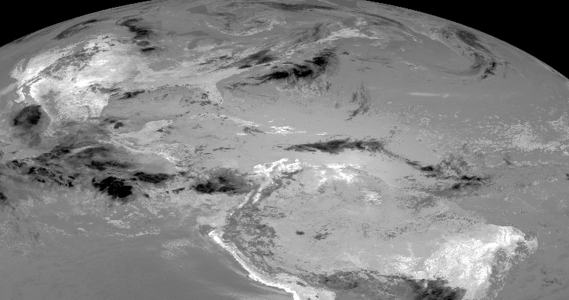
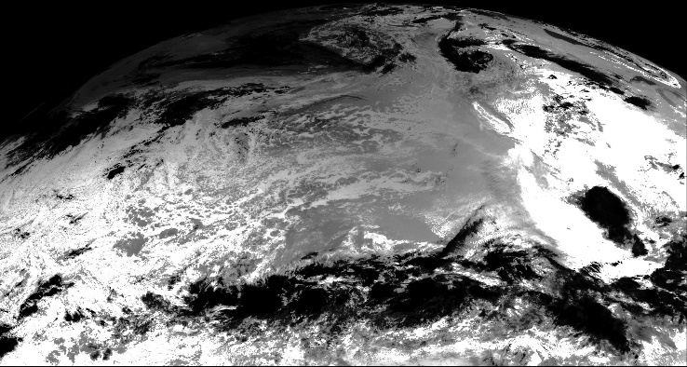
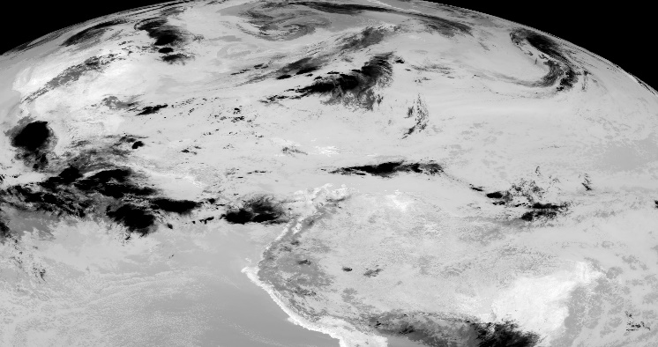
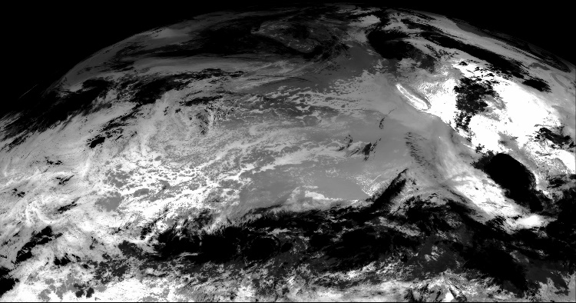
GOES Data Processor (GDP)
 | GOES East | GOES West
BT3.9
BT11
Notes:
Examples of original input GOES images

Slide 129
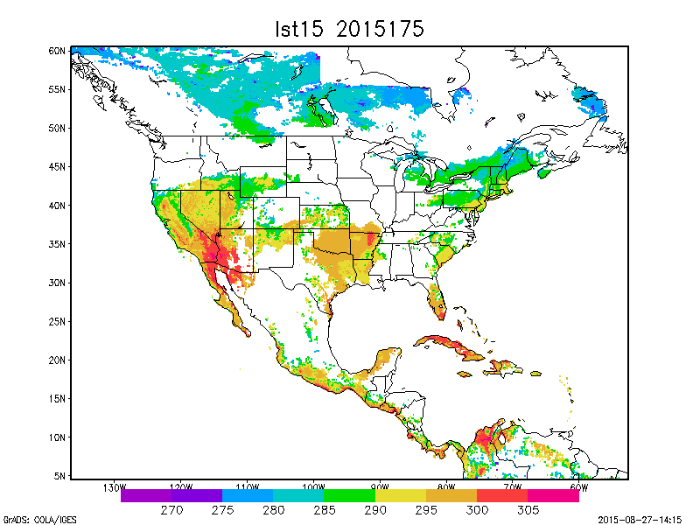
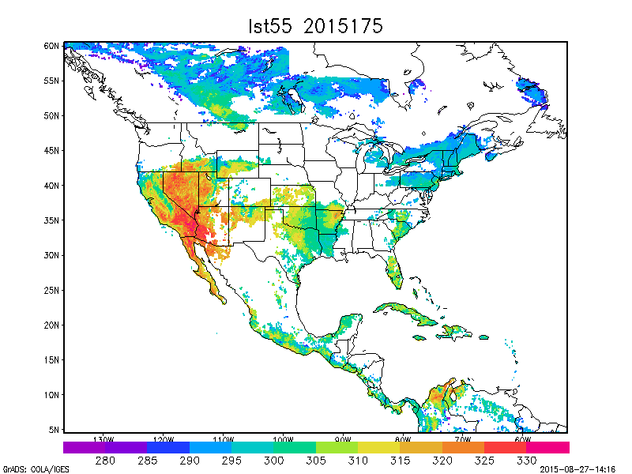
GDP test results

Slide 130
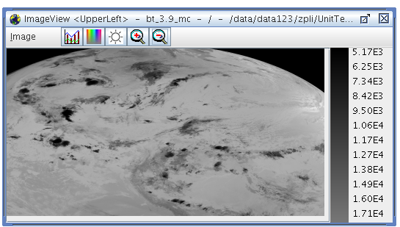
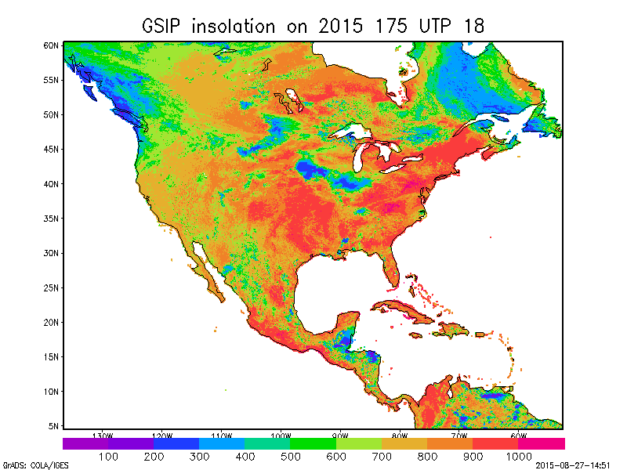
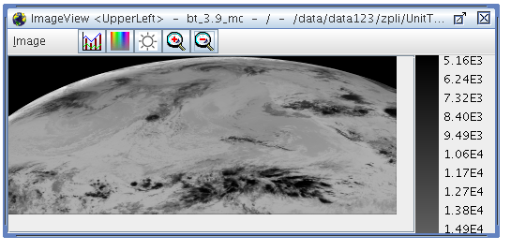
Insolation Processor (INSO-GSIPL2)
Purpose: Read GSIP L2 product in NETCDF format and extract insolation variables for common grid

Slide 131
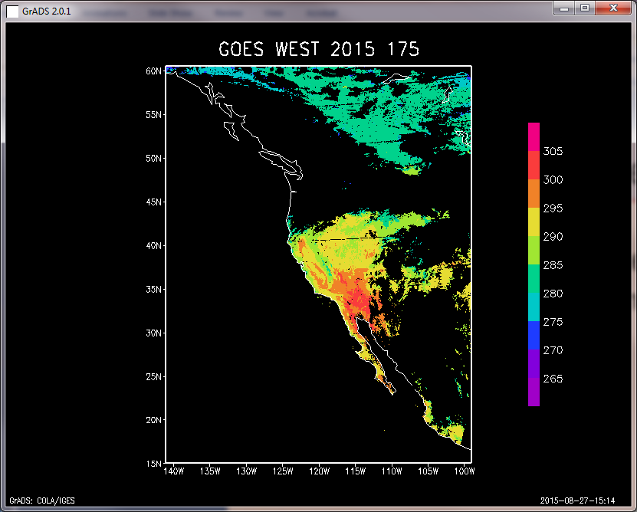
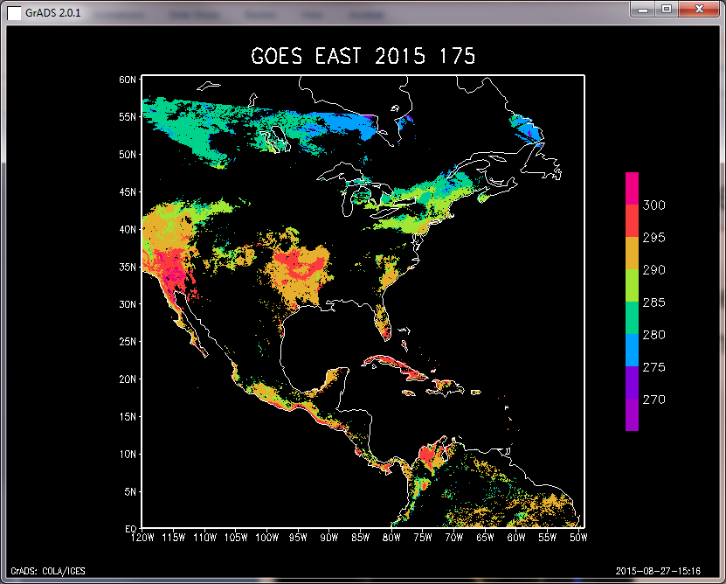
Cloud Mask Processor (CMP)
Purpose: Reads the processed BT at 3.9 um and calculate the cloud mask with climatology data for GOES EAST and WEST.

Slide 132
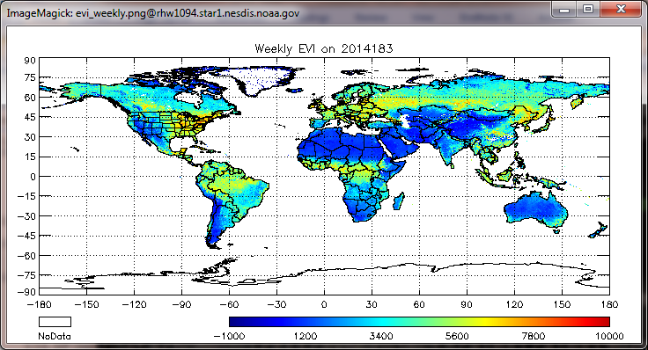
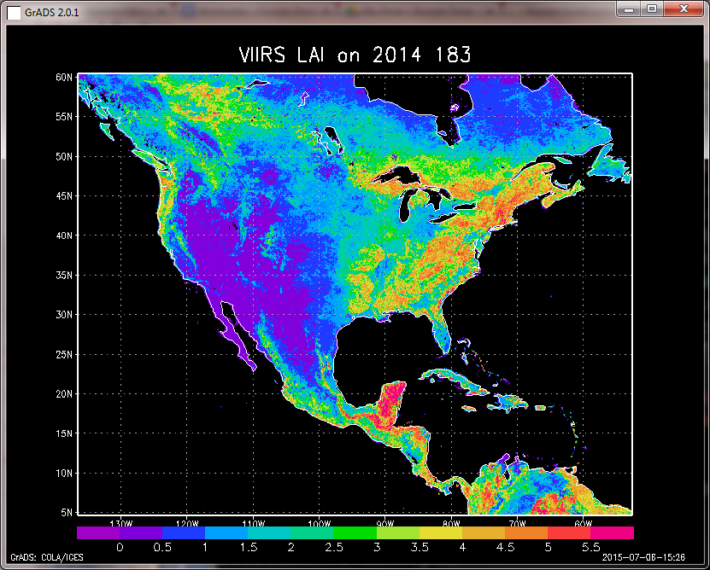
Vegetation Index Processor for VIIRS EVI/NDVI
(VIP-VIIRS)
Purpose: Read the VIIRS EVI data in binary format and compute the Leaf Area Index (LAI) for ALEXI model.
Program
  Remap the EVI to the NA domain
  Use regression parameters to compute the LAI from the EVI

Slide 133
Snow Map Processor (SMP)
Purpose: Read the snow mask from IMS and reproject the snow mask in the NA domain.

Slide 134
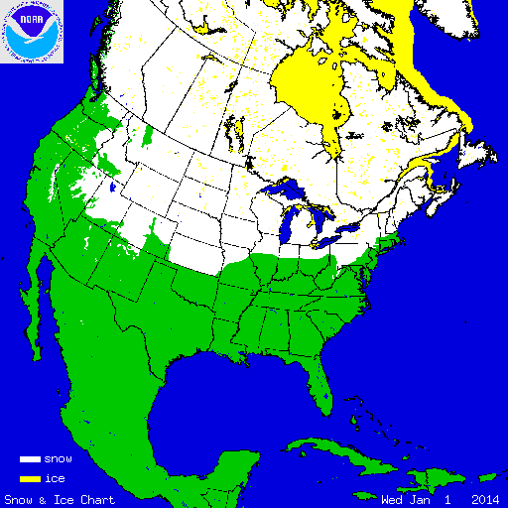
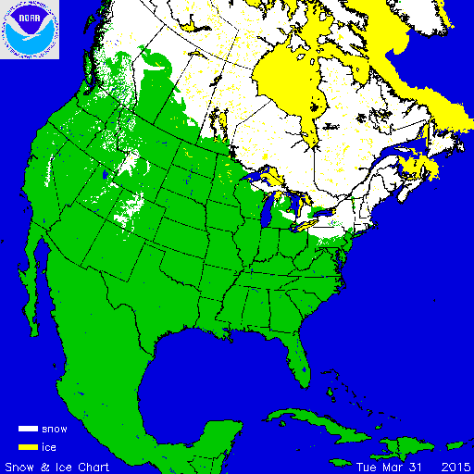
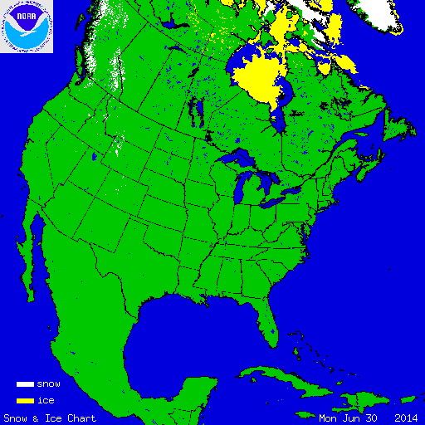
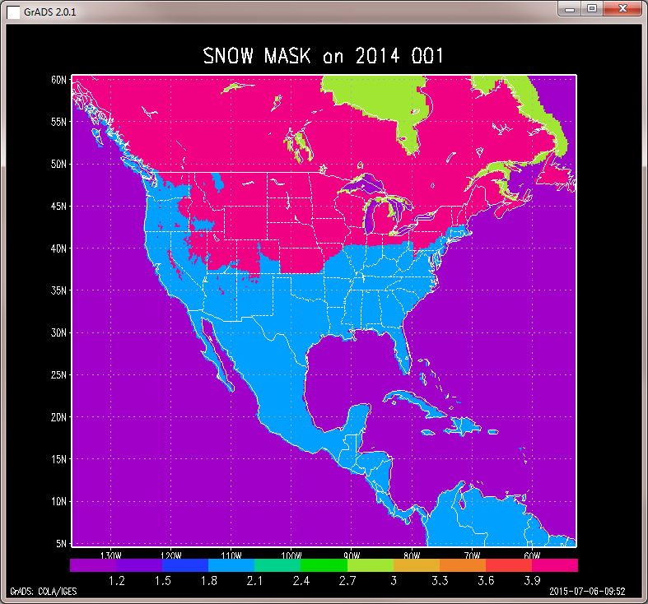
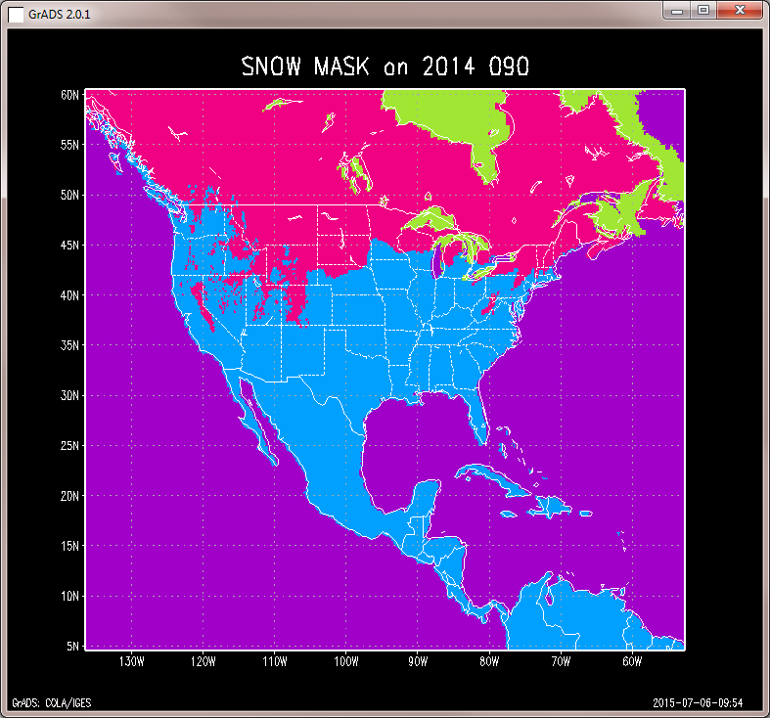
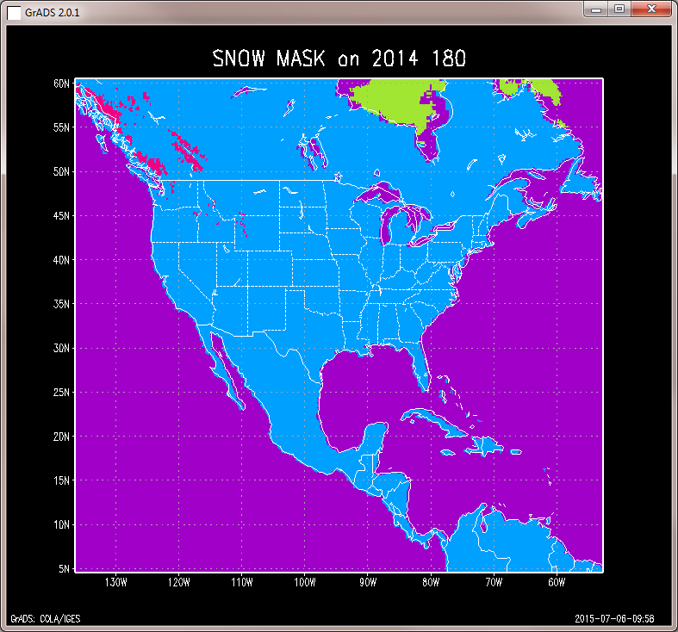
SMP test results
2014 001 | 2014 090 | 2014 180

Slide 135
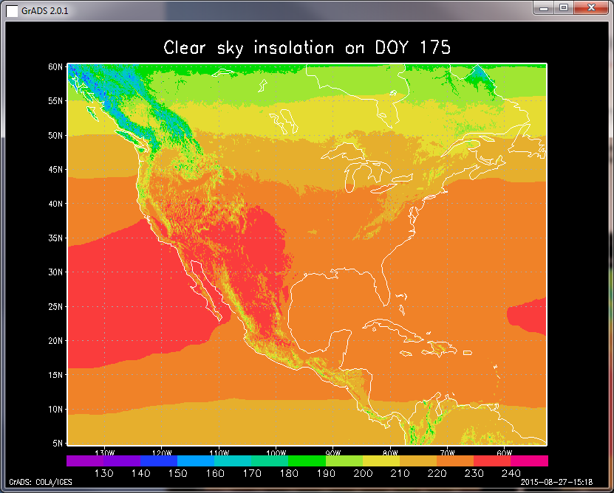
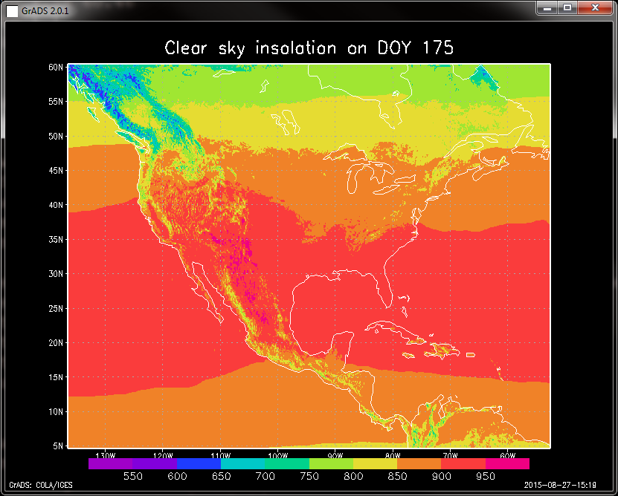
Clear Sky Insolation Processor (CIP)
Purpose: Read the clear sky insolation data and extract the information for the ALEXI domain.

Slide 136
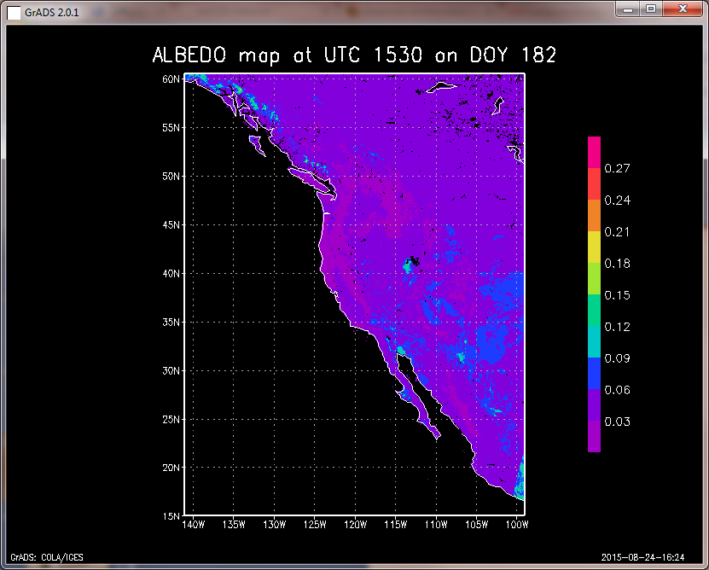
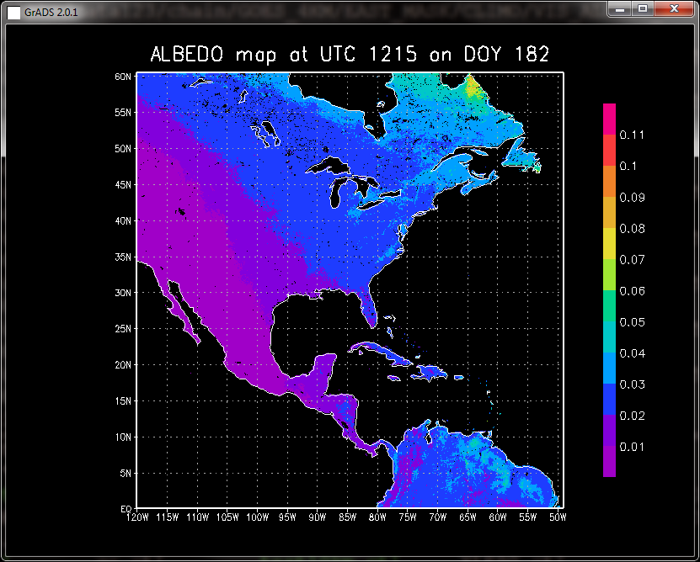
Albedo Processor (AP)
Purpose: Read the Albedo map and extract the information for the ALEXI domain.

Slide 137
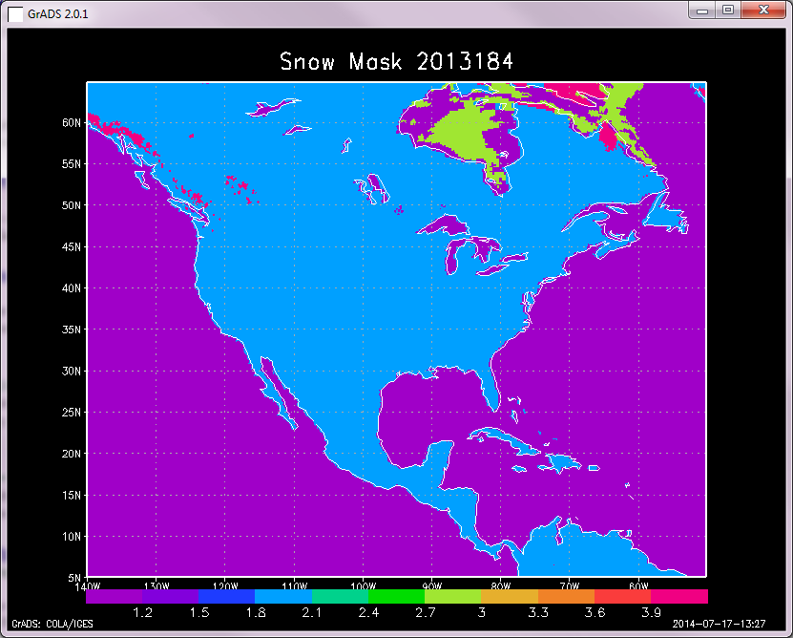
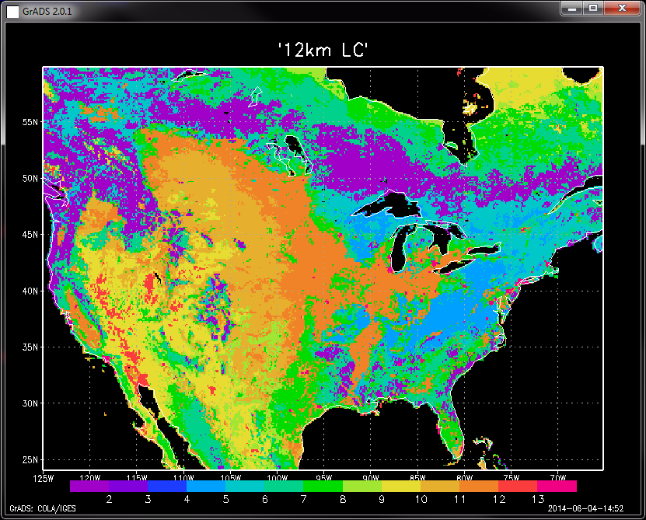
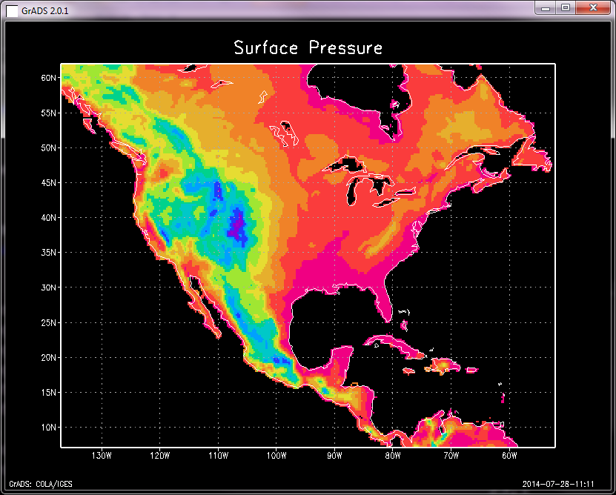
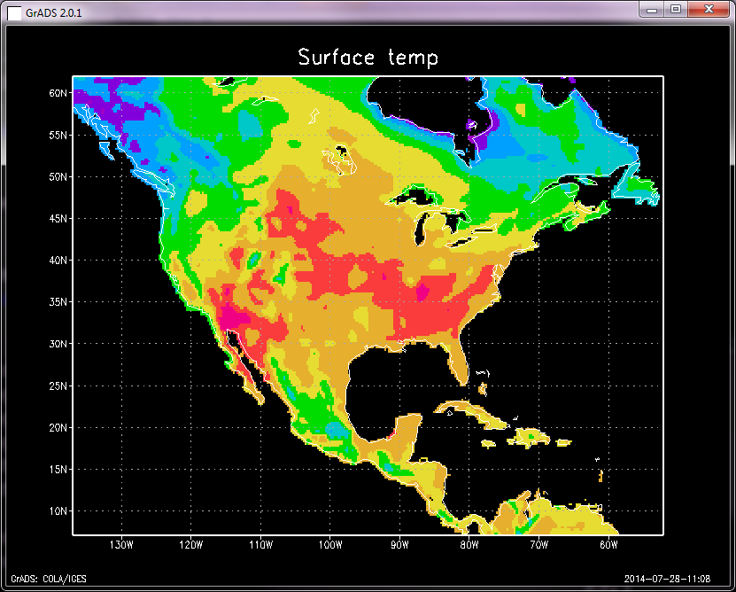
Regional Inputs Processor (RIP)
Purpose: Read all the input variables required in ALEXI model at single pixel from all the input data sets
Program: GETD_set_RIP()
ALEXI loc | -90.05 | 36.15
Date | 2013 | 183
Vegetation | 1.69
GOES view angel | 41.26
Obs time 1 and 2 (UTC) | 12.42 | 16.42
Brightness temperature | 19.37 | 29.55
… | … | …

Slide 138
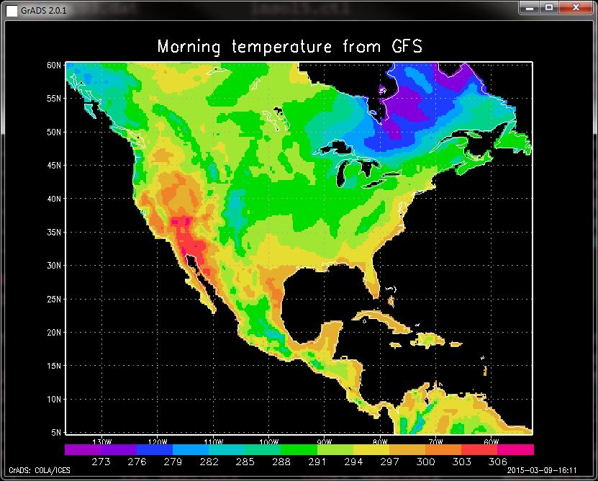
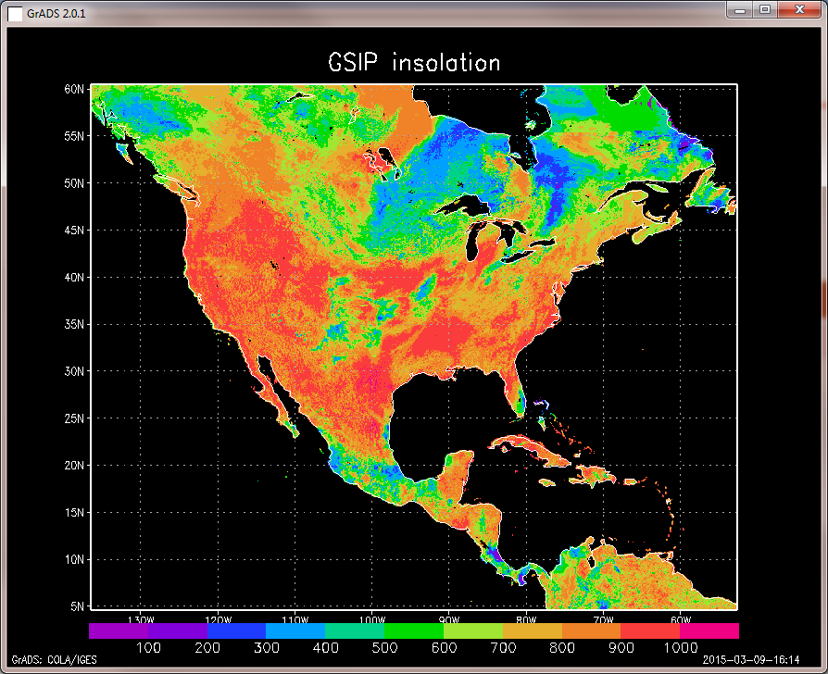
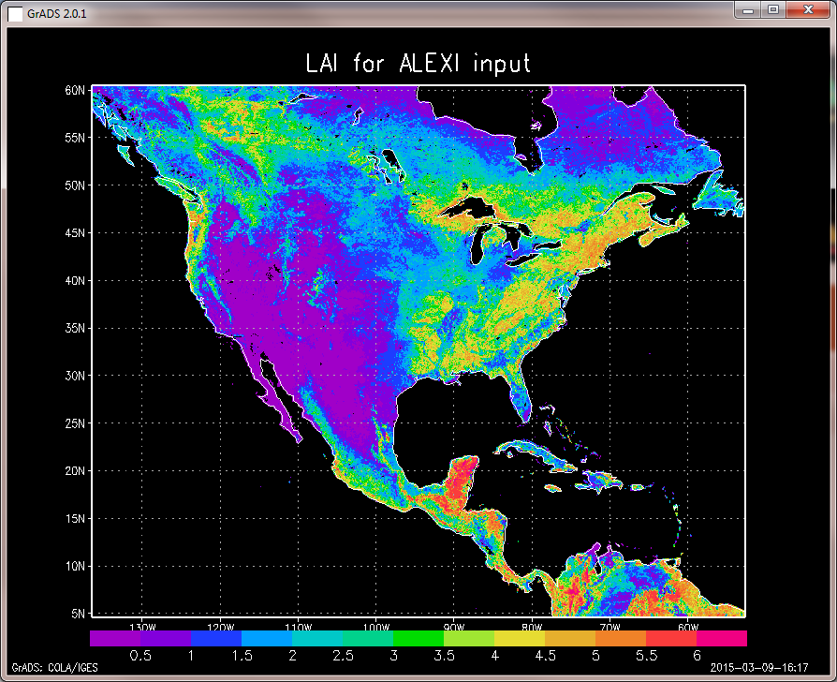
RIP test results
GOES land surface temperatures | CFS meteorological variables | GSIP insolation
LAI | Snow mask

Slide 139
ALEXI Point Model (APM)
Purpose: Run ALEXI at single pixel where all the input variables are valid and outputs ALEXI retrievals
Program
  ALEXI_run_point(landcover_filename, indata_filename, run_mode, input_flag, istate)
Test Sequence
  Output pixel ALEXI retrievals (Radiation RN, Sensible H, Soil heat flux G, Total ET, Soil ET, Canopy ET, P-M reference ET and short wave down SDN)
  Check the correctness of output values at several sample pixels
  Record the status of process (success or failure) in log file
Inputs
ALEXI run at : -90.85 36.15 on : 2013 183 Vegetation lai NDVI: 1.69 1.00 GOES view angel: 41.26 UTC Time 1 and 2 : 12.42 16.42 GOES observed temp(k): 19.37 29.55 GOES observed sdn(k) : 196.37 843.93 Long wave down(w): 348.68 387.09 Wind speed (m-2 s-1) : 1.68 2.22 Air temperature(k): 17.21 23.40 Surface pressure(Pa) : 994.65 995.74 ……

Slide 140
APM test results
----- ALEXI Site Inputs ---------------------
Site lc 9 Closed_Shrubland
At Lat, Lon: 31.780 -111.620
Canopy FC, XLAI : 0.155 0.338
Tloc1, Tloc2 ( Obs time): 6.982 11.004
Tobs1,Tobs2(Obs air temp): 26.971 31.508
Trad1,Trad2(radiometric): 25.596 45.340
Wind11,Wind2(Wind Speed): 5.582 4.887
Input SDN1,SDN2(W m-2): 219.255 877.019
----- ALEXI Site Outputs --------------------
Morning variables TIME1 TIME2
TC1,TC2 (canopy temp): 26.303 36.673
TS1,TS2 (soil temp): 25.419 47.515
TA1,TA2 (modeled air temp): 26.660 32.642
Rnet Net Radiation (w m-2): 70.276 429.268
Zen (sun zenith): 1.252 0.370
----------T2 only----------------------------
Z2 (boundary layer ht): 562.890
RA2 (aerodynamic res): 23.929
RS2 (soil res): 58.164
RX2 (b.l. res): 96.074
SWUP (W m-2): 265.769
LWUP (W m-2): 542.916
Canopy latent(w m-2): 61.081
Soil latent(w m-2): 56.739
Total latent(w m-2): 117.820
Canopy sensible(w m-2): -4.973
Soil sensible(w m-2): 193.571
Total sensible(w m-2): 188.597
Ground cond(w m-2): 122.851
Energy balance(w m-2): 0.000
------------------------------------------
Daily integrated fluxes FORTRAN90
Radiation RN (w m-2): 9.711
Sensible H (w m-2): 5.896
Soil heat flux G (w m-2): 0.000
Total ET (MJ day-1): 3.815
Soil ET (mm s-1): 1.837
Canopy ET (mm s-1): 1.978
P-M reference ET (mm s-1): 26.514
Short wave down sdn(w m-2): 28.398

Slide 141
Regional Outputs Processor (ROP)
Purpose: Calculate the daily ET and 2, 4, 8, 12 week composite ESI from ALEXI point outputs to the output buffer
Program
  alexi.x –r NA_8km_VLAI.cfg 2015 175
  getd.x -
Test Sequence
  Output Daily ET (ET.bin, ET_QC.bin).
  Output ESI composites (ESI_*week.bin, ESI_*week_QC.bin).
  Output daily radiances and fluxes (SD, SNET, LWDN, LWUP, H, G)
  Test output spatial pattern and the file size (coverage & resolution)
  Check the correctness of output values at several sample pixels
  Record the status of process (success or failure) in log file

Slide 142
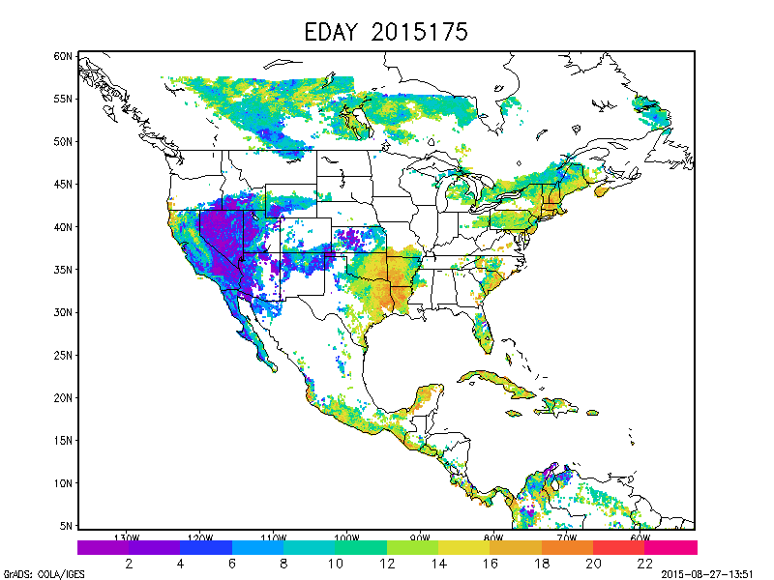
ROP test results on 2015 175
Daily ET

Slide 143
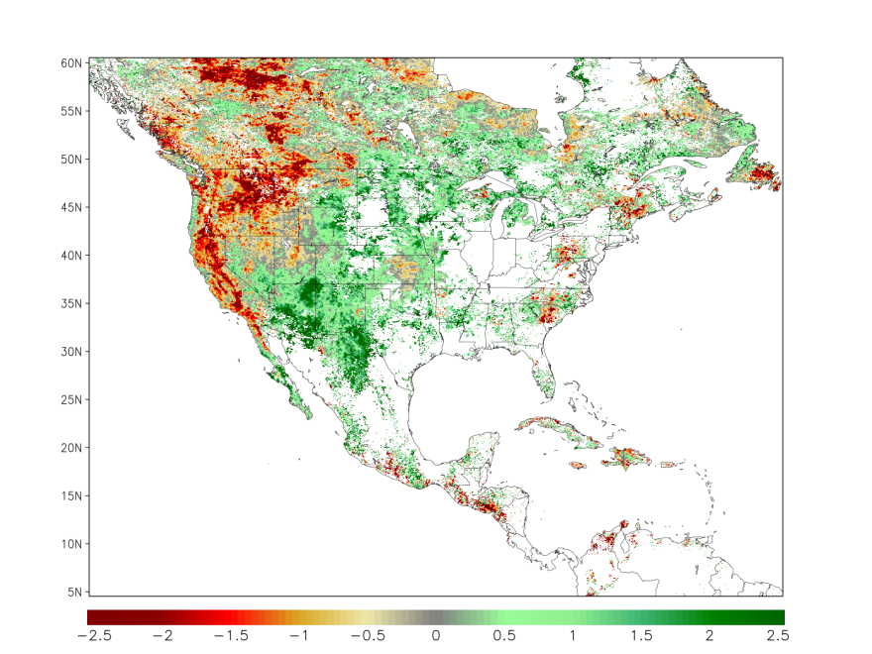
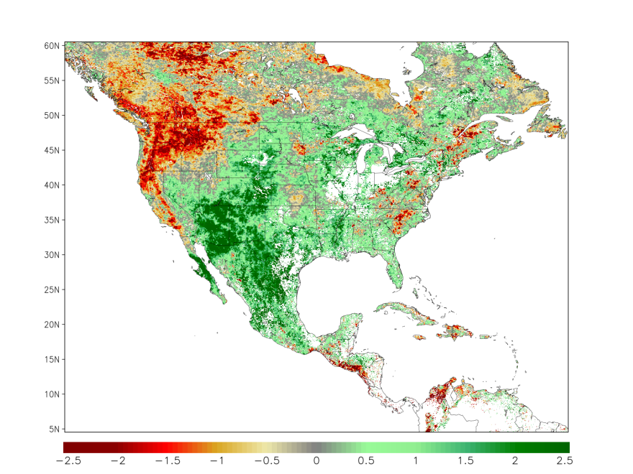
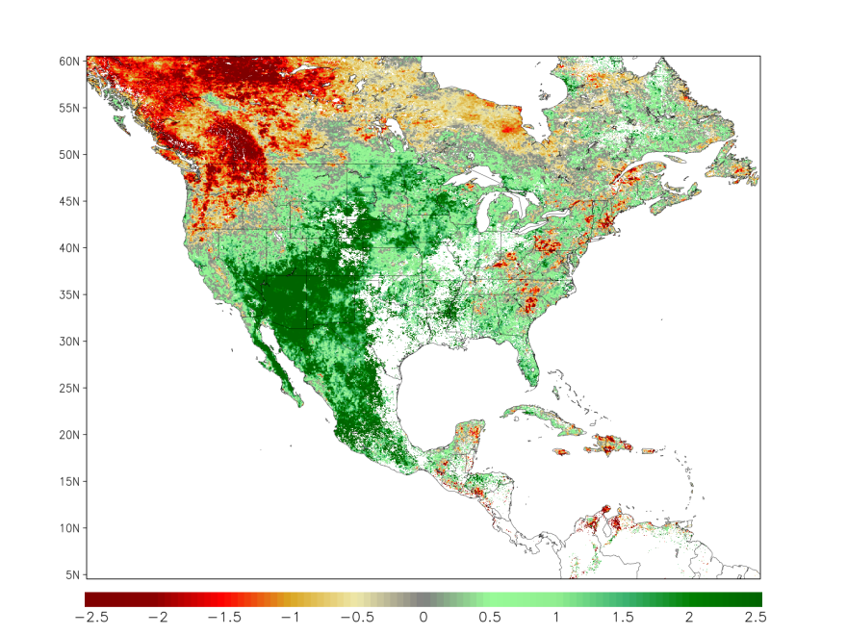
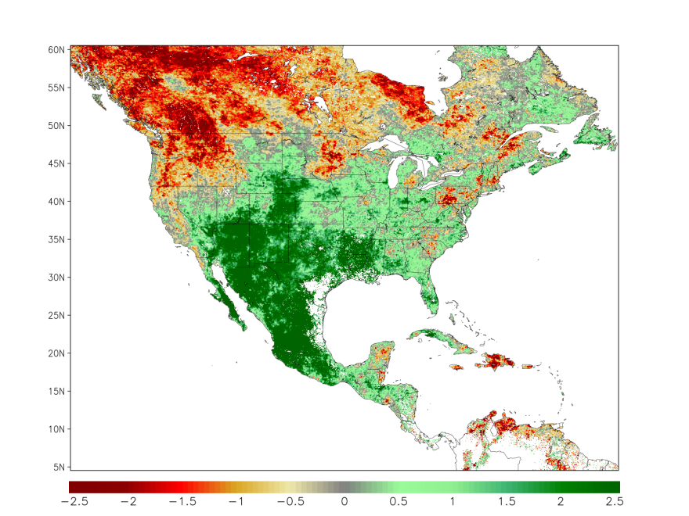
ROP test results on 2015 175
ESI Composites
4 weeks
2 weeks
8 weeks
12 weeks

Slide 144
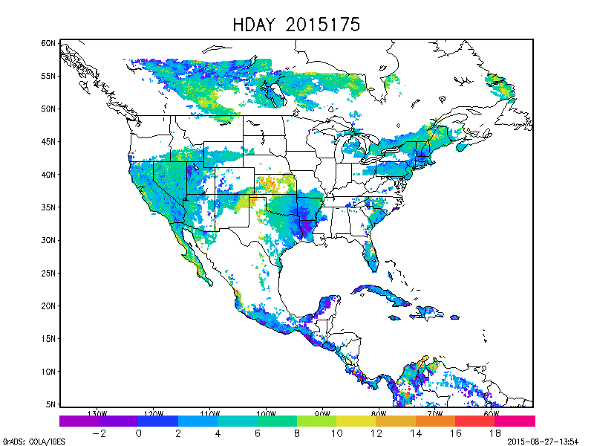
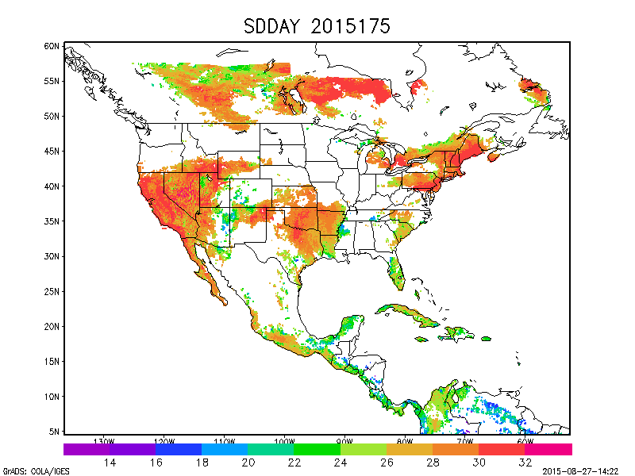
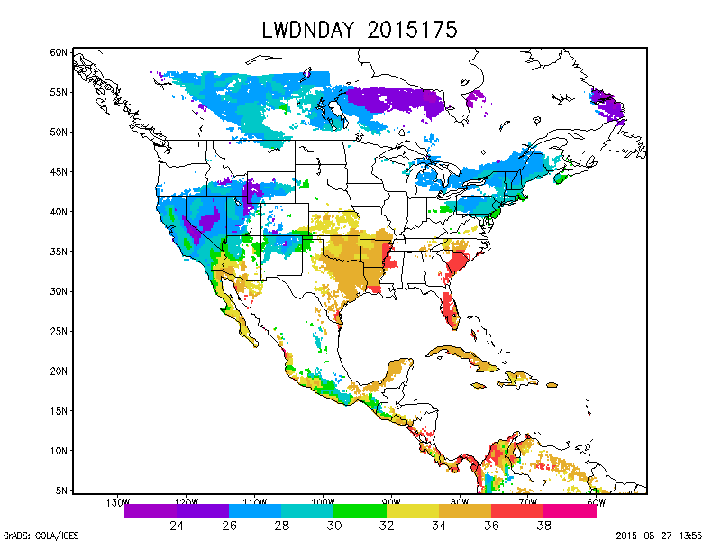
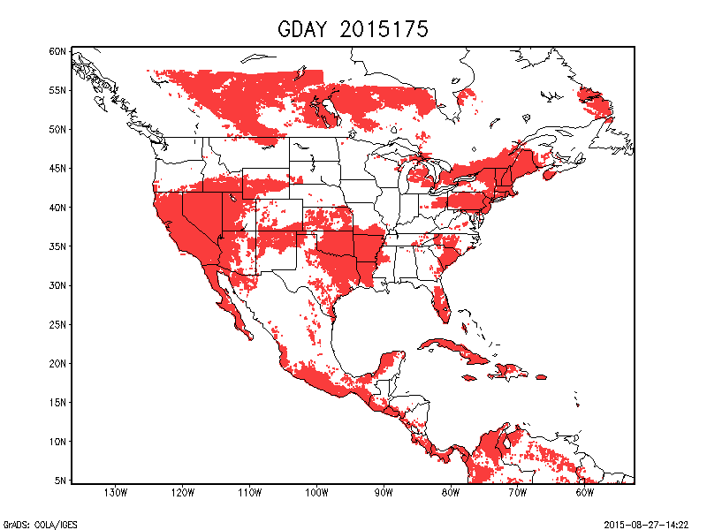
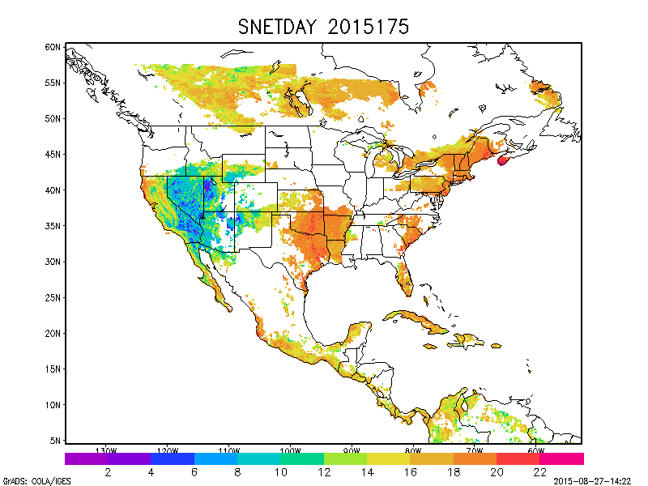

ROP test results on 2015 175
H, G, SD, SDNET, LWDN, LWUP

Slide 145
Quality control flags (QCF)
Purpose: Setup QCF for each pixel based on the quality of all the input variables and ALEXI retrievals
Program: GETD_set_QCF()
Test Sequence
  Output : pixel based QCF for ET and ESI
  Check the correctness of output values at several sample pixels
  Record the status of process (success or failure) in log file

Slide 146

QCF test results

Slide 147
Product Output Processor (POP)
Purpose: Write the ET/ESI and QC information in the output buffer to desired output format
Program
  GETD_pop()
Test Sequence
  Convert ET/ESI maps in binary format to NetCDF, GRIB2 and PNG formats
  Open ET/ESI maps in NetCDF, GRIB2 and PNG in ENVI/PanolyWin/wgrib2 and compare with the original binary files
  Record the status of process (success or failure) in log file

Slide 148
Error Handling
It is assumed that the input test data are free of errors, so that the Processing will run to completion without error.
To test the system’s ability to handle errors, additional Processing runs will be performed with induced errors.
There will be a separate test run for each induced error.
The unit test includes 10 induced errors
Condition | Affected Units | Expected result
Number of command arguments less than desired | GETD_main | Exit with Usage message
Unrecognized Processor mode | GETD_main | Exit with Error message
Wrong configure file | GETD_main | Exit with Error message
Missing land mask file | GETD_load_land_data | Exit with Error message
Missing CFS file | GETD_Processor_meteorological_data | Exit with Error message
Missing GOES file | GETD_Processor_GOES_data | Exit with Error message
Missing GSIP file | GETD_Processor_GSIP_data | Exit with Error message
Missing EVI file | GETD_Processor_EVI_data | Exit with Error message
Missing Land cover file | GETD_Processor_land_cover | Exit with Error message
Missing Snow mask file | GETD_Processor_snow_mask | Exit with Error message
Notes:
148
148

Slide 149
Unit Test Summary
Test plans for 16 sub-units
10 Error handlings
The software architecture design and interfaces of each component in GETD system have been presented.
The system data flow of each processing unit has been presented.
The error handling and product generation information that can be used for GETD system product processing monitoring have been presented.
Notes:
Priyanka: Add summary.

Slide 150
System Test Results
The Figure shows an example of Daily outputs from GET-D on 2015/06/24, day of the year 175.
Daily ET 8km
2, 4, 8, 12 week composite ESI
Other daily fluxes (H, G, SD, SDNET, LWDN, LWUP)

Slide 151
Daily ET output on 2015 175

Slide 152
Daily ESI Composites on 2015 175
4 weeks
2 weeks
8 weeks
12 weeks

Slide 153
System Test results on 2015 175
H, G, SD, SDNET, LWDN, LWUP

Slide 154

Algorithm Theoretical Basis
SURFACE TEMPERATURE
PRECIPITATION
SURFACE TEMPERATURE
T_{soil} & T_{veg}
transpiration &
evaporation
transpiration &
evaporation
Veg stress parms
T_{veg}
Bare soil evap parms
runoff
soil evaporation
Sfc moisture
T_{Soil}
soil evaporation
infiltration
Soil hydraulic parms
Soil moisture
holding capacity
Given known radiative energy inputs, how much water loss is required to keep the soil and vegetation at the observed temperatures?
Rootzone moisture
Root uptake
drainage
Root distribution parms
WATER BALANCE APPROACH
REMOTE SENSING APPROACH
(“forward modeling”)
(“inverse modeling”)

Slide 155
ESI for Drought Monitoring
Evaporative stress index – ESI
Potential ET (PET) is calculated using the observed temperature, wind speed, and net radiation at the surface.
Actual ET is estimated by the ALEXI model.
Drought severity can then be inferred through reductions in the ratio of the actual to potential ET, as represented by the ESI.
The ESI represents standardized anomalies in the ET/PET ratio:
  Negative anomalies indicate drier than normal conditions, whereas positive anomalies indicate wetter conditions
Because the ESI relies on thermal infrared satellite imagery, it can only be computed for locations that remain clear during the morning integration period used by the ALEXI model.
To remedy this problem, composite anomalies are computed using clear-sky data from longer time periods (2, 4, 8 and 12 weeks).

Slide 156
System Results Validation
ET validation
ESI comparison

Slide 157



ALEXI ET Validation
SMEX02
SMEX02
Soil Moisture Experiment 2002
Ames, Iowa
Rainfed corn and soybean
4 km
BEAREX08
Bushland ET and Remote sensing Experiment 2008
Bushland, Texas
Rainfed and irrigated cotton
MEAD
Ameriflux site (S. Verma)
Mead, NE
Rainfed and irrigated corn and soybean

Slide 158



ALEXI ET Validation
SMEX02
BEAREX08
MEAD
MAE:
RE:
1.08 MJ m⁻² d⁻¹
8%
1.3 MJ m⁻² d⁻¹
10%
1.3 MJ m⁻² d⁻¹
11%
Martha Anderson,
USDA-ARS

Slide 159


ALEXI ET Validation
Loblolly Pine Plantation, NC

Slide 160

ALEXI ET Validation
NC2
MAE:
RE:
0.41 mm/day
13.6%
NC3
MAE:
RE:
0.23 mm/day
10.9%
Yun Yang and Martha Anderson,
USDA-ARS

Slide 161




GET-D ET comparison

Slide 162

ALEXI ESI CORN YIELD CORRELATIONS
(10-km ESI vs. state level yields)
FIRST YIELD FORECAST
Dave Johnson,
National Agricultural Statistics Service

Slide 163

2012 Central U.S. Flash Drought Example
Rainfall
ESI
RCI
USDM
Large negative RCI values in the top row indicate that moisture stress was rapidly increasing at the beginning of summer
Impressive scope of the unusually rapid decrease in the ESI anomalies is clearly depicted by the large area of negative RCI values
Initial appearance of negative RCI values led the introduction of severe drought in the USDM by more than 4 weeks

Slide 164
Outline
Introduction
Pre ARR Risks and Actions
Requirements
System Architecture
Algorithm Readiness
Delivered Algorithm Package
Quality Assurance
Risk and Action Summary
Summary and Conclusion

Slide 165
Section 6 –
Delivered Algorithm Package
Presented by
Li Fang(STAR/CICS)

Slide 166
GET-D DAP
The DAP shall contain:
  Science algorithm source code, including make files and scripts.
  Test plans, test description, test procedures, and detailed performance testing results.
  Test input data, temporary files, and expected output data.
  Coefficient files and/or look-up tables.
  Quality monitoring information (quality flags, quality flag values).
  Production rule-set definitions.
  Product file specifications – layout, content, and size.
  Data flow diagrams.
  List of exit codes and their associated messages.
  List of expected compiler warnings.
  Estimates of resources required for execution.
  Algorithm Theoretical Basis Documents (ATBDs) or reference to where the ATBDs can be obtained.
  Delivery Memo.
  README text file.

Slide 167
GET-D DAP
Delivery memo will contain:
  Point(s) of contact for questions specific to the algorithm (include name, telephone, e-mail address).
  List of delivery contents.
  Purpose of the delivery, e.g. an initial release, modification, etc.
  Description of problem(s) resolved, if any, and method of resolution.
  Description of significant changes from previous version, if any.
  List of documents updated/added/superseded, if any.
  List of known remaining defects.
The README text file in the DAP must contain:
  Location of all required DAP contents.
  DAP version number.
  Supporting COTS/Open Source software package requirements.
  Target configuration for setup (directories and files after setup scripts have been executed). This is understood to be a list of where everything is located once the DAP has been unpacked.
  Other pertinent information as judged by the algorithm developer(s) (e.g. compiler settings, etc.).

Slide 168
Outline
Introduction
Pre ARR Risks and Actions
Requirements
System Architecture
Algorithm Readiness
Delivered Algorithm Package
Quality Assurance
Risk and Action Summary
Summary and Conclusion

Slide 169
Section 7 –
Quality Assurance
Presented by
Priyanka Roy (STAR)

Slide 170
Quality Assurance Background
STAR has used the Enterprise Process Lifecycle (EPL) process to improve processes and practices for development and the transfer of research to operations.
The GET-D project will follow the updated SPSRB process that has been influenced by the STAR EPL process.

Slide 171
Quality Assurance – Project
Critical Design Review (August 2014)
  To finalize requirements and to verify that the chosen design is able to meet those requirements.
Software Review (Oct 2014)
  Will be conducted to ensure that the GET-D software is able to fulfill the functional software requirements.
Unit Test Review Combined with System/Algorithm Readiness Review (August 2015)
  Will show that the GET-D system is ready to be transitioned to operations.
Operational Readiness Review (September 2015)
  Will show that the GET-D system is ready to be declared operational.

Slide 172
Configuration Management (CM)
STAR CM Tool (Subversion)
  Open source.
OSPO CM Tool – Subversion
  Open source
CM personnel have been identified.
CM training:
  Administrator training completed.
  If required, developers will be trained by the CM administrator.

Slide 173
SPSRB Coding Standards
Coding standards guidelines and quick references are available.
Provide a common list of abbreviations.
Adhere to the standards throughout the development life cycle.
Code is checked for compliance during the software review.

Slide 174
Quality Assurance – Software
The GET-D software will be delivered incrementally as part of the series of algorithm package deliveries.
  Preliminary DAP – July 2015
  Final DAP – Sept 2015
This will allow system testing of the code within OSPO.

Slide 175
Quality Assurance – Software
All code development is being conducted on a platform that is nearly identical to the test and production target platforms using the same compilers and operating system.
The status of all system calls and intrinsic functions are checked.
Unit tests will be conducted for each product individually.
  The PALs will have access to test data products to verify that values appear reasonable.

Slide 176
Quality Assurance – Software
An official algorithm package will be delivered:
  All Product Monitoring code and system files
  Test plans
  Test data sets
  Error messaging/handling
  Configuration files
  Production rules
  Database specifications
  Data flow diagrams
  Estimates of resource usage
  Delivery memo

Slide 177
Quality Assurance – Products
GET-D developers will work with:
  The algorithm developers to ensure that the implemented algorithms are producing the correct results
  The PALs to ensure that the system has been implemented correctly
  The users to ensure that the products are what the users require

Slide 178
Quality Assurance – Archive and Maintenance
Archive Plan
  Currently no plan to archive any of the products
Long Term Maintenance Plan
  The Product Monitoring System will be maintained by the OSPO staff
  STAR system developers will be available

Slide 179
Quality Assurance – Documentation and Metadata
Documentation/Metadata Plan
  The Documentation will include the SPRSB documents along with the RAD and RID
  Metadata associated with these products are the variables that may be used for product monitoring

Slide 180
Quality Assurance – Summary
Quality assurance plan will consist of:
  Project reviews at which stakeholders are encouraged to participate.
  Ongoing interaction with algorithm developers and OSPO PALs.
  Adhering to SPSRB software standards and use of standard libraries only.
  Software unit tests shall be presented in the UTR.
  Documentation of the code operation, production rules, and software tests will be in the algorithm package.
  Documentation of requirements will be in the GET-D RAD.
  Early release of software will allow for early system implementation.

Slide 181
Section 8 –
Risks and Actions
Presented by
Priyanka Roy (STAR)

Slide 182
Outline
Introduction
Pre ARR Risks and Actions
Requirements
System Architecture
Algorithm Readiness
Delivered Algorithm Package
Quality Assurance
Risk and Action Summary
Summary and Conclusion

Slide 183
Risks and Actions
Risk # 5: Following OSPO's SMOMS contract situation, the project schedule may be impacted due to lack of SMOMS contract support.
Impact: Product Schedule.
Mitigation: PAL will work to ensure contract support is available.
Likelihood: Medium
Severity: High
Assessment: High
Status: Open
CONSEQUENCES
1
2
3
4
5
5
LIKELIHOOD
4
3
X
2
1

Slide 184
Risk and Action Summary
There are 1 open CDR risks
No new ARR risks

Slide 185
Outline
Introduction
Pre ARR Risks and Actions
Requirements
System Architecture
Algorithm Readiness
Delivered Algorithm Package
Quality Assurance
Risk and Action Summary
Summary and Conclusion

Slide 186
Section 9 –
Review Summary
Presented by
Xiwu Zhan (STAR)

Slide 187
Review Objectives Have Been Addressed
The Project Objectives and Schedule have been reviewed.
The Project Requirements have been reviewed
The Algorithms Readiness has been reviewed
Software architecture, hardware, data, and interfaces have been reviewed.
Risks and Actions have been reviewed.

Slide 188
Current Status
Development on the GET-D system has been completed
The GET-D system algorithm test case has been implemented on the STAR development machine
The final GET-D system will be delivered to OSPO
Notes:
May be updated.

Slide 189
Open Discussion
The review is now open for free discussion

